Slide 1



Slide 2
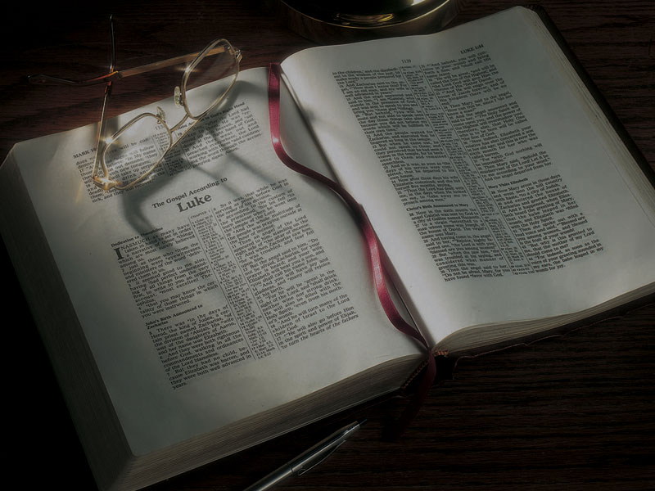
Remez
Key to
Understanding
Several Gospel Puzzles

Slide 3
Isaiah 1:2
2 Hear, O heavens, and give ear, O earth! For the LORD has spoken: “I have nourished and brought up children . . .”

Slide 4
Isaiah 1:2
2 Hear, O heavens, and give ear, O earth! For the LORD has spoken: “I have nourished and brought up children, and they have rebelled against Me”

Slide 5
John 1:1
1 In the beginning was the Word, and the Word was with God, and the Word was God.

Slide 6
John 1:1
1 In the beginning was the Word, and the Word was with God, and the Word was God.
Genesis 1:1
1 In the beginning God created the heavens and the earth.

Slide 7
John 1:1
1 In the beginning was the Word, and the Word was with God, and the Word was God.
John 1:1
1 In the beginning God created the heavens and the earth.
So what’s his point?

Slide 8
John 1:1
1 In the beginning was the Word, and the Word was with God, and the Word was God.
John 1:1
1 In the beginning God created the heavens and the earth.
John 1:14
14 And the Word became flesh and dwelt among us, and we beheld His glory, the glory as of the only begotten of the Father, full of grace and truth.

Slide 9
What title does Jesus Christ
use most often for Himself?

Slide 10
What title does Jesus Christ
use most often for Himself?
“Son of Man”

Slide 11
What title does Jesus Christ
use most often for Himself?
“Son of Man”
He uses it 84 times in the Gospels

Slide 12
“Son of Man”
Matthew 10:23 “When they persecute you in this city, flee to another. For assuredly, I say to you, you will not have gone through the cities of Israel before the Son of Man comes.
Matthew 12:8 “For the Son of Man is Lord even of the Sabbath.”
Matthew 12:40 “For as Jonah was three days and three nights in the belly of the great fish, so will the Son of Man be three days and three nights in the heart of the earth.

Slide 13
“Son of Man”
Matthew 13:41 “The Son of Man will send out His angels, and they will gather out of His kingdom all things that offend, and those who practice lawlessness,
Matthew 16:13 When Jesus came into the region of Caesarea Philippi, He asked His disciples, saying, “Who do men say that I, the Son of Man, am?”
Matthew 16:27 “For the Son of Man will come in the glory of His Father with His angels, and then He will reward each according to his works.

Slide 14
“Son of Man”
Matthew 16:28 “Assuredly, I say to you, there are some standing here who shall not taste death till they see the Son of Man coming in His kingdom.”
Matthew 18:11 “For the Son of Man has come to save that which was lost.
Matthew 19:28 So Jesus said to them, “Assuredly I say to you, that in the regeneration, when the Son of Man sits on the throne of His glory, you who have followed Me will also sit on twelve thrones, judging the twelve tribes of Israel.

Slide 15
“Son of Man”
Matthew 20:28 “just as the Son of Man did not come to be served, but to serve, and to give His life a ransom for many.”
Matthew 24:27 “For as the lightning comes from the east and flashes to the west, so also will the coming of the Son of Man be.
Matthew 24:30 “Then the sign of the Son of Man will appear in heaven, and then all the tribes of the earth will mourn, and they will see the Son of Man coming on the clouds of heaven with power and great glory.

Slide 16
“Son of Man”
Matthew 24:37 “But as the days of Noah were, so also will the coming of the Son of Man be.
Matthew 24:44 “Therefore you also be ready, for the Son of Man is coming at an hour you do not expect.
Matthew 25:13 “Watch therefore, for you know neither the day nor the hour in which the Son of Man is coming.

Slide 17
“Son of Man”
Matthew 25:31 “When the Son of Man comes in His glory, and all the holy angels with Him, then He will sit on the throne of His glory.

Slide 18
“Son of Man”
Matthew 25:31 “When the Son of Man comes in His glory, and all the holy angels with Him, then He will sit on the throne of His glory.
So what’s His point?

Slide 19
Daniel 7:13-14
13 “I was watching in the night visions, and behold, One like the Son of Man, coming with the clouds of heaven! He came to the Ancient of Days, and they brought Him near before Him.
14 Then to Him was given dominion and glory and a kingdom, that all peoples, nations, and languages should serve Him. His dominion is an everlasting dominion, which shall not pass away, and His kingdom the one which shall not be destroyed.

Slide 20
Matthew 21:12-16
12 Then Jesus went into the temple of God and drove out all those who bought and sold in the temple, and overturned the tables of the money changers and the seats of those who sold doves.
13 And He said to them, “It is written, ‘My house shall be called a house of prayer,’ but you have made it a ‘den of thieves.’”
14 Then the blind and the lame came to Him in the temple, and He healed them.

Slide 21
Matthew 21:12-16
15 But when the chief priests and scribes saw the wonderful things that He did, and the children crying out in the temple and saying, “Hosanna to the Son of David!” they were indignant
16 and said to Him, “Do You hear what these are saying?” And Jesus said to them, “Yes. Have you never read, ‘Out of the mouth of babes and nursing infants You have perfected praise’?”

Slide 22
Matthew 21:12-16
16 And Jesus said to them, “Yes. Have you never read, ‘Out of the mouth of babes and nursing infants You have perfected praise’?”
Psalm 8:2 (NLT)
2 You have taught children and nursing infants to give you praise.

Slide 23
Matthew 21:12-16
16 And Jesus said to them, “Yes. Have you never read, ‘Out of the mouth of babes and nursing infants You have perfected praise’?”
Psalm 8:2 (NLT)
2 You have taught children and nursing infants to give you praise. They silence your enemies who were seeking revenge.

Slide 24
Mark 11:18
18 And the scribes and chief priests heard it and sought how they might destroy Him; for they feared Him, because all the people were astonished at His teaching.
Luke 19:47-48
47 But the chief priests, the scribes, and the leaders of the people sought to destroy Him,
48 and were unable to do anything; for all the people were very attentive to hear Him.

Slide 25
Matthew 11:28-29
28 “Come to Me, all you who labor and are heavy laden, and I will give you rest.
29 “Take My yoke upon you and learn from Me, for I am gentle and lowly in heart, and you will find rest for your souls.”

Slide 26
Matthew 11:28
28 “Come to Me, all you who labor and are heavy laden, and I will give you rest.”
Exodus 33:14
14 (God speaking:) “My Presence will go with you, and I will give you rest.”

Slide 27
Matthew 11:29
29 “Take My yoke upon you and learn from Me, for I am gentle and lowly in heart, and you will find rest for your souls.”

Slide 28
Matthew 11:29
29 “Take My yoke upon you and learn from Me, for I am gentle and lowly in heart, and you will find rest for your souls.”
Jeremiah 6:16
16 Thus says the LORD: “Stand in the ways and see, and ask for the old paths, where the good way is, and walk in it; then you will find rest for your souls.”

Slide 29
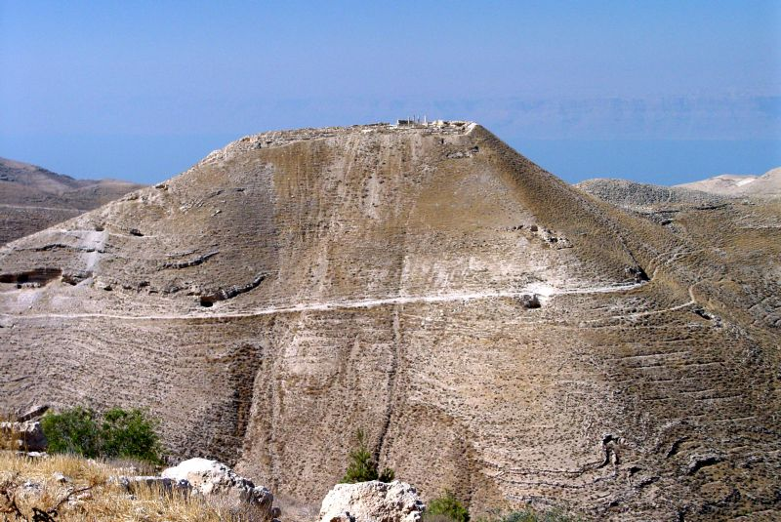

Slide 30
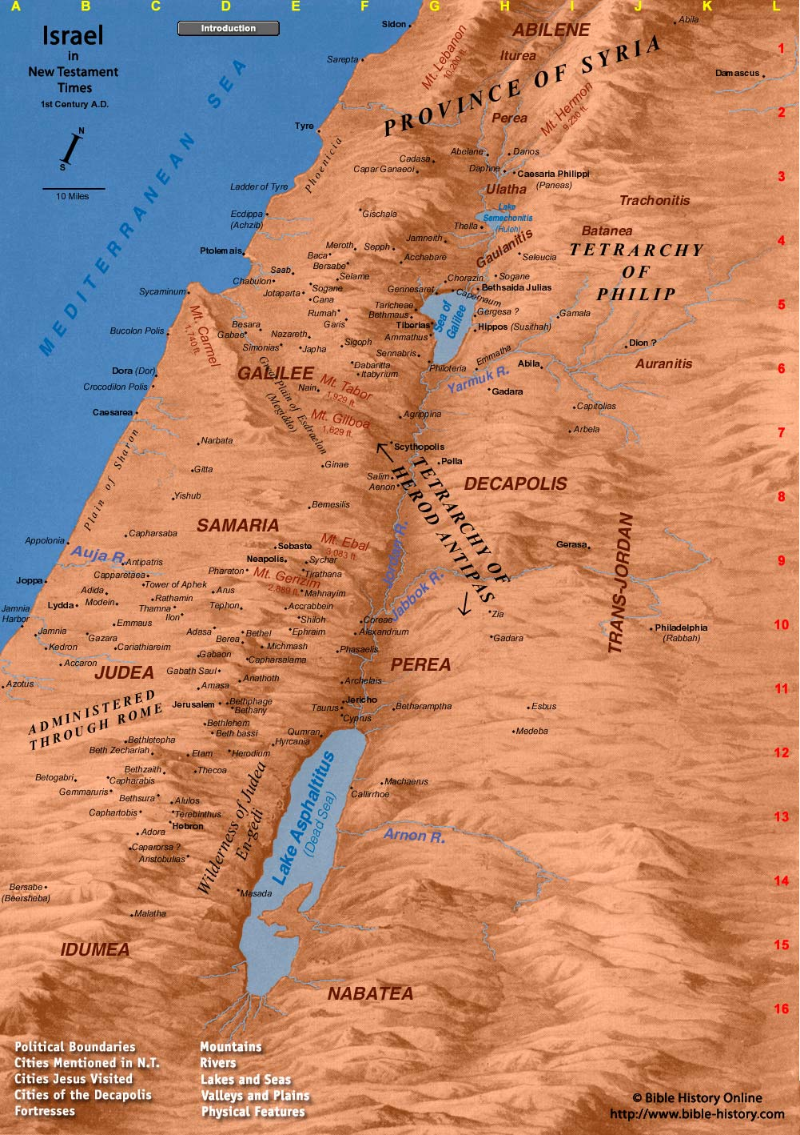

Slide 31
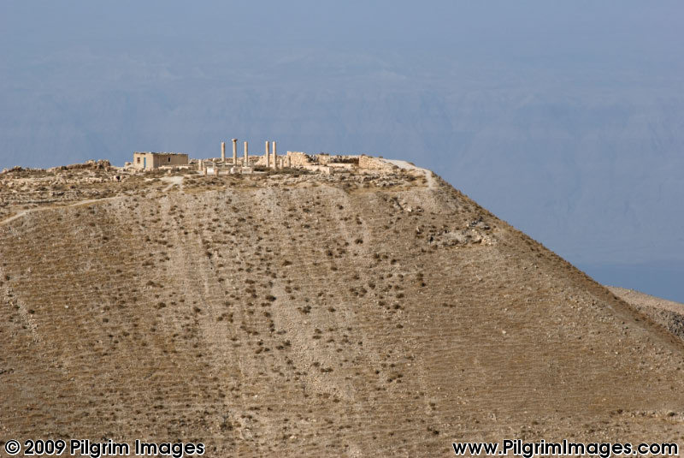

Slide 32
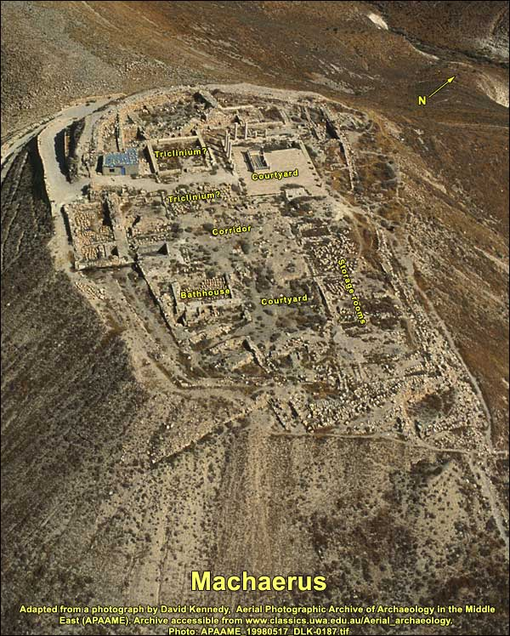

Slide 33
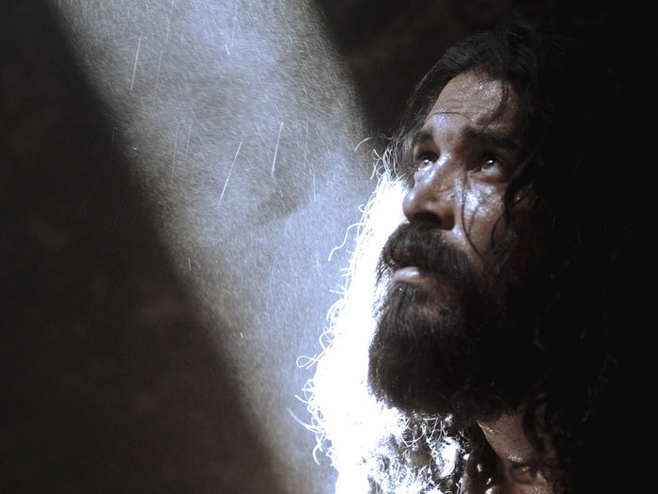

Slide 34
Matthew 11:2-5
2 And when John had heard in prison about the works of Christ, he sent two of his disciples
3 and said to Him, “Are You the Coming One,
or do we look for another?”
4 Jesus answered and said to them, “Go and tell John the things which you hear and see:
5 “The blind see and the lame walk; the lepers are cleansed and the deaf hear; the dead are raised up and the poor have the gospel preached to them.

Slide 35
Zechariah 9:9-11
9 “Rejoice greatly, O daughter of Zion! Shout,
O daughter of Jerusalem! Behold, your King is coming to you; He is just and having salvation, lowly and riding on a donkey, a colt, the foal
of a donkey . . .

Slide 36
Zechariah 9:9-11
9 “Rejoice greatly, O daughter of Zion! Shout,
O daughter of Jerusalem! Behold, your King is coming to you; He is just and having salvation, lowly and riding on a donkey, a colt, the foal
of a donkey . . .
11 “[And] I will set your prisoners free from the waterless pit.”

Slide 37
Matthew 11:2-5
4 Jesus answered and said to them, “Go and tell John the things which you hear and see:
5 “The blind see and the lame walk; the lepers are cleansed and the deaf hear; the dead are raised up and the poor have the gospel preached to them.

Slide 38
Matthew 11:2-5
5 “The blind see and the lame walk; the lepers are cleansed and the deaf hear; the dead are raised up and the poor have the gospel preached to them.
Isaiah 35:5-10
5 Then the eyes of the blind shall be opened, and the ears of the deaf shall be unstopped.
6 Then the lame shall leap like a deer, and the tongue of the dumb sing . . .
10 And the ransomed of the LORD shall return . . .

Slide 39
Matthew 11:2-5
5 “The blind see and the lame walk; the lepers are cleansed and the deaf hear; the dead are raised up and the poor have the gospel preached to them.
Isaiah 42:6-7
6 “I, the LORD, have called You in righteousness
. . . ; I will keep You and give You as a covenant to the people, as a light to the Gentiles,
7 To open blind eyes, to bring out prisoners from the prison, those who sit in darkness from the prison house.

Slide 40
Matthew 11:2-5
5 “The blind see and the lame walk; the lepers are cleansed and the deaf hear; the dead are raised up and the poor have the gospel preached to them.
Isaiah 61:1
1 “The Spirit of the Lord GOD is upon Me, because the LORD has anointed Me to preach good tidings to the poor; He has sent Me to heal the broken-hearted, to proclaim liberty to the captives, and the opening of the prison to those who are bound;

Slide 41
Matthew 11:2-5
5 “The blind see and the lame walk; the lepers are cleansed and the deaf hear; the dead are raised up and the poor have the gospel preached to them.
Isaiah 35:5-10
5 Then the eyes of the blind shall be opened, and the ears of the deaf shall be unstopped.
6 Then the lame shall leap like a deer, and the tongue of the dumb sing . . .
10 And the ransomed of the LORD shall return . . .

Slide 42
Matthew 11:2-5
5 “The blind see and the lame walk; the lepers are cleansed and the deaf hear; the dead are raised up and the poor have the gospel preached to them.
Isaiah 42:6-7
6 “I, the LORD, have called You in righteousness
. . . ; I will keep You and give You as a covenant to the people, as a light to the Gentiles,
7 To open blind eyes, to bring out prisoners from the prison, those who sit in darkness from the prison house.

Slide 43
Matthew 11:2-5
5 “The blind see and the lame walk; the lepers are cleansed and the deaf hear; the dead are raised up and the poor have the gospel preached to them.
Isaiah 61:1
1 “The Spirit of the Lord GOD is upon Me, because the LORD has anointed Me to preach good tidings to the poor; He has sent Me to heal the broken-hearted, to proclaim liberty to the captives, and the opening of the prison to those who are bound;

Slide 44
Matthew 11:2-5
5 “The blind see and the lame walk; the lepers are cleansed and the deaf hear; the dead are raised up and the poor have the gospel preached to them.
6 (NIV) “Blessed is the man who does not fall away on account of me.”

Slide 45
Matthew 3:16-17
16 When He had been baptized, Jesus came up immediately from the water; and behold, the heavens were opened to Him, and He saw the
Spirit of God descending like a dove and alighting upon Him.
17 And suddenly a voice came from heaven, saying, “This is My beloved Son, in whom I am well pleased.”

Slide 46
Matthew 3:16-17
17 “This is My beloved Son, in whom I am well pleased.”

Slide 47
Matthew 3:16-17
17 “This is My beloved Son, in whom I am well pleased.”
Psalm 2:1
1 The LORD has said to Me, “You are My Son, today I have begotten You.”

Slide 48
Matthew 3:16-17
17 “This is My beloved Son, in whom I am well pleased.”
Psalm 2:1
1 The LORD has said to Me, “You are My Son, today I have begotten You.”
Isaiah 42:1
1 “Behold! My Servant whom I uphold, My Elect One in whom My soul delights!”

Slide 49
Matthew 3:4
4 And John himself was clothed in camel’s hair, with a leather belt around his waist . . .

Slide 50
Matthew 3:4
4 And John himself was clothed in camel’s hair, with a leather belt around his waist . . .
2 Kings 1:7-8
7 Then he [King Amaziah] said to them [messengers], “What kind of man was it who came up to meet you and told you these words?”
8 So they answered him, “A hairy man wearing a leather belt around his waist.” And he said, “It is Elijah the Tishbite.”

Slide 51
Luke 1:13-17
13 But the angel said to him, “Do not be afraid, Zacharias, for your prayer is heard; and your wife Elizabeth will bear you a son, and you shall call his name John . . .
16 “And he will turn many of the children of Israel to the Lord their God.
17 “He will also go before Him in the spirit and power of Elijah, ‘to turn the hearts of the fathers to the children,’ and the disobedient to the wisdom of the just, to make ready a people prepared for the Lord.”

Slide 52
Matthew 11:11-14
11 “Assuredly, I say to you, among those born of women there has not risen one greater than John the Baptist; but he who is least in the kingdom of heaven is greater than he.
12 “And from the days of John the Baptist until now the kingdom of heaven suffers violence, and the violent take it by force.
13 “For all the prophets and the law prophesied until John.
14 “And if you are willing to receive it, he is Elijah who is to come.”

Slide 53
John 1:28
28 These things were done in Bethabara beyond the Jordan, where John was baptizing.
John 3:23
23 Now John also was baptizing in Aenon near Salim, because there was much water there.

Slide 55
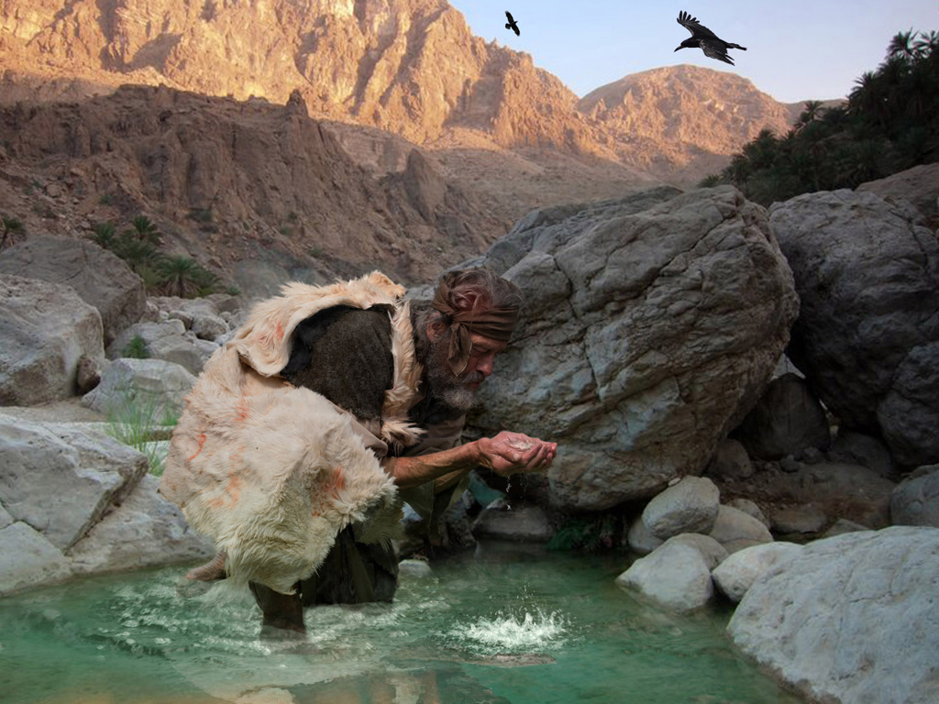

Slide 57
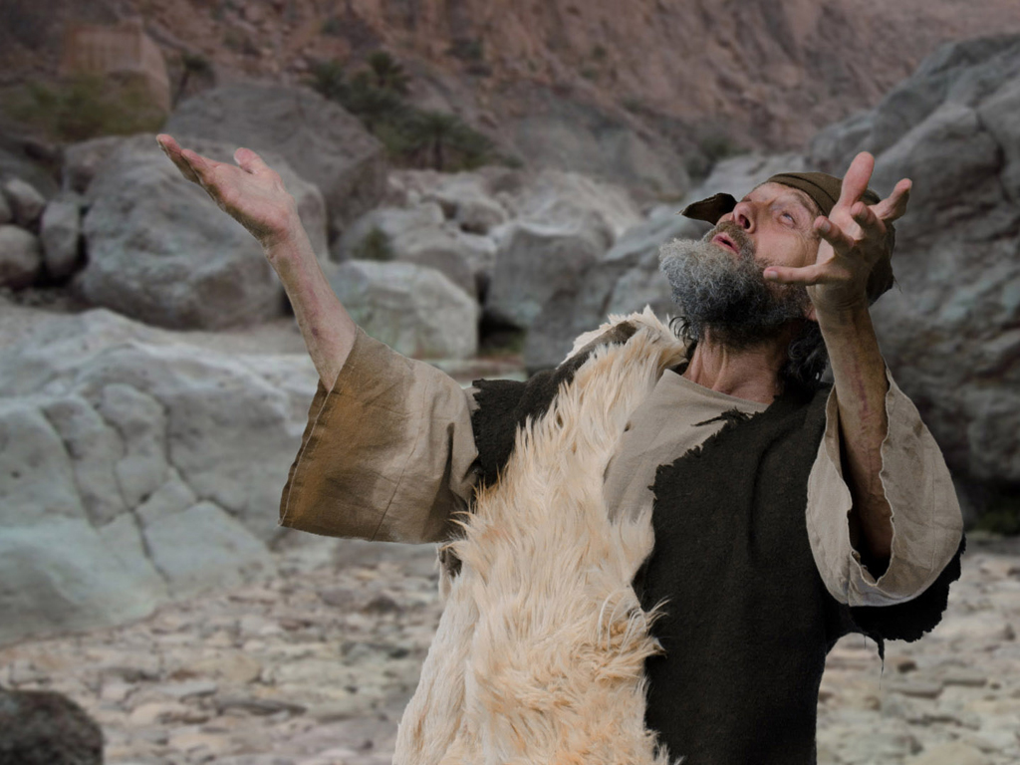

Slide 59
John 8:2-11
2 Now early in the morning He came again into the temple, and all the people came to Him; and He sat down and taught them.
3 Then the scribes and Pharisees brought to Him a woman caught in adultery. And when they had set her in the midst,
4 they said to Him, “Teacher, this woman was caught in adultery, in the very act.
5 “Now Moses, in the law, commanded us that such should be stoned. But what do You say?”

Slide 60
John 8:2-11
6 This they said, testing Him, that they might have something of which to accuse Him. But Jesus stooped down and wrote on the ground with His finger, as though He did not hear.
7 So when they continued asking Him, He raised Himself up and said to them, “He who is without sin among you, let him throw a stone at her first.”
8 And again He stooped down and wrote on the ground.

Slide 61
John 8:2-11
9 Then those who heard it, being convicted by their conscience, went out one by one, beginning with the oldest even to the last. And Jesus was left alone, and the woman standing in the midst.
10 When Jesus had raised Himself up and saw no one but the woman, He said to her, “Woman, where are those accusers of yours? Has no one condemned you?”
11 She said, “No one, Lord.” And Jesus said to her, “Neither do I condemn you; go and sin no more.”

Slide 62
John 8:2-11
6 This they said, testing Him, that they might have something of which to accuse Him. But Jesus stooped down and wrote on the ground with His finger, as though He did not hear.
7 So when they continued asking Him, He raised Himself up and said to them, “He who is without sin among you, let him throw a stone at her first.”
8 And again He stooped down and wrote on the ground.

Slide 63
Jeremiah 17:13 (NIV)
13 O LORD, the hope of Israel, all who forsake you will be put to shame. Those who turn away from you will be written in the dust because they have forsaken the LORD . . .

Slide 64
Jeremiah 17:13 (NIV)
13 O LORD, the hope of Israel, all who forsake you will be put to shame. Those who turn away from you will be written in the dust because they have forsaken the LORD . . .
John 8:9
9 Then those who heard it, being convicted by their conscience, went out one by one, beginning with the oldest even to the last. And Jesus was left alone, and the woman standing in the midst.

Slide 65
What do we learn from this?

Slide 66
What do we learn from this?
• The culture of that day and place is very different from ours today.

Slide 67
What do we learn from this?
• The culture of that day and place is very different from ours today.
• If we are to properly understand God’s Word,
we must first understand what it meant to the audience to whom it was originally written.

Slide 68
What do we learn from this?
• The culture of that day and place is very different from ours today.
• If we are to properly understand God’s Word,
we must first understand what it meant to the audience to whom it was originally written.
• God’s Word has a depth and richness to which we have only begun to scratch the surface.

Slide 69
What do we learn from this?
• The culture of that day and place is very different from ours today.
• If we are to properly understand God’s Word,
we must first understand what it meant to the audience to whom it was originally written.
• God’s Word has a depth and richness to which we have only begun to scratch the surface.
• If we are to understand God’s Word as He expects us to, we need to be diligently studying it.

Slide 70
What do we learn from this?
• The culture of that day and place is very different from ours today.
• If we are to properly understand God’s Word,
we must first understand what it meant to the audience to whom it was originally written.
• God’s Word has a depth and richness to which we have only begun to scratch the surface.
• If we are to understand God’s Word as He expects us to, we need to be diligently studying it.
• God cannot use His Word within us if we don’t know that Word—if we’re not putting it within us.

