Slide 1



Slide 2
Psalm 23:
The Sheep Who Follow Their Shepherd

Slide 3
Psalm 23:1-6
1 <A Psalm of David.> The LORD is my shepherd; I shall not want.
2 He makes me to lie down in green pastures; He leads me beside the still waters.
3 He restores my soul; He leads me in the paths of righteousness for His name’s sake.
4 Yea, though I walk through the valley of the shadow of death, I will fear no evil; For You are with me; Your rod and Your staff, they comfort me.

Slide 4
Psalm 23:1-6
5 You prepare a table before me in the presence of my enemies; You anoint my head with oil; my cup runs over.
6 Surely goodness and mercy shall follow me all the days of my life; and I will dwell in the house of the LORD forever.

Slide 5
Psalm 23:1-6
1 <A Psalm of David.> The LORD is my shepherd; I shall not want.

Slide 6
1 Samuel 16:11
11 And Samuel said to Jesse, “Are all the young men here?” Then he said, “There remains yet the youngest, and there he is, keeping the sheep.” And Samuel said to Jesse, “Send and bring him. For we will not sit down till he comes here.”

Slide 7
1 Samuel 17:28
28 Now Eliab his oldest brother heard when he spoke to the men; and Eliab’s anger was aroused against David, and he said, “Why did you come down here? And with whom have you left those few sheep in the wilderness?”

Slide 8
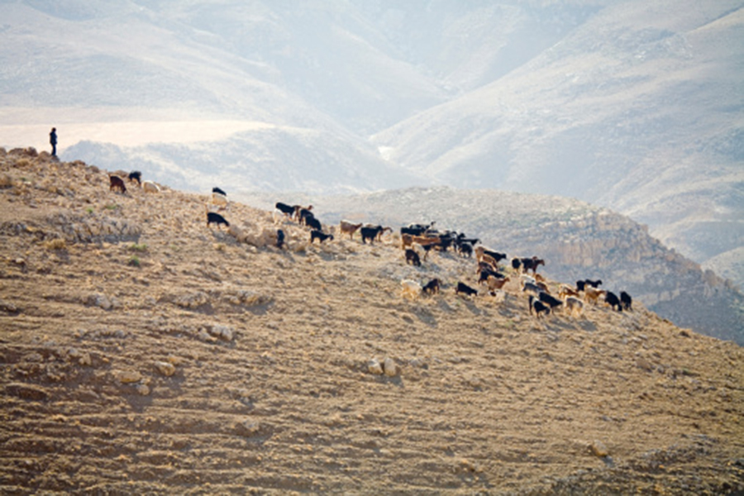

Slide 9
Psalm 100:3
3 Know that the LORD, He is God; It is He who has made us, and not we ourselves; we are His people and the sheep of His pasture.

Slide 10
Psalm 100:3
3 Know that the LORD, He is God; It is He who has made us, and not we ourselves; we are His people and the sheep of His pasture.
1 Peter 2:25
25 For you were like sheep going astray, but have now returned to the Shepherd and Overseer of
your souls.

Slide 11
Psalm 23:1-6
1 <A Psalm of David.> The LORD is my shepherd;

Slide 12
Colossians 1:15-20 (NIV)
15 He is the image of the invisible God, the firstborn over all creation.
16 For by him all things were created: things in heaven and on earth, visible and invisible, whether thrones or powers or rulers or authorities; all things were created by him and
for him.
17 He is before all things, and in him all things hold together.

Slide 13
Colossians 1:15-20 (NIV)
18 And he is the head of the body, the church; he is the beginning and the firstborn from among the dead, so that in everything he might have the supremacy.
19 For God was pleased to have all his fullness dwell in him,
20 and through him to reconcile to himself all things, whether things on earth or things in heaven, by making peace through his blood, shed on the cross.

Slide 14
John 15:16, 19
16 “You did not choose Me, but I chose you . . .
19 “. . . I chose you out of the world.”

Slide 15
John 10:11-15
11 “I am the good shepherd. The good shepherd gives His life for the sheep.
. . .
14 “I am the good shepherd; and I know My sheep, and am known by My own.
15 “As the Father knows Me, even so I know the Father; and I lay down My life for the sheep.

Slide 16
John 10:2-4
2 “But he who enters by the door is the shepherd of the sheep.
3 “To him the doorkeeper opens, and the sheep hear his voice; and he calls his own sheep by name and leads them out.
4 “And when he brings out his own sheep, he goes before them; and the sheep follow him, for they know his voice.

Slide 17
Psalm 23:1-6
1 <A Psalm of David.> The LORD is my shepherd; I shall not want.

Slide 18
Psalm 23:1-6
1 <A Psalm of David.> The LORD is my shepherd; I shall not want.
“I will never be in need..” (CEV)
“I have everything I need.” (NLT)
“I will not be without any good thing.” (BBE)

Slide 19
Philippians 4:11-13
11 Not that I speak in regard to need, for I have learned in whatever state I am, to be content:
I know how to be abased, and I know how to abound. Everywhere and in all things I have learned both to be full and to be hungry, both to abound and to suffer need.
13 I can do all things through Christ who strengthens me.

Slide 20
John 16:33
33 “These things I have spoken to you, that in Me you may have peace. In the world you will have tribulation; but be of good cheer, I have overcome the world.”

Slide 21
Hebrews 13:5-6
5 Let your conduct be without covetousness;
be content with such things as you have. For He Himself has said, “I will never leave you nor forsake you.”
6 So we may boldly say: “The LORD is my helper;
I will not fear. What can man do to me?”

Slide 22
Psalm 23:1-6
1 <A Psalm of David.> The LORD is my shepherd; I shall not want.
2 He makes me to lie down in green pastures; He leads me beside the still waters.

Slide 23
Four conditions for sheep
to calmly lie down:

Slide 24
Four conditions for sheep
to calmly lie down:
• They need to be free from fear.

Slide 25
Four conditions for sheep
to calmly lie down:
• They need to be free from fear.
• They need to be free from friction in the flock.

Slide 26
Four conditions for sheep
to calmly lie down:
• They need to be free from fear.
• They need to be free from friction in the flock.
• They need to be free from pests—insects or parasites that bug them.

Slide 27
Four conditions for sheep
to lie down and be content:
• They need to be free from fear.
• They need to be free from friction in the flock.
• They need to be free from pests—insects or parasites that bug them.
• They need to be free from hunger.

Slide 28
Psalm 23:1-6
1 <A Psalm of David.> The LORD is my shepherd; I shall not want.
2 He makes me to lie down in green pastures;
He leads me beside the still waters.

Slide 29
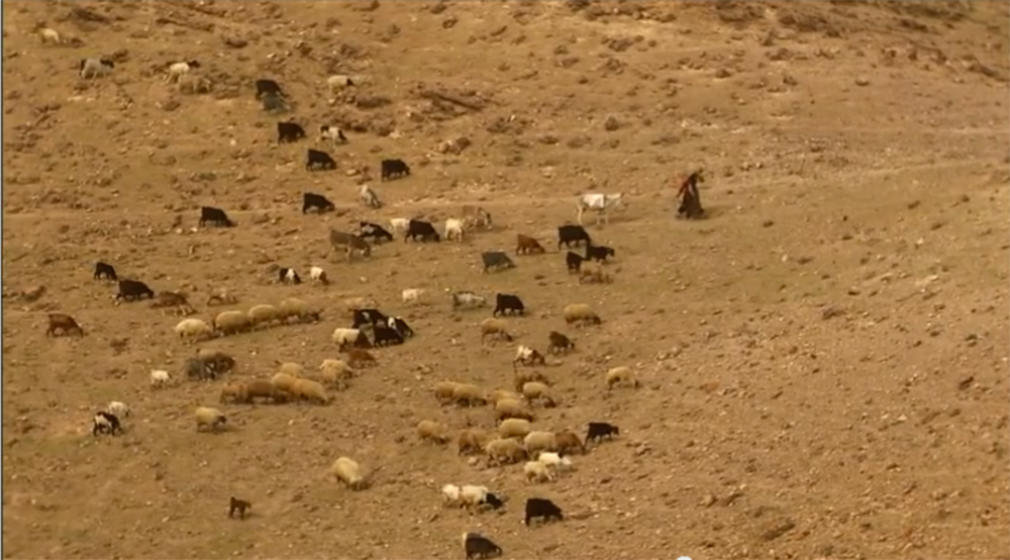

Slide 30
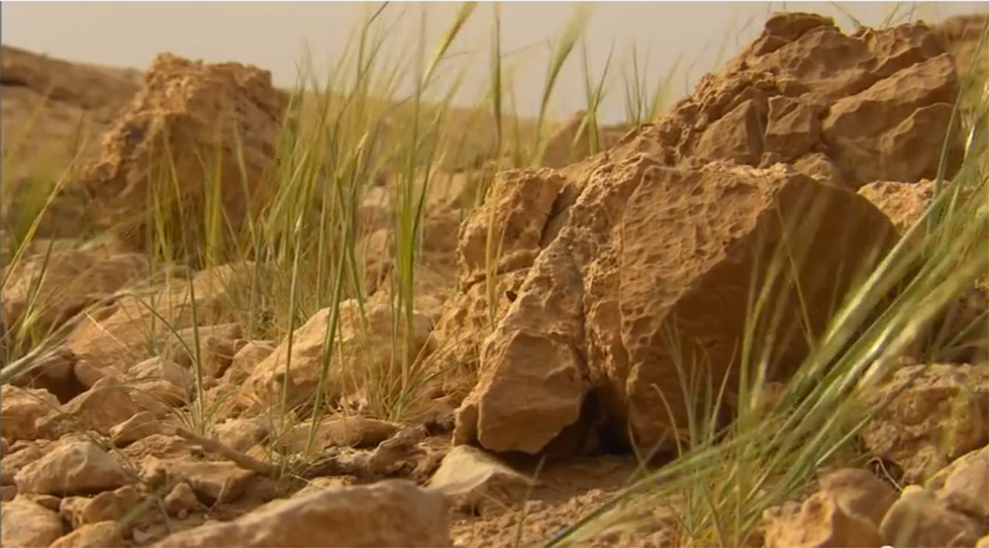

Slide 31
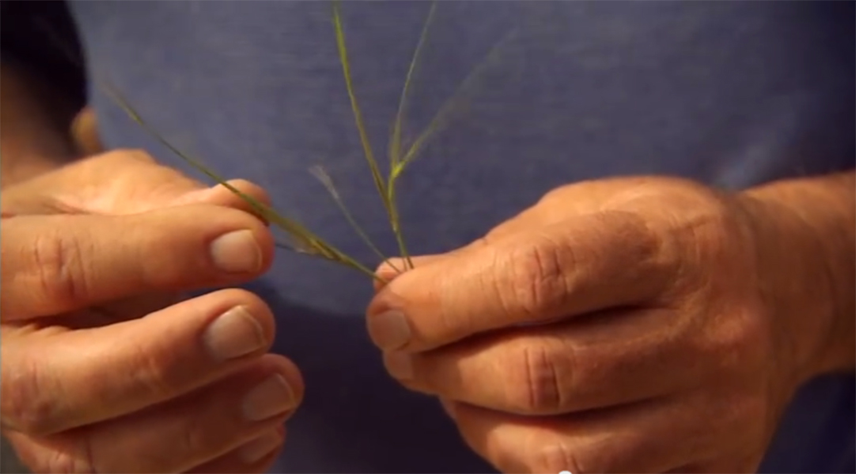

Slide 32
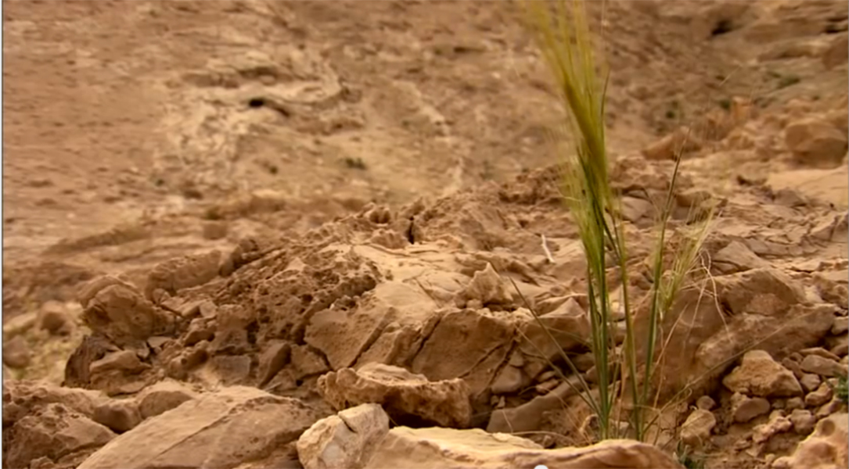

Slide 33
Psalm 23:1-2
1 The LORD is my shepherd; I shall not want.
2 He makes me to lie down in green pastures . . .

Slide 34
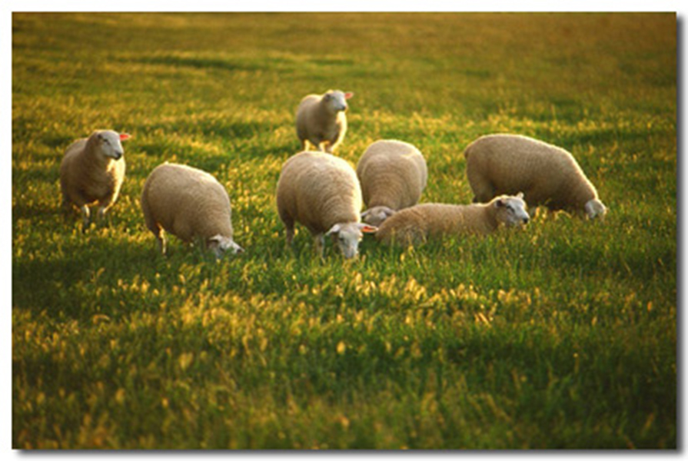

Slide 36
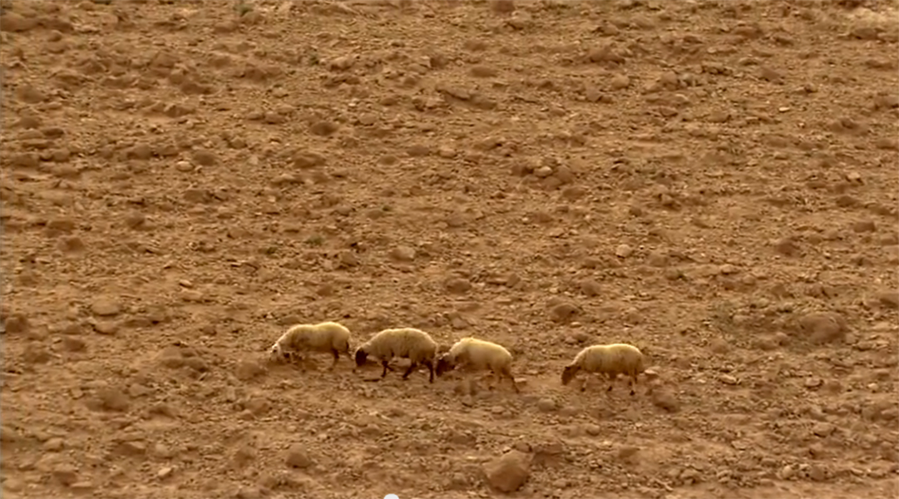

Slide 39
Psalm 23:1-6
1 <A Psalm of David.> The LORD is my shepherd; I shall not want.
2 He makes me to lie down in green pastures;
He leads me beside the still waters.

Slide 40
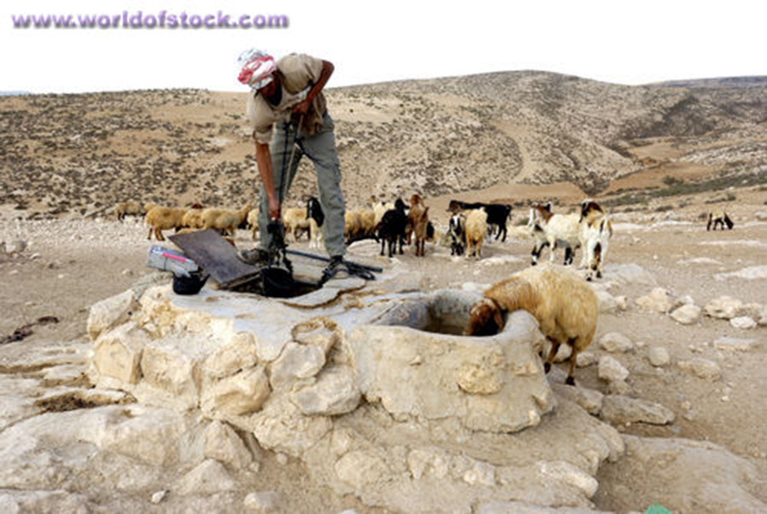

Slide 41
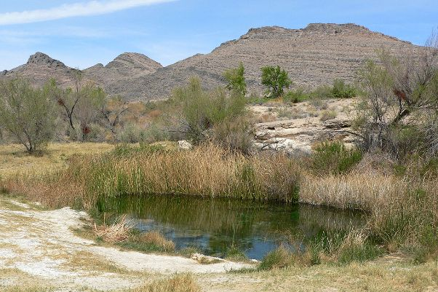

Slide 42
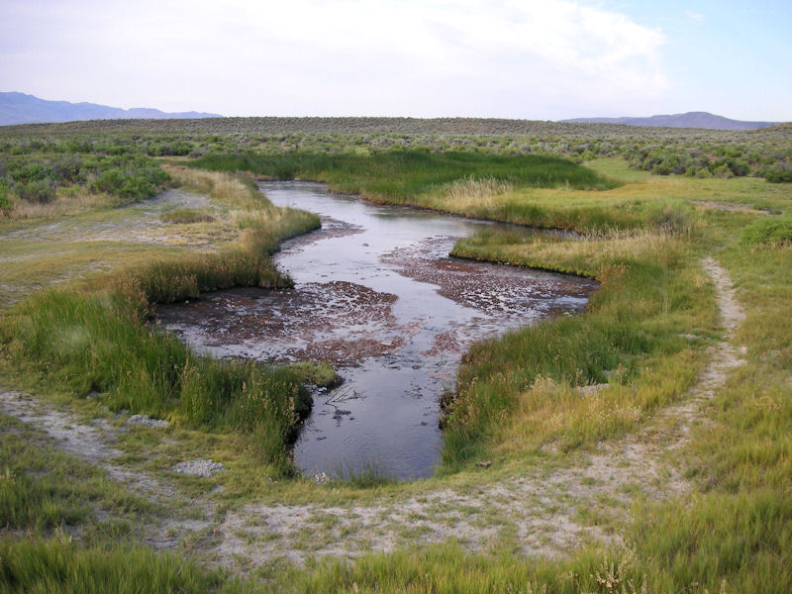

Slide 43
Psalm 23:1-6
1 <A Psalm of David.> The LORD is my shepherd; I shall not want.
2 He makes me to lie down in green pastures;
He leads me beside the still waters.

Slide 44
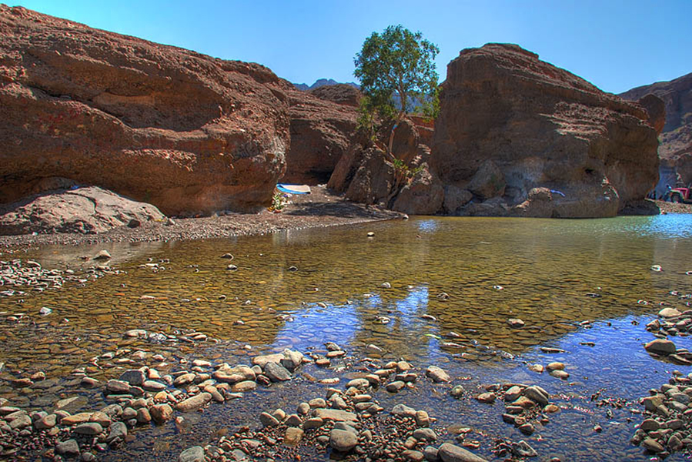

Slide 45
Psalm 23:1-6
1 <A Psalm of David.> The LORD is my shepherd; I shall not want.
2 He makes me to lie down in green pastures; He leads me beside the still waters.
3 He restores my soul; He leads me in the paths of righteousness for His name’s sake.

Slide 46
Psalm 42:11
11 Why are you cast down, O my soul? And why are you disquieted within me? Hope in God; for I shall yet praise Him, the help of my countenance and my God.

Slide 47
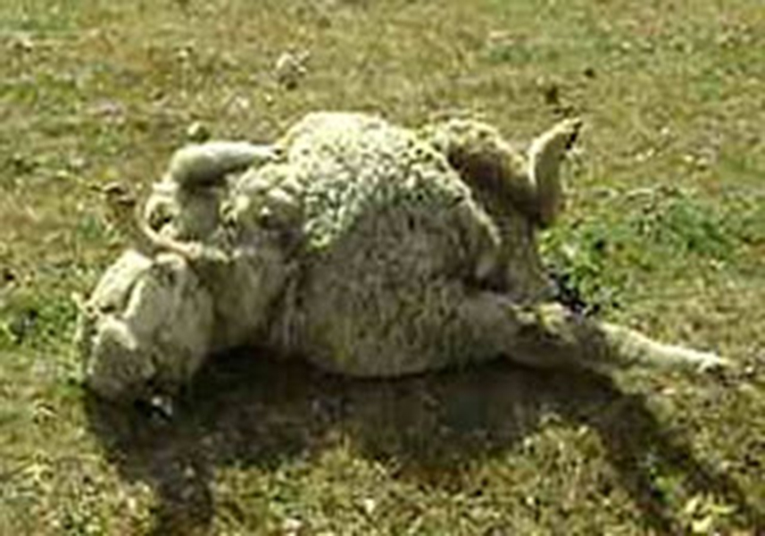

Slide 48
Luke 15:4-6
4 “What man of you, having a hundred sheep, if he loses one of them, does not leave the ninety-nine in the wilderness, and go after the one which is lost until he finds it?
5 “And when he has found it, he lays it on his shoulders, rejoicing.
6 “And when he comes home, he calls together his friends and neighbors, saying to them, ‘Rejoice with me, for I have found my sheep which was lost!’

Slide 49
Psalm 23:1-6
1 <A Psalm of David.> The LORD is my shepherd; I shall not want.
2 He makes me to lie down in green pastures; He leads me beside the still waters.
3 He restores my soul; He leads me in the paths
of righteousness for His name’s sake.

Slide 50
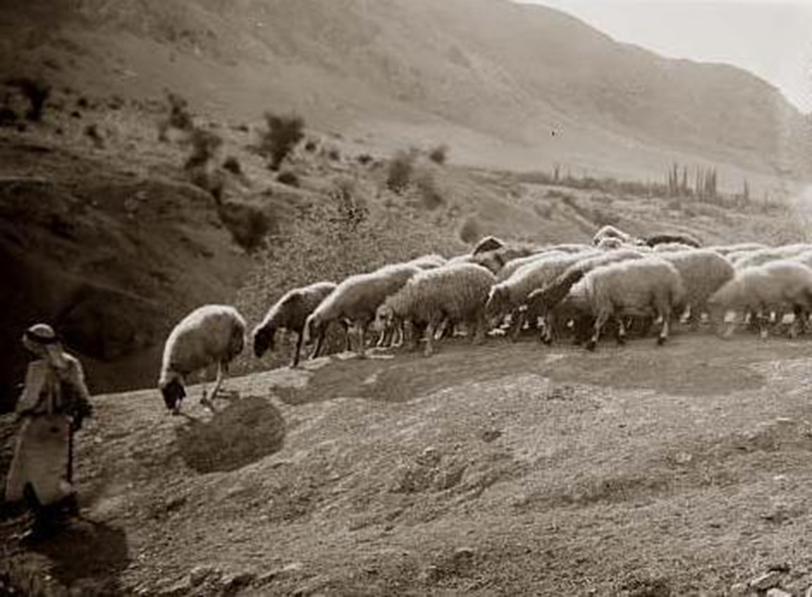

Slide 51
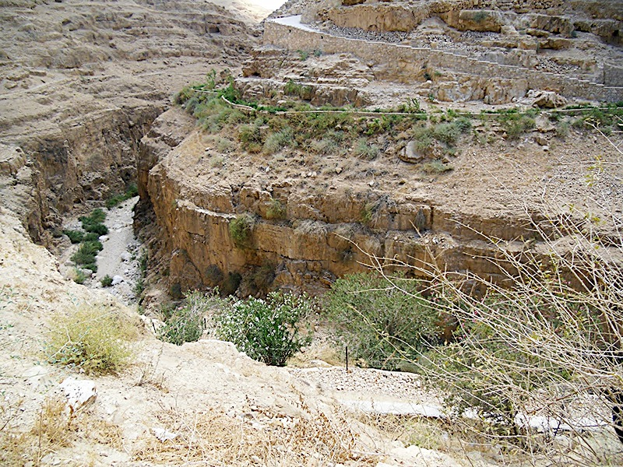

Slide 52
Psalm 23:1-6
1 <A Psalm of David.> The LORD is my shepherd; I shall not want.
2 He makes me to lie down in green pastures; He leads me beside the still waters.
3 He restores my soul; He leads me in the paths of righteousness for His name’s sake.
4 Yea, though I walk through the valley of the shadow of death, I will fear no evil; for You are with me; Your rod and Your staff, they comfort me.

Slide 53
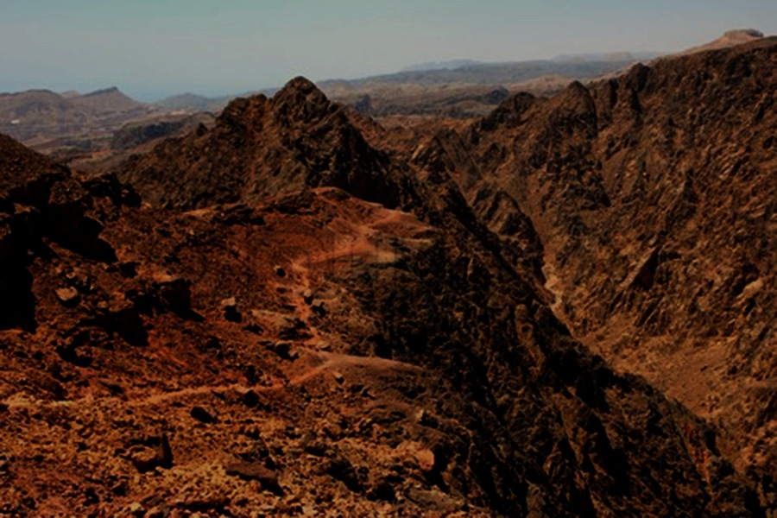

Slide 54
Psalm 23:1-6
1 <A Psalm of David.> The LORD is my shepherd; I shall not want.
2 He makes me to lie down in green pastures; He leads me beside the still waters.
3 He restores my soul; He leads me in the paths of righteousness for His name’s sake.
4 Yea, though I walk through the valley of the shadow of death, I will fear no evil; for You are with me; Your rod and Your staff, they comfort me.

Slide 55
Psalm 23:1-6
1 <A Psalm of David.> The LORD is my shepherd; I shall not want.
2 He makes me to lie down in green pastures; He leads me beside the still waters.
3 He restores my soul; He leads me in the paths of righteousness for His name’s sake.
4 Yea, though I walk through the valley of the shadow of death, I will fear no evil; for You are with me; Your rod and Your staff, they comfort me.

Slide 56
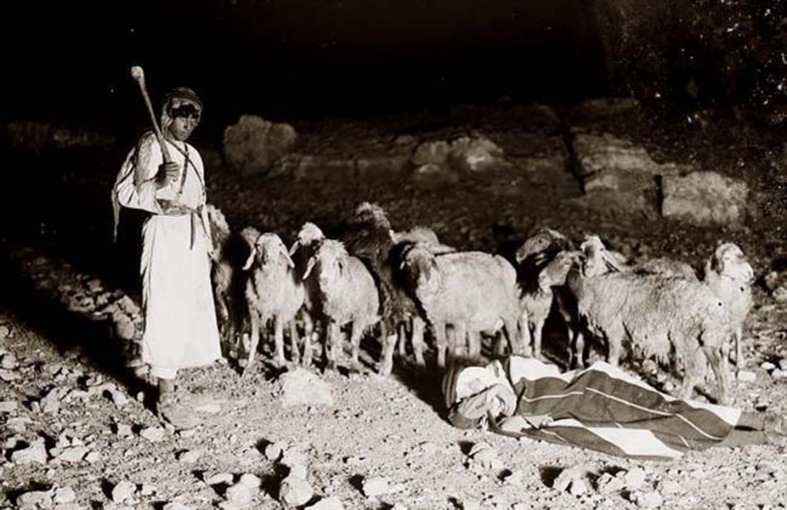

Slide 57
1 Samuel 17:34-36
34 But David said to Saul, “Your servant used to keep his father’s sheep, and when a lion or a bear came and took a lamb out of the flock,
35 I went out after it and struck it, and delivered the lamb from its mouth; and when it arose against me, I caught it by its beard, and struck and killed it.
36 “Your servant has killed both lion and bear; and this uncircumcised Philistine will be like one of them, seeing he has defied the armies of the living God.”

Slide 58
1 Samuel 17:34-36
34 But David said to Saul, “Your servant used to keep his father’s sheep, and when a lion or a bear came and took a lamb out of the flock,
35 I went out after it and struck it, and delivered the lamb from its mouth; and when it arose against me, I caught it by its beard, and struck and killed it.
36 “Your servant has killed both lion and bear; and this uncircumcised Philistine will be like one of them, seeing he has defied the armies of the living God.”

Slide 59
Ezekiel 20:37-38
37 “I will make you pass under the rod, and I will bring you into the bond of the covenant;
38 “I will purge the rebels from among you, and those who transgress against Me; I will bring them out of the country where they dwell, but they shall not enter the land of Israel. Then you will know that I am the LORD.

Slide 60
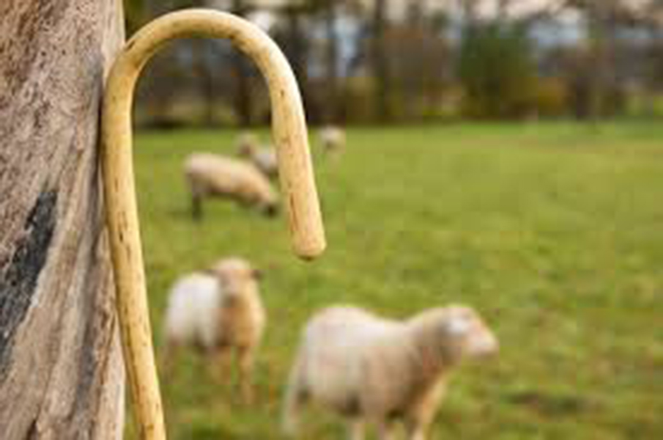

Slide 61
Three uses for the staff:
• Used to lift newborn lambs and guide them to their mother.
• Used to gently catch and draw a sheep to him.
• Used to guide the sheep.
All connote tender care and protection—thus to comfort the sheep.

Slide 62
Psalm 23:1-6
5 You prepare a table before me in the presence of my enemies; You anoint my head with oil; my cup runs over.
6 Surely goodness and mercy shall follow me all the days of my life; and I will dwell in the house of the LORD forever.

Slide 64
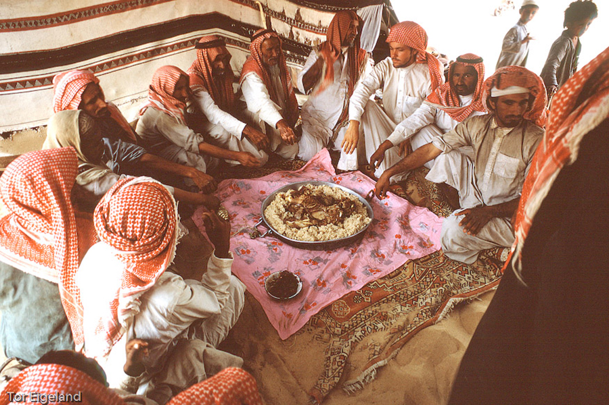

Slide 65
Psalm 23:1-6
5 You prepare a table before me in the presence of my enemies; You anoint my head with oil; my cup runs over.
6 Surely goodness and mercy shall follow me all the days of my life; and I will dwell in the house of the LORD forever.

Slide 66
