Slide 1

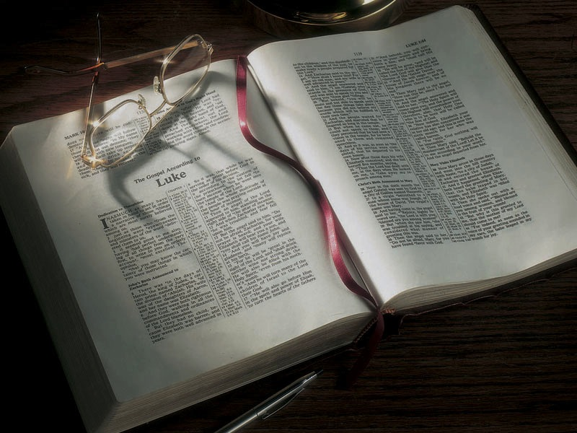

Slide 2
Fill in the blank:
God is _____________________.
God is _____________________ .
God is _____________________ .

Slide 3
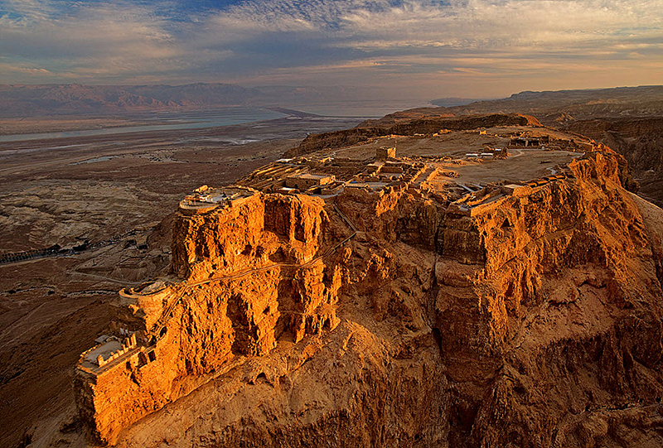

Slide 4
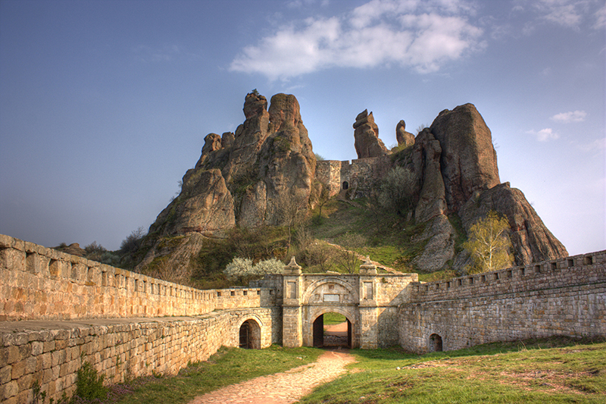

Slide 5
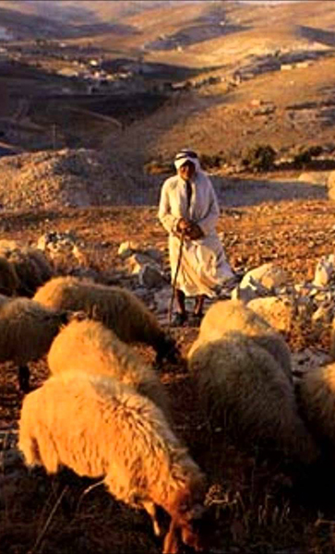

Slide 6
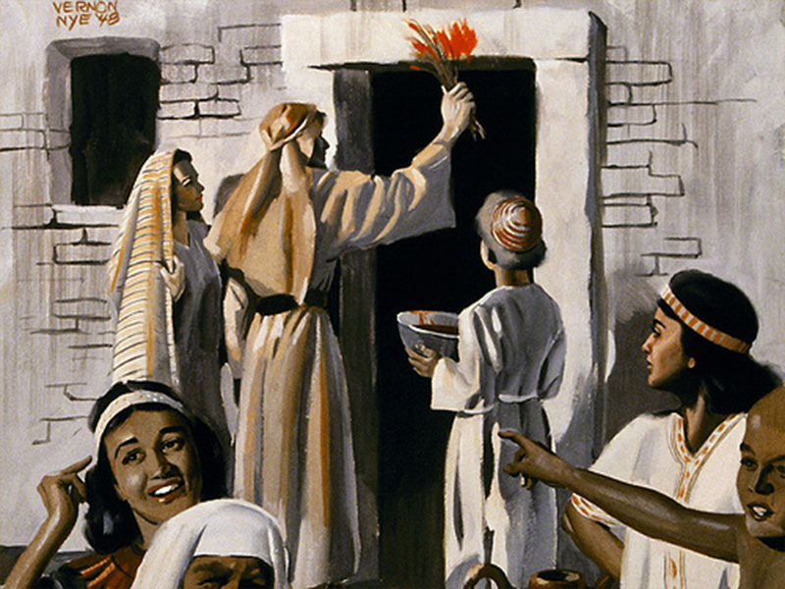
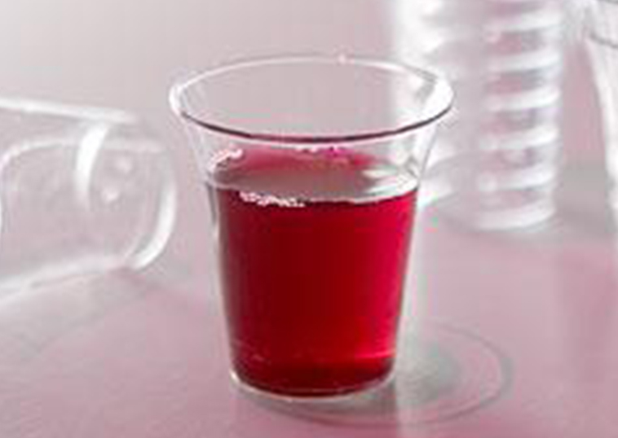
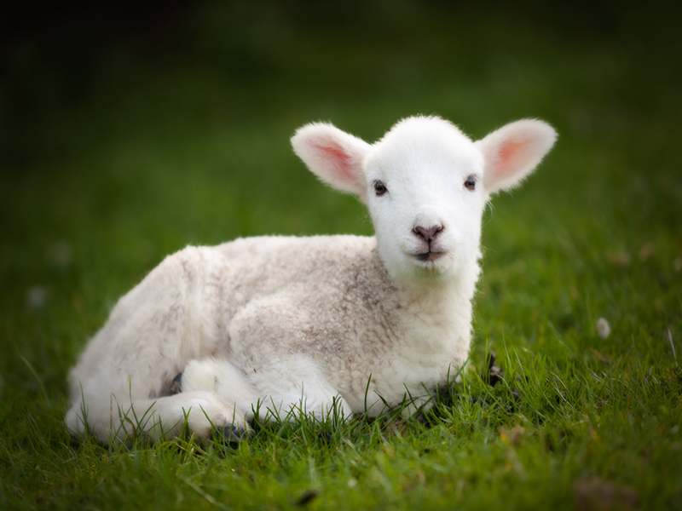
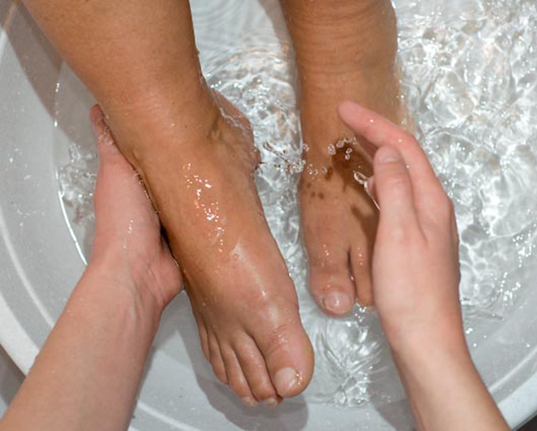
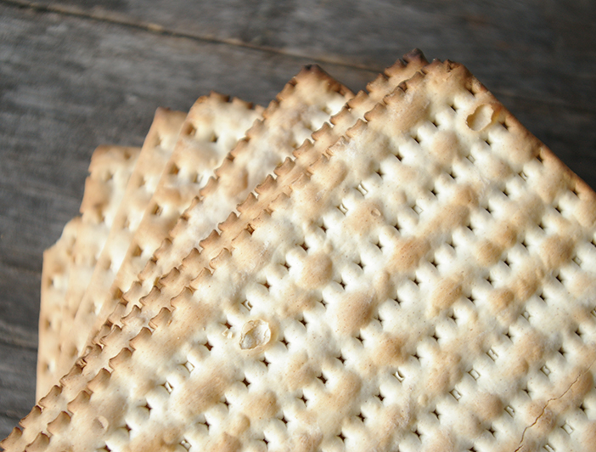

Slide 7
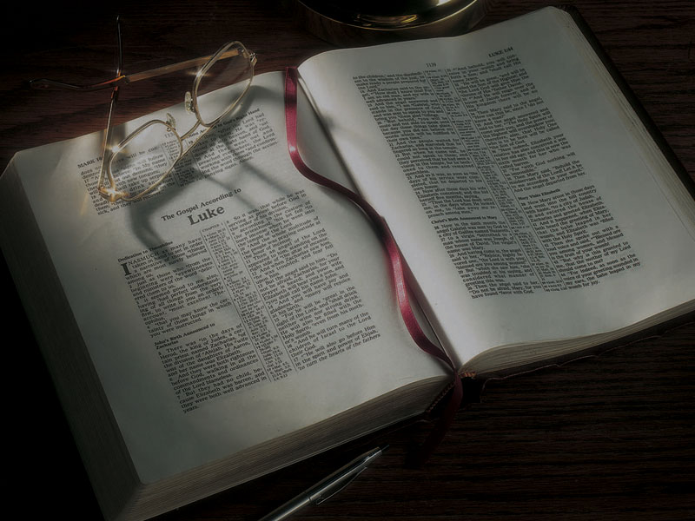
Pictures
of
Passover

Slide 14
Revelation 13:8
8 “the Lamb slain from the foundation of the world”

Slide 15
Revelation 13:8
8 “the Lamb slain from the foundation of the world”

Slide 16
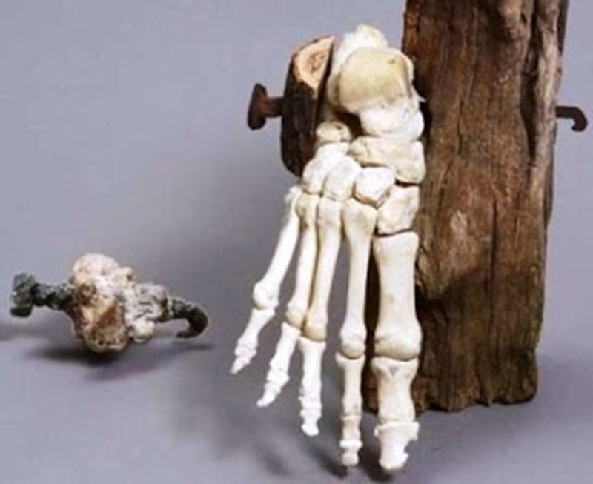

Slide 17
Genesis 12:1-3
1 Now the LORD had said to Abram: “Get out
of your country, from your family and from your father’s house, to a land that I will show you.
2 I will make you a great nation; I will bless you and make your name great; and you shall be a blessing.
3 I will bless those who bless you, and I will curse him who curses you; and in you all the families of the earth shall be blessed.”

Slide 18
Genesis 17:1-2
1 When Abram was ninety-nine years old, the LORD appeared to Abram and said to him, “I am Almighty God; walk before Me and be blameless.
2 “And I will make My covenant between Me and you, and will multiply you exceedingly.”

Slide 19
Genesis 17:1-2
1 When Abram was ninety-nine years old, the LORD appeared to Abram and said to him, “I am Almighty God; walk before Me and be blameless.
2 “And I will make My covenant between Me and you, and will multiply you exceedingly.”
48 “Therefore you shall be perfect, just as your Father in heaven is perfect.”
Matthew 5:48

Slide 20
Genesis 15:18
18 On the same day the LORD made a covenant with Abram . . .

Slide 21
Genesis 15:1
1 After these things the word of the LORD came
to Abram in a vision, saying, “Do not be afraid, Abram. I am your shield, your exceedingly great reward.”

Slide 22
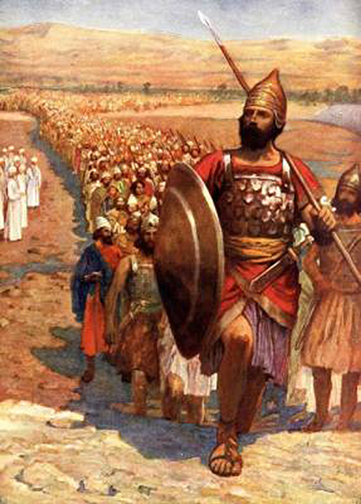

Slide 23
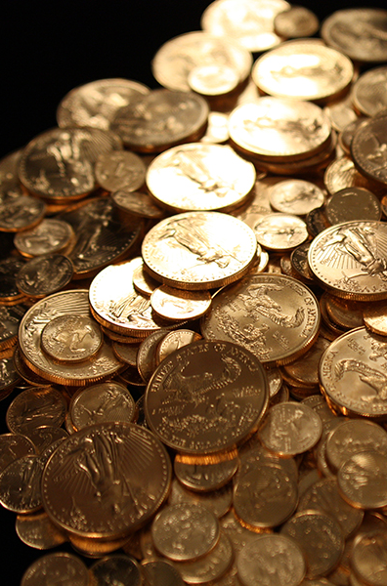

Slide 24
Genesis 15:5
5 Then He brought him outside and said, “Look now toward heaven, and count the stars if you
are able to number them.” And He said to him,
“So shall your descendants be.”

Slide 25
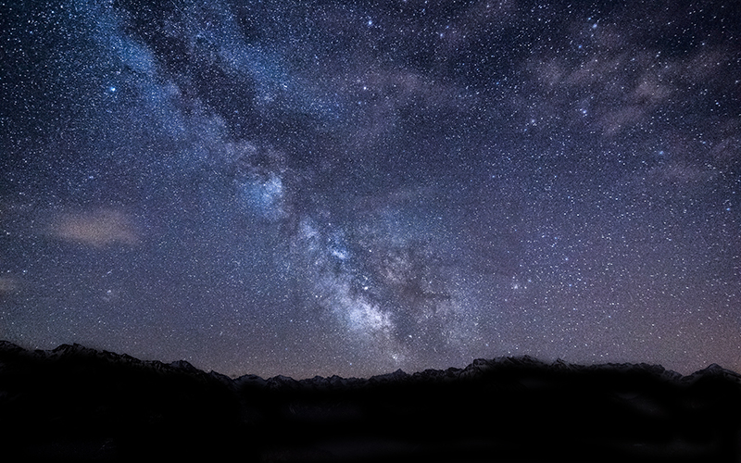

Slide 26
Genesis 15:9-17
9 So He said to him, “Bring Me a three-year-old heifer, a three-year-old female goat, a three-year-old ram [a sheep], a turtledove, and a young pigeon.”
10 Then he brought all these to Him and cut them in two, down the middle, and placed each piece opposite the other; but he did not cut the birds in two.
11 And when the vultures came down on the carcasses, Abram drove them away.

Slide 27
Genesis 15:9-17
12 Now when the sun was going down, a deep sleep fell upon Abram; and behold, horror and great darkness fell upon him . . .
17 And it came to pass, when the sun went down and it was dark, that behold, there appeared a smoking oven and a burning torch that passed between those pieces.

Slide 28
Genesis 15:9-17
9 So He said to him, “Bring Me a three-year-old heifer, a three-year-old female goat, a three-year-old ram [a sheep], a turtledove, and a young pigeon.”
10 Then he brought all these to Him and cut them in two, down the middle, and placed each piece opposite the other; but he did not cut the birds in two.

Slide 29
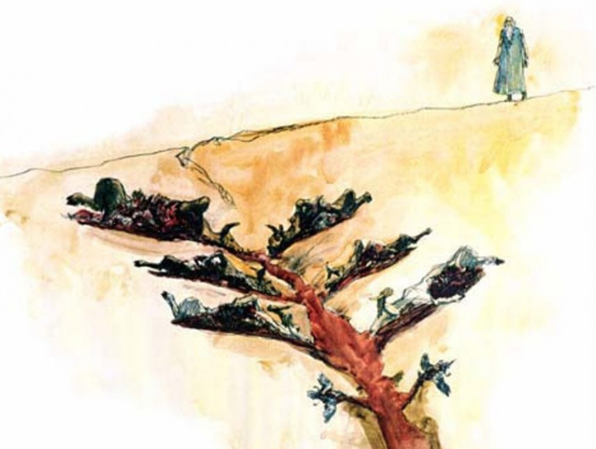

Slide 30
Genesis 15:17
17 And it came to pass, when the sun went down and it was dark, that behold, there appeared a smoking oven and a burning torch that passed between those pieces.

Slide 31
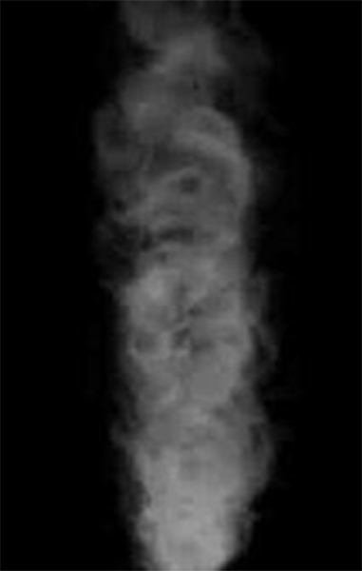

Slide 32
What does smoke represent?
Exodus 19:18—Mount Sinai was covered with smoke when God descended onto it.
Isaiah 6:4—The temple was filled with smoke when God came to it.
Revelation 15:8—The temple in heaven is filled with smoke from the glory of God.
Joel 2:30 and Acts 2:19—Pillars of smoke are a sign of the day of the Lord.

Slide 34
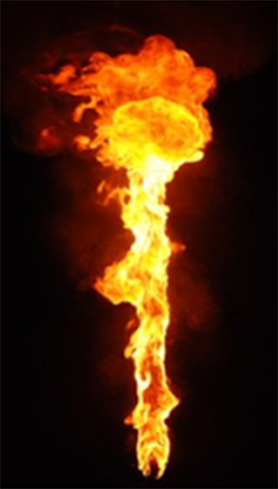

Slide 35
What does fire represent?
Exodus 3:2—God appears to Moses through a burning bush.
Exodus 13:21—God leads the Israelites by a burning pillar of fire.
Exodus 24:17—God appears like a consuming fire on Mount Sinai.
Hebrews 12:29—”Our God is a consuming fire.”

Slide 39
Genesis 22:1-14
1 Now it came to pass after these things that God tested Abraham, and said to him, “Abraham!” And he said, “Here I am.”
2 Then He said, “Take now your son, your only son Isaac, whom you love, and go to the land of Moriah, and offer him there as a burnt offering on one of the mountains of which I shall tell you.”

Slide 40
Genesis 22:1-14
3 So Abraham rose early in the morning and saddled his donkey, and took two of his young men with him, and Isaac his son; and he split the wood for the burnt offering, and arose and went to the place of which God had told him.
4 Then on the third day Abraham lifted his eyes and saw the place afar off.
5 And Abraham said to his young men, “Stay here with the donkey; the lad and I will go yonder and worship, and we will come back to you.”

Slide 41
Genesis 22:1-14
6 So Abraham took the wood of the burnt offering and laid it on Isaac his son; and he took the fire in his hand, and a knife, and the two of them went together.
7 But Isaac spoke to Abraham his father and said, “My father!” And he said, “Here I am, my son.” Then he said, “Look, the fire and the wood, but where is the lamb for a burnt offering?”
8 And Abraham said, “My son, God will provide for Himself the lamb for a burnt offering.” So the two of them went together.

Slide 42
Genesis 22:1-14
9 Then they came to the place of which God had told him. And Abraham built an altar there and placed the wood in order; and he bound Isaac his son and laid him on the altar, upon the wood.
10 And Abraham stretched out his hand and took the knife to slay his son.

Slide 43
Genesis 22:1-14
11 But the Angel of the LORD called to him from heaven and said, “Abraham, Abraham!” So he said, “Here I am.”
12 And He said, “Do not lay your hand on the lad, or do anything to him; for now I know that you fear God, since you have not withheld your son, your only son, from Me.”
13 Then Abraham lifted his eyes and looked, and there behind him was a ram caught in a thicket by its horns. So Abraham went and took the ram, and offered it up for a burnt offering instead of his son.

Slide 44
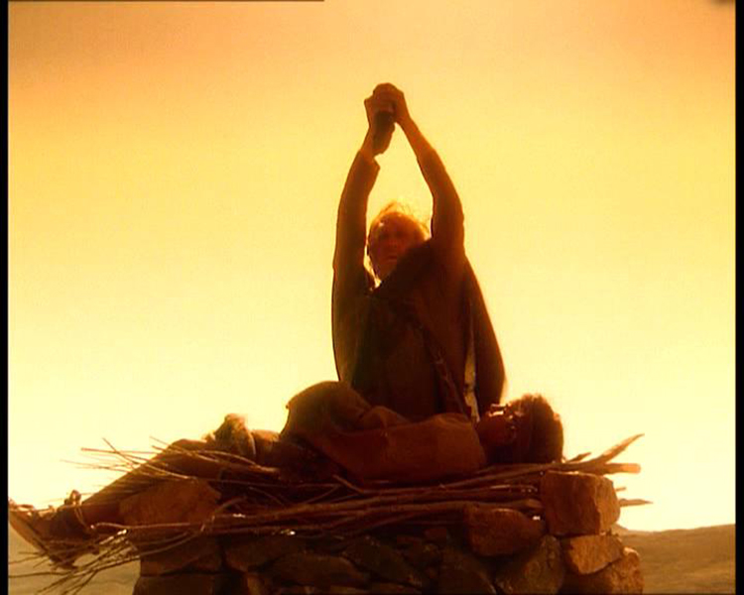

Slide 45
Genesis 22:1-14
14 And Abraham called the name of the place, The-LORD-Will-Provide; as it is said to this day,
“In the Mount of The LORD it shall be provided.”

Slide 46
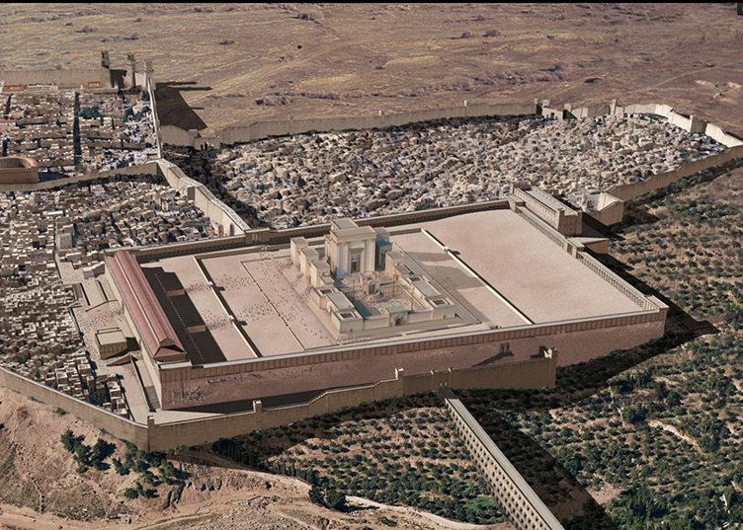

Slide 47
Exodus 12:1-14
1 Now the LORD spoke to Moses and Aaron in the land of Egypt, saying, . . .
3 ‘On the tenth day of this month every man shall take for himself a lamb . . .
5 ‘Your lamb shall be without blemish . . .
6 ‘Now you shall keep it until the fourteenth day of the same month. Then the whole assembly of the congregation of Israel shall kill it at twilight.
7 ‘And they shall take some of the blood and put it on the two doorposts and on the lintel of the houses where they eat it. . .

Slide 48
Exodus 12:1-14
11 It is the LORD’S Passover.
12 ‘For I will pass through the land of Egypt on that night, and will strike all the firstborn in the land of Egypt, both man and beast; and against all the gods of Egypt I will execute judgment: I am the LORD.
13 ‘Now the blood shall be a sign for you on the houses where you are. And when I see the blood, I will pass over you; and the plague shall not be on you to destroy you when I strike the land of Egypt.

Slide 49
Exodus 12:1-14
14 ‘So this day shall be to you a memorial; and you shall keep it as a feast to the LORD throughout your generations. You shall keep it as a feast by an everlasting ordinance.

Slide 51
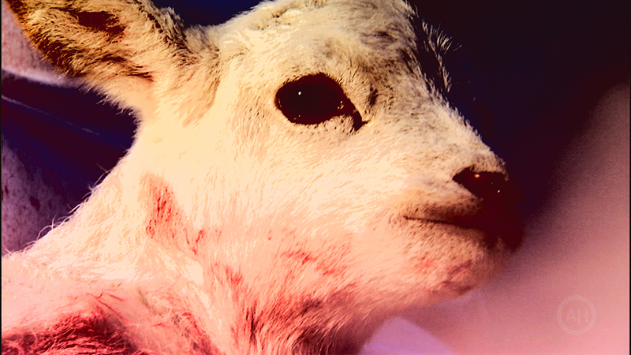

Slide 52
Hebrews 10:1-4
1 For the law, having a shadow of the good things to come, and not the very image of the things, can never with these same sacrifices, which they offer continually year by year, make those who approach perfect.
2 For then would they not have ceased to be offered? For the worshipers, once purified, would have had no more consciousness of sins.

Slide 53
Hebrews 10:1-4
3 But in those sacrifices there is a reminder of sins every year.
4 For it is not possible that the blood of bulls and goats could take away sins.

Slide 55
Numbers 28:1-6
1 Now the LORD spoke to Moses, saying,
2 “Command the children of Israel, and say to them, ‘My offering, My food for My offerings made by fire as a sweet aroma to Me, you shall be careful to offer to Me at their appointed time.’
3 “And you shall say to them, ‘This is the offering made by fire which you shall offer to the LORD: two male lambs in their first year without blemish, day by day, as a regular burnt offering.

Slide 56
Numbers 28:1-6
4 ‘The one lamb you shall offer in the morning,
the other lamb you shall offer in the evening
[or afternoon] . . .
6 ‘It is a regular burnt offering which was ordained at Mount Sinai for a sweet aroma,
an offering made by fire to the LORD.

Slide 59
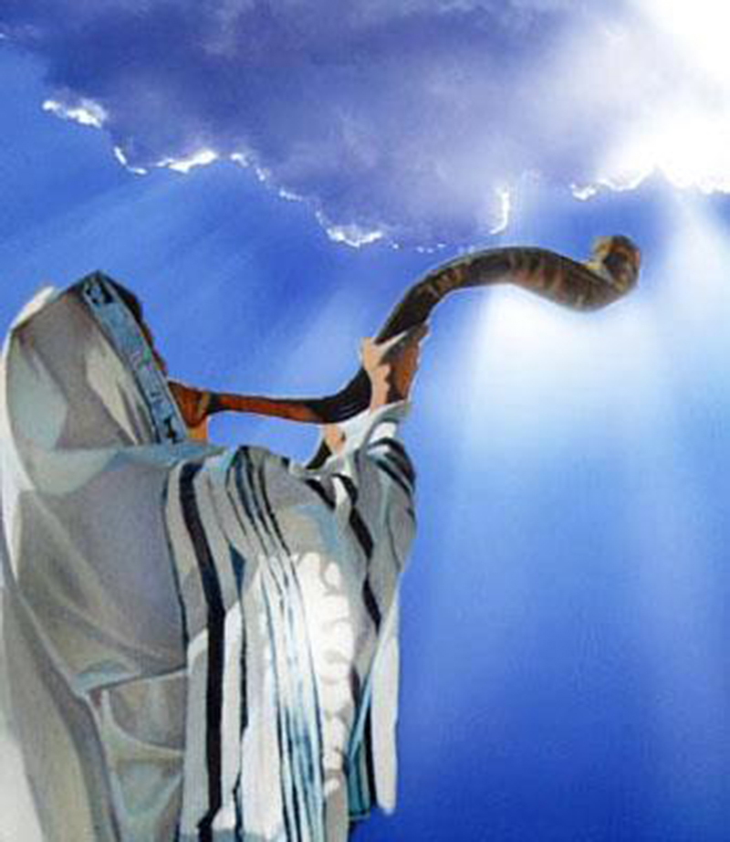

Slide 61
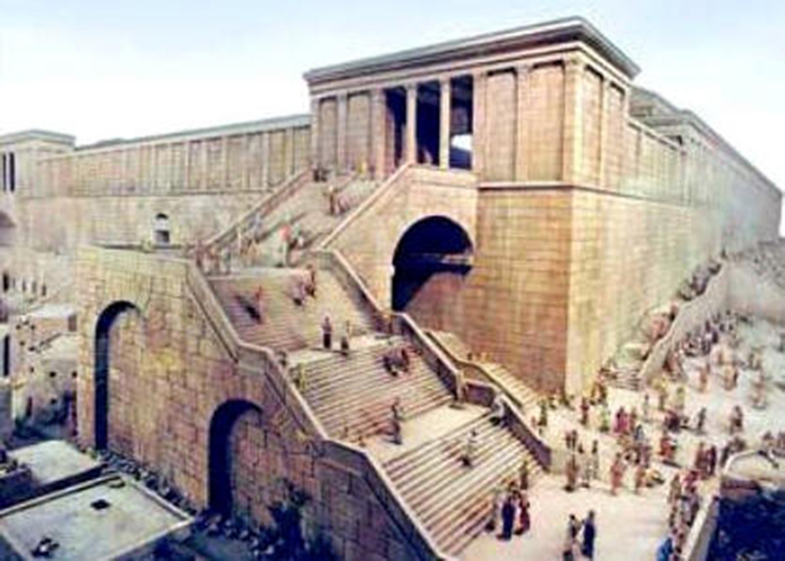

Slide 63
Mark 15:25
25 Now it was the third hour, and they
crucified Him.

Slide 64
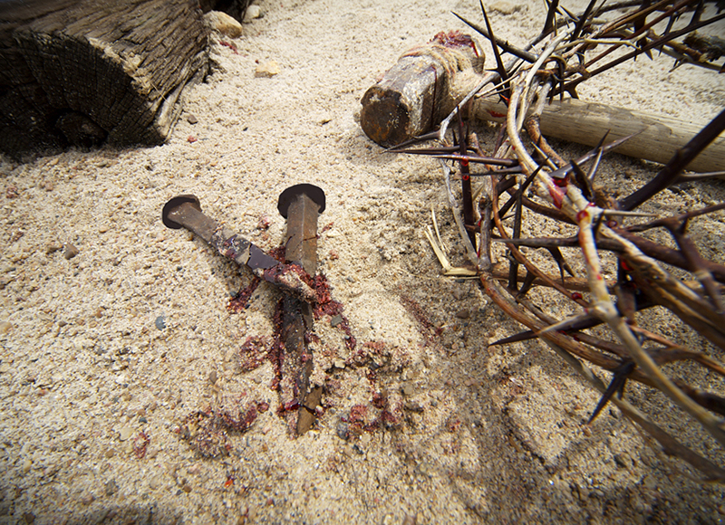

Slide 74
Genesis 37:31-34
31 So they took Joseph’s tunic, killed a kid of the goats, and dipped the tunic in the blood.
32 Then they sent the tunic of many colors, and they brought it to their father and said, “We have found this. Do you know whether it is your son’s tunic or not?”
33 And he recognized it and said, “It is my son’s tunic. A wild beast has devoured him. Without doubt Joseph is torn to pieces.”
34 Then Jacob tore his clothes, put sackcloth on his waist, and mourned for his son many days.

Slide 75
Job 1:18-20
18 While he was still speaking, another also came and said, “Your sons and daughters were eating and drinking wine in their oldest brother’s house,
19 “and suddenly a great wind came from across the wilderness and struck the four corners of the house, and it fell on the young people, and they are dead; and I alone have escaped to tell you!”
20 Then Job arose, [and] tore his robe . . .

Slide 76
2 Samuel 1:11-12
11 Therefore David took hold of his own clothes and tore them, and so did all the men who were with him.
12 And they mourned and wept and fasted until evening for Saul and for Jonathan his son, for the people of the LORD and for the house of Israel, because they had fallen by the sword.

Slide 77
Matthew 27:50-51
50 And Jesus cried out again with a loud voice, and yielded up His spirit.
51 Then, behold, the veil of the temple was torn
in two from top to bottom . . .

