Slide 1

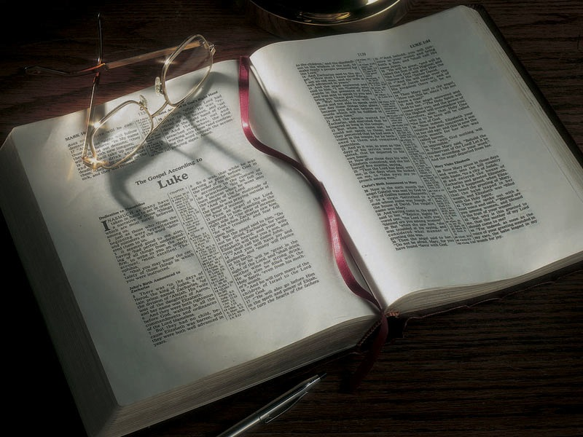

Slide 2
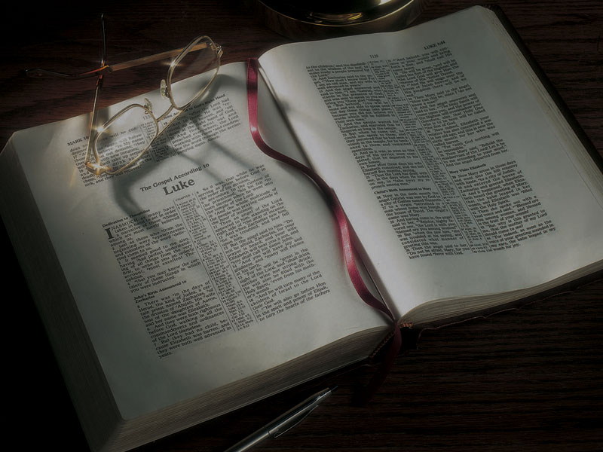
The Gospels
The Ministry of
John the Baptizer

Slide 3
Luke 1:5-17
5 There was in the days of Herod, the king of Judea, a certain priest named Zacharias, of the division of Abijah. His wife was of the daughters
of Aaron, and her name was Elizabeth.
6 And they were both righteous before God, walking in all the commandments and ordinances of the Lord blameless.
7 But they had no child, because Elizabeth was barren, and they were both well advanced in years.

Slide 4
Luke 1:5-17
8 So it was, that while he was serving as priest before God in the order of his division,
9 according to the custom of the priesthood, his lot fell to burn incense when he went into the temple of the Lord.
10 And the whole multitude of the people was praying outside at the hour of incense.
11 Then an angel of the Lord appeared to him, standing on the right side of the altar of incense.

Slide 5
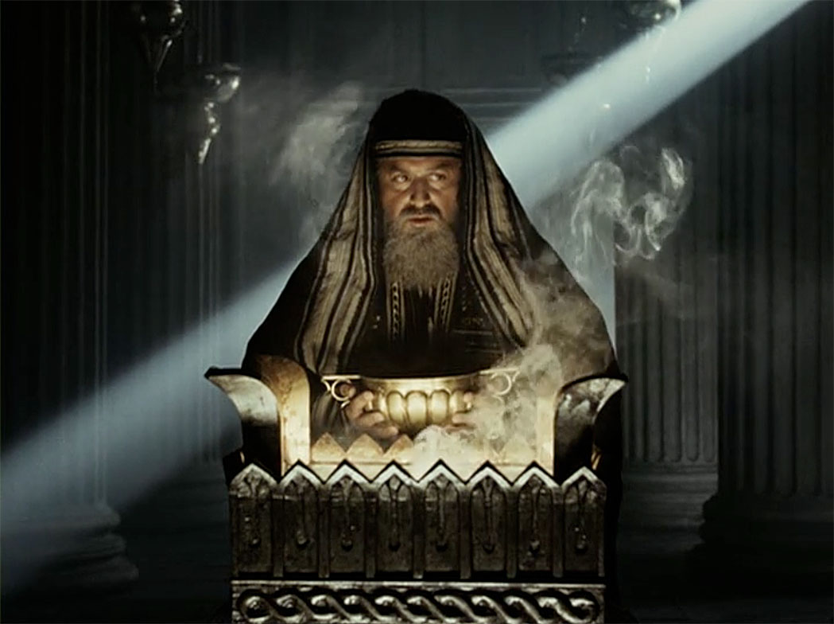

Slide 6
Luke 1:5-17
12 And when Zacharias saw him, he was troubled, and fear fell upon him.
13 But the angel said to him, “Do not be afraid, Zacharias, for your prayer is heard; and your wife Elizabeth will bear you a son, and you shall call his name John.
14 “And you will have joy and gladness, and many will rejoice at his birth.

Slide 7
Luke 1:5-17
15 “For he will be great in the sight of the Lord, and shall drink neither wine nor strong drink. He will also be filled with the Holy Spirit, even from his mother’s womb.
16 “And he will turn many of the children of Israel to the Lord their God.
17 “He will also go before Him in the spirit and power of Elijah, ‘to turn the hearts of the fathers to the children,’ and the disobedient to the wisdom of the just, to make ready a people prepared for the Lord.”

Slide 8
Luke 3:1-14
1 Now in the fifteenth year of the reign of Tiberius Caesar, Pontius Pilate being governor of Judea, Herod being tetrarch of Galilee, his brother Philip tetrarch of Iturea and the region of Trachonitis, and Lysanias tetrarch of Abilene,
2 while Annas and Caiaphas were high priests, the word of God came to John the son of Zacharias in the wilderness.
3 And he went into all the region around the Jordan, preaching a baptism of repentance for the remission of sins,

Slide 9
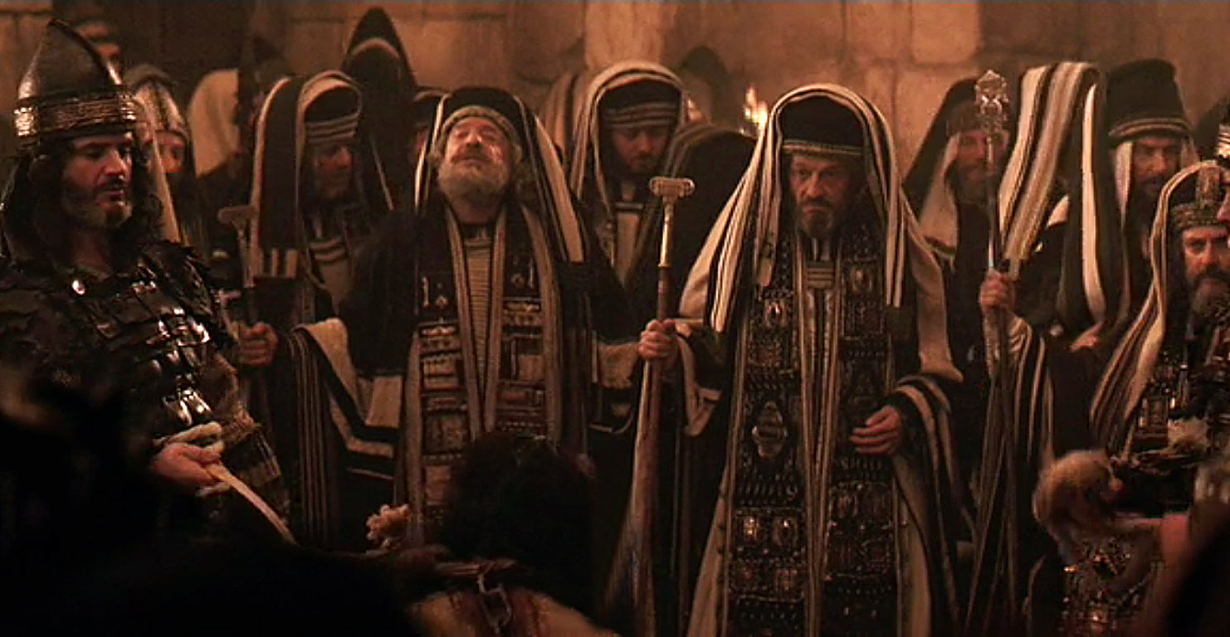

Slide 10
Luke 3:1-18
1 Now in the fifteenth year of the reign of Tiberius Caesar, Pontius Pilate being governor of Judea, Herod being tetrarch of Galilee, his brother Philip tetrarch of Iturea and the region of Trachonitis, and Lysanias tetrarch of Abilene,
2 while Annas and Caiaphas were high priests, the word of God came to John the son of Zacharias in the wilderness.
3 And he went into all the region around the Jordan, preaching a baptism of repentance for the remission of sins,

Slide 11
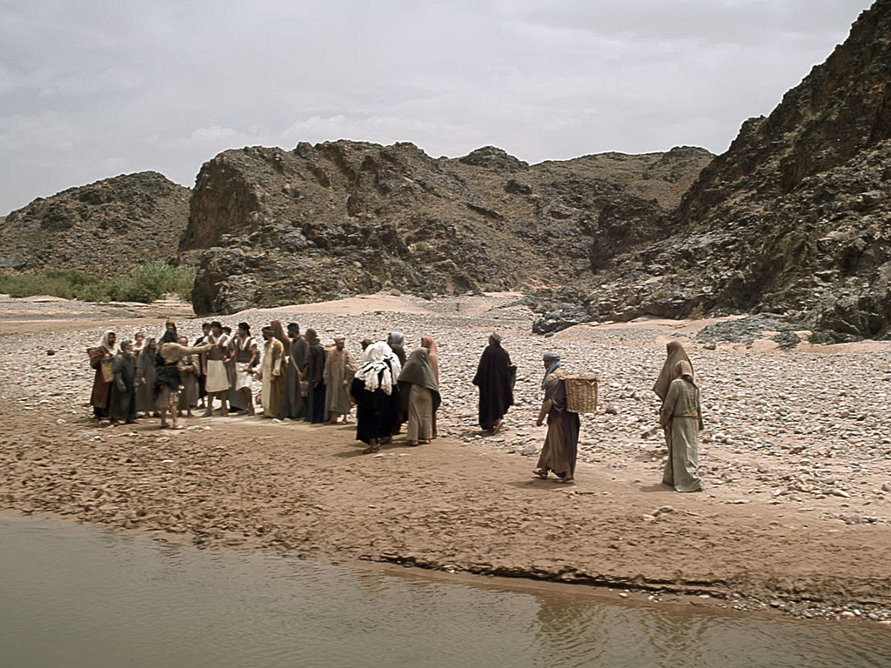

Slide 12
Luke 3:1-18
4 as it is written in the book of the words of Isaiah the prophet, saying: “The voice of one crying in the wilderness: ‘Prepare the way of the LORD; make His paths straight.
5 Every valley shall be filled and every mountain and hill brought low; the crooked places shall be made straight and the rough ways smooth;
6 And all flesh shall see the salvation of God.’”

Slide 13
Isaiah 40:3-5
3 The voice of one crying in the wilderness: “Prepare the way of the LORD; make straight in the desert a highway for our God.
4 Every valley shall be exalted and every mountain and hill brought low; the crooked places shall be made straight and the rough places smooth;
5 The glory of the LORD shall be revealed, and all flesh shall see it together; for the mouth of the LORD has spoken.”

Slide 14
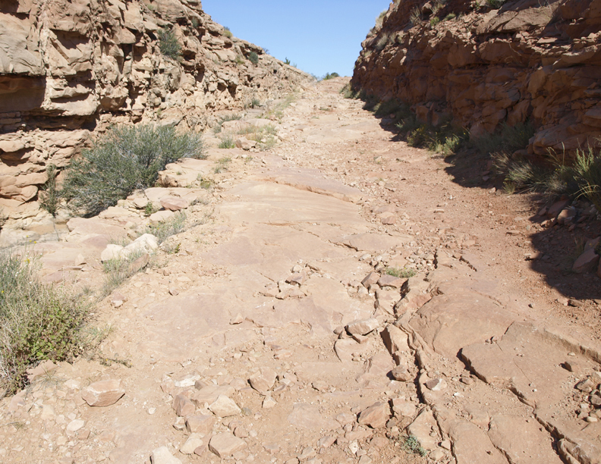

Slide 15
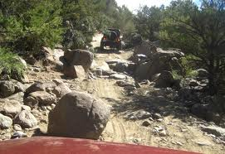

Slide 16
Mark 1:1-4
1 The beginning of the gospel of Jesus Christ, the Son of God.
2 As it is written in the Prophets: “Behold, I send My messenger before Your face, Who will prepare Your way before You.”
3 “The voice of one crying in the wilderness: ‘Prepare the way of the LORD; Make His paths straight.’”
4 John came baptizing in the wilderness and preaching a baptism of repentance for the remission of sins.

Slide 17
Matthew 3:4
4 And John himself was clothed in camel’s hair, with a leather belt around his waist . . .
Mark 1:6
6 Now John was clothed with camel’s hair and with a leather belt around his waist . . .

Slide 18
2 Kings 1:7-8
7 Then he [King Amaziah] said to them [the messengers], “What kind of man was it who came up to meet you and told you these words?”
8 So they answered him, “A hairy man wearing a leather belt around his waist.” And he said, “It is Elijah the Tishbite.”

Slide 19
2 Kings 1:7-8
7 Then he [King Amaziah] said to them [the messengers], “What kind of man was it who came up to meet you and told you these words?”
8 So they answered him, “A hairy man wearing a leather belt around his waist.” And he said, “It is Elijah the Tishbite.”
“Hairy man” in the original Hebrew is literally
“master/owner/possessor of hair.”

Slide 20
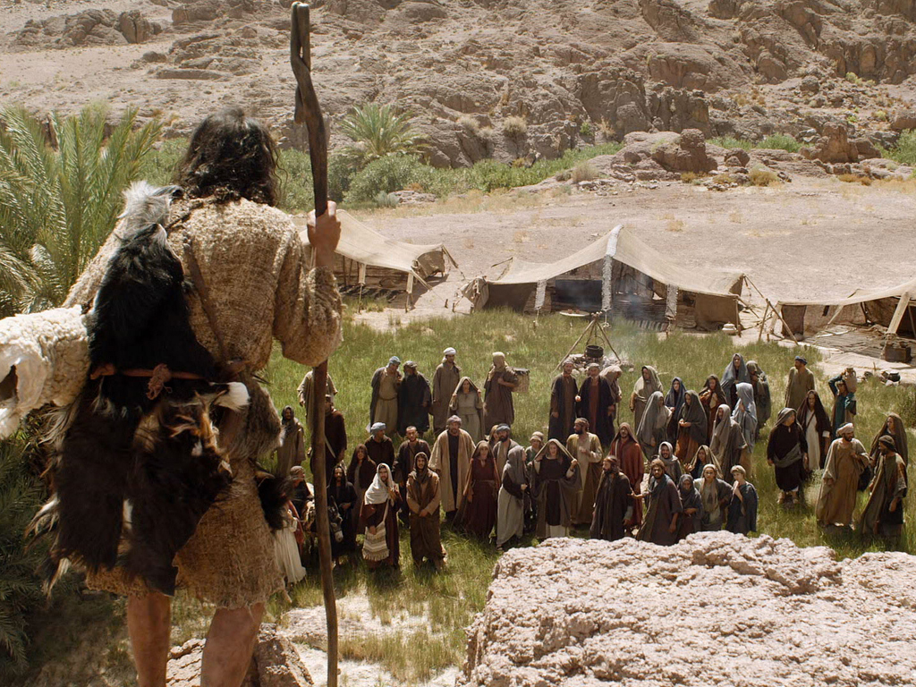

Slide 21
Luke 1:13-17
13 But the angel said to him, “Do not be afraid, Zacharias, for your prayer is heard; and your wife Elizabeth will bear you a son, and you shall call his name John . . .
16 “And he will turn many of the children of Israel to the Lord their God.
17 “He will also go before Him in the spirit and power of Elijah . . .”

Slide 22
Matthew 11:11-14
11 “Assuredly, I say to you, among those born of women there has not risen one greater than John the Baptist . . .
14 “And if you are willing to receive it, he is Elijah who is to come.”

Slide 24
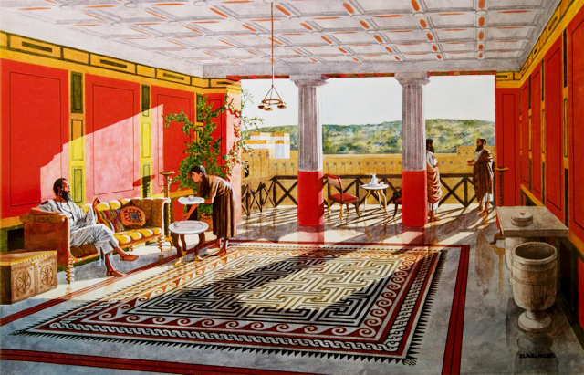

Slide 25
Luke 3:1-18
7 Then he said to the multitudes that came out to be baptized by him, “Brood of vipers! Who warned you to flee from the wrath to come?
8 “Therefore bear fruits worthy of repentance,
and do not begin to say to yourselves, ‘We have Abraham as our father.’ For I say to you that God
is able to raise up children to Abraham from these stones.
9 “And even now the ax is laid to the root of the trees. Therefore every tree which does not bear good fruit is cut down and thrown into the fire.”

Slide 26
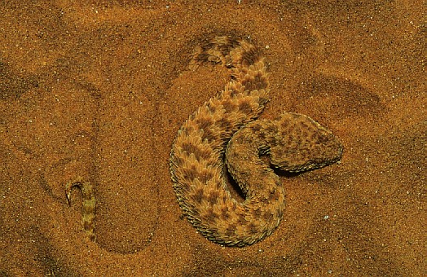

Slide 27
Luke 3:1-14
7 Then he said to the multitudes that came out to be baptized by him, “Brood of vipers! Who warned you to flee from the wrath to come?
8 “Therefore bear fruits worthy of repentance,
and do not begin to say to yourselves, ‘We have Abraham as our father.’ For I say to you that God
is able to raise up children to Abraham from these stones.
9 “And even now the ax is laid to the root of the trees. Therefore every tree which does not bear good fruit is cut down and thrown into the fire.”

Slide 28
Luke 3:1-14
10 So the people asked him, saying, “What shall we do then?”
11 He answered and said to them, “He who has two tunics, let him give to him who has none; and he who has food, let him do likewise.”
12 Then tax collectors also came to be baptized, and said to him, “Teacher, what shall we do?”
13 And he said to them, “Collect no more than what is appointed for you.”

Slide 29
Luke 3:1-14
14 Likewise the soldiers asked him, saying, “And what shall we do?” So he said to them, “Do not intimidate anyone or accuse falsely, and be content with your wages.”

Slide 31
Luke 3:1-14
1 Now in the fifteenth year of the reign of Tiberius Caesar, Pontius Pilate being governor of Judea, Herod being tetrarch of Galilee, his brother Philip tetrarch of Iturea and the region of Trachonitis, and Lysanias tetrarch of Abilene,
2 while Annas and Caiaphas were high priests, the word of God came to John the son of Zacharias in the wilderness.
3 And he went into all the region around the Jordan, preaching a baptism of repentance for the remission of sins,
4 as it is written in the book of the words of Isaiah the prophet, saying: “The voice of one crying in the wilderness: ‘Prepare the way of the LORD; make His paths straight.
5 Every valley shall be filled and every mountain and hill brought low; the crooked places shall be made straight and the rough ways smooth;
6 And all flesh shall see the salvation of God.’”
7 Then he said to the multitudes that came out to be baptized by him, “Brood of vipers! Who warned you to flee from the wrath to come?
8 “Therefore bear fruits worthy of repentance, and do not begin to say to yourselves, ‘We have Abraham as our father.’ For I say to you that God is able to raise up children to Abraham from these stones.
9 “And even now the ax is laid to the root of the trees. Therefore every tree which does not bear good fruit is cut down and thrown into the fire.”
10 So the people asked him, saying, “What shall we do then?”
11 He answered and said to them, “He who has two tunics, let him give to him who has none; and he who has food, let him do likewise.”
12 Then tax collectors also came to be baptized, and said to him, “Teacher, what shall we do?”
13 And he said to them, “Collect no more than what is appointed for you.”
14 Likewise the soldiers asked him, saying, “And what shall we do?” So he said to them, “Do not intimidate anyone or accuse falsely, and be content with your wages.”
15 Now as the people were in expectation, and all reasoned in their hearts about John, whether he was the Christ or not,
16 John answered, saying to all, “I indeed baptize you with water; but One mightier than I is coming, whose sandal strap I am not worthy to loose. He will baptize you with the Holy Spirit and fire.
17 “His winnowing fan is in His hand, and He will thoroughly clean out His threshing floor, and gather the wheat into His barn; but the chaff He will burn with unquenchable fire.”
18 And with many other exhortations he preached to the people.

Slide 32
Luke 3:1-14
1 Now in the fifteenth year of the reign of Tiberius Caesar, Pontius Pilate being governor of Judea, Herod being tetrarch of Galilee, his brother Philip tetrarch of Iturea and the region of Trachonitis, and Lysanias tetrarch of Abilene,
2 while Annas and Caiaphas were high priests, the word of God came to John the son of Zacharias in the wilderness.
3 And he went into all the region around the Jordan, preaching a baptism of repentance for the remission of sins,
4 as it is written in the book of the words of Isaiah the prophet, saying: “The voice of one crying in the wilderness: ‘Prepare the way of the LORD; make His paths straight.
5 Every valley shall be filled and every mountain and hill brought low; the crooked places shall be made straight and the rough ways smooth;
6 And all flesh shall see the salvation of God.’”
7 Then he said to the multitudes that came out to be baptized by him, “Brood of vipers! Who warned you to flee from the wrath to come?
8 “Therefore bear fruits worthy of repentance, and do not begin to say to yourselves, ‘We have Abraham as our father.’ For I say to you that God is able to raise up children to Abraham from these stones.
9 “And even now the ax is laid to the root of the trees. Therefore every tree which does not bear good fruit is cut down and thrown into the fire.”
10 So the people asked him, saying, “What shall we do then?”
11 He answered and said to them, “He who has two tunics, let him give to him who has none; and he who has food, let him do likewise.”
12 Then tax collectors also came to be baptized, and said to him, “Teacher, what shall we do?”
13 And he said to them, “Collect no more than what is appointed for you.”
14 Likewise the soldiers asked him, saying, “And what shall we do?” So he said to them, “Do not intimidate anyone or accuse falsely, and be content with your wages.”
15 Now as the people were in expectation, and all reasoned in their hearts about John, whether he was the Christ or not,
16 John answered, saying to all, “I indeed baptize you with water; but One mightier than I is coming, whose sandal strap I am not worthy to loose. He will baptize you with the Holy Spirit and fire.
17 “His winnowing fan is in His hand, and He will thoroughly clean out His threshing floor, and gather the wheat into His barn; but the chaff He will burn with unquenchable fire.”
18 And with many other exhortations he preached to the people.

Slide 33
Luke 3:1-14
1 Now in the fifteenth year of the reign of Tiberius Caesar, Pontius Pilate being governor of Judea, Herod being tetrarch of Galilee, his brother Philip tetrarch of Iturea and the region of Trachonitis, and Lysanias tetrarch of Abilene,
2 while Annas and Caiaphas were high priests, the word of God came to John the son of Zacharias in the wilderness.
3 And he went into all the region around the Jordan, preaching a baptism of repentance for the remission of sins,
4 as it is written in the book of the words of Isaiah the prophet, saying: “The voice of one crying in the wilderness: ‘Prepare the way of the LORD; make His paths straight.
5 Every valley shall be filled and every mountain and hill brought low; the crooked places shall be made straight and the rough ways smooth;
6 And all flesh shall see the salvation of God.’”
7 Then he said to the multitudes that came out to be baptized by him, “Brood of vipers! Who warned you to flee from the wrath to come?
8 “Therefore bear fruits worthy of repentance, and do not begin to say to yourselves, ‘We have Abraham as our father.’ For I say to you that God is able to raise up children to Abraham from these stones.
9 “And even now the ax is laid to the root of the trees. Therefore every tree which does not bear good fruit is cut down and thrown into the fire.”
10 So the people asked him, saying, “What shall we do then?”
11 He answered and said to them, “He who has two tunics, let him give to him who has none; and he who has food, let him do likewise.”
12 Then tax collectors also came to be baptized, and said to him, “Teacher, what shall we do?”
13 And he said to them, “Collect no more than what is appointed for you.”
14 Likewise the soldiers asked him, saying, “And what shall we do?” So he said to them, “Do not intimidate anyone or accuse falsely, and be content with your wages.”
15 Now as the people were in expectation, and all reasoned in their hearts about John, whether he was the Christ or not,
16 John answered, saying to all, “I indeed baptize you with water; but One mightier than I is coming, whose sandal strap I am not worthy to loose. He will baptize you with the Holy Spirit and fire.
17 “His winnowing fan is in His hand, and He will thoroughly clean out His threshing floor, and gather the wheat into His barn; but the chaff He will burn with unquenchable fire.”
18 And with many other exhortations he preached to the people.

Slide 34
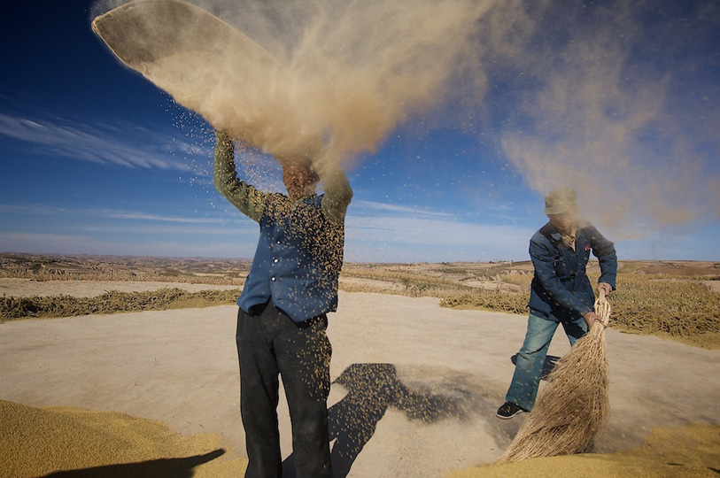

Slide 35
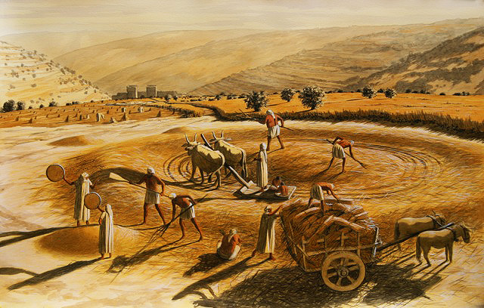

Slide 36
Matthew 3:1-6
1 In those days John the Baptist came preaching in the wilderness of Judea,
2 and saying, “Repent, for the kingdom of heaven is at hand!”
3 For this is he who was spoken of by the prophet Isaiah, saying: “The voice of one crying in the wilderness: ‘Prepare the way of the LORD; make His paths straight.’”
4 And John himself was clothed in camel’s hair, with a leather belt around his waist; and his food was locusts and wild honey.
5 Then Jerusalem, all Judea, and all the region around the Jordan went out to him
6 and were baptized by him in the Jordan, confessing their sins.

Slide 37
Mark 1:1-6
1 The beginning of the gospel of Jesus Christ, the Son of God.
2 As it is written in the Prophets: “Behold, I send My messenger before Your face, Who will prepare Your way before You.”
3 “The voice of one crying in the wilderness: ‘Prepare the way of the LORD; Make His paths straight.’”
4 John came baptizing in the wilderness and preaching a baptism of repentance for the remission of sins.
5 Then all the land of Judea, and those from Jerusalem, went out to him and were all baptized by him in the Jordan River, confessing their sins.
6 Now John was clothed with camel’s hair and with a leather belt around his waist, and he ate locusts and wild honey.

Slide 38
Malachi 3:1
1 “Behold, I send My messenger, and he will prepare the way before Me. And the Lord, whom you seek, will suddenly come to His temple, even the Messenger of the covenant, in whom you delight. Behold, He is coming,” says the LORD of hosts.

Slide 39
2 Kings 1:6-8
6 So they said to him, “A man came up to meet us, and said to us, ‘Go, return to the king who sent you, and say to him, “Thus says the LORD: ‘Is it because there is no God in Israel that you are sending to inquire of Baal-Zebub, the god of Ekron? Therefore you shall not come down from the bed to which you have gone up, but you shall surely die.’”’”
7 Then he said to them, “What kind of man was it who came up to meet you and told you these words?”
8 So they answered him, “A hairy man wearing a leather belt around his waist.” And he said, “It is Elijah the Tishbite.”

Slide 40
Matthew 3:4
4 And John himself was clothed in camel’s hair, with a leather belt around his waist . . .
2 Kings 1:7-8
7 Then he [King Amaziah] said to them [messengers], “What kind of man was it who came up to meet you and told you these words?”
8 So they answered him, “A hairy man wearing a leather belt around his waist.” And he said, “It is Elijah the Tishbite.”

Slide 41
Luke 1:13-17
13 But the angel said to him, “Do not be afraid, Zacharias, for your prayer is heard; and your wife Elizabeth will bear you a son, and you shall call his name John . . .
16 “And he will turn many of the children of Israel to the Lord their God.
17 “He will also go before Him in the spirit and power of Elijah, ‘to turn the hearts of the fathers to the children,’ and the disobedient to the wisdom of the just, to make ready a people prepared for the Lord.”

Slide 42
Matthew 3:4
4 And John himself was clothed in camel’s hair, with a leather belt around his waist . . .

Slide 43
Matthew 3:4
4 And John himself was clothed in camel’s hair, with a leather belt around his waist . . .
2 Kings 1:7-8
7 Then he [King Amaziah] said to them [messengers], “What kind of man was it who came up to meet you and told you these words?”
8 So they answered him, “A hairy man wearing a leather belt around his waist.” And he said, “It is Elijah the Tishbite.”

Slide 44
Luke 1:13-17
13 But the angel said to him, “Do not be afraid, Zacharias, for your prayer is heard; and your wife Elizabeth will bear you a son, and you shall call his name John . . .
16 “And he will turn many of the children of Israel to the Lord their God.
17 “He will also go before Him in the spirit and power of Elijah, ‘to turn the hearts of the fathers to the children,’ and the disobedient to the wisdom of the just, to make ready a people prepared for the Lord.”

Slide 45
Matthew 11:11-14
11 “Assuredly, I say to you, among those born of women there has not risen one greater than John the Baptist; but he who is least in the kingdom of heaven is greater than he.
12 “And from the days of John the Baptist until now the kingdom of heaven suffers violence, and the violent take it by force.
13 “For all the prophets and the law prophesied until John.
14 “And if you are willing to receive it, he is Elijah who is to come.”

Slide 46
Jeremiah 15:7
7 And I will winnow them with a winnowing fan
in the gates of the land; I will bereave them of children; I will destroy My people, since they do
not return from their ways.

Slide 47
Jeremiah 15:5-9
5 “For who will have pity on you, O Jerusalem? Or who will bemoan you? Or who will turn aside to ask how you are doing?
6 You have forsaken Me,” says the LORD, “You have gone backward. Therefore I will stretch out My hand against you and destroy you; I am weary of relenting!
7 And I will winnow them with a winnowing fan
in the gates of the land; I will bereave them of children; I will destroy My people, since they do
not return from their ways.
8 Their widows will be increased to Me more than the sand of the seas; I will bring against them, against the mother of the young men, a plunderer at noonday; I will cause anguish and terror to fall on them suddenly.
9 “She languishes who has borne seven; she has breathed her last; her sun has gone down while it was yet day; she has been ashamed and confounded. And the remnant of them I will deliver to the sword before their enemies,” says the LORD.

Slide 48
Isaiah 66:23-24
23 And it shall come to pass that from one New Moon to another, and from one Sabbath to another, all flesh shall come to worship before Me,” says the LORD.
24 “And they shall go forth and look upon the corpses of the men who have transgressed against Me. For their worm does not die, and their fire is not quenched. They shall be an abhorrence to all flesh.”

Slide 49
Psalm 1:4
4 The ungodly are not so, but are like the chaff which the wind drives away.

Slide 50
Jeremiah 7:20
20 Therefore thus says the Lord GOD: “Behold, My anger and My fury will be poured out on this place—on man and on beast, on the trees of the field and on the fruit of the ground. And it will burn and not be quenched.”

Slide 51
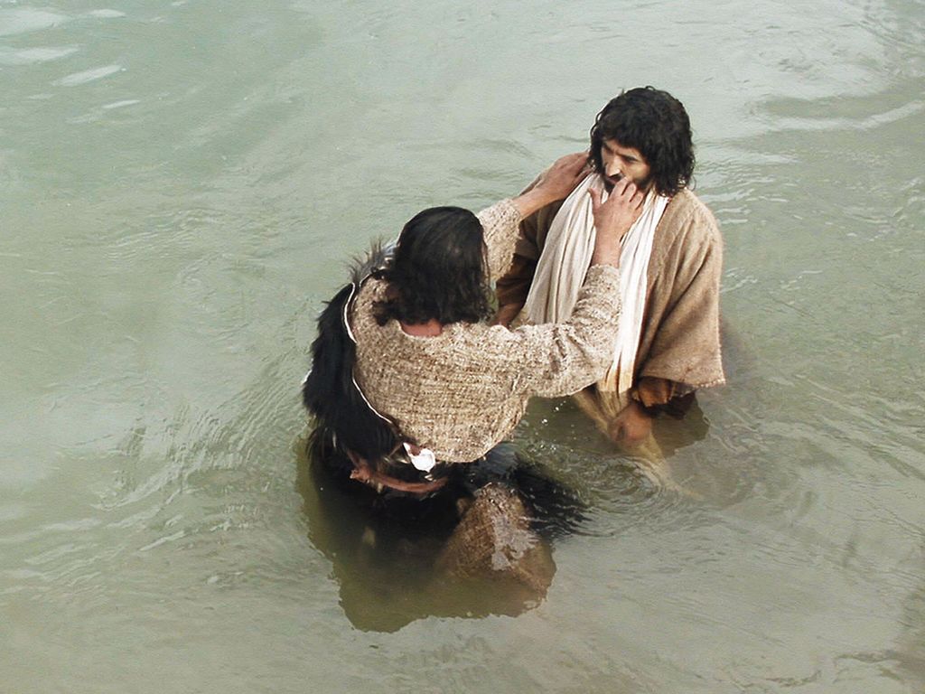

Slide 52
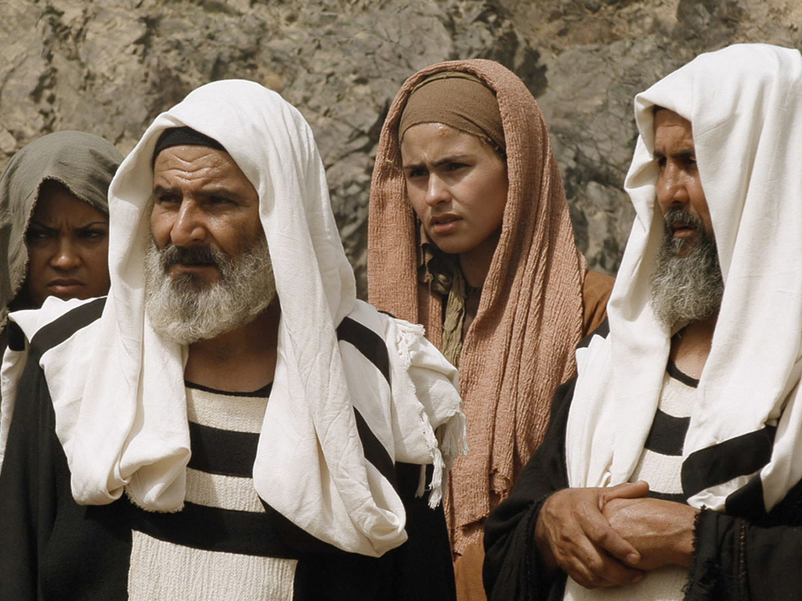

Slide 53
Luke 2:40-52
45 So when they did not find Him, they returned to Jerusalem, seeking Him.
46 Now so it was that after three days they found Him in the temple, sitting in the midst of the teachers, both listening to them and asking them questions.
47 And all who heard Him were astonished at His understanding and answers.

Slide 54
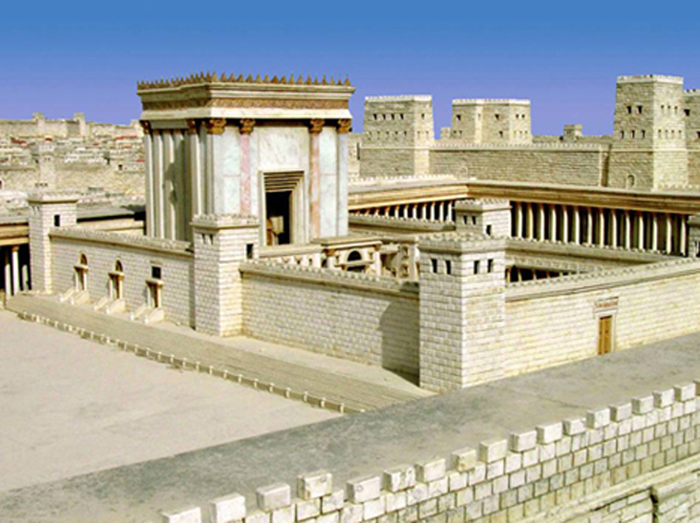

Slide 55
Matthew 12:9-13
9 Now when He had departed from there, He went into their synagogue.
10 And behold, there was a man who had a withered hand. And they asked Him, saying, “Is it lawful to heal on the Sabbath?”—that they might accuse Him.

Slide 56
Matthew 12:9-13
11 Then He said to them, “What man is there among you who has one sheep, and if it falls into
a pit on the Sabbath, will not lay hold of it and lift it out?
12 “Of how much more value then is a man than
a sheep? Therefore it is lawful to do good on the Sabbath.”
13 Then He said to the man, “Stretch out your hand.” And he stretched it out, and it was restored as whole as the other.

Slide 57
Matthew 21:23-27
23 Now when He came into the temple, the chief priests and the elders of the people confronted Him as He was teaching, and said, “By what authority are You doing these things? And who gave You this authority?”
24 But Jesus answered and said to them, “I also will ask you one thing, which if you tell Me, I likewise will tell you by what authority I do these things:

Slide 58
Matthew 21:23-27
25 “The baptism of John—where was it from? From heaven or from men?” And they reasoned among themselves, saying, “If we say, ‘From heaven,’ He will say to us, ‘Why then did you not believe him?’
26 “But if we say, ‘From men,’ we fear the multitude, for all count John as a prophet.”
27 So they answered Jesus and said, “We do not know.” And He said to them, “Neither will I tell you by what authority I do these things.

Slide 59
Luke 2:40-52
47 And all who heard Him were astonished at His understanding and answers.
48 So when they saw Him, they were amazed; and His mother said to Him, “Son, why have You done this to us? Look, Your father and I have sought You anxiously.”
49 And He said to them, “Why did you seek Me? Did you not know that I must be about My Father’s business?”
50 But they did not understand the statement which He spoke to them.

Slide 60
Hebrews 5:8-9
8 though He was a Son, yet He learned obedience by the things which He suffered.
9 And having been perfected, He became the author of eternal salvation to all who obey Him

Slide 61
Hebrews 5:8-9
8 though He was a Son, yet He learned obedience by the things which He suffered.
9 And having been perfected, He became the author of eternal salvation to all who obey Him
John 8:28
28 Then Jesus said to them, “When you lift up the Son of Man, then you will know that I am He, and that I do nothing of Myself; but as My Father taught Me, I speak these things.

Slide 62
Luke 2:40-52
51 Then He went down with them and came to Nazareth, and was subject to them, but His mother kept all these things in her heart.
52 And Jesus increased in wisdom and stature, and in favor with God and men.

Slide 64
