Slide 1

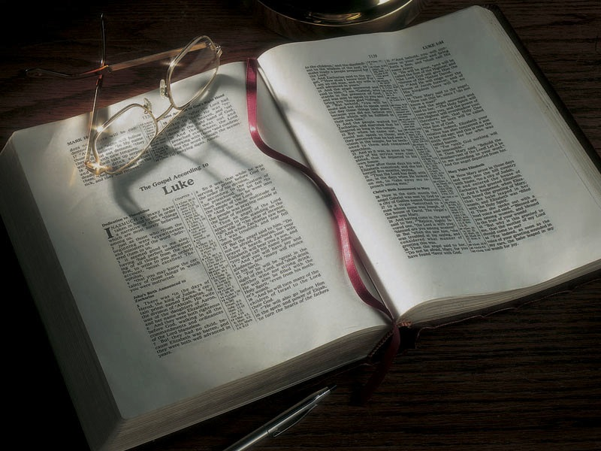

Slide 2
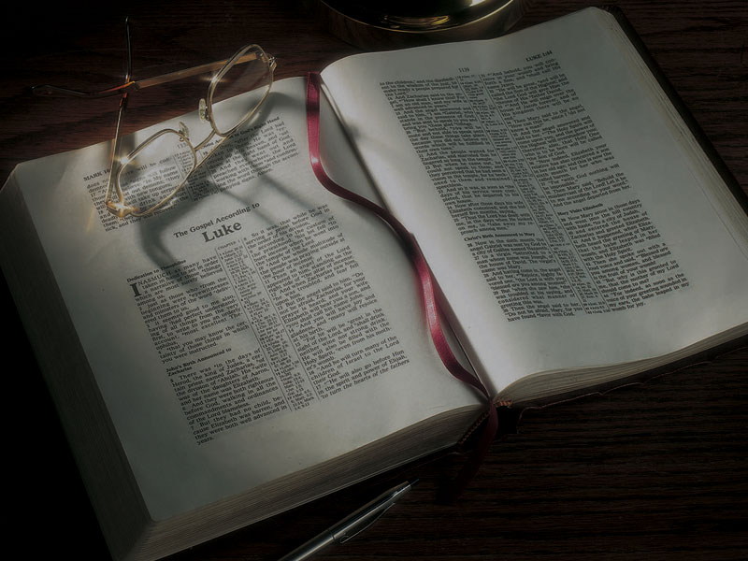
The Gospels
Jesus Christ’s
Later Childhood

Slide 3
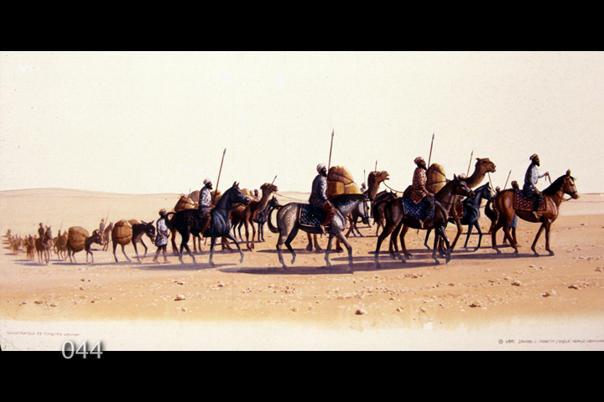

Slide 4
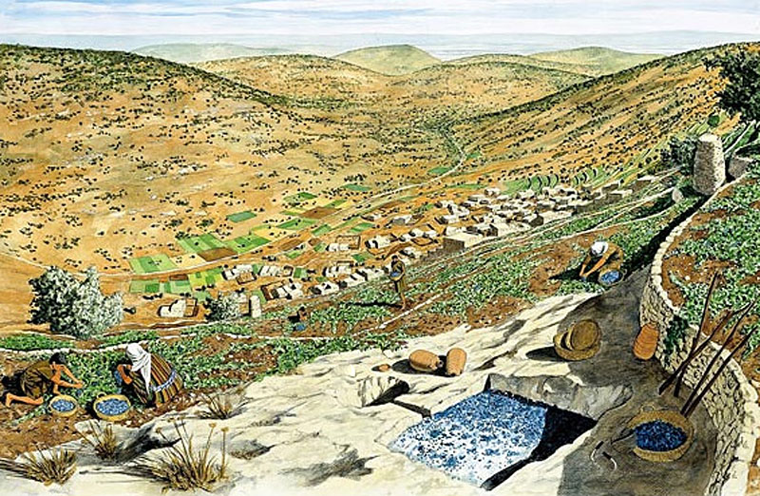

Slide 5
Luke 2:40-52
40 And the Child grew and became strong in spirit, filled with wisdom; and the grace of God was upon Him.

Slide 6
John 2:11
11 This beginning of signs [miracles] Jesus did in Cana of Galilee, and manifested His glory; and His disciples believed in Him.

Slide 7
Luke 2:40-52
41 His parents went to Jerusalem every year at the Feast of the Passover.

Slide 8
Deuteronomy 16:16
16 Three times a year all your males shall appear before the LORD your God in the place which
He chooses: at the Feast of Unleavened Bread,
at the Feast of Weeks, and at the Feast of Tabernacles; and they shall not appear before the LORD empty-handed.

Slide 9
Deuteronomy 16:16
16 Three times a year all your males shall appear before the LORD your God in the place which
He chooses: at the Feast of Unleavened Bread,
at the Feast of Weeks, and at the Feast of Tabernacles; and they shall not appear before the LORD empty-handed.
“Pilgrimage Feasts” because
of pilgrimage to Jerusalem

Slide 10
Luke 2:40-52
42 And when He was twelve years old, they went up to Jerusalem according to the custom of the feast.

Slide 11
Luke 2:40-52
42 And when He was twelve years old, they went up to Jerusalem according to the custom of the feast.
Ages 5-6 to 12 studied in bet sefer
”house of writing” or “house of the book”

Slide 12
Luke 2:40-52
42 And when He was twelve years old, they went up to Jerusalem according to the custom of the feast.
Ages 5-6 to 12 studied in bet sefer
”house of writing” or “house of the book”
Ages 12 to 15 studied in bet midrash
”house of explanation”

Slide 13
Luke 2:40-52
42 And when He was twelve years old, they went up to Jerusalem according to the custom of the feast.
43 When they had finished the days, as they returned, the Boy Jesus lingered behind in Jerusalem. And Joseph and His mother did not know it;
44 but supposing Him to have been in the company, they went a day’s journey, and sought Him among their relatives and acquaintances.

Slide 14
Luke 2:40-52
45 So when they did not find Him, they returned to Jerusalem, seeking Him.
46 Now so it was that after three days they found Him in the temple, sitting in the midst of the teachers, both listening to them and asking them questions.
47 And all who heard Him were astonished at His understanding and answers.

Slide 15
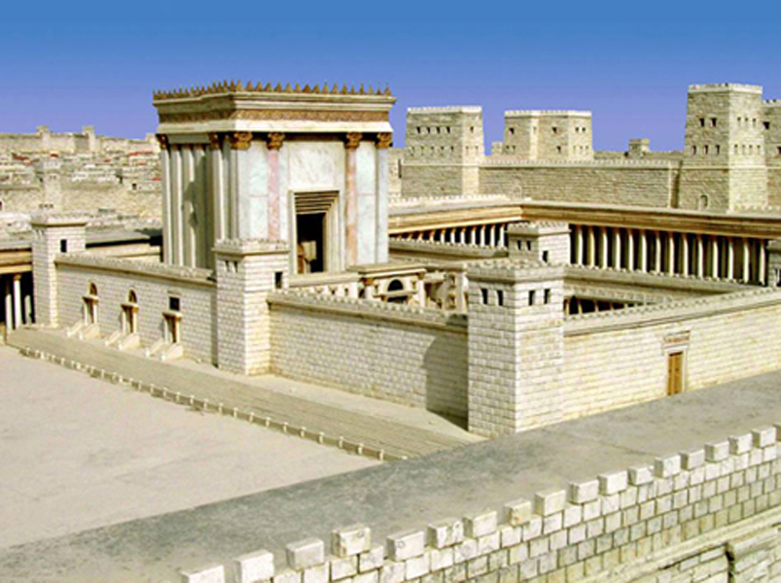

Slide 16
Matthew 12:9-13
9 Now when He had departed from there, He went into their synagogue.
10 And behold, there was a man who had a withered hand. And they asked Him, saying, “Is it lawful to heal on the Sabbath?”—that they might accuse Him.

Slide 17
Matthew 12:9-13
11 Then He said to them, “What man is there among you who has one sheep, and if it falls into
a pit on the Sabbath, will not lay hold of it and lift it out?
12 “Of how much more value then is a man than
a sheep? Therefore it is lawful to do good on the Sabbath.”
13 Then He said to the man, “Stretch out your hand.” And he stretched it out, and it was restored as whole as the other.

Slide 18
Matthew 21:23-27
23 Now when He came into the temple, the chief priests and the elders of the people confronted Him as He was teaching, and said, “By what authority are You doing these things? And who gave You this authority?”
24 But Jesus answered and said to them, “I also will ask you one thing, which if you tell Me, I likewise will tell you by what authority I do these things:

Slide 19
Matthew 21:23-27
25 “The baptism of John—where was it from? From heaven or from men?” And they reasoned among themselves, saying, “If we say, ‘From heaven,’ He will say to us, ‘Why then did you not believe him?’
26 “But if we say, ‘From men,’ we fear the multitude, for all count John as a prophet.”
27 So they answered Jesus and said, “We do not know.” And He said to them, “Neither will I tell you by what authority I do these things.

Slide 20
Luke 2:40-52
47 And all who heard Him were astonished at His understanding and answers.
48 So when they saw Him, they were amazed; and His mother said to Him, “Son, why have You done this to us? Look, Your father and I have sought You anxiously.”
49 And He said to them, “Why did you seek Me? Did you not know that I must be about My Father’s business?”
50 But they did not understand the statement which He spoke to them.

Slide 21
Hebrews 5:8-9
8 though He was a Son, yet He learned obedience by the things which He suffered.
9 And having been perfected, He became the author of eternal salvation to all who obey Him

Slide 22
Hebrews 5:8-9
8 though He was a Son, yet He learned obedience by the things which He suffered.
9 And having been perfected, He became the author of eternal salvation to all who obey Him
John 8:28
28 Then Jesus said to them, “When you lift up the Son of Man, then you will know that I am He, and that I do nothing of Myself; but as My Father taught Me, I speak these things.

Slide 23
Luke 2:40-52
51 Then He went down with them and came to Nazareth, and was subject to them, but His mother kept all these things in her heart.
52 And Jesus increased in wisdom and stature, and in favor with God and men.

Slide 25
