Slide 1



Slide 2
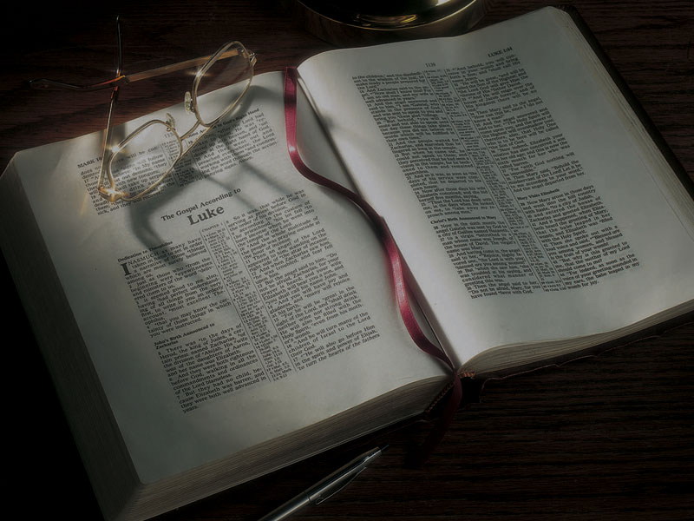
The Gospels
Jesus Christ’s
Early Childhood
part 2

Slide 3
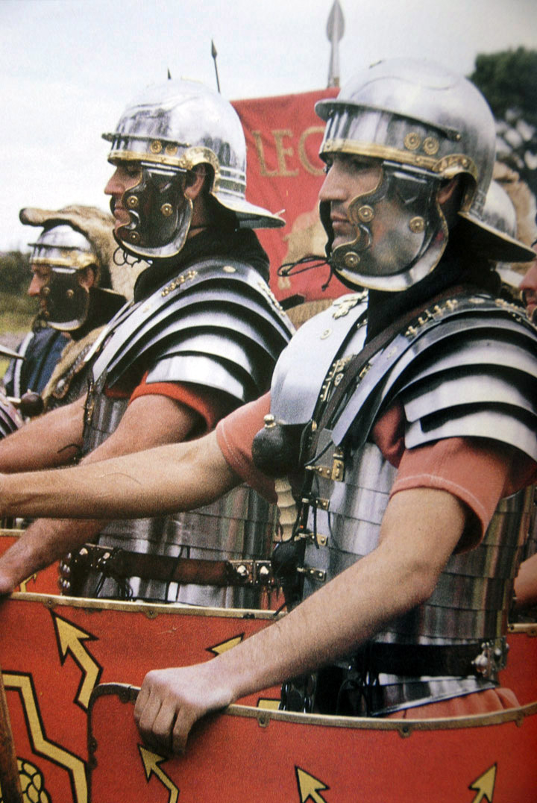

Slide 4
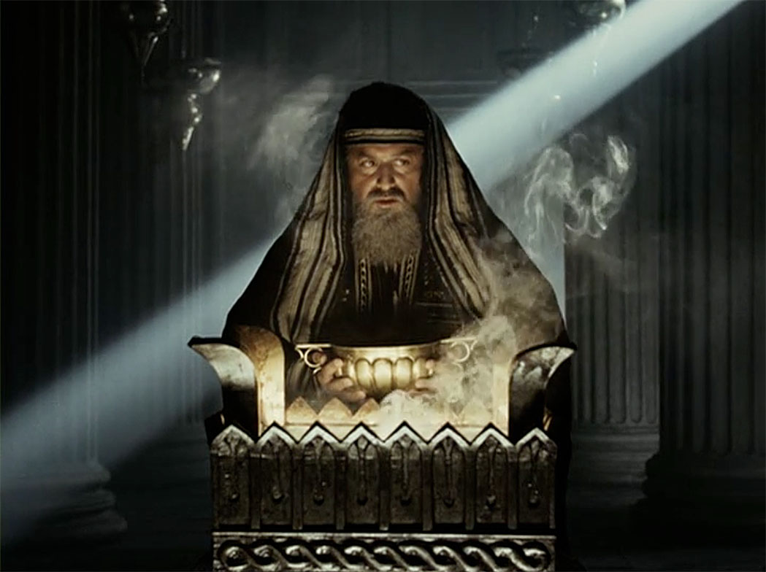

Slide 5
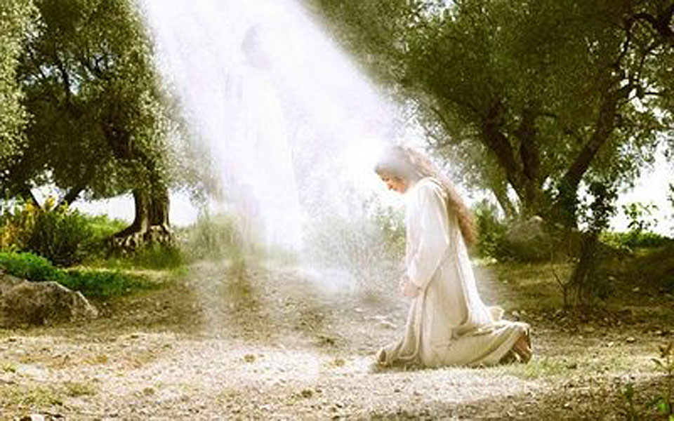

Slide 6
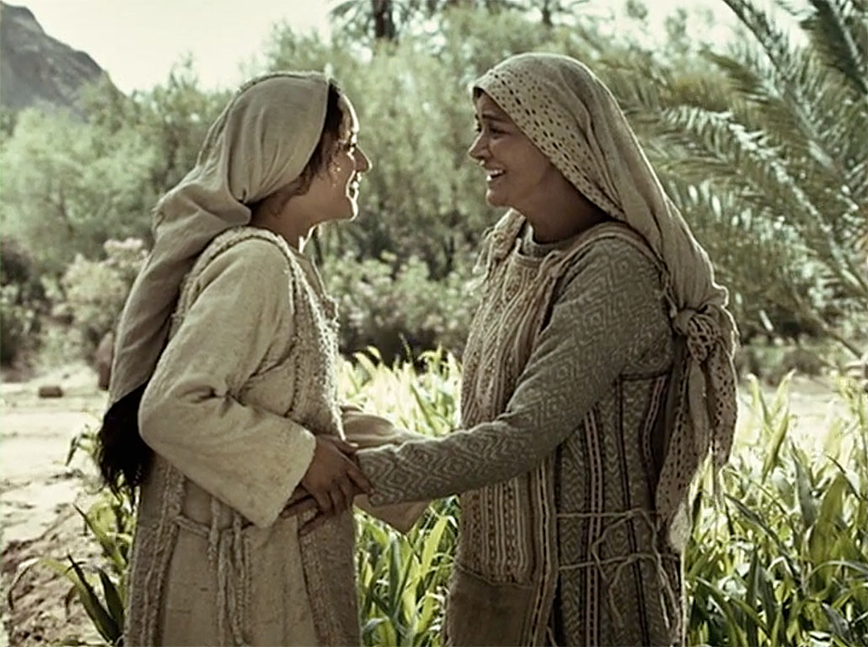

Slide 7
Matthew 2:1-23
2:1 Now after Jesus was born in Bethlehem of Judea in the days of Herod the king, behold, wise men from the East came to Jerusalem,
2 saying, “Where is He who has been born King
of the Jews? For we have seen His star in the East and have come to worship Him.”
3 When Herod the king heard this, he was troubled, and all Jerusalem with him.

Slide 8
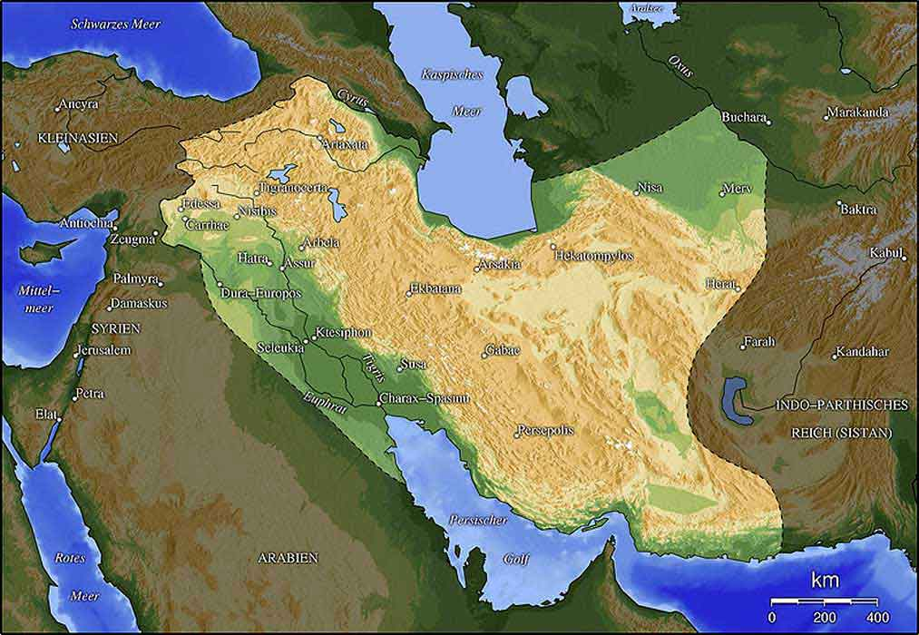

Slide 9
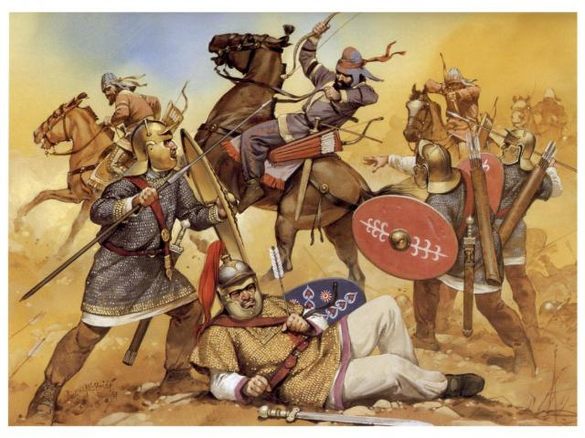

Slide 10
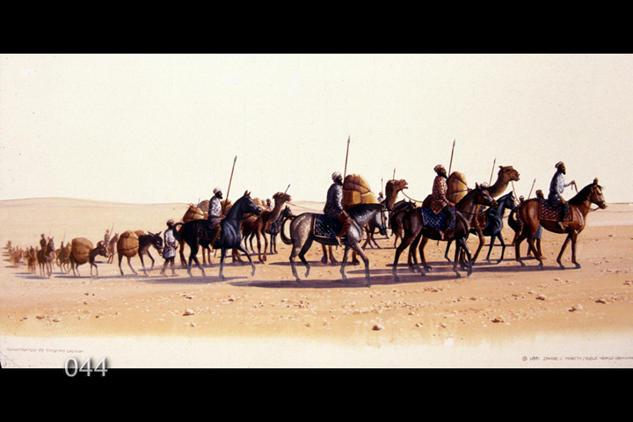

Slide 11
Roman historians say:
“There had spread all over the Orient an old and established belief, that it was fated at that time for men coming from Judea to rule the world. This prediction… the Jews took to themselves; accordingly they revolted” (Suetonius,
Lives of the Caesars—Vespasian, book IV:5).

Slide 12
Roman historians say:
“There was a firm persuasion … that at this very time, the East was to grow powerful, and rulers coming from Judea were to acquire a universal empire” (Tacitus: Histories, 5:13).
“About that time one from their country should become governor of the habitable earth”
(Josephus, Wars of the Jews, 6:5:4).

Slide 13
Matthew 2:1-23
4 And when he had gathered all the chief priests and scribes of the people together, he inquired of them where the Christ was to be born.
5 So they said to him, “In Bethlehem of Judea, for thus it is written by the prophet:
6 ‘But you, Bethlehem, in the land of Judah, are not the least among the rulers of Judah; for out of you shall come a Ruler Who will shepherd My people Israel.’”

Slide 14
Micah 5:2
2 But you, Bethlehem Ephrathah, though you are little among the thousands of Judah, yet out of you shall come forth to Me the One to be Ruler in Israel, Whose goings forth are from of old, from everlasting.

Slide 15
Matthew 2:1-23
7 Then Herod, when he had secretly called the wise men, determined from them what time the star appeared.
8 And he sent them to Bethlehem and said, “Go and search carefully for the young Child, and when you have found Him, bring back word to me, that
I may come and worship Him also.”

Slide 16
Matthew 2:1-23
9 When they heard the king, they departed; and behold, the star which they had seen in the East went before them, till it came and stood over where the young Child was.
10 When they saw the star, they rejoiced with exceedingly great joy.
11 And when they had come into the house, they saw the young Child with Mary His mother, and fell down and worshiped Him. And when they had opened their treasures, they presented gifts to Him: gold, frankincense, and myrrh.

Slide 17
Matthew 2:1-23
9 When they heard the king, they departed; and behold, the star which they had seen in the East went before them, till it came and stood over where the young Child was.
10 When they saw the star, they rejoiced with exceedingly great joy.
11 And when they had come into the house, they saw the young Child with Mary His mother, and fell down and worshiped Him. And when they had opened their treasures, they presented gifts to Him: gold, frankincense, and myrrh.

Slide 18
Exodus 30:34-37
34 And the LORD said to Moses: “Take sweet spices, stacte and onycha and galbanum, and pure frankincense with these sweet spices; there shall be equal amounts of each.
35 “You shall make of these an incense, a compound according to the art of the perfumer, salted, pure, and holy . . .
37 “But as for the incense which you shall make, you shall not make any for yourselves, according to its composition. It shall be to you holy for the LORD.

Slide 19
John 19:39-40
39 And Nicodemus, who at first came to Jesus by night, also came, bringing a mixture of myrrh and aloes, about a hundred pounds.
40 Then they took the body of Jesus, and bound it in strips of linen with the spices, as the custom of the Jews is to bury.

Slide 20
Matthew 2:1-23
12 Then, being divinely warned in a dream that they should not return to Herod, they departed for their own country another way.
13 Now when they had departed, behold, an angel of the Lord appeared to Joseph in a dream, saying, “Arise, take the young Child and His mother, flee to Egypt, and stay there until I bring you word; for Herod will seek the young Child to destroy Him.”

Slide 21
Matthew 2:1-23
14 When he arose, he took the young Child and His mother by night and departed for Egypt,
15 and was there until the death of Herod, that it might be fulfilled which was spoken by the Lord through the prophet, saying, “Out of Egypt I called My Son.”

Slide 22
Matthew 2:1-23
14 When he arose, he took the young Child and His mother by night and departed for Egypt,
15 and was there until the death of Herod, that it might be fulfilled which was spoken by the Lord through the prophet, saying, “Out of Egypt I called My Son.”
Hosea 11:1
1 When Israel was a child, I loved him, and out of Egypt I called My son.

Slide 23
Matthew 2:1-23
16 Then Herod, when he saw that he was deceived by the wise men, was exceedingly angry; and he sent forth and put to death all the male children who were in Bethlehem and in all its districts, from two years old and under, according to the time which he had determined from the wise men.

Slide 24
Matthew 2:1-23
17 Then was fulfilled what was spoken by Jeremiah the prophet, saying:
18 “A voice was heard in Ramah, lamentation, weeping, and great mourning, Rachel weeping for her children, refusing to be comforted, because they are no more.”
(quoting Jeremiah 31:15)

Slide 25
Genesis 35:16-19
16 Then they journeyed from Bethel. And when there was but a little distance to go to Ephrath, Rachel labored in childbirth, and she had hard labor.
17 Now it came to pass, when she was in hard labor, that the midwife said to her, “Do not fear; you will have this son also.”
18 And so it was, as her soul was departing (for she died), that she called his name Ben-Oni; but his father called him Benjamin.
19 So Rachel died and was buried on the way to Ephrath (that is, Bethlehem).

Slide 26
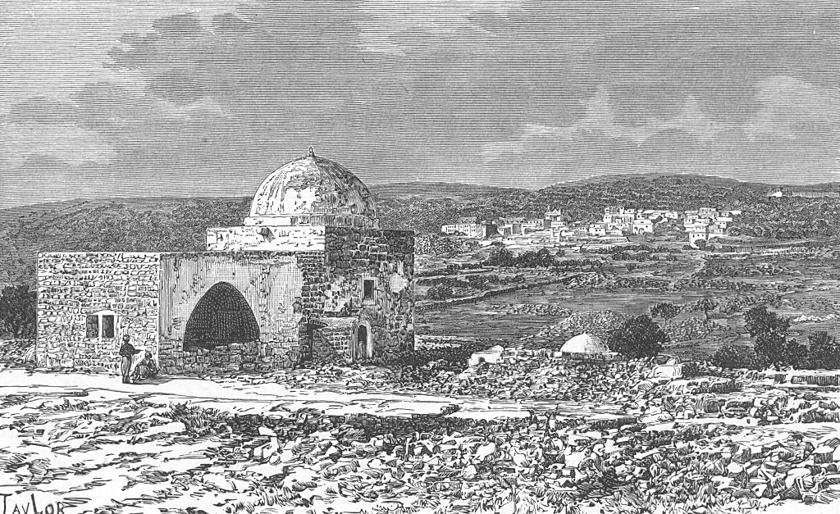

Slide 27
Revelation 12:3-5
3 And another sign appeared in heaven: behold, a great, fiery red dragon having seven heads and ten horns, and seven diadems on his heads.
4 His tail drew a third of the stars of heaven and threw them to the earth. And the dragon stood before the woman who was ready to give birth,
to devour her Child as soon as it was born.
5 She bore a male Child who was to rule all nations with a rod of iron. And her Child was caught up to God and His throne.

Slide 28
Matthew 2:1-23
19 But when Herod was dead, behold, an angel of the Lord appeared in a dream to Joseph in Egypt,
20 saying, “Arise, take the young Child and His mother, and go to the land of Israel, for those who sought the young Child’s life are dead.”
21 Then he arose, took the young Child and His mother, and came into the land of Israel.

Slide 29
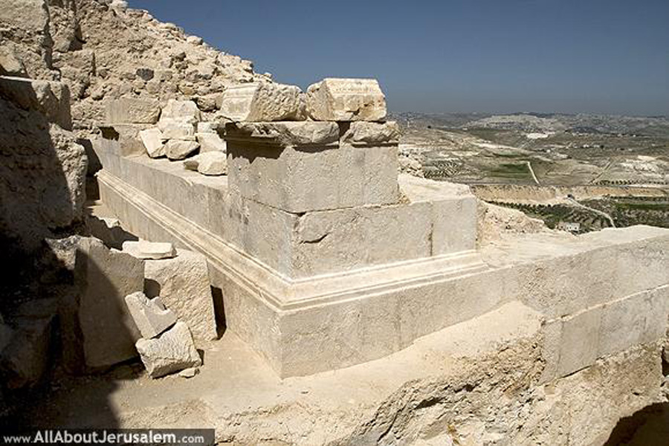

Slide 30
Matthew 2:1-23
19 But when Herod was dead, behold, an angel of the Lord appeared in a dream to Joseph in Egypt,
20 saying, “Arise, take the young Child and His mother, and go to the land of Israel, for those who sought the young Child’s life are dead.”
21 Then he arose, took the young Child and His mother, and came into the land of Israel.

Slide 31
Matthew 2:1-23
22 But when he heard that Archelaus was reigning over Judea instead of his father Herod, he was afraid to go there. And being warned by God in a dream, he turned aside into the region of Galilee.
23 And he came and dwelt in a city called Nazareth, that it might be fulfilled which was spoken by the prophets, “He shall be called a Nazarene.”

Slide 32
Isaiah 53:3
3 He is despised and rejected by men, a Man of sorrows and acquainted with grief. And we hid, as it were, our faces from Him; He was despised, and we did not esteem Him.

Slide 33
Isaiah 53:3
3 He is despised and rejected by men, a Man of sorrows and acquainted with grief. And we hid, as it were, our faces from Him; He was despised, and we did not esteem Him.
John 1:45-46
45 Philip found Nathanael and said to him, “We have found Him of whom Moses in the law, and also the prophets, wrote—Jesus of Nazareth, the son of Joseph.”
46 And Nathanael said to him, “Can anything good come out of Nazareth?”

Slide 35
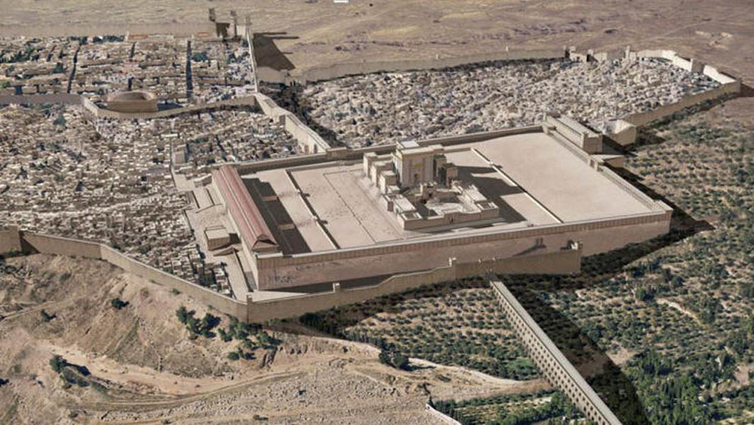

Slide 36
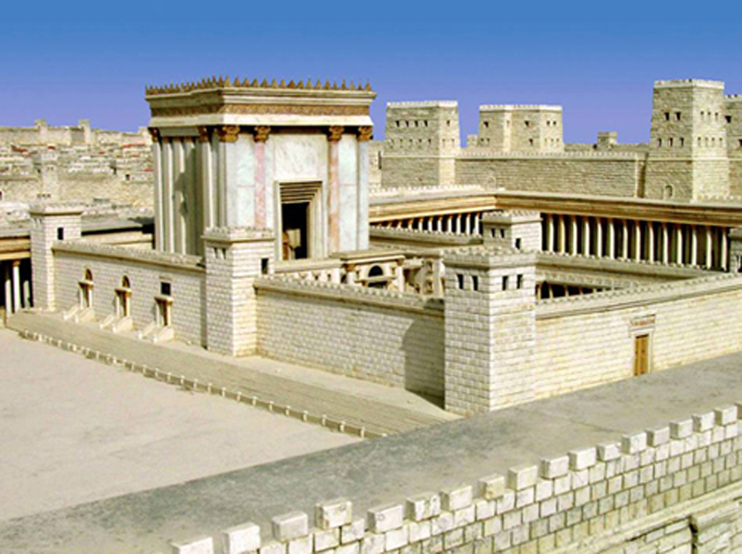

Slide 37
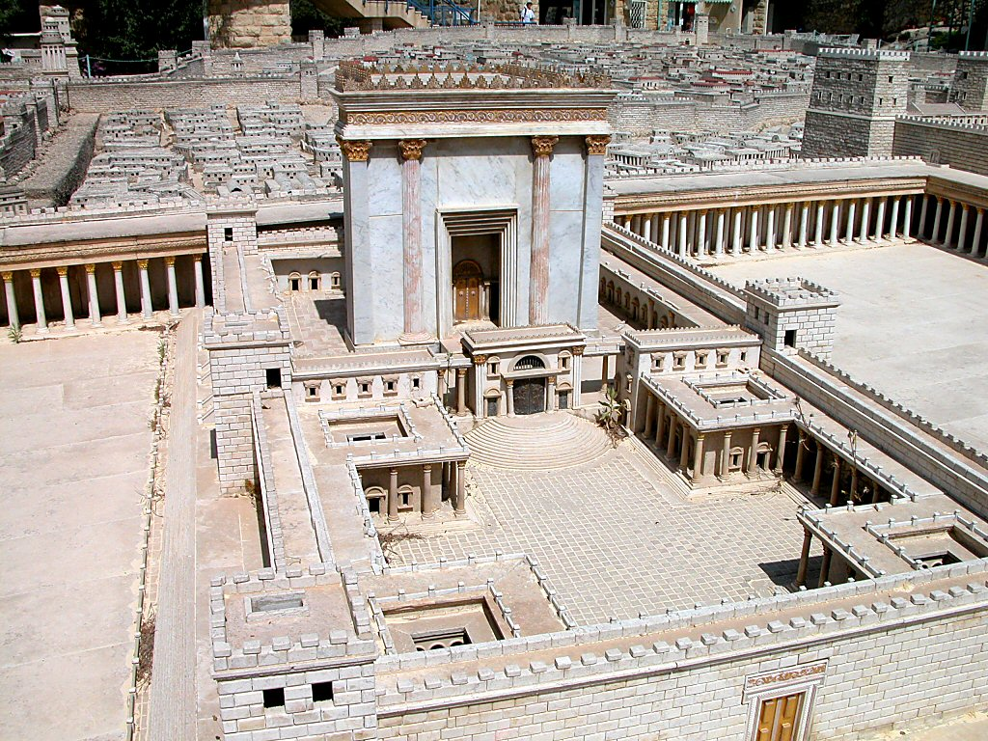
Jerusalem model Temple Court of Women from east
Notes:
The Balustrade
The Court of the Gentiles was separated from the Court of the Women by a balustrade 3 cubits (4.6 feet [1.4 m]) high known as the “Soreg.” Warnings to Gentiles against entry lined the outside of this fence. One complete inscription has been found and is on display in the Archaeological Museum of Istanbul. A fragmentary inscription can be seen in the Israel Museum.
tb051703214

Slide 38
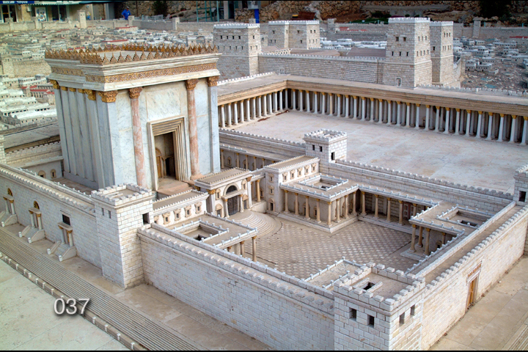

Slide 41
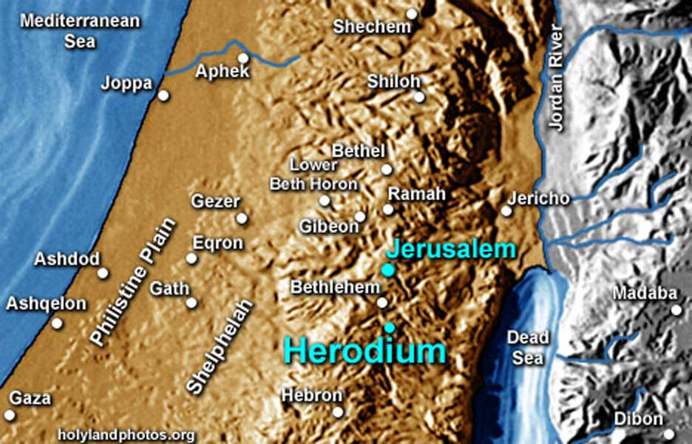

Slide 42
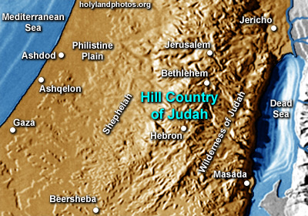

Slide 43
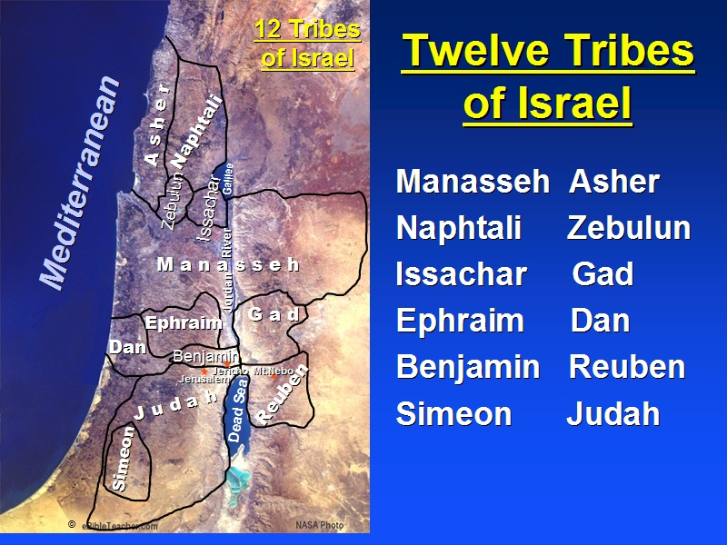

Slide 46
Matthew 1:17
17 So all the generations from Abraham to David are fourteen generations, from David until the captivity in Babylon are fourteen generations, and from the captivity in Babylon until the Christ are fourteen generations.

Slide 47
Matthew 1:17
17 So all the generations from Abraham to David are fourteen generations, from David until the captivity in Babylon are fourteen generations, and from the captivity in Babylon until the Christ are fourteen generations.
Roman numerals: I = 1, V = 5, X = 10, L = 50,
C = 100, D = 500, M = 1,000
Hebrew numerals: A = 1, B = 2,… D = 4, V = 6
David = D-V-D D = 4, V = 6, D = 4 DVD = 14
DAVID DAVID DAVID

Slide 48
The Gospels

