Slide 1

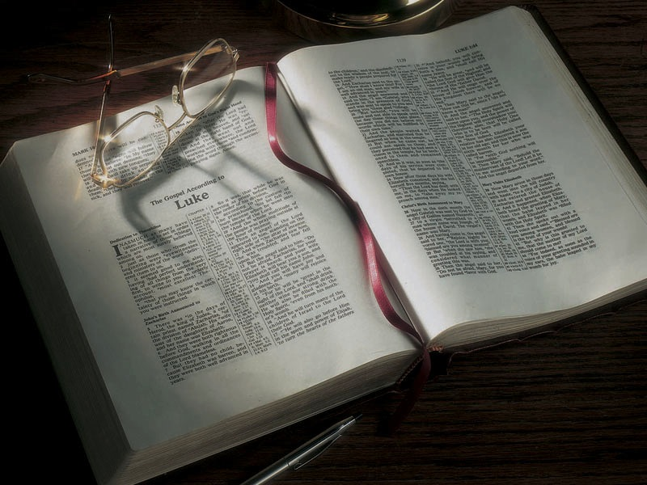

Slide 2
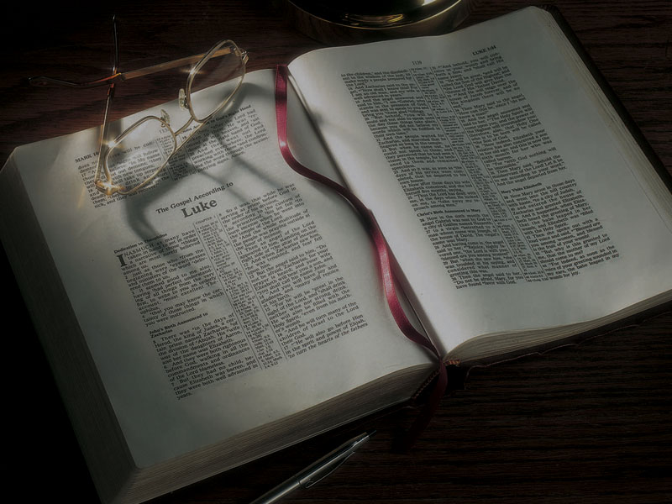
The Gospels
The Birth of
Jesus the Messiah
In Bethlehem

Slide 3
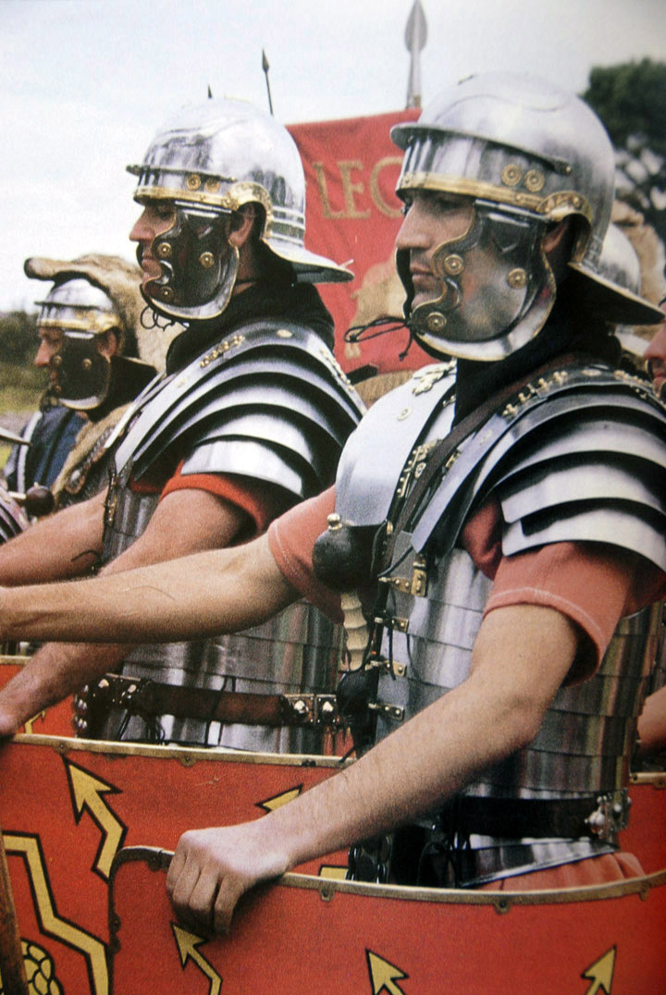

Slide 4
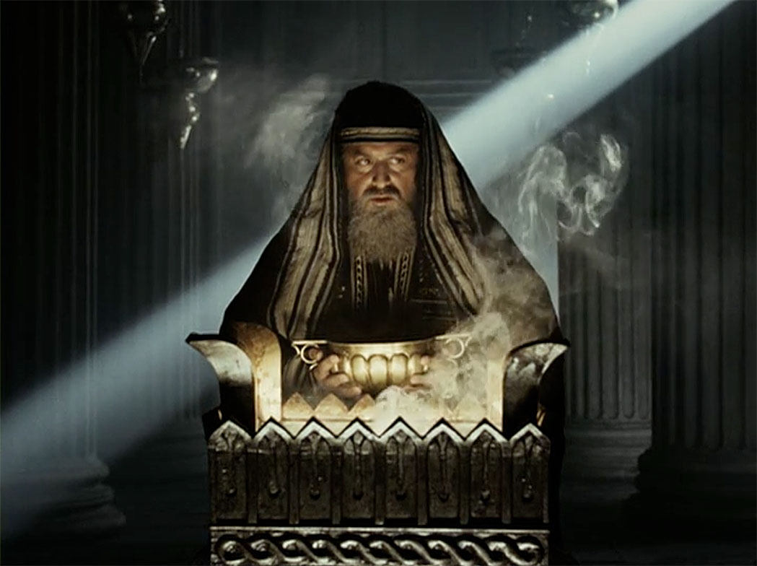

Slide 5
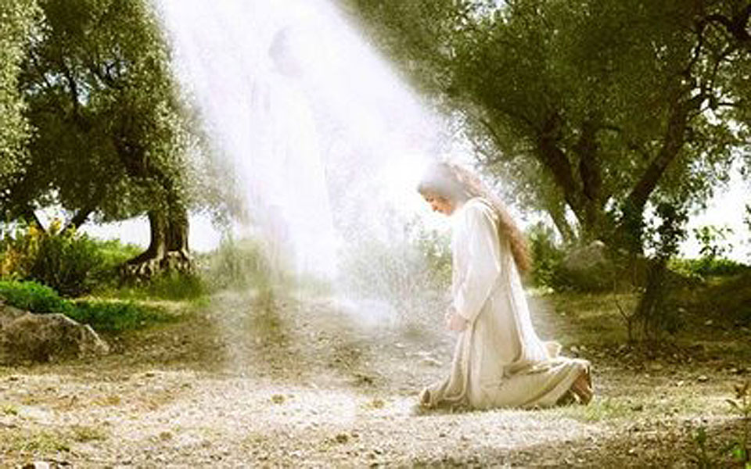

Slide 6
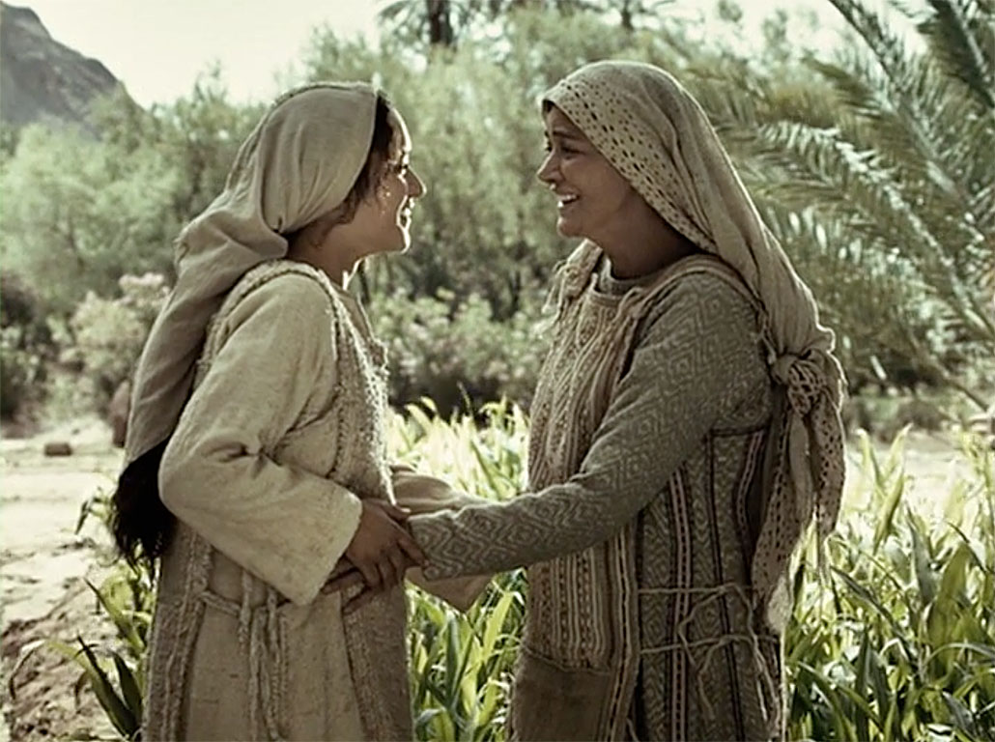

Slide 7
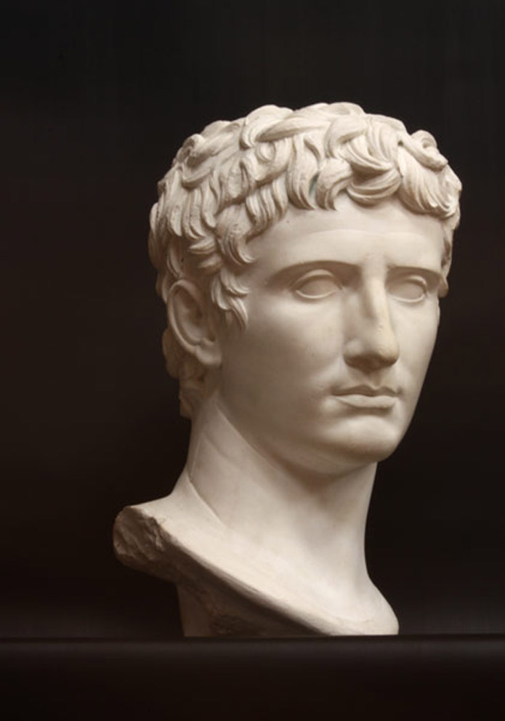
Luke 2:1-20
2:1 And it came to pass in those days that a decree went out from Caesar Augustus that all the world should be registered.
2 This census first took place while Quirinius was governing Syria.
Augustus Caesar
27 B.C.-
A.D. 14

Slide 8
Luke 2:1-20
2:1 And it came to pass in those days that a decree went out from Caesar Augustus that all the world should be registered.
2 This census took place before Quirinius was governing Syria.

Slide 9
Luke 2:1-20
2:1 And it came to pass in those days that a decree went out from Caesar Augustus that all the world should be registered.
2 This census took place before Quirinius was governing Syria.
translated “before” in John 1:15; 15:58

Slide 10
Luke 2:1-20
3 So all went to be registered, everyone to his own city.

Slide 11
Luke 2:1-20
3 So all went to be registered, everyone to his own city.
Gaius Vibius Maximus, Prefect of Egypt, orders:
Seeing that the time has come for the house-to-house census, it is necessary to compel all those who for any cause whatsoever are residing outside their districts to return to their own homes, that they may both carry out the regular order of the census, and may also diligently attend to the cultivation of their allotments.

Slide 12
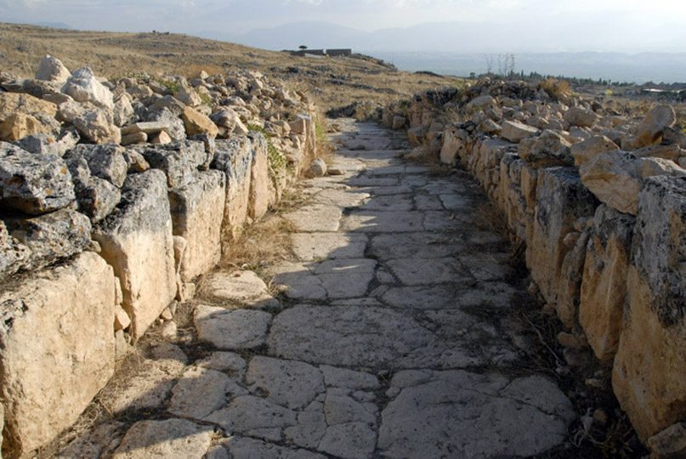
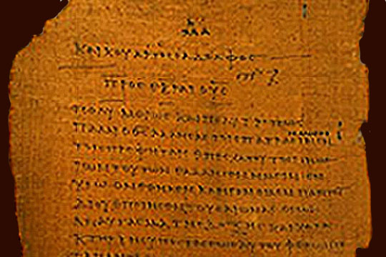
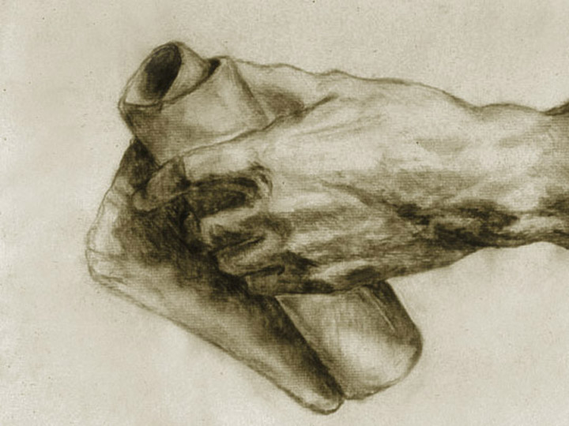

Slide 13
Luke 2:1-20
4 Joseph also went up from Galilee, out of the city of Nazareth, into Judea, to the city of David, which is called Bethlehem, because he was of the house and lineage of David,
5 to be registered with Mary, his betrothed wife, who was with child.

Slide 15
Isaiah 9:1-2
1 The land of Zebulun and the land of Naphtali, . . . By the way of the sea, beyond the Jordan, in Galilee of the Gentiles.
2 The people who walked in darkness have seen
a great light; those who dwelt in the land of the shadow of death, upon them a light has shined.

Slide 16
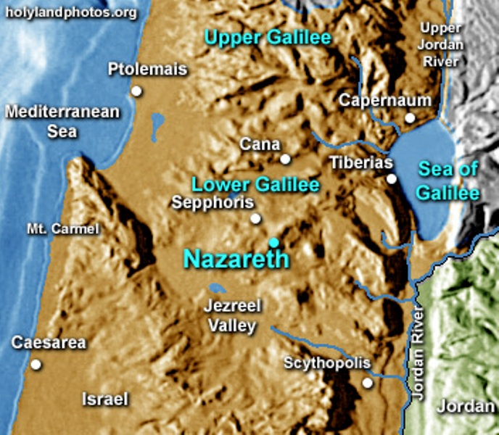

Slide 17
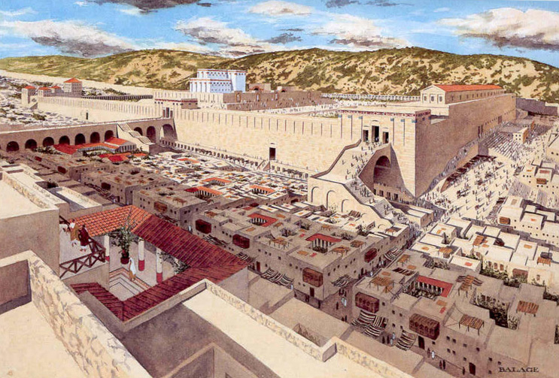

Slide 18
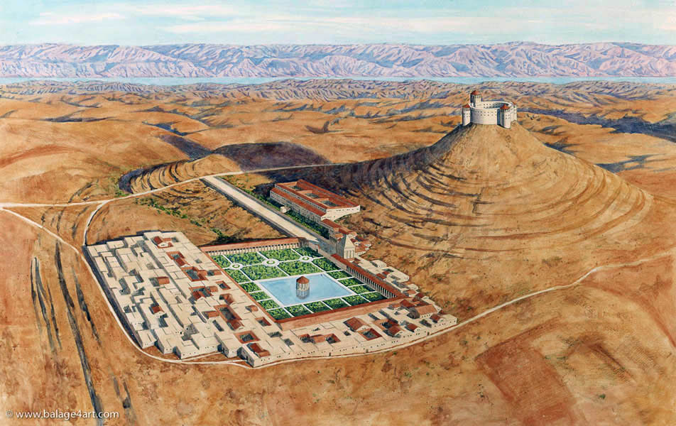

Slide 19
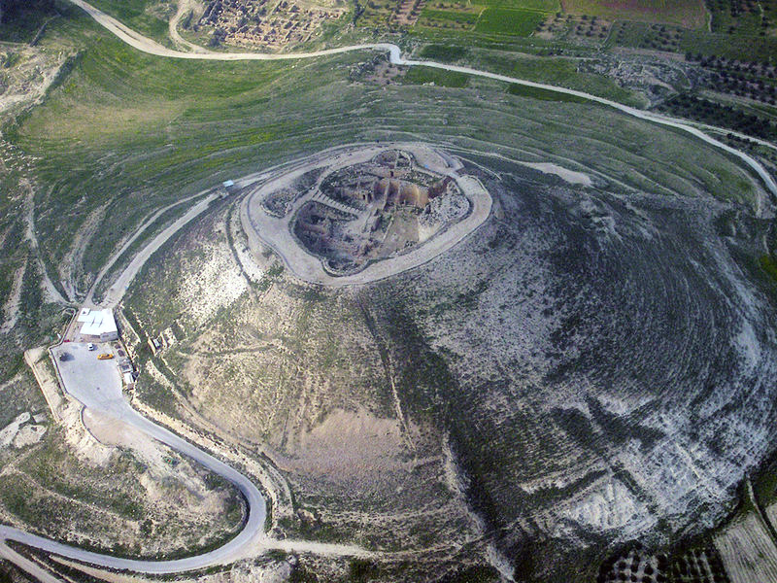

Slide 20
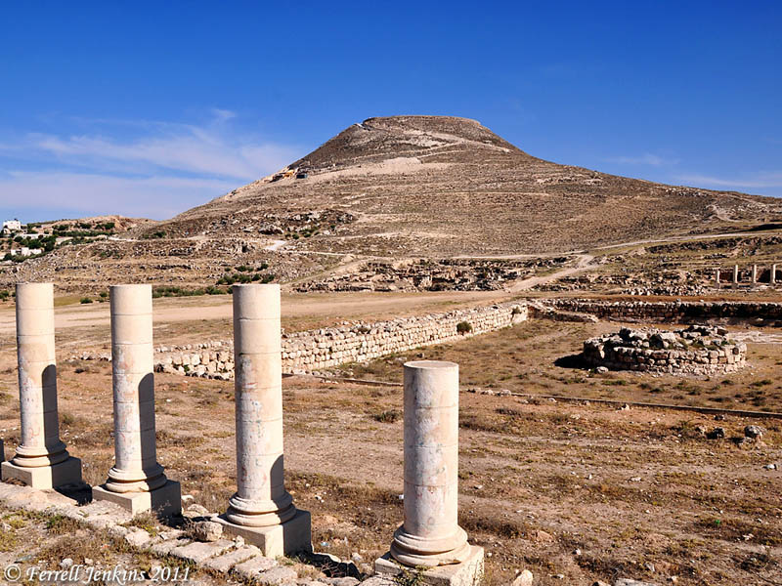

Slide 21
Micah 5:2
2 But you, Bethlehem Ephrathah, though you are little among the thousands of Judah, yet out of you shall come forth to Me the One to be Ruler in Israel, Whose goings forth are from of old, from everlasting.

Slide 22
Luke 2:1-20
6 So it was, that while they were there, the days were completed for her to be delivered.
7 And she brought forth her firstborn Son, and wrapped Him in swaddling cloths, and laid Him in a manger, because there was no room for them in the inn.

Slide 23
Luke 2:1-20
6 So it was, that while they were there, the days were completed for her to be delivered.
7 And she brought forth her firstborn Son, and wrapped Him in swaddling cloths, and laid Him in a manger, because there was no room for them in the inn [kataluma].

Slide 24
Luke 10:34
So he [the Good Samaritan] went to him [the man beaten by robbers] and bandaged his wounds, pouring on oil and wine; and he set him on his own animal, brought him to an inn [pandocheion], and took care of him.

Slide 25
Luke 2:1-20
6 So it was, that while they were there, the days were completed for her to be delivered.
7 And she brought forth her firstborn Son, and wrapped Him in swaddling cloths, and laid Him in a manger, because there was no space for them in the guest room.

Slide 26
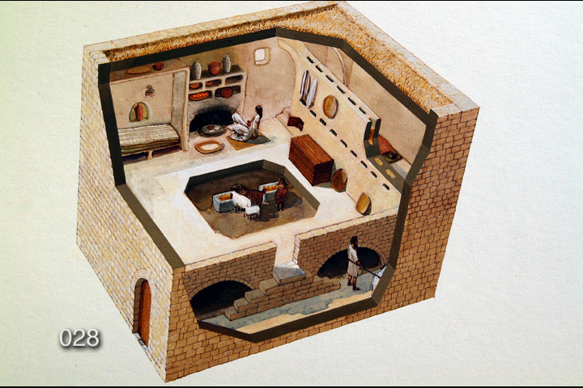

Slide 27
1 Samuel 28:24
24 Now the woman had a fatted calf in the house . . .

Slide 28
1 Samuel 28:24
24 Now the woman had a fatted calf in the house . . .
Judges 11:30-31
And Jephthah made a vow to the LORD, and said, “If You will indeed deliver the people of Ammon into my hands, then it will be that whatever comes out of the doors of my house to meet me, when I return in peace from the people of Ammon, shall surely be the LORD’S, and I will offer it up as a burnt offering.”

Slide 29
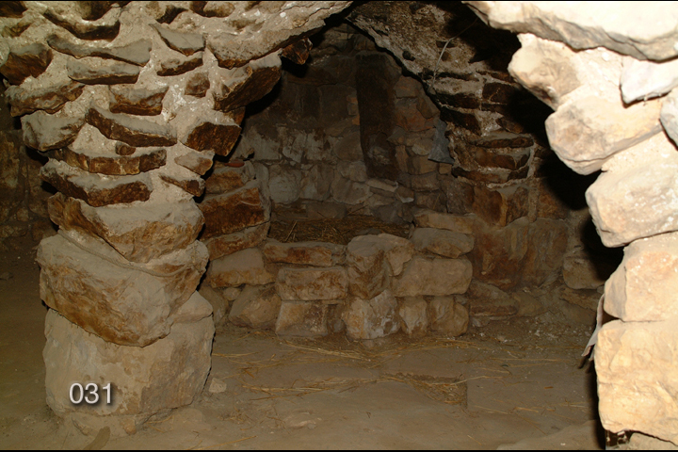

Slide 30
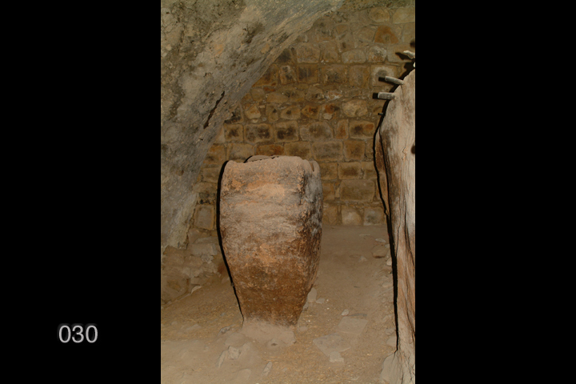

Slide 31
Luke 2:1-20
8 Now there were in the same country shepherds living out in the fields, keeping watch over their flock by night.

Slide 32
“As these shepherds had not yet brought home their flocks, it is a presumptive argument that October had not yet commenced, and that, consequently, our Lord was not born on the 25th
of December, when no flocks were out in the fields; nor could He have been born later than September, as the flocks were still in the fields by night. On this very ground the nativity in December should be given up” (Adam Clarke's Commentary, note on Luke 2:8).

Slide 33
“These humble pastoral folk are out in the field at night with their flock—a feature of the story which would argue against the birth (of Christ) occurring on Dec. 25 since the weather would not have permitted it” (The Interpreter's One-Volume Commentary, note on Luke 2:4-7).

Slide 34
According to Celebrations: The Complete Book of American Holidays, Luke's account "suggests that Jesus may have been born in summer or early fall. Since December is cold and rainy in Judea, it is likely the shepherds would have sought shelter for their flocks at night" (p. 309).

Slide 35
The Roman census “could hardly have been at
that season (December 25), however, for such
a time would surely not have been chosen by
the authorities for a public enrollment, which necessitated the population's traveling from all parts to their natal districts, storms and rain making journeys both unsafe and unpleasant
in winter, except in specially favorable years”
("Christmas at Bethlehem," Holy-Days and Holidays, Cunningham Geikie).

Slide 36
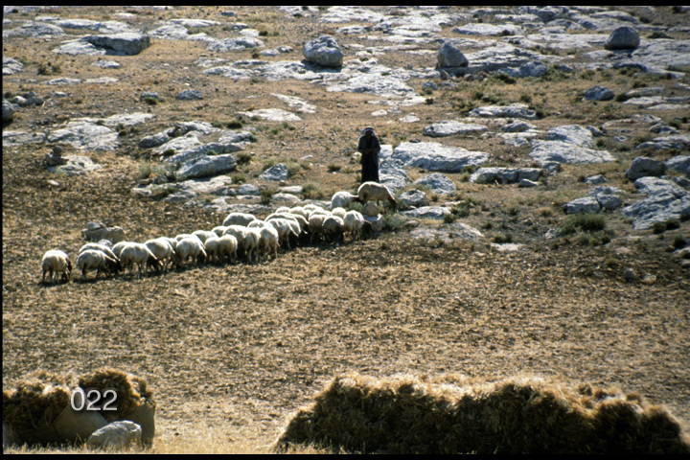

Slide 37
Luke 2:1-20
9 And behold, an angel of the Lord stood before them, and the glory of the Lord shone around them, and they were greatly afraid.
10 Then the angel said to them, “Do not be afraid, for behold, I bring you good tidings of great joy which will be to all people.
11 “For there is born to you this day in the city of David a Savior, who is Christ the Lord.
12 “And this will be the sign to you: You will find
a Babe wrapped in swaddling cloths, lying in a manger.”

Slide 38
Luke 2:1-20
13 And suddenly there was with the angel a multitude of the heavenly host praising God and saying:
14 “Glory to God in the highest, and on earth peace, goodwill toward men!”

Slide 39
Luke 2:1-20
13 And suddenly there was with the angel a multitude of the heavenly host praising God and saying:
14 “Glory to God in the highest, and on earth peace, goodwill toward men!”
“peace among men of good will!”

Slide 40
Luke 2:1-20
15 So it was, when the angels had gone away from them into heaven, that the shepherds said to one another, “Let us now go to Bethlehem and see this thing that has come to pass, which the Lord has made known to us.”
16 And they came with haste and found Mary and Joseph, and the Babe lying in a manger.
17 Now when they had seen Him, they made widely known the saying which was told them concerning this Child.

Slide 41
Luke 2:1-20
18 And all those who heard it marveled at those things which were told them by the shepherds.
19 But Mary kept all these things and pondered them in her heart.
20 Then the shepherds returned, glorifying and praising God for all the things that they had heard and seen, as it was told them.

Slide 42
What does this tell us about
God the Father and our Savior?

Slide 44
What does this tell us about
God the Father and our Savior?
• We have a Savior who lifts people out of shame and reconciles them to the Father.

Slide 45
1 Corinthians 1:26-29
26 For you see your calling, brethren, that not many wise according to the flesh, not many mighty, not many noble, are called.
27 But God has chosen the foolish things of the world to put to shame the wise, and God has chosen the weak things of the world to put to shame the things which are mighty,
28 and the base things of the world and the things which are despised God has chosen, and the things which are not, to bring to nothing the things that are, that no flesh should glory in His presence.

Slide 46
What does this tell us about
God the Father and our Savior?
• We have a Savior who lifts people out of shame and reconciles them to the Father.
• It’s not about us, it’s about God and what He can do through us.

Slide 47
What does this tell us about
God the Father and our Savior?
• We have a Savior who lifts people out of shame and reconciles them to the Father.
• It’s not about us, it’s about God and what He can do through us.
• God is willing to do whatever it takes to restore a relationship with His children.

Slide 48
What does this tell us about
God the Father and our Savior?
• We have a Savior who lifts people out of shame and reconciles them to the Father.
• It’s not about us, it’s about God and what He can do through us.
• God is willing to do whatever it takes to restore a relationship with His children.
• God is surprising and unpredictable in how He carries out His purpose and plan.

Slide 49
Isaiah 55:8-9
8 “For My thoughts are not your thoughts, nor are your ways My ways,” says the LORD.
9 “For as the heavens are higher than the earth,
so are My ways higher than your ways, and My thoughts than your thoughts.”

Slide 50
What does this tell us about
God the Father and our Savior?
• Being in God’s plan doesn’t make for an easy life.

Slide 51
What does this tell us about
God the Father and our Savior?
• Being in God’s plan doesn’t make for an easy life.
• Being a disciple of Christ isn’t about self, it’s about self-sacrifice.

Slide 52
What does this tell us about
God the Father and our Savior?
• Being in God’s plan doesn’t make for an easy life.
• Being a disciple of Christ isn’t about self, it’s about self-sacrifice.
• The self-righteous define those God values as unworthy. Don’t make the same mistake.

Slide 53
What does this tell us about
God the Father and our Savior?
• Being in God’s plan doesn’t make for an easy life.
• Being a disciple of Christ isn’t about self, it’s about self-sacrifice.
• The self-righteous define those God values as unworthy. Don’t make the same mistake.
• God’s plan is centered in the person and power of Jesus Christ.

Slide 54
What does this tell us about
God the Father and our Savior?
• Being in God’s plan doesn’t make for an easy life.
• Being a disciple of Christ isn’t about self, it’s about self-sacrifice.
• The self-righteous define those God values as unworthy. Don’t make the same mistake.
• God’s plan is centered in the person and power of Jesus Christ.
• The real story of Jesus Christ’s birth is far greater than the counterfeit foisted off on the world.

Slide 55
What does this tell us about
God the Father and our Savior?
• We have a Savior who lifts people out of shame and reconciles them to the Father.
• It’s not about us, it’s about God and what He can do through us.
• God is willing to do whatever it takes to restore a relationship with His children.
• God is surprising and unpredictable in how He carries out His purpose and plan.

Slide 58
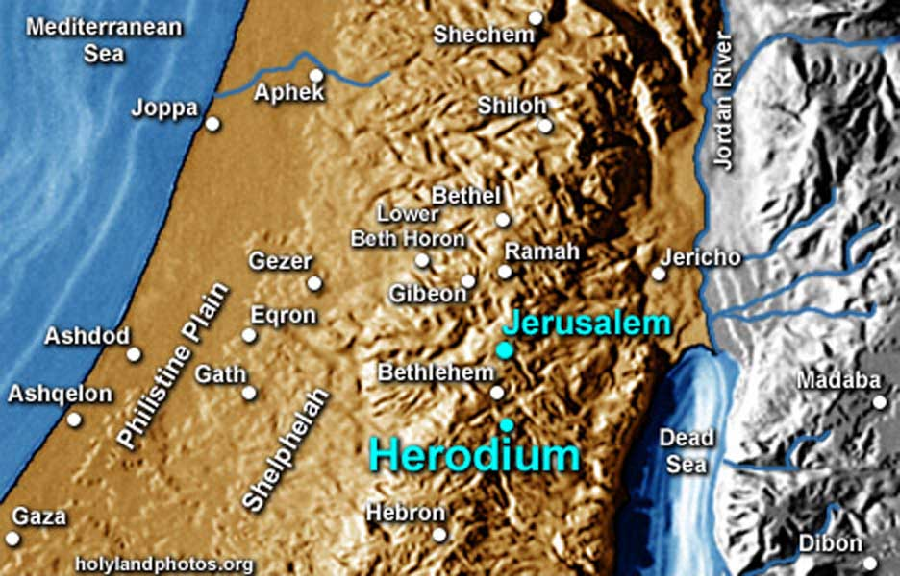

Slide 59
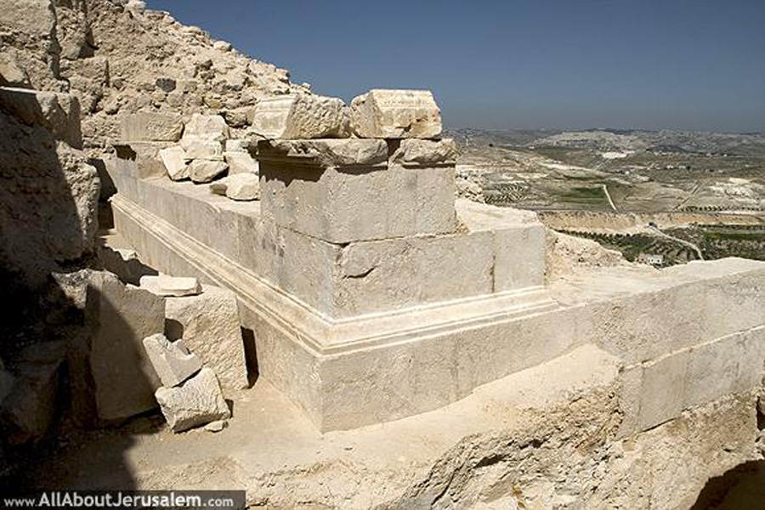

Slide 60
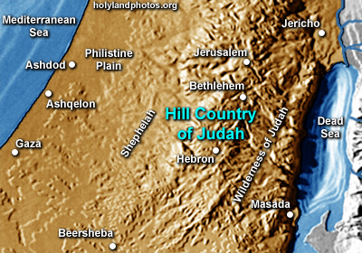

Slide 61
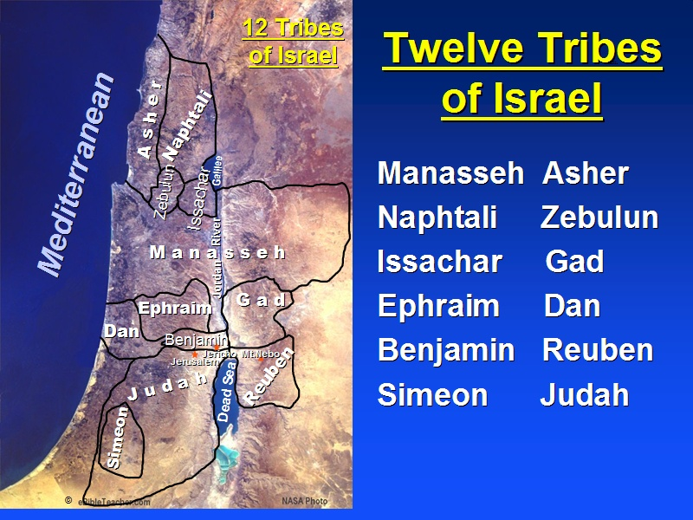

Slide 63
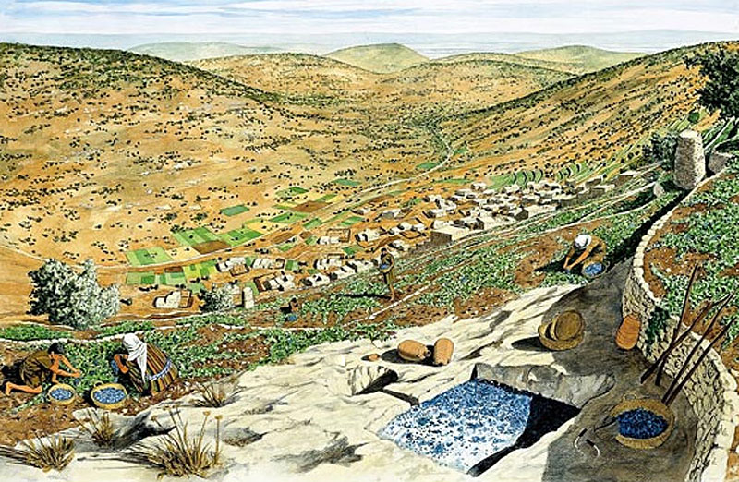

Slide 65
Luke 2:1-20
4 Joseph also went up from Galilee, out of the city of Nazareth, into Judea, to the city of David, which is called Bethlehem, because he was of the house and lineage of David,
5 to be registered with Mary, his betrothed wife, who was with child.
6 So it was, that while they were there, the days were completed for her to be delivered.
7 And she brought forth her firstborn Son, and wrapped Him in swaddling cloths, and laid Him in a manger, because there was no room for them in the inn.
8 Now there were in the same country shepherds living out in the fields, keeping watch over their flock by night.
9 And behold, an angel of the Lord stood before them, and the glory of the Lord shone around them, and they were greatly afraid.
10 Then the angel said to them, “Do not be afraid, for behold, I bring you good tidings of great joy which will be to all people.
11 “For there is born to you this day in the city of David a Savior, who is Christ the Lord.
12 “And this will be the sign to you: You will find a Babe wrapped in swaddling cloths, lying in a manger.”
13 And suddenly there was with the angel a multitude of the heavenly host praising God and saying:
14 “Glory to God in the highest, And on earth peace, goodwill toward men!”
15 So it was, when the angels had gone away from them into heaven, that the shepherds said to one another, “Let us now go to Bethlehem and see this thing that has come to pass, which the Lord has made known to us.”
16 And they came with haste and found Mary and Joseph, and the Babe lying in a manger.
17 Now when they had seen Him, they made widely known the saying which was told them concerning this Child.
18 And all those who heard it marveled at those things which were told them by the shepherds.
19 But Mary kept all these things and pondered them in her heart.
20 Then the shepherds returned, glorifying and praising God for all the things that they had heard and seen, as it was told them.

Slide 67
Matthew 1:17
17 So all the generations from Abraham to David are fourteen generations, from David until the captivity in Babylon are fourteen generations, and from the captivity in Babylon until the Christ are fourteen generations.

Slide 68
Matthew 1:17
17 So all the generations from Abraham to David are fourteen generations, from David until the captivity in Babylon are fourteen generations, and from the captivity in Babylon until the Christ are fourteen generations.
Roman numerals: I = 1, V = 5, X = 10, L = 50,
C = 100, D = 500, M = 1,000
Hebrew numerals: A = 1, B = 2,… D = 4, V = 6
David = D-V-D D = 4, V = 6, D = 4 DVD = 14
DAVID DAVID DAVID

Slide 69
The Gospels

