Slide 1



Slide 2
The Gospels
The Sermon on the Mount
Part 2:
Introduction to the Beatitudes

Slide 3
What were Jesus’ credentials?
He was of the promised lineage of the Messiah
(son of Abraham, son of David, son of others)
Matthew 1, Luke 3
His birth was divinely foretold by angels
Matthew 1, Luke 1
He was the fulfillment of prophecy
Matthew 2, 3, Luke 2, 3
He had been preceded by John the Baptist, “Elijah”
Matthew 3, Luke 3

Slide 4
What were Jesus’ credentials?
The Father had proclaimed Jesus to be His Beloved Son
Matthew 3, Luke 3
He had defeated Satan
Matthew 4, Luke 4
He had performed miracles
Matthew 4, Luke 4, 5, 6

Slide 5
“The Granddaddy of all remezim”:
• Jesus and Moses escaped death as an infant
• Jesus and Moses entered Egypt
• Jesus and Moses went into the wilderness
• Jesus and Moses were tempted
in the wilderness
• Jesus and Moses fasted 40 days
• Jesus and Moses ascended a mountain
• Jesus and Moses revealed the law
from the mountain

Slide 6
Matthew’s parallels with Moses:
What’s the point?
• Jesus is a second Moses, fulfilling the prophecy that God would raise up another prophet like Moses.
• As Moses was the great lawgiver,
Jesus is also a great lawgiver.
• Jesus was the I AM, the LORD,
Yahweh, who gave the law.

Slide 7
Christianity 101:
The basic Christianity that Jesus Christ
wants and expects His followers to practice.

Slide 8
Christianity 101:
The basic Christianity that Jesus Christ
wants and expects His followers to practice.
Beatitude: from Latin beatus, “blessed” or “happy”

Slide 9
Matthew 5:1-12
1 And seeing the multitudes, He went up on a mountain, and when He was seated His disciples came to Him.
2 Then He opened His mouth and taught them, saying:
3 “Blessed are the poor in spirit, for theirs is the kingdom of heaven.
4 Blessed are those who mourn, for they shall be comforted.
5 Blessed are the meek, for they shall inherit the earth.

Slide 10
Matthew 5:1-12
6 Blessed are those who hunger and thirst for righteousness, for they shall be filled.
7 Blessed are the merciful, for they shall obtain mercy.
8 Blessed are the pure in heart, for they shall see God.
9 Blessed are the peacemakers, for they shall be called sons of God.
10 Blessed are those who are persecuted for righteousness’ sake, for theirs is the kingdom of heaven.

Slide 11
Matthew 5:1-12
11 Blessed are you when they revile and persecute you, and say all kinds of evil against you falsely for My sake.
12 Rejoice and be exceedingly glad, for great is your reward in heaven, for so they persecuted the prophets who were before you.

Slide 12
What were others’ priorities?
The Jews thought blessing and happiness would come from throwing off the Romans and establishing a Jewish kingdom.

Slide 13
What were others’ priorities?
The Jews thought blessing and happiness would come from throwing off the Romans and establishing a Jewish kingdom.
The Pharisees thought blessing and happiness
came about through fastidiously observing their traditions and every detail of the Mosaic law.

Slide 14
What were others’ priorities?
The Jews thought blessing and happiness would come from throwing off the Romans and establishing a Jewish kingdom.
The Pharisees thought blessing and happiness
came about through fastidiously observing their traditions and every detail of the Mosaic law.
The Sadducees’ version of happiness was to get all you could in this life because they didn’t believe in a resurrection or an afterlife.

Slide 15
Jesus’ astounding promises:
For theirs is the kingdom of heaven
For they shall be comforted
For they shall inherit the earth
For they shall be filled
For they shall obtain mercy
For they shall see God
For they shall be called sons of God
For great is your reward

Slide 16
Jesus’ astounding promises:
These promises are linked to:
Attitudes
Character
Behavior
What we truly are down deep inside.
They are conditional.

Slide 17
Jesus’ astounding teaching:
It was RADICAL then, and it is RADICAL now.
• It compels us to turn our priorities in life
upside-down and inside-out.
• It compels us to look deeply inside ourselves.
• It requires us to take a long hard look at ourselves and compare what we are with what God wants
us to be—which is spelled out for us in the
Sermon on the Mount.

Slide 18
Matthew 5:1-2 (background)
1 And seeing the multitudes, He went up on a mountain, and when He was seated His disciples came to Him.
2 Then He opened His mouth and taught them, saying:

Slide 19
Matthew 5:1-2 (background)
1 And seeing the multitudes, He went up on a mountain, and when He was seated His disciples came to Him.
2 Then He opened His mouth and taught them, saying:

Slide 20
Matthew 5:1-2 (background)
1 And seeing the multitudes, He went up on a mountain, and when He was seated His disciples came to Him.
2 Then He opened His mouth and taught them, saying:
Rabbis gave authoritative teaching while seated.

Slide 21
Matthew 23:1-3
1 Then Jesus spoke to the multitudes and to His disciples,
2 saying: “The scribes and the Pharisees sit in Moses’ seat.
3 “Therefore whatever they tell you to observe, that observe and do . . .

Slide 22
Luke 4:20
20 Then He closed the book, and gave it back to the attendant and sat down. And the eyes of all who were in the synagogue were fixed on Him.

Slide 23
Luke 4:20
20 Then He closed the book, and gave it back to the attendant and sat down. And the eyes of all who were in the synagogue were fixed on Him.
Mark 9:35
35 And He sat down, called the twelve, and said to them, “If anyone desires to be first, he shall be last of all and servant of all.”

Slide 24
Matthew 13:1-2
1 On the same day Jesus went out of the house and sat by the sea.
2 And great multitudes were gathered together
to Him . . .

Slide 25
Matthew 13:1-2
1 On the same day Jesus went out of the house and sat by the sea.
2 And great multitudes were gathered together
to Him . . .
Matthew 15:29-30
29 Jesus departed from there, skirted the Sea
of Galilee, and went up on the mountain and
sat down there.
30 Then great multitudes came to Him . . .

Slide 26
Matthew 24:3
3 Now as He sat on the Mount of Olives, the disciples came to Him privately, saying, “Tell us, when will these things be?”

Slide 27
Matthew 24:3
3 Now as He sat on the Mount of Olives, the disciples came to Him privately, saying, “Tell us, when will these things be?”
Matthew 26:55
55 In that hour Jesus said to the multitudes, “Have you come out, as against a robber, with swords and clubs to take Me? I sat daily with you, teaching in the temple, and you did not seize Me.”

Slide 28
Matthew 5:1-2 (background)
1 And seeing the multitudes, He went up on a mountain, and when He was seated His disciples came to Him.
2 Then He opened His mouth and taught them, saying:

Slide 29
Matthew 5:1-2 (background)
1 And seeing the multitudes, He went up on a mountain, and when He was seated His disciples came to Him.
2 Then He opened His mouth and taught them, saying:
To “open one’s mouth” is a Hebrew expression
that signifies a profound or important discourse
or proclamation.

Slide 30
Psalm 51:15
15 From David: O Lord, open my lips, and my mouth shall show forth Your praise.

Slide 31
Psalm 51:15
15 From David: O Lord, open my lips, and my mouth shall show forth Your praise.
Psalm 78:1
1 From Asaph: Give ear, O my people, to my law; incline your ears to the words of my mouth.
2 I will open my mouth in a parable; I will utter dark sayings of old . . .

Slide 32
Proverbs 31:9
9 From Solomon: Open your mouth, judge righteously, and plead the cause of the poor and needy.

Slide 33
Ezekiel 3:27
27 God to Ezekiel: But when I speak with you,
I will open your mouth, and you shall say to them, ‘Thus says the Lord GOD.’

Slide 34
Ezekiel 3:27
27 God to Ezekiel: But when I speak with you,
I will open your mouth, and you shall say to them, ‘Thus says the Lord GOD.’
Ezekiel 29:21
21 In that day I will cause the horn of the house
of Israel to spring forth, and I will open your mouth to speak in their midst. Then they shall know that
I am the LORD.

Slide 35
Matthew 5:1-2 (background)
2 Then He opened His mouth and taught them, saying:

Slide 36
Matthew 5:1-2 (background)
2 Then He opened His mouth and taught them, saying:
2 Then He opened His mouth and this is what He used to regularly teach them, saying:

Slide 37
Matthew 5:1-12
3 “Blessed are the poor in spirit, for theirs is the kingdom of heaven.
4 Blessed are those who mourn, for they shall be comforted.
5 Blessed are the meek, for they shall inherit the earth.
6 Blessed are those who hunger and thirst for righteousness, for they shall be filled.

Slide 38
Matthew 5:1-12
7 Blessed are the merciful, for they shall obtain mercy.
8 Blessed are the pure in heart, for they shall see God.
9 Blessed are the peacemakers, for they shall be called sons of God.

Slide 39
Matthew 5:1-12
7 Blessed are the merciful, for they shall obtain mercy.
8 Blessed are the pure in heart, for they shall see God.
9 Blessed are the peacemakers, for they shall be called sons of God.
Is this a remez? If so, what is the deeper meaning?

Slide 40
“Blessed are” or “Blessed is”
Psalm 1:1—Blessed is the man that walks not in the counsel of the ungodly, nor stands in the way of sinners, nor sits in the seat of the scornful.
Psalm 2:12—Blessed are all they that put their trust in him.
Psalm 32:1—Blessed is he whose transgression is forgiven, whose sin is covered.
Psalm 32:2—Blessed is the man unto whom the LORD imputes not iniquity, and in whose spirit there
is no guile.

Slide 41
“Blessed are” or “Blessed is”
Psalm 33:12—Blessed is the nation whose God is the LORD . . .
Psalm 34:8—Blessed is the man that trusteth in Him.
Psalm 40:4—Blessed is that man that makes the LORD his trust . . .
Psalm 41:1—Blessed is he that considers the poor . . .
Psalm 65:4—Blessed is the man whom You choose . . .
Psalm 84:4—Blessed are they that dwell in Your house . . .

Slide 42
“Blessed are” or “Blessed is”
Psalm 84:5—Blessed is the man whose strength
is in You . . .
Psalm 84:12—Blessed is the man that trusts in You.
Psalm 89:15—Blessed is the people that know the joyful sound . . .
Psalm 94:12—Blessed is the man whom You chasten, . . . and teachest him out of Your law;
Psalm 106:3—Blessed are they that keep judgment, and he that does righteousness at all times.

Slide 43
“Blessed are” or “Blessed is”
Psalm 112:1—Blessed is the man that fears the LORD, that delights greatly in His commandments.
Psalm 119:1—Blessed are the undefiled in the way, who walk in the law of the LORD.
Psalm 119:2—Blessed are they that keep His testimonies, and that seek Him with the whole heart.
Psalm 127:5—Happy is the man that has his quiver full of [children] . . .
Psalm 128:1—Blessed is every one that fears the LORD; that walks in His ways.

Slide 44
“Blessed are” or “Blessed is”
Psalm 128:2—Happy [blessed] shalt you be, and it shall be well with you.
Psalm 144:15—Happy [blessed] is that people, whose God is the LORD.
Psalm 146:5—Happy [blessed] is he that hath the God of Jacob for his help, whose hope is in the LORD his God:

Slide 45
“Blessed are” or “Blessed is”
Proverbs 3:13—Happy [blessed] is the man that finds wisdom, and the man that gets understanding.
Proverbs 8:32—Blessed are they that keep my ways.
Proverbs 8:34—Blessed is the man that hears me . . .
Proverbs 14:21—He that has mercy on the poor, happy [blessed] is he.

Slide 46
“Blessed are” or “Blessed is”
Proverbs 14:21—He that has mercy on the poor, happy [blessed] is he.
Proverbs 16:20—Whoso trusts in the LORD, happy [blessed] is he.
Proverbs 28:14—Happy [blessed] is the man that fears always . . .
Proverbs 29:18—He that keeps the law, happy [blessed] is he.

Slide 47
What’s the point of Jesus’ remez?

Slide 48
What’s the point of Jesus’ remez?
Who was David? David was Israel’s greatest and most beloved king.

Slide 49
What’s the point of Jesus’ remez?
Who was David? David was Israel’s greatest and most beloved king.
Who is Jesus? He’s saying that He will be like David, becoming Israel’s greatest and most beloved King.

Slide 50
What’s the point of Jesus’ remez?
Who was David? David was Israel’s greatest and most beloved king.
Who is Jesus? He’s saying that He will be like David, becoming Israel’s greatest and most beloved King.
Who was Solomon? Solomon was Israel’s wisest king, known through the ancient world for his wisdom.

Slide 51
What’s the point of Jesus’ remez?
Who was David? David was Israel’s greatest and most beloved king.
Who is Jesus? He’s saying that He will be like David, becoming Israel’s greatest and most beloved King.
Who was Solomon? Solomon was Israel’s wisest king, known through the ancient world for his wisdom.
Who is Jesus? He’s saying that He is like Solomon, Israel’s wisest King.

Slide 52
“Blessed” in Hebrew
Hebrew esher, meaning “blessed” or “happy”
KJV: Translated “blessed” 60 percent of the time, translated “happy” 40 percent of the time.

Slide 53
“Blessed” in Hebrew
Hebrew esher, meaning “blessed” or “happy”
KJV: Translated “blessed” 60 percent of the time, translated “happy” 40 percent of the time.
Esher is a noun, referring to a person living in a state or condition of blessedness or happiness.

Slide 54
“Blessed” in Hebrew
Vine’s Complete Expository Dictionary of Old
and New Testament Words:
“Basically, this word connotes the state of ‘prosperity’ or ‘happiness’ that comes when a superior bestows his favor (blessing) on one.
In most passages [where this word is used],
the one bestowing favor is God Himself . . .”

Slide 55
“Blessed” in Greek
Greek makarios

Slide 56
“Blessed” in Greek
Greek makarios, meaning “blessed” or “happy”

Slide 57
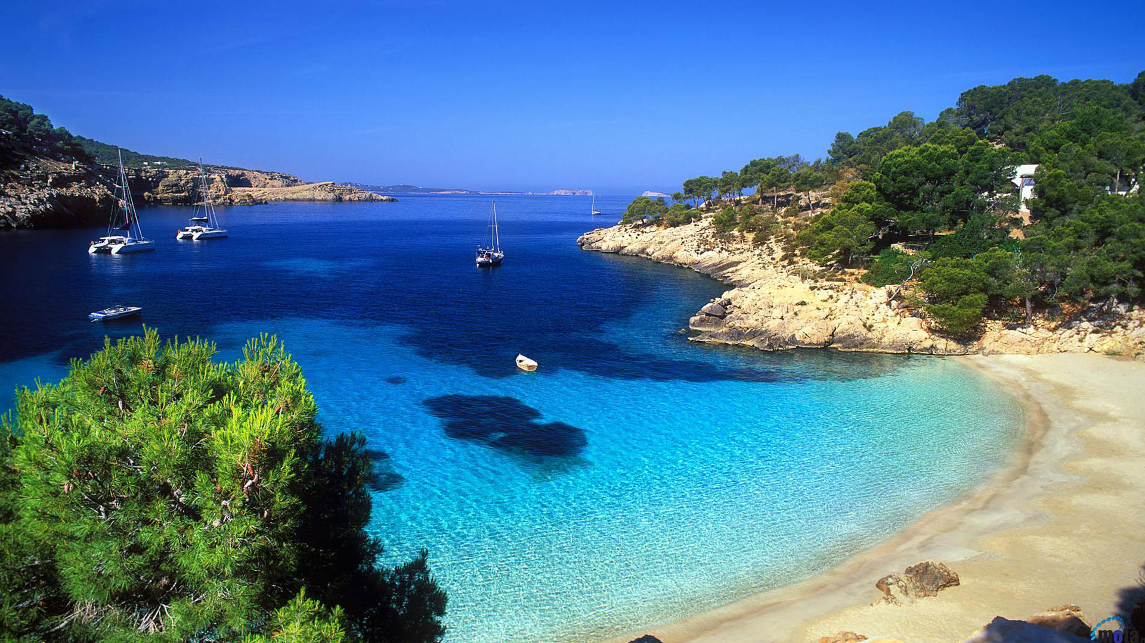
“Blessed” in Greek

Slide 58

“Blessed” in Greek

Slide 59
Philippians 4:11-13
11 I have learned in whatever state I am, to be content:
12 I know how to be abased, and I know how to abound. Everywhere and in all things I have learned both to be full and to be hungry, both to abound and to suffer need.

Slide 60
How do we have that relationship?
• being poor in spirit
• mourning
• being meek
• hungering and thirsting for righteousness
• being merciful
• being pure in heart
• being peacemakers
• being persecuted for righteousness’ sake

Slide 61
How are we blessed?
• For theirs is the kingdom of heaven
• For they shall be comforted
• For they shall inherit the earth
• For they shall be filled
• For they shall obtain mercy
• For they shall see God
• For they shall be called sons of God
• For theirs is the kingdom of heaven

