Slide 1



Slide 2
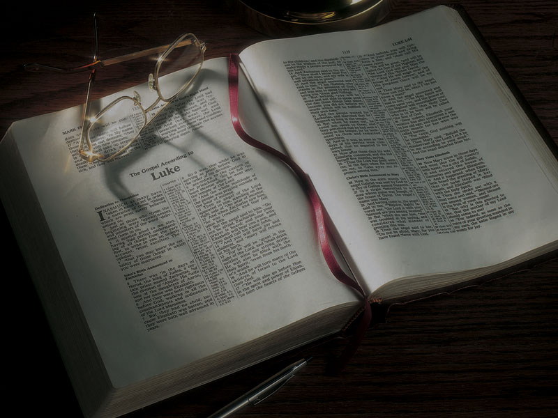
The Gospels
The Sermon on the Mount
Part 1: Background
and Introduction

Slide 3
Mark 1:14-15
14 Now after John was put in prison, Jesus came
to Galilee, preaching the gospel of the kingdom
of God,
15 and saying, “The time is fulfilled, and the kingdom of God is at hand. Repent, and believe
in the gospel.”

Slide 4
Matthew 4:23—And Jesus went about all Galilee, teaching in their synagogues . . .
Mark 1:21—Then they went into Capernaum, and immediately on the Sabbath He entered the synagogue and taught.
Mark 2:13—Then He went out again by the sea; and all the multitude came to Him, and He taught them.
Luke 4:15—And He taught in their synagogues, being glorified by all.
Luke 4:31—Then He went down to Capernaum,
a city of Galilee, and was teaching them on the Sabbaths.

Slide 5
What were Jesus’ credentials?

Slide 6
What were Jesus’ credentials?
He was of the promised lineage of the Messiah
(son of Abraham, son of David, son of others)
Matthew 1, Luke 3

Slide 7
What were Jesus’ credentials?
He was of the promised lineage of the Messiah
(son of Abraham, son of David, son of others)
Matthew 1, Luke 3
His birth was divinely foretold by angels
Matthew 1, Luke 1

Slide 8
What were Jesus’ credentials?
He was of the promised lineage of the Messiah
(son of Abraham, son of David, son of others)
Matthew 1, Luke 3
His birth was divinely foretold by angels
Matthew 1, Luke 1
He was the fulfillment of prophecy
Matthew 2, 3, Luke 2, 3

Slide 9
What were Jesus’ credentials?
He was of the promised lineage of the Messiah
(son of Abraham, son of David, son of others)
Matthew 1, Luke 3
His birth was divinely foretold by angels
Matthew 1, Luke 1
He was the fulfillment of prophecy
Matthew 2, 3, Luke 2, 3
He had been preceded by John the Baptist, “Elijah”
Matthew 3, Luke 3

Slide 10
What were Jesus’ credentials?
The Father had proclaimed Jesus to be His Beloved Son
Matthew 3, Luke 3

Slide 11
What were Jesus’ credentials?
The Father had proclaimed Jesus to be His Beloved Son
Matthew 3, Luke 3
He had defeated Satan
Matthew 4, Luke 4

Slide 12
What were Jesus’ credentials?
The Father had proclaimed Jesus to be His Beloved Son
Matthew 3, Luke 3
He had defeated Satan
Matthew 4, Luke 4
He had performed miracles
Matthew 4, Luke 4, 5, 6

Slide 13
“The Granddaddy of all remezim”:

Slide 14
Matthew 5:1
1 And seeing the multitudes, He went up on a mountain, and when He was seated His disciples came to Him.

Slide 15
Matthew’s parallels with Moses:

Slide 16
Matthew’s parallels with Moses:
Matthew 2: Jesus escaped death as an infant

Slide 17
Matthew’s parallels with Moses:
Matthew 2: Jesus escaped death as an infant
Matthew 2: Jesus entered Egypt

Slide 18
Matthew’s parallels with Moses:
Matthew 2: Jesus escaped death as an infant
Matthew 2: Jesus entered Egypt
Matthew 4: Jesus went into the wilderness

Slide 19
Matthew’s parallels with Moses:
Matthew 2: Jesus escaped death as an infant
Matthew 2: Jesus entered Egypt
Matthew 4: Jesus went into the wilderness
Matthew 4: Jesus was tempted in the wilderness

Slide 20
Matthew’s parallels with Moses:
Matthew 2: Jesus escaped death as an infant
Matthew 2: Jesus entered Egypt
Matthew 4: Jesus went into the wilderness
Matthew 4: Jesus was tempted in the wilderness
Matthew 4: Jesus fasted 40 days

Slide 21
Matthew’s parallels with Moses:
Matthew 2: Jesus escaped death as an infant
Matthew 2: Jesus entered Egypt
Matthew 4: Jesus went into the wilderness
Matthew 4: Jesus was tempted in the wilderness
Matthew 4: Jesus fasted 40 days
Matthew 5: Jesus ascended a mountain

Slide 22
Matthew’s parallels with Moses:
Matthew 2: Jesus escaped death as an infant
Matthew 2: Jesus entered Egypt
Matthew 4: Jesus went into the wilderness
Matthew 4: Jesus was tempted in the wilderness
Matthew 4: Jesus fasted 40 days
Matthew 5: Jesus ascended a mountain
Matthew 5: Jesus revealed the law from the mountain

Slide 23
Matthew’s parallels with Moses:
Matthew 2: Jesus escaped death as an infant

Slide 24
Matthew’s parallels with Moses:
Matthew 2: Jesus escaped death as an infant
(as did Moses)

Slide 25
Matthew’s parallels with Moses:
Matthew 2: Jesus escaped death as an infant
(as did Moses)
Matthew 2: Jesus entered Egypt (as did Moses)

Slide 26
Matthew’s parallels with Moses:
Matthew 2: Jesus escaped death as an infant
(as did Moses)
Matthew 2: Jesus entered Egypt (as did Moses)

Slide 27
Matthew’s parallels with Moses:
Matthew 2: Jesus escaped death as an infant
(as did Moses)
Matthew 2: Jesus entered Egypt (as did Moses)
Matthew 4: Jesus went into the wilderness

Slide 28
Matthew’s parallels with Moses:
Matthew 2: Jesus escaped death as an infant
(as did Moses)
Matthew 2: Jesus entered Egypt (as did Moses)
Matthew 4: Jesus went into the wilderness
(as did Moses)

Slide 29
Matthew’s parallels with Moses:
Matthew 2: Jesus escaped death as an infant
(as did Moses)
Matthew 2: Jesus entered Egypt (as did Moses)
Matthew 4: Jesus went into the wilderness
(as did Moses)
Matthew 4: Jesus was tempted in the wilderness

Slide 30
Matthew’s parallels with Moses:
Matthew 2: Jesus escaped death as an infant
(as did Moses)
Matthew 2: Jesus entered Egypt (as did Moses)
Matthew 4: Jesus went into the wilderness
(as did Moses)
Matthew 4: Jesus was tempted in the wilderness
(as was Moses and Israel)

Slide 31
Matthew’s parallels with Moses:
Matthew 2: Jesus escaped death as an infant
(as did Moses)
Matthew 2: Jesus entered Egypt (as did Moses)
Matthew 4: Jesus went into the wilderness
(as did Moses)
Matthew 4: Jesus was tempted in the wilderness
(as was Moses and Israel)
Matthew 4: Jesus fasted 40 days (as did Moses)

Slide 32
Matthew’s parallels with Moses:
Matthew 2: Jesus escaped death as an infant
(as did Moses)
Matthew 2: Jesus entered Egypt (as did Moses)
Matthew 4: Jesus went into the wilderness
(as did Moses)
Matthew 4: Jesus was tempted in the wilderness
(as was Moses and Israel)
Matthew 4: Jesus fasted 40 days (as did Moses)

Slide 33
Matthew’s parallels with Moses:
Matthew 2: Jesus escaped death as an infant
(as did Moses)
Matthew 2: Jesus entered Egypt (as did Moses)
Matthew 4: Jesus went into the wilderness
(as did Moses)
Matthew 4: Jesus was tempted in the wilderness
(as was Moses and Israel)
Matthew 4: Jesus fasted 40 days (as did Moses)
Matthew 5: Jesus ascended a mountain (as did Moses)

Slide 34
Matthew’s parallels with Moses:
Matthew 2: Jesus escaped death as an infant
(as did Moses)
Matthew 2: Jesus entered Egypt (as did Moses)
Matthew 4: Jesus went into the wilderness
(as did Moses)
Matthew 4: Jesus was tempted in the wilderness
(as was Moses and Israel)
Matthew 4: Jesus fasted 40 days (as did Moses)
Matthew 5: Jesus ascended a mountain (as did Moses)

Slide 35
Matthew’s parallels with Moses:
Matthew 2: Jesus escaped death as an infant
(as did Moses)
Matthew 2: Jesus entered Egypt (as did Moses)
Matthew 4: Jesus went into the wilderness
(as did Moses)
Matthew 4: Jesus was tempted in the wilderness
(as was Moses and Israel)
Matthew 4: Jesus fasted 40 days (as did Moses)
Matthew 5: Jesus ascended a mountain (as did Moses)
Matthew 5: Jesus revealed the law from the mountain

Slide 36
Matthew’s parallels with Moses:
Matthew 2: Jesus escaped death as an infant
(as did Moses)
Matthew 2: Jesus entered Egypt (as did Moses)
Matthew 4: Jesus went into the wilderness
(as did Moses)
Matthew 4: Jesus was tempted in the wilderness
(as was Moses and Israel)
Matthew 4: Jesus fasted 40 days (as did Moses)
Matthew 5: Jesus ascended a mountain (as did Moses)
Matthew 5: Jesus revealed the law from the mountain
(as did Moses)

Slide 37
Matthew’s parallels with Moses:
What’s the point?

Slide 38
Matthew’s parallels with Moses:
What’s the point?
Jesus is a second Moses, fulfilling the prophecy that God would raise up another prophet like Moses.

Slide 39
Matthew’s parallels with Moses:
What’s the point?
Jesus is a second Moses, fulfilling the prophecy that God would raise up another prophet like Moses.
Deuteronomy 18:15
15 The LORD your God will raise up for you a Prophet like me from your midst, from your brethren. Him you shall hear.

Slide 40
Matthew’s parallels with Moses:
Matthew makes another point:
As Moses was the great lawgiver,
Jesus is also a great lawgiver.

Slide 41
Matthew’s parallels with Moses:
What’s the point?
As Moses was the great lawgiver,
Jesus is also a great lawgiver.
Isaiah 42:21 (KJV)
21 The LORD is well pleased for his righteousness’ sake; he will magnify the law, and make it honourable.

Slide 42
Matthew’s parallels with Moses:
Who was the I AM, the LORD,
Yahweh, who gave the law?

Slide 43
1 Corinthians 10:1-4, 9
1 Moreover, brethren, I do not want you to be unaware that all our fathers were under the cloud, all passed through the sea,
2 all were baptized into Moses in the cloud and in the sea,
3 all ate the same spiritual food,
4 and all drank the same spiritual drink. For they drank of that spiritual Rock that followed them, and that Rock was Christ. . . .
9 nor let us tempt Christ, as some of them also tempted . . .

Slide 44
John 1, Hebrews 1, Colossians 1
All show that Jesus was the Creator and the Divine Being who interacted with people before His birth as a human being.

Slide 45
What differences do we see
between Matthew and Luke?

Slide 46
What differences do we see
between Matthew and Luke?
• Some of the wording is different.

Slide 47
What differences do we see
between Matthew and Luke?
• Some of the wording is different. (Jesus is speaking Hebrew or Aramaic, which is translated into Greek)

Slide 48
What differences do we see
between Matthew and Luke?
• Some of the wording is different. (Jesus is speaking Hebrew or Aramaic, which is translated into Greek)
• Matthew is much longer and Luke is much shorter.

Slide 49
What differences do we see
between Matthew and Luke?
• Some of the wording is different. (Jesus is speaking Hebrew or Aramaic, which is translated into Greek)
• Matthew is much longer and Luke is much shorter.
• Matthew has several long sections that aren’t found at all in Luke. (47 verses total)

Slide 50
What differences do we see
between Matthew and Luke?
• Some of the wording is different. (Jesus is speaking Hebrew or Aramaic, which is translated into Greek)
• Matthew is much longer and Luke is much shorter.
• Matthew has several long sections that aren’t found at all in Luke. (47 verses total)
• Luke has a few sections that aren’t found at all in Matthew. (12 verses total)

Slide 51
What differences do we see
between Matthew and Luke?
• Some of the wording is different. (Jesus is speaking Hebrew or Aramaic, which is translated into Greek)
• Matthew is much longer and Luke is much shorter.
• Matthew has several long sections that aren’t found at all in Luke. (47 verses total)
• Luke has a few sections that aren’t found at all in Matthew. (12 verses total)
• Some parts that are found in Matthew appear in completely different places and contexts in Luke.
(34 verses)

Slide 52
Examples of differences
Matthew 5:13 = Luke 14:34-35
Matthew 5:15 = Luke 8:16
Matthew 5:18 = Luke 16:17
Matthew 7:7-11= Luke 11:9-13

Slide 53
“You are the salt of the earth”
Matthew 5:18—For assuredly, I say to you, till heaven and earth pass away, one jot or one tittle will by no means pass from the law till all is fulfilled.
Luke 14:34-35—Salt is good; but if the salt has lost its flavor, how shall it be seasoned?
35 It is neither fit for the land nor for the dunghill, but men throw it out. He who has ears to hear, let him hear!

Slide 54
“You are the light of the world”
Matthew 5:15—Nor do they light a lamp and put
it under a basket, but on a lampstand, and it gives light to all who are in the house.
Luke 8:16— No one, when he has lit a lamp, covers it with a vessel or puts it under a bed, but sets it
on a lampstand, that those who enter may see the light.

Slide 55
The law isn’t done away
Matthew 5:18—For assuredly, I say to you, till heaven and earth pass away, one jot or one tittle will by no means pass from the law till all is fulfilled.
Luke 16:17—And it is easier for heaven and earth to pass away than for one tittle of the law to fail.

Slide 56
“Ask, and it will be given to you”
Matthew 7:7—“Ask, and it will be given to you; seek, and you will find; knock, and it will be opened to you.
8 “For everyone who asks receives, and he who seeks finds, and to him who knocks it will be opened.
9 “Or what man is there among you who, if his son asks for bread, will give him a stone?
10 “Or if he asks for a fish, will he give him a serpent?
11 “If you then, being evil, know how to give good gifts to your children, how much more will your Father who is in heaven give good things to those who ask Him!” Appears in Luke in Luke 11:9-13

Slide 57
Why do we see differences?
Matthew and Luke took different approaches
to writing their Gospels.

Slide 58
Luke 1:1-4
1 “Inasmuch as many have taken in hand to set in order a narrative of those things which have been fulfilled among us,
2 just as those who from the beginning were eyewitnesses and ministers of the word delivered them to us,
3 “It seemed good to me also, having had perfect understanding of all things from the very first, to write to you an orderly account, most excellent Theophilus,
4 that you may know the certainty of those things in which you were instructed.”

Slide 59
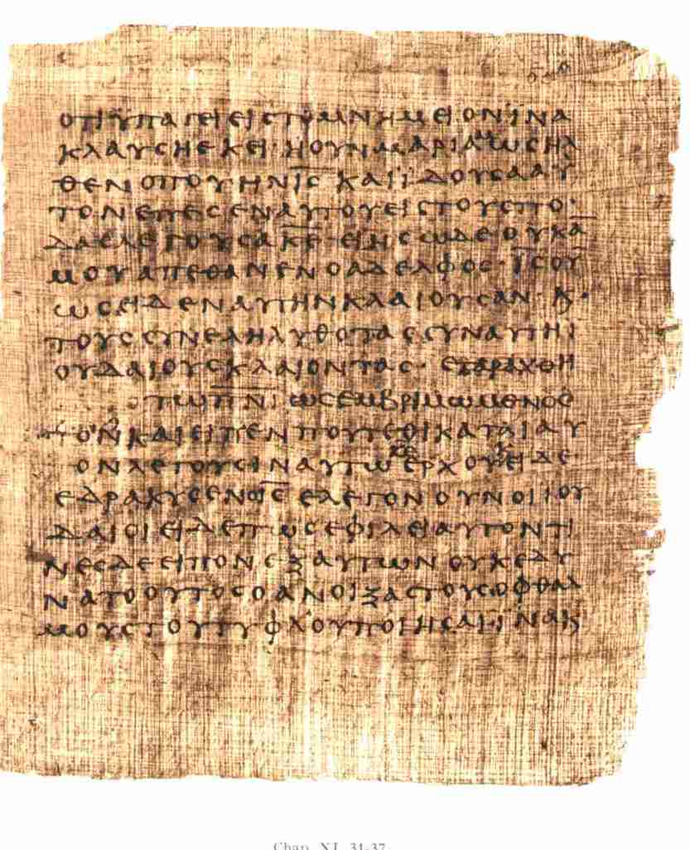

Slide 60
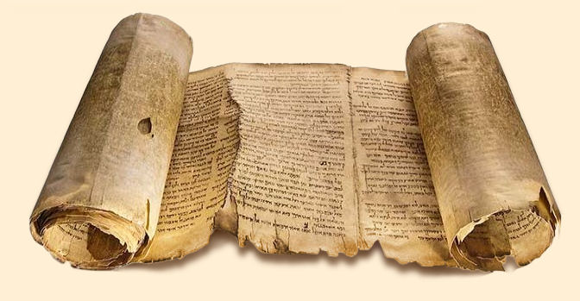

Slide 61
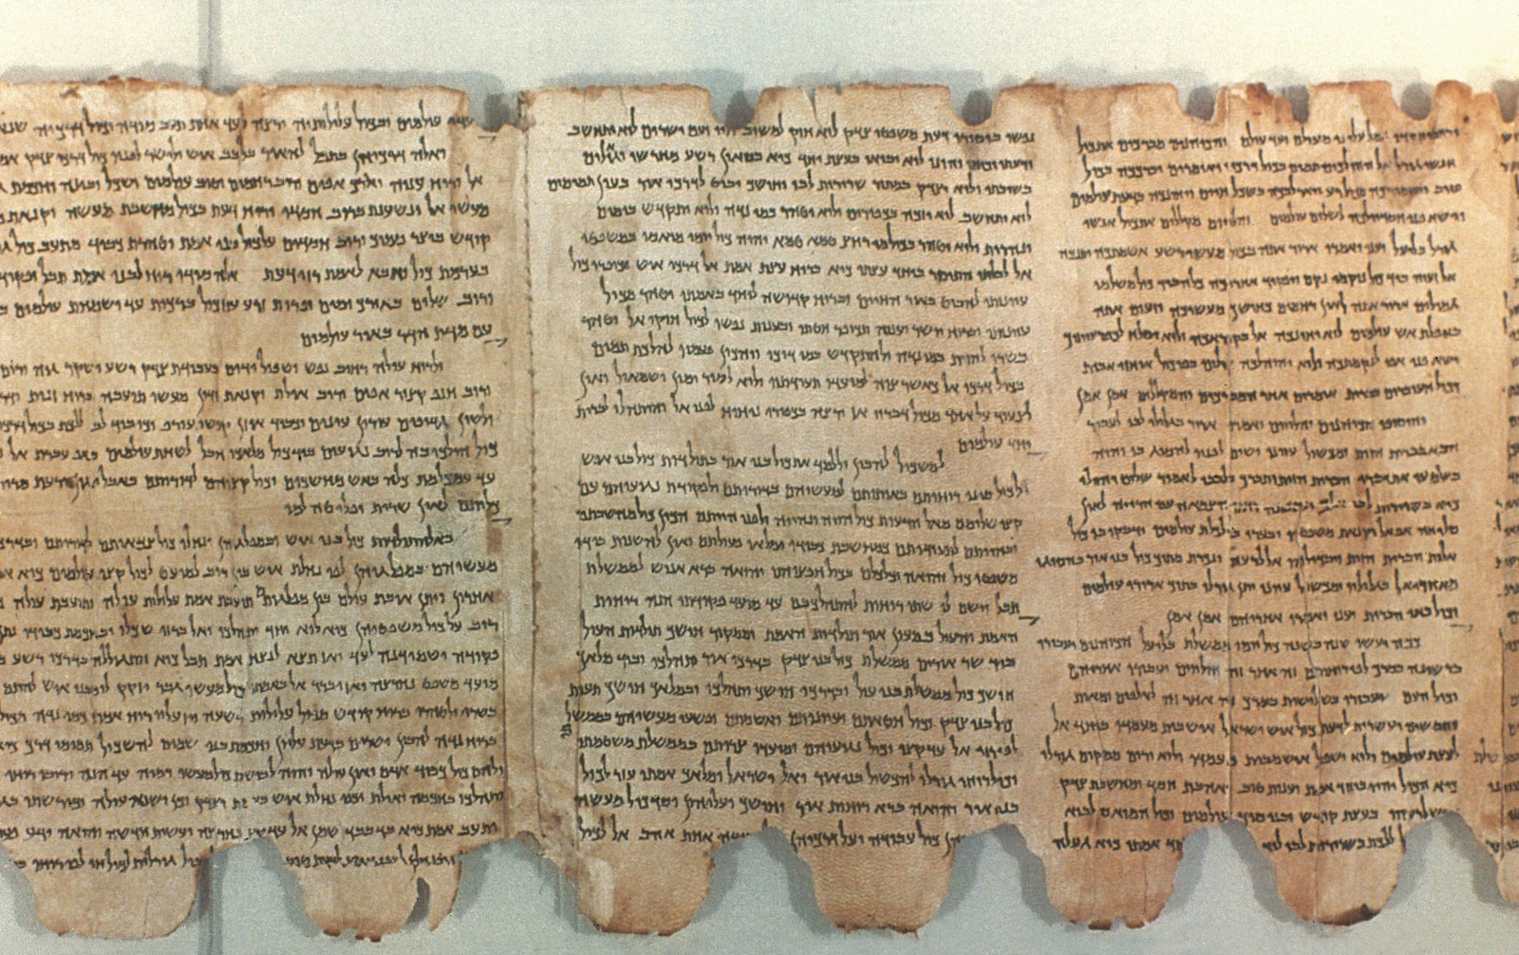

Slide 62
How is Matthew’s Gospel structured?

Slide 63
How is Matthew’s Gospel structured?
Five collections of Jesus Christ’s sayings:
The sermon on the mount in chapters 5-7.
The commission to the 12 disciples in chapter 10.
The parables of the kingdom in chapter 13.
The need for humility and forgiveness in chapter 18.
The Olivet Prophecy in chapters 24-25.

Slide 64
How is Matthew’s Gospel structured?
Matthew 7:28—And so it was, when Jesus had ended these sayings . . .
Matthew 11:1—Now it came to pass, when Jesus finished commanding His twelve disciples . . .
Matthew 13:53—Now it came to pass, when Jesus had finished these parables . . .
Matthew 19:1—Now it came to pass, when Jesus had finished these sayings . . .
Matthew 26:1—Now it came to pass, when Jesus had finished all these sayings . . .

Slide 65
Matthew 5:1
1 And seeing the multitudes, He went up on a mountain, and when He was seated His disciples came to Him.
Luke 6:17
17 And He came down with them and stood on a level place with a crowd of His disciples and a great multitude of people from all Judea and Jerusalem, and from the seacoast of Tyre and Sidon, who came to hear Him and be healed of their diseases . . .

Slide 66
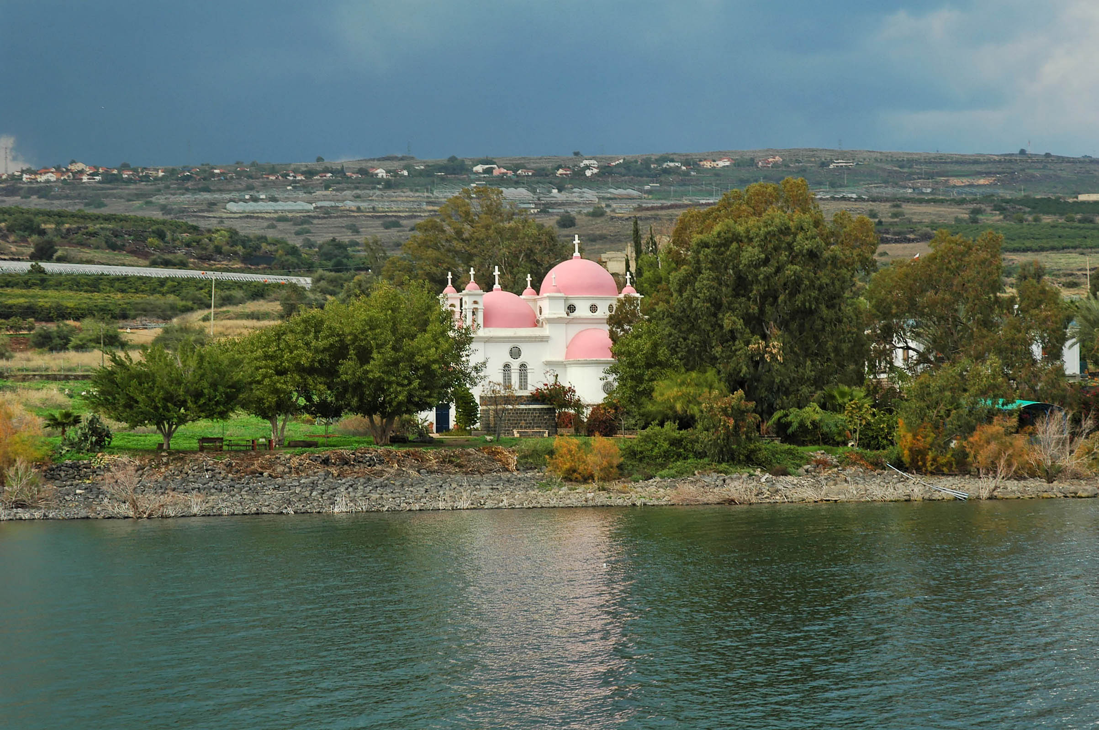

Slide 67
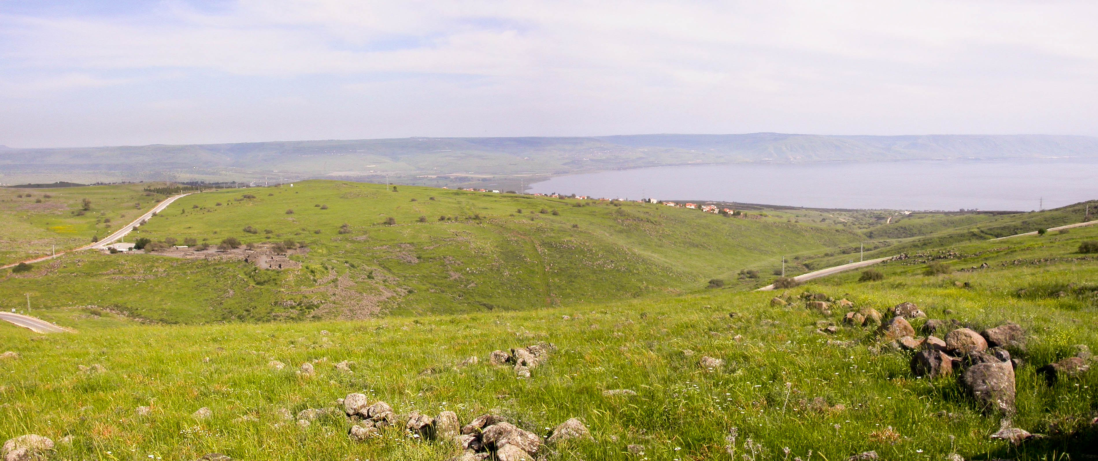

Slide 68
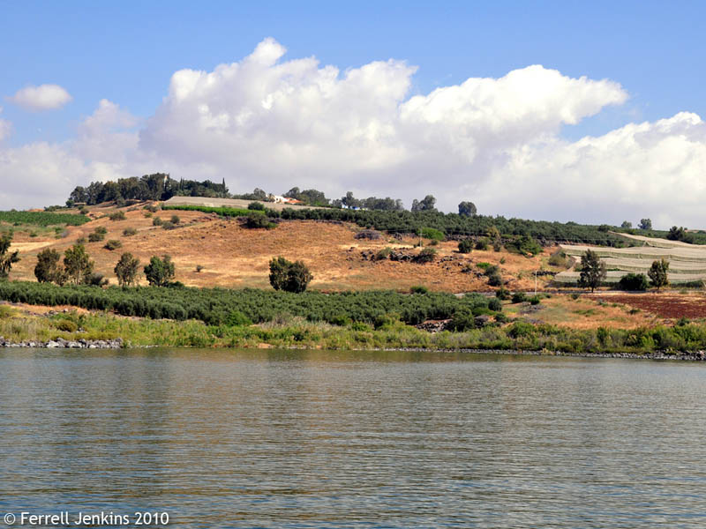

Slide 69
Luke 6:13
13 And when it was day, He called His disciples to Himself; and from them He chose twelve whom He also named apostles . . .

Slide 70
Luke 6:13
13 And when it was day, He called His disciples to Himself; and from them He chose twelve whom He also named apostles . . .
“Apostle” = messenger, one sent with a message

Slide 71
Luke 6:13
13 And when it was day, He called His disciples to Himself; and from them He chose twelve whom He also named apostles . . .
“Apostle” = messenger, one sent with a message
Luke 10:1
1 After these things the Lord appointed seventy others also, and sent them two by two before His face into every city and place where He Himself was about to go.

Slide 72
Acts 1:15, 21-23
15 And in those days Peter stood up in the midst of the disciples (altogether the number of names was about a hundred and twenty), and said . . .
21 “of these men who have accompanied us all the time that the Lord Jesus went in and out among us,
22 “beginning from the baptism of John to that day when He was taken up from us, one of these must become a witness with us of His resurrection.”
23 And they proposed two: Joseph called Barsabas, who was surnamed Justus, and Matthias.

Slide 73
Matthew 5:1
1 And seeing the multitudes, He went up on a mountain, and when He was seated His disciples came to Him.

Slide 74
Matthew 5:1
1 And seeing the multitudes, He went up on a mountain, and when He was seated His disciples came to Him.
Matthew 7:28
28 And so it was, when Jesus had ended these sayings, that the people were astonished at His teaching . . .

Slide 75
Luke 6:17-20
17 And He came down with them and stood on a level place with a crowd of His disciples and a great multitude of people from all Judea and Jerusalem, and from the seacoast of Tyre and Sidon, who came to hear Him and be healed of their diseases,
18 as well as those who were tormented with unclean spirits. And they were healed.
19 And the whole multitude sought to touch Him, for power went out from Him and healed them all.
20 Then He lifted up His eyes toward His disciples, and said . . .

