Slide 1



Slide 2
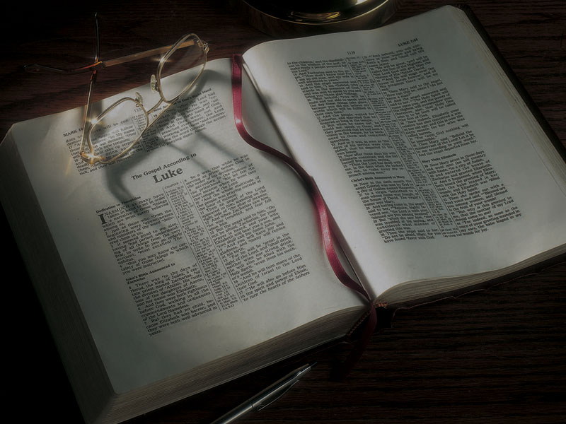
The Gospels
Jesus and the
Four Witnesses

Slide 3
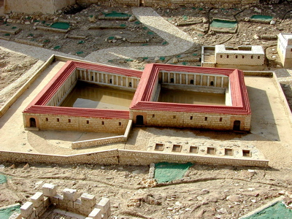

Slide 4
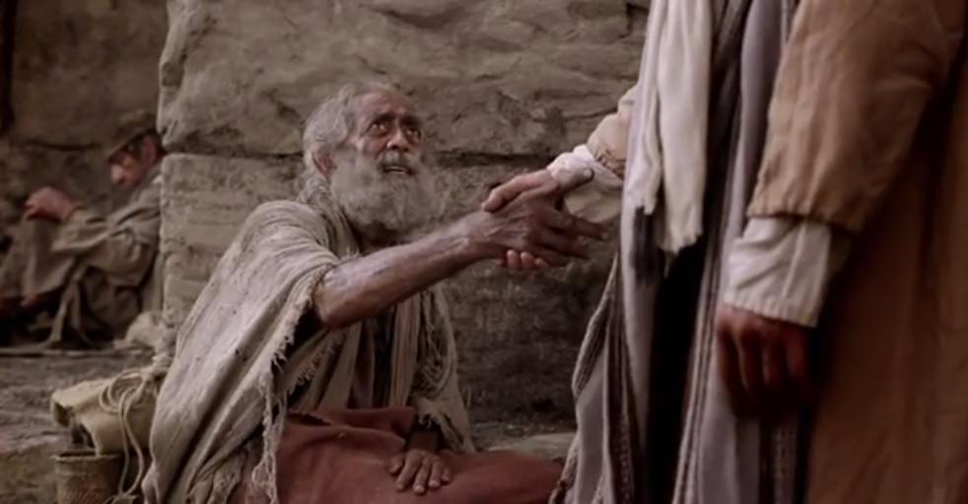

Slide 5
John 3:2
2 This man [Nicodemus] came to Jesus by night
and said to Him, “Rabbi, we know that You are a teacher come from God; for no one can do these signs that You do unless God is with him.”

Slide 6
John 5:17
NKJV: But Jesus answered them, “My Father has been working until now, and I have been working.”

Slide 7
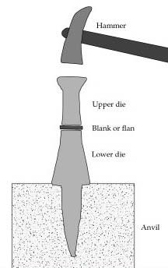
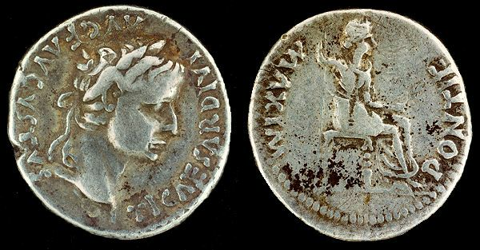
Charakter

Slide 8
John 5:24-47
24 “Most assuredly, I say to you, he who hears My word and believes in Him who sent Me has everlasting life, and shall not come into judgment, but has passed from death into life.
25 “Most assuredly, I say to you, the hour is coming, and now is, when the dead will hear the voice of the Son of God; and those who hear will live.

Slide 9
John 5:24-47
26 “For as the Father has life in Himself, so He has granted the Son to have life in Himself,
27 “and has given Him authority to execute judgment also, because He is the Son of Man.
28 “Do not marvel at this; for the hour is coming in which all who are in the graves will hear His voice
29 “and come forth—those who have done good, to the resurrection of life, and those who have done evil, to the resurrection of condemnation.

Slide 10
John 5:24-47
30 “I can of Myself do nothing. As I hear, I judge; and My judgment is righteous, because I do not seek My own will but the will of the Father who sent Me.
31 “If I bear witness of Myself, My witness is not true.
32 “There is another who bears witness of Me, and I know that the witness which He witnesses of Me is true.
33 “You have sent to John, and he has borne witness to the truth.

Slide 11
John 5:24-47
34 “Yet I do not receive testimony from man, but I say these things that you may be saved.
35 “He was the burning and shining lamp, and you were willing for a time to rejoice in his light.
36 “But I have a greater witness than John’s; for the works which the Father has given Me to finish—the very works that I do—bear witness of Me, that the Father has sent Me.
37 “And the Father Himself, who sent Me, has testified of Me. You have neither heard His voice at any time, nor seen His form.

Slide 12
John 5:24-47
38 “But you do not have His word abiding in you, because whom He sent, Him you do not believe.
39 “You search the Scriptures, for in them you think you have eternal life; and these are they which testify of Me.
40 “But you are not willing to come to Me that you may have life.
41 “I do not receive honor from men.
42 “But I know you, that you do not have the love of God in you.

Slide 13
John 5:24-47
43 “I have come in My Father’s name, and you do not receive Me; if another comes in his own name, him you will receive.
44 “How can you believe, who receive honor from one another, and do not seek the honor that comes from the only God?
45 “Do not think that I shall accuse you to the Father; there is one who accuses you—Moses, in whom you trust.

Slide 14
John 5:24-47
46 “For if you believed Moses, you would believe Me; for he wrote about Me.
47 “But if you do not believe his writings, how will you believe My words?”

Slide 15
John 5:24-47
24 “Most assuredly, I say to you, he who hears My word and believes in Him who sent Me has everlasting life, and shall not come into judgment, but has passed from death into life.

Slide 16
Hebrews 3:18-19
18 And to whom did He swear that they would not enter His rest, but to those who did not obey?
19 So we see that they could not enter in because of unbelief.

Slide 17
John 5:24-47
25 “Most assuredly, I say to you, the hour is coming, and now is, when the dead will hear the voice of the Son of God; and those who hear will live.

Slide 18
John 5:24-47
25 “Most assuredly, I say to you, the hour is coming, and now is, when the dead will hear the voice of the Son of God; and those who hear will live.
Matthew 8:21-22
21 Then another of His disciples said to Him,
“Lord, let me first go and bury my father.”
22 But Jesus said to him, “Follow Me, and let
the dead bury their own dead.”

Slide 19
John 5:24-47
26 “For as the Father has life in Himself, so He has granted the Son to have life in Himself,

Slide 20
John 5:24-47
26 “For as the Father has life in Himself, so He has granted the Son to have life in Himself,
John 1:1-4
1 In the beginning was the Word, and the Word was with God, and the Word was God.
2 He was in the beginning with God.
3 All things were made through Him, and without Him nothing was made that was made.
4 In Him was life, and the life was the light of men.

Slide 21
John 5:24-47
27 “and has given Him authority to execute judgment also, because He is the Son of Man.

Slide 22
John 5:24-47
27 “and has given Him authority to execute judgment also, because He is the Son of Man.
John 5:22
22 “For the Father judges no one, but has committed all judgment to the Son,
judgment also, because He is the Son of Man.

Slide 23
Hebrews 4:15
15 For we do not have a High Priest who cannot sympathize with our weaknesses, but was in all points tempted as we are, yet without sin.

Slide 24
Hebrews 4:15
15 For we do not have a High Priest who cannot sympathize with our weaknesses, but was in all points tempted as we are, yet without sin.
Hebrews 2:17-18
17 Therefore, in all things He had to be made like His brethren, that He might be a merciful and faithful High Priest in things pertaining to God,
to make propitiation for the sins of the people.
18 For in that He Himself has suffered, being tempted, He is able to aid those who are tempted.

Slide 25
John 5:24-47
28 “Do not marvel at this; for the hour is coming in which all who are in the graves will hear His voice
29 “and come forth—those who have done good, to the resurrection of life, and those who have done evil, to the resurrection of condemnation.

Slide 26
1 Peter 4:17
17 For the time has come for judgment to begin
at the house of God . . .

Slide 27
John 5:24-47
30 “I can of Myself do nothing. As I hear, I judge; and My judgment is righteous, because I do not seek My own will but the will of the Father who sent Me.

Slide 28
John 5:24-47
30 “I can of Myself do nothing. As I hear, I judge; and My judgment is righteous, because I do not seek My own will but the will of the Father who sent Me.
John 5:19
30 “the Son can do nothing of Himself, but what He sees the Father do.”

Slide 29
John 5:24-47
31 “If I bear witness of Myself, My witness is not true.

Slide 30
John 5:24-47
31 “If I bear witness of Myself, My witness is not true.
Deuteronomy 19:15
15 One witness shall not rise against a man concerning any iniquity or any sin that he commits; by the mouth of two or three witnesses the matter shall be established.

Slide 31
John 5:24-47
32 “There is another who bears witness of Me,
and I know that the witness which He witnesses
of Me is true.
33 “You have sent to John, and he has borne witness to the truth.
34 “Yet I do not receive testimony from man, but
I say these things that you may be saved.
35 “He was the burning and shining lamp, and you were willing for a time to rejoice in his light.

Slide 32
John 5:24-47
36 “But I have a greater witness than John’s; for the works which the Father has given Me to finish—the very works that I do—bear witness of Me, that the Father has sent Me.

Slide 33
John 5:24-47
36 “But I have a greater witness than John’s; for the works which the Father has given Me to finish—the very works that I do—bear witness of Me, that the Father has sent Me.
Isaiah 35:5-6
5 Then the eyes of the blind shall be opened, and the ears of the deaf shall be unstopped.
6 Then the lame shall leap like a deer, and the tongue of the dumb sing. For waters shall burst forth in the wilderness, and streams in the desert.

Slide 34
John 5:24-47
37 “And the Father Himself, who sent Me, has testified of Me. You have neither heard His voice
at any time, nor seen His form.

Slide 35
John 5:24-47
37 “And the Father Himself, who sent Me, has testified of Me. You have neither heard His voice
at any time, nor seen His form.
John 1:18
18 No man has seen God at any time. The only begotten Son, who is in the bosom of the Father,
He has declared Him.

Slide 36
John 5:24-47
38 “But you do not have His word abiding in you, because whom He sent, Him you do not believe.
39 “You search the Scriptures, for in them you
think you have eternal life; and these are they which testify of Me.
40 “But you are not willing to come to Me that
you may have life.
41 “I do not receive honor from men.

Slide 37
John 5:24-47
42 “But I know you, that you do not have the
love of God in you.

Slide 38
John 5:24-47
42 “But I know you, that you do not have the
love of God in you.
What is the “love of God”?

Slide 39
John 5:24-47
42 “But I know you, that you do not have the
love of God in you.
What is the “love of God”?
Love that comes from God

Slide 40
John 5:24-47
42 “But I know you, that you do not have the
love of God in you.
What is the “love of God”?
Love that comes from God
Love for God

Slide 41
John 5:24-47
43 “I have come in My Father’s name, and you do not receive Me; if another comes in his own name, him you will receive.
44 “How can you believe, who receive honor from one another, and do not seek the honor that comes from the only God?

Slide 42
Matthew 23:5-12
5 “But all their works they do to be seen by men. They make their phylacteries broad and enlarge
the borders of their garments.
6 “They love the best places at feasts, the best seats in the synagogues,
7 “greetings in the marketplaces, and to be called by men, ‘Rabbi, Rabbi.’
8 “But you, do not be called ‘Rabbi’; for One is
your Teacher, the Christ, and you are all brethren.

Slide 43
Matthew 23:5-12
9 “Do not call anyone on earth your father;
for One is your Father, He who is in heaven.
10 “And do not be called teachers; for One
is your Teacher, the Christ.
11 “But he who is greatest among you shall be your servant.
12 “And whoever exalts himself will be humbled, and he who humbles himself will be exalted.

Slide 44
Isaiah 66:2 (NIV)
2 “This is the one I esteem: he who is humble
and contrite in spirit, and trembles at my word.”

Slide 45
John 5:24-47
44 “How can you believe, who receive honor from one another, and do not seek the honor that comes from the only God?
45 “Do not think that I shall accuse you to the Father; there is one who accuses you—Moses, in whom you trust.

Slide 46
John 5:24-47
46 “For if you believed Moses, you would believe Me; for he wrote about Me.

Slide 47
John 5:24-47
46 “For if you believed Moses, you would believe Me; for he wrote about Me.
Deuteronomy 18:18-19
18 ‘I will raise up for them a Prophet like you from among their brethren, and will put My words in
His mouth, and He shall speak to them all that
I command Him.
19 ‘And it shall be that whoever will not hear My words, which He speaks in My name, I will require
it of him.

Slide 48
John 5:24-47
47 “But if you do not believe his writings,
how will you believe My words?”

Slide 49
John 5:24-47
47 “But if you do not believe his writings,
how will you believe My words?”
What was their problem?

Slide 50
John 5:24-47
47 “But if you do not believe his writings,
how will you believe My words?”
What was their problem?
Pride and self-righteousness.

Slide 51
John 5:24-47
47 “But if you do not believe his writings,
how will you believe My words?”
What was their problem?
Pride and self-righteousness—spiritual poison.

Slide 52
John 5:24-47
47 “But if you do not believe his writings,
how will you believe My words?”
What was their problem?
Pride and self-righteousness—spiritual poison.

Slide 53
John 5:24-47
47 “But if you do not believe his writings,
how will you believe My words?”
What was their problem?
Pride and self-righteousness—spiritual poison.
What is the antidote?

Slide 54
John 5:24-47
47 “But if you do not believe his writings,
how will you believe My words?”
What was their problem?
Pride and self-righteousness—spiritual poison.
What is the antidote?
Humility and realizing that we need to change.

