Slide 1

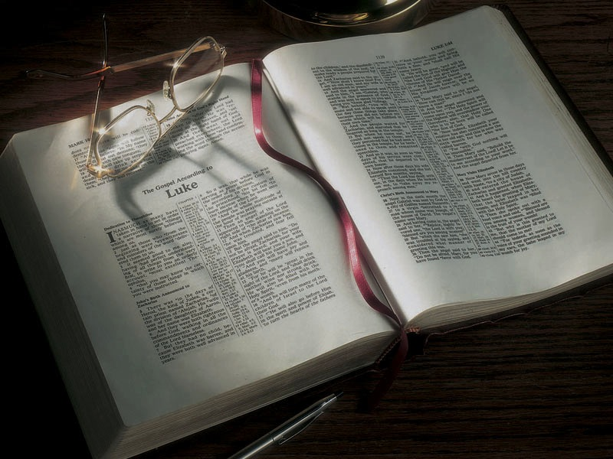

Slide 2
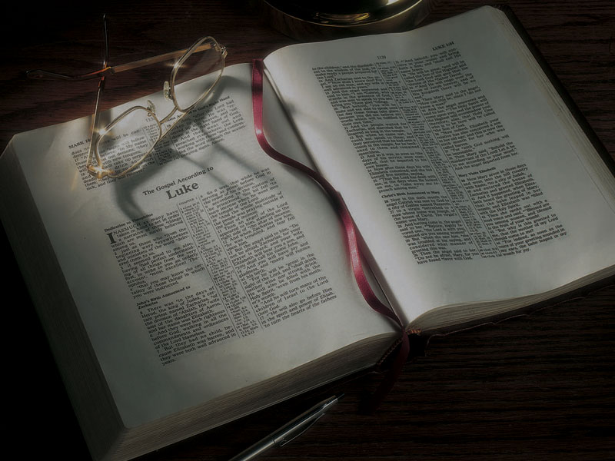
The Gospels
To Fast or not to Fast; Parables of the Garments and Wineskins,
Jesus Heals a Man at the Pool of Bethesda

Slide 3
Mark 2:18-20
18 The disciples of John and of the Pharisees were fasting. Then they came and said to Him, “Why do the disciples of John and of the Pharisees fast, but Your disciples do not fast?”
19 And Jesus said to them, “Can the friends of the bridegroom fast while the bridegroom is with them? As long as they have the bridegroom with them they cannot fast.
20 “But the days will come when the bridegroom will be taken away from them, and then they will fast in those days.

Slide 4
Matthew 6:16-18
16 “Moreover, when you fast, do not be like the hypocrites, with a sad countenance. For they disfigure their faces that they may appear to men to be fasting. Assuredly, I say to you, they have their reward.
17 “But you, when you fast, anoint your head and wash your face,
18 “so that you do not appear to men to be fasting, but to your Father who is in the secret place; and your Father who sees in secret will reward you openly.

Slide 5
Luke 18:10-12
10 “Two men went up to the temple to pray, one a Pharisee and the other a tax collector.
11 “The Pharisee stood and prayed thus with himself, ‘God, I thank You that I am not like other men—extortioners, unjust, adulterers, or even as this tax collector.
12 ‘I fast twice a week; I give tithes of all that I possess.’

Slide 6
Mark 2:18-20
18 The disciples of John and of the Pharisees were fasting. Then they came and said to Him, “Why do the disciples of John and of the Pharisees fast, but Your disciples do not fast?”
19 And Jesus said to them, “Can the friends of the bridegroom fast while the bridegroom is with them? As long as they have the bridegroom with them they cannot fast.
20 “But the days will come when the bridegroom will be taken away from them, and then they will fast in those days.

Slide 7
Mark 2:18-20
18 The disciples of John and of the Pharisees were fasting. Then they came and said to Him, “Why do the disciples of John and of the Pharisees fast, but Your disciples do not fast?”
19 And Jesus said to them, “Can the friends of the bridegroom fast while the bridegroom is with them? As long as they have the bridegroom with them they cannot fast.
20 “But the days will come when the bridegroom will be taken away from them, and then they will fast in those days.

Slide 8
Luke 5:36-39
36 Then He spoke a parable to them: “No one puts a piece from a new garment on an old one; otherwise the new makes a tear, and also the piece that was taken out of the new does not match the old.
37 “And no one puts new wine into old wineskins; or else the new wine will burst the wineskins and be spilled, and the wineskins will be ruined.
38 “But new wine must be put into new wineskins, and both are preserved.
39 “And no one, having drunk old wine, immediately desires new; for he says, ‘The old is better.’”

Slide 9
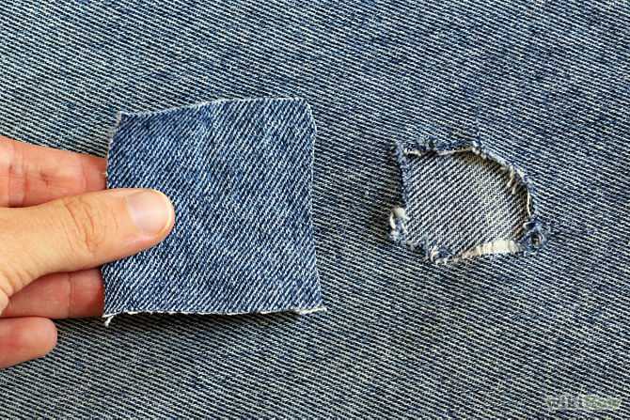

Slide 10
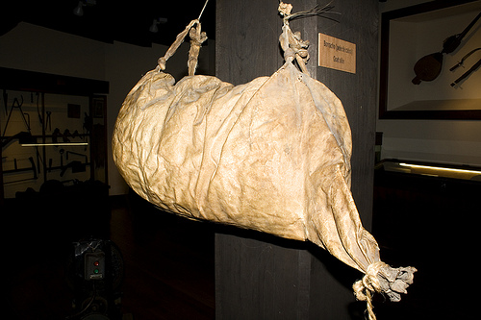

Slide 11
2 Corinthians 5:17
17 Therefore, if anyone is in Christ, he is a new creation; old things have passed away; behold, all things have become new.

Slide 12
John 5:1-18
1 After this there was a feast of the Jews, and Jesus went up to Jerusalem.
2 Now there is in Jerusalem by the Sheep Gate a pool, which is called in Hebrew, Bethesda, having five porches.
3 In these lay a great multitude of sick people, blind, lame, paralyzed, waiting for the moving of the water.
4 For an angel went down at a certain time into the pool and stirred up the water; then whoever stepped in first, after the stirring of the water, was made well of whatever disease he had.

Slide 13
John 5:1-18
5 Now a certain man was there who had an infirmity thirty-eight years.
6 When Jesus saw him lying there, and knew that he already had been in that condition a long time, He said to him, “Do you want to be made well?”
7 The sick man answered Him, “Sir, I have no man to put me into the pool when the water is stirred up; but while I am coming, another steps down before me.”
8 Jesus said to him, “Rise, take up your bed and walk.”

Slide 14
John 5:1-18
9 And immediately the man was made well, took up his bed, and walked. And that day was the Sabbath.
10 The Jews therefore said to him who was cured,
“It is the Sabbath; it is not lawful for you to carry your bed.”
11 He answered them, “He who made me well said to me, ‘Take up your bed and walk.’”
12 Then they asked him, “Who is the Man who said to you, ‘Take up your bed and walk’?”

Slide 15
John 5:1-18
13 But the one who was healed did not know who it was, for Jesus had withdrawn, a multitude being in that place.
14 Afterward Jesus found him in the temple, and said to him, “See, you have been made well. Sin no more, lest a worse thing come upon you.”
15 The man departed and told the Jews that it was Jesus who had made him well.
16 For this reason the Jews persecuted Jesus, and sought to kill Him, because He had done these things on the Sabbath.

Slide 16
John 5:1-18
1 After this there was a feast of the Jews, and Jesus went up to Jerusalem.
2 Now there is in Jerusalem by the Sheep Gate a pool, which is called in Hebrew, Bethesda, having five porches.
3 In these lay a great multitude of sick people, blind, lame, paralyzed, waiting for the moving of the water.
4 For an angel went down at a certain time into the pool and stirred up the water; then whoever stepped in first, after the stirring of the water, was made well of whatever disease he had.

Slide 17
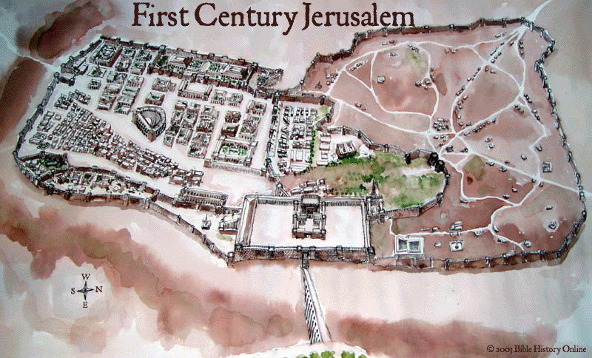

Slide 18
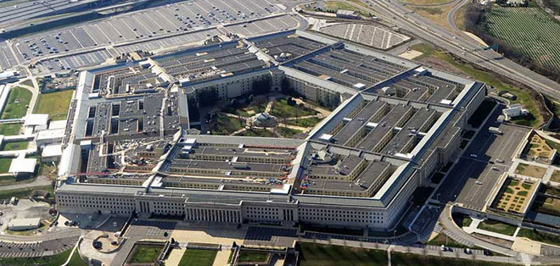

Slide 19
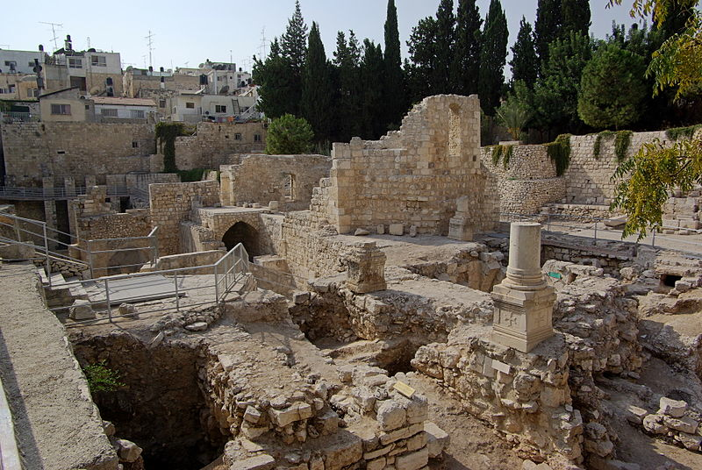

Slide 20
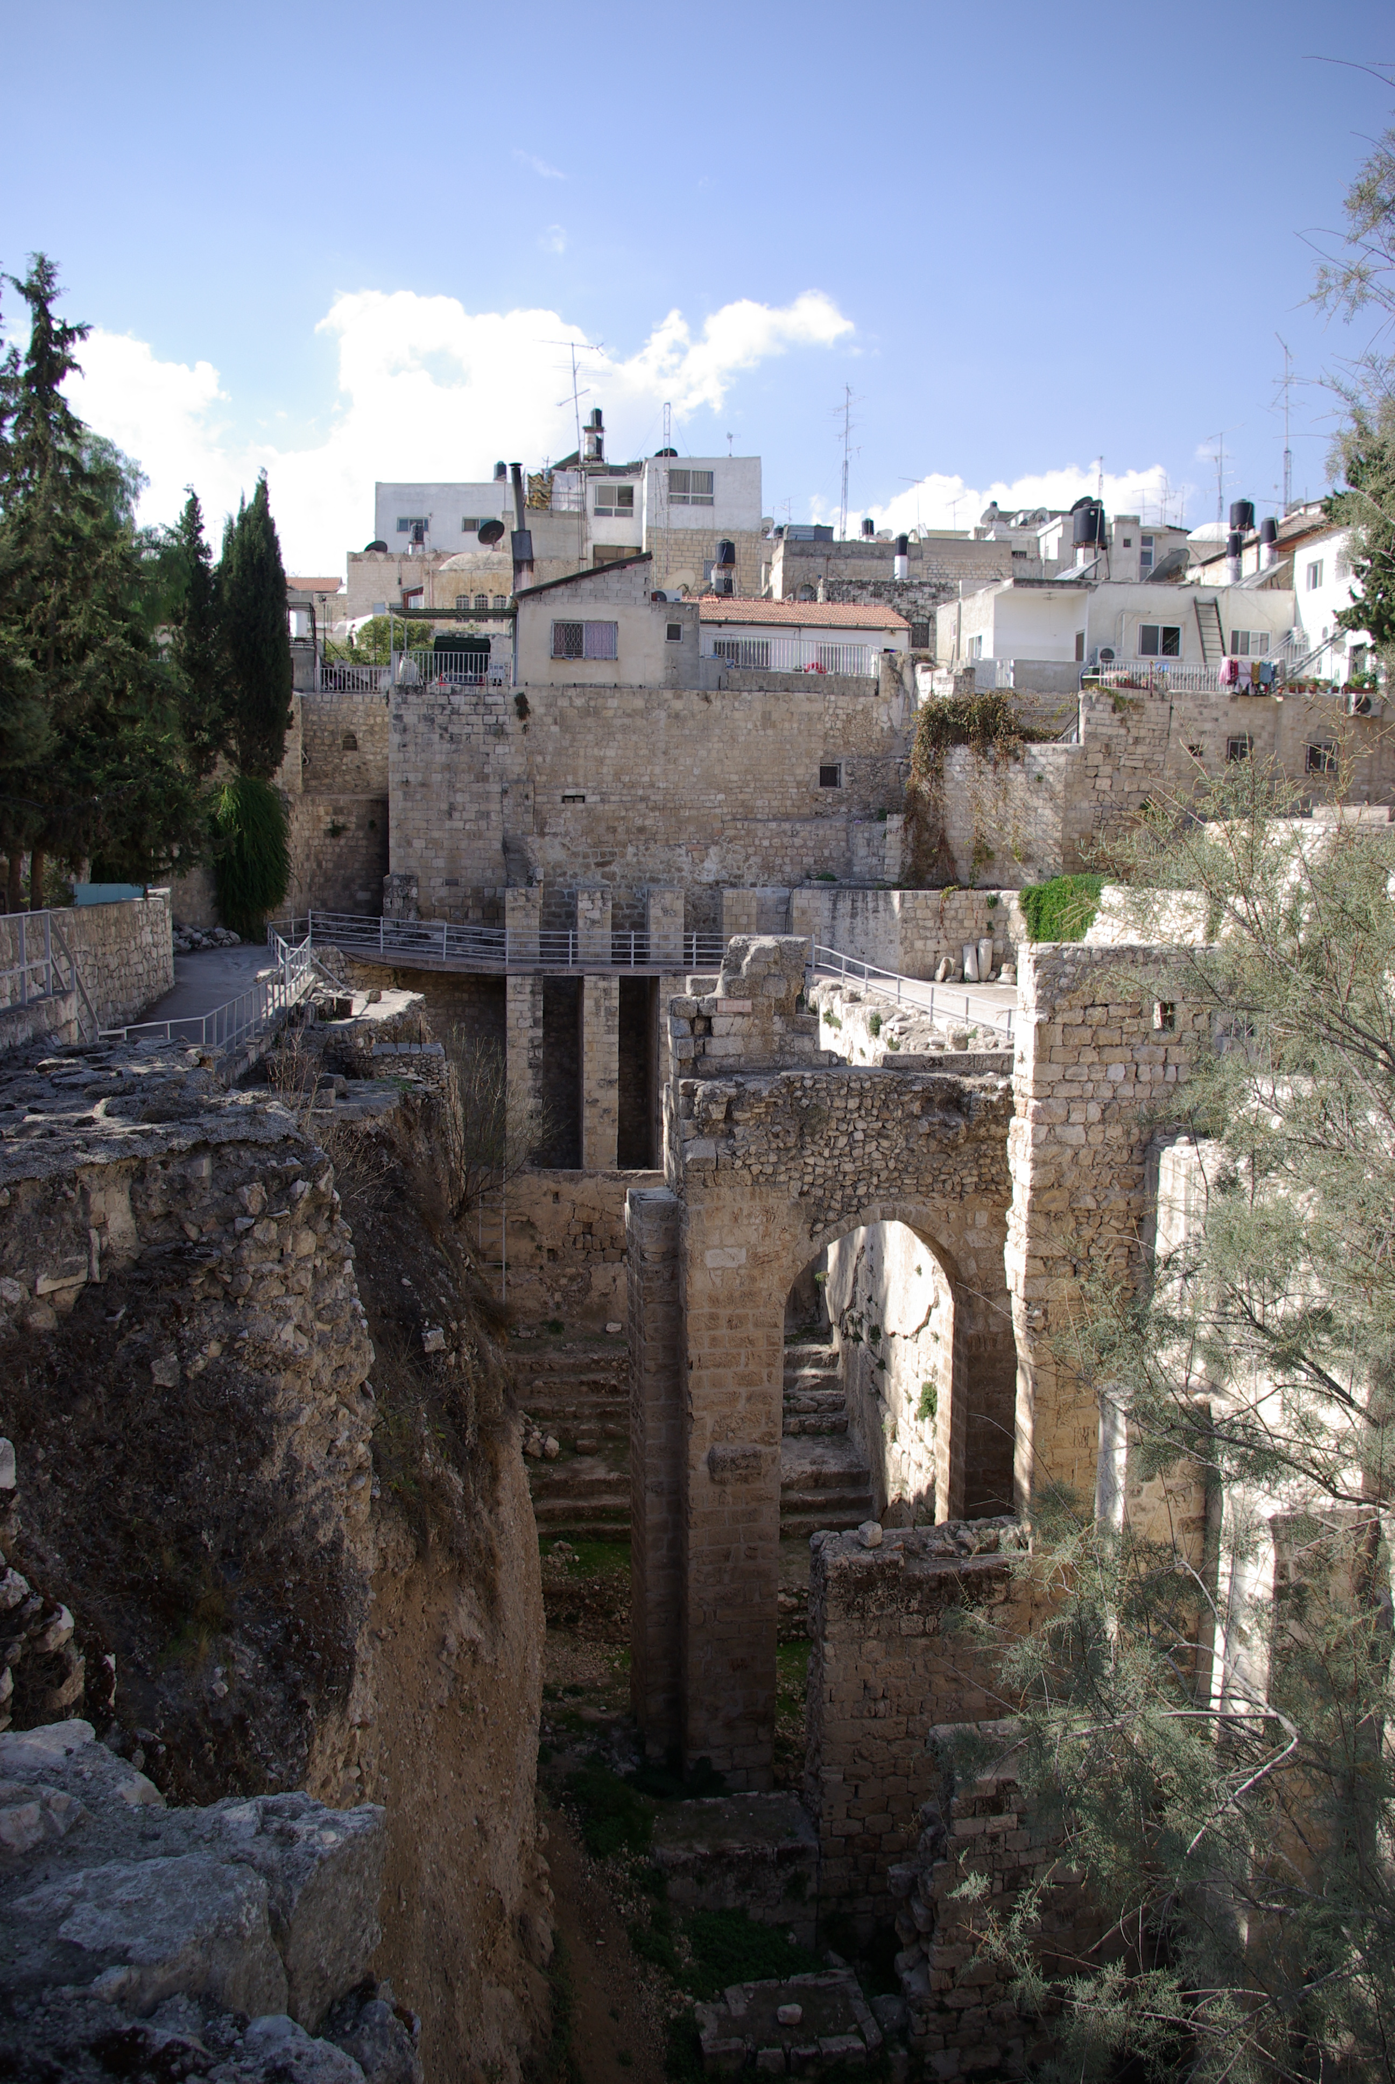

Slide 21
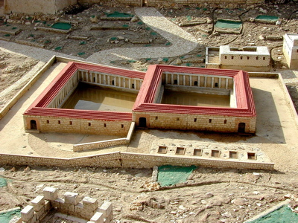

Slide 22
John 5:1-18
1 After this there was a feast of the Jews, and Jesus went up to Jerusalem.
2 Now there is in Jerusalem by the Sheep Gate a pool, which is called in Hebrew, Bethesda, having five porches.
3 In these lay a great multitude of sick people, blind, lame, paralyzed, waiting for the moving of the water.
4 For an angel went down at a certain time into the pool and stirred up the water; then whoever stepped in first, after the stirring of the water, was made well of whatever disease he had.

Slide 23
John 5:18
1 Therefore the Jews sought all the more to kill Him, because He not only broke the Sabbath . . .

Slide 24
John 5:1-18
1 After this there was a feast of the Jews, and Jesus went up to Jerusalem.
2 Now there is in Jerusalem by the Sheep Gate a pool, which is called in Hebrew, Bethesda, having five porches.
3 In these lay a great multitude of sick people, blind, lame, paralyzed, waiting for the moving of the water.
4 For an angel went down at a certain time into the pool and stirred up the water; then whoever stepped in first, after the stirring of the water, was made well of whatever disease he had.

Slide 25
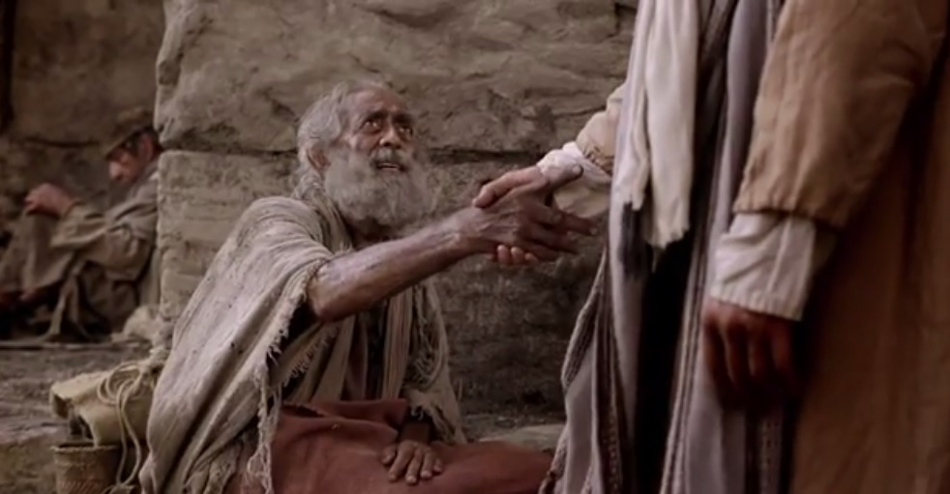

Slide 26
John 5:1-18
5 Now a certain man was there who had an infirmity thirty-eight years.
6 When Jesus saw him lying there, and knew that he already had been in that condition a long time, He said to him, “Do you want to be made well?”
7 The sick man answered Him, “Sir, I have no man to put me into the pool when the water is stirred up; but while I am coming, another steps down before me.”
8 Jesus said to him, “Rise, take up your bed and walk.”

Slide 27
John 5:1-18
9 And immediately the man was made well, took up his bed, and walked. And that day was the Sabbath.
10 The Jews therefore said to him who was cured,
“It is the Sabbath; it is not lawful for you to carry your bed.”
11 He answered them, “He who made me well said to me, ‘Take up your bed and walk.’”
12 Then they asked him, “Who is the Man who said to you, ‘Take up your bed and walk’?”

Slide 28
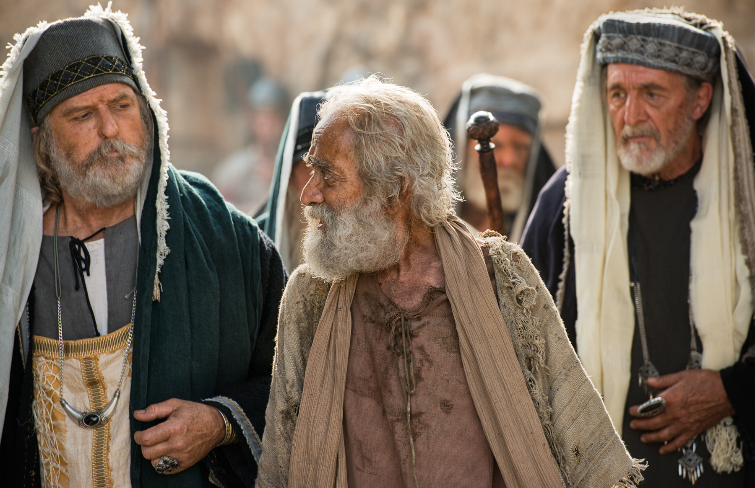

Slide 29
John 5:1-18
9 And immediately the man was made well, took up his bed, and walked. And that day was the Sabbath.
10 The Jews therefore said to him who was cured,
“It is the Sabbath; it is not lawful for you to carry your bed.”
11 He answered them, “He who made me well said to me, ‘Take up your bed and walk.’”
12 Then they asked him, “Who is the Man who said to you, ‘Take up your bed and walk’?”

Slide 30
John 5:1-18
13 But the one who was healed did not know who it was, for Jesus had withdrawn, a multitude being in that place.
14 Afterward Jesus found him in the temple, and said to him, “See, you have been made well. Sin no more, lest a worse thing come upon you.”
15 The man departed and told the Jews that it was Jesus who had made him well.
16 For this reason the Jews persecuted Jesus, and sought to kill Him, because He had done these things on the Sabbath.

Slide 31
John 9:1-3
1 Now as Jesus passed by, He saw a man who was blind from birth.
2 And His disciples asked Him, saying, “Rabbi, who sinned, this man or his parents, that he was born blind?”
3 Jesus answered, “Neither this man nor his parents sinned, but that the works of God should
be revealed in him.”

Slide 32
John 5:1-18
13 But the one who was healed did not know who it was, for Jesus had withdrawn, a multitude being in that place.
14 Afterward Jesus found him in the temple, and said to him, “See, you have been made well. Sin no more, lest a worse thing come upon you.”
15 The man departed and told the Jews that it was Jesus who had made him well.
16 For this reason the Jews persecuted Jesus, and sought to kill Him, because He had done these things on the Sabbath.

Slide 33
John 5:1-18
17 But Jesus answered them, “My Father has been working until now, and I have been working.”
18 Therefore the Jews sought all the more to kill Him, because He not only broke the Sabbath, but also said that God was His Father, making Himself equal with God.

Slide 34
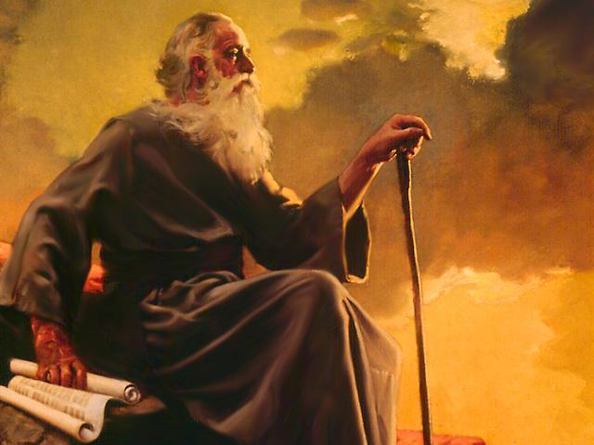

Slide 35
Miracles in John’s Gospel
• Changing water into wine (John 2:1-11) only John
• Healing the nobleman’s son (John 4:43-54) only John
• Healing at the Pool of Bethesda (John 5:1-9) only John
• Feeding of the 5,000 (John 6:1-5) all four Gospels
• Walking on the water (John 6:16-25) Matthew, Mark
• Healing the man born blind (John 9:1-41) only John
• Resurrection of Lazarus (John 11:1-44) only John
• Jesus’ resurrection, ascension (John 11:1-44) all four

Slide 36
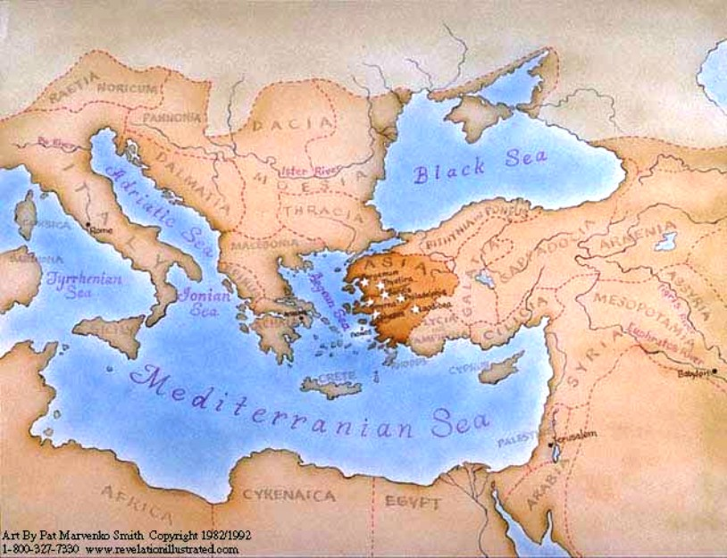

Slide 37
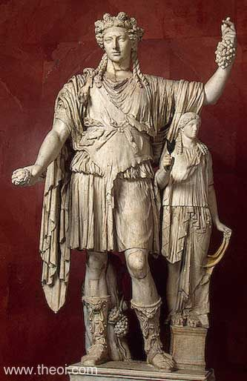
Dionysus,
god of wine

Slide 38
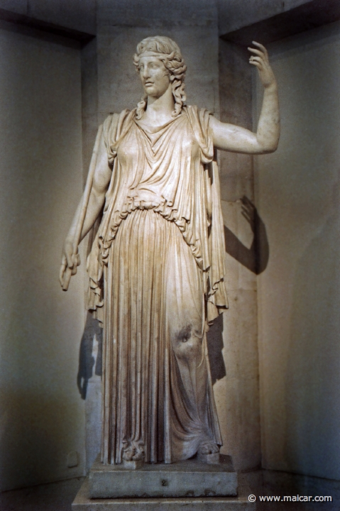
Demeter,
goddess
of grain
and bread

Slide 39
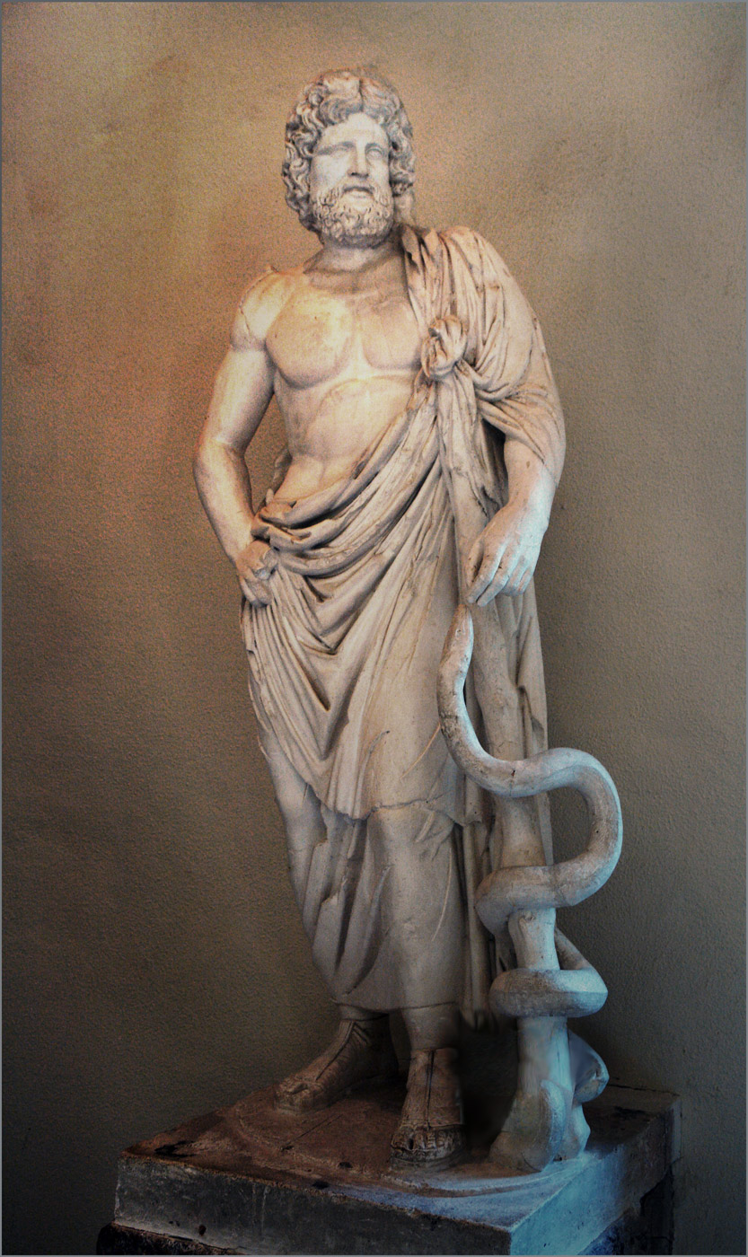
Asclepios,
god of healing

Slide 40
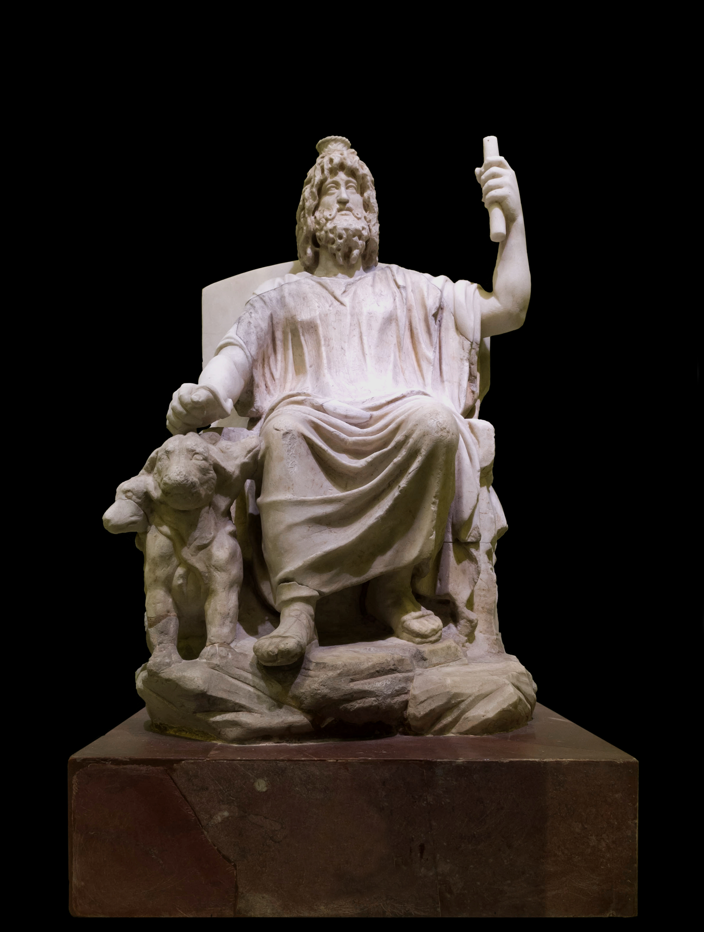
Serapis,
god who could heal sight

Slide 41
Asclepios,
god of healing

Slide 42
Asclepios,
god of healing

Slide 43
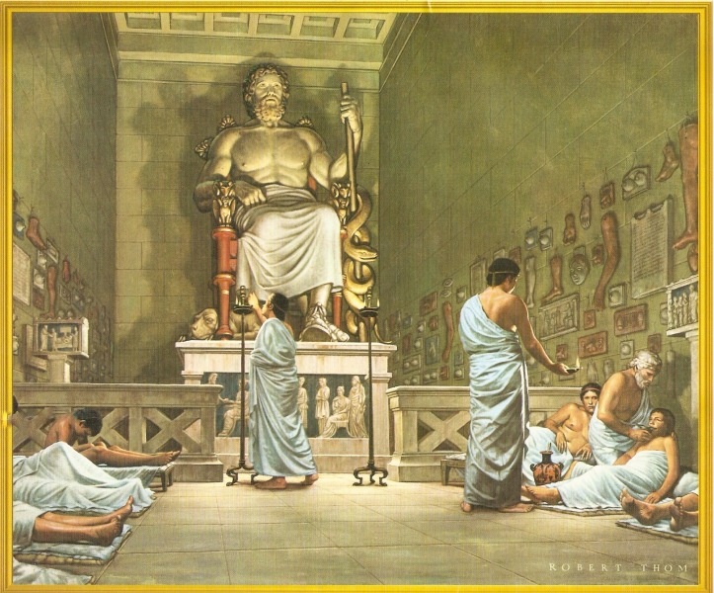

Slide 45
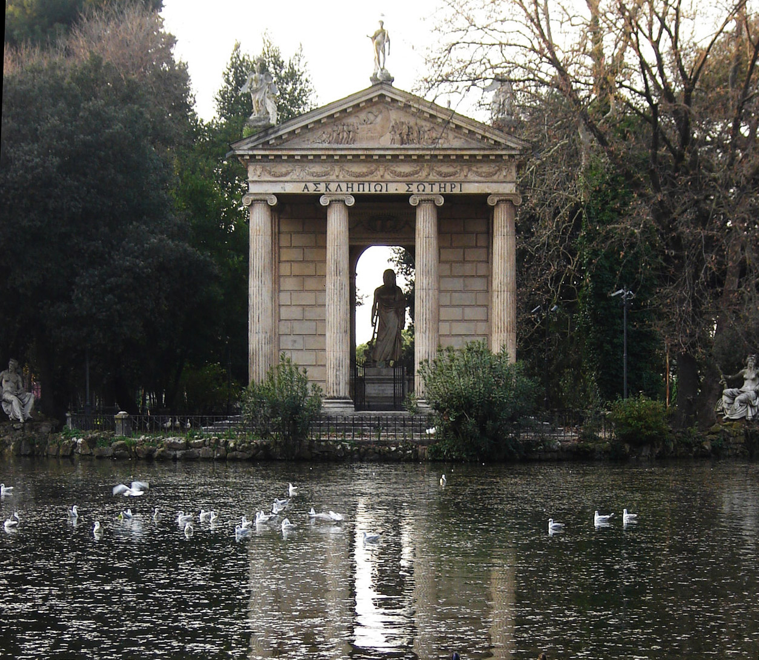

Slide 46
Miracles in John’s Gospel
• Changing water into wine (John 2:1-11) only John
• Healing the nobleman’s son (John 4:43-54) only John
• Healing at the Pool of Bethesda (John 5:1-9) only John
• Feeding of the 5,000 (John 6:1-5) all four Gospels
• Walking on the water (John 6:16-25) Matthew, Mark
• Healing the man born blind (John 9:1-41) only John
• Resurrection of Lazarus (John 11:1-44) only John
• Jesus’ resurrection, ascension (John 11:1-44) all four

Slide 47
Dionysus,
god of wine

Slide 48
Miracles in John’s Gospel
• Changing water into wine (John 2:1-11) only John
• Healing the nobleman’s son (John 4:43-54) only John
• Healing at the Pool of Bethesda (John 5:1-9) only John
• Feeding of the 5,000 (John 6:1-5) all four Gospels
• Walking on the water (John 6:16-25) Matthew, Mark
• Healing the man born blind (John 9:1-41) only John
• Resurrection of Lazarus (John 11:1-44) only John
• Jesus’ resurrection, ascension (John 11:1-44) all four

Slide 49
Asclepios,
god of healing

Slide 50
Miracles in John’s Gospel
• Changing water into wine (John 2:1-11) only John
• Healing the nobleman’s son (John 4:43-54) only John
• Healing at the Pool of Bethesda (John 5:1-9) only John
• Feeding of the 5,000 (John 6:1-5) all four Gospels
• Walking on the water (John 6:16-25) Matthew, Mark
• Healing the man born blind (John 9:1-41) only John
• Resurrection of Lazarus (John 11:1-44) only John
• Jesus’ resurrection, ascension (John 11:1-44) all four

Slide 52
Miracles in John’s Gospel
• Changing water into wine (John 2:1-11) only John
• Healing the nobleman’s son (John 4:43-54) only John
• Healing at the Pool of Bethesda (John 5:1-9) only John
• Feeding of the 5,000 (John 6:1-5) all four Gospels
• Walking on the water (John 6:16-25) Matthew, Mark
• Healing the man born blind (John 9:1-41) only John
• Resurrection of Lazarus (John 11:1-44) only John
• Jesus’ resurrection, ascension (John 11:1-44) all four

Slide 53
Demeter,
goddess
of grain
and bread

Slide 54
Miracles in John’s Gospel
• Changing water into wine (John 2:1-11) only John
• Healing the nobleman’s son (John 4:43-54) only John
• Healing at the Pool of Bethesda (John 5:1-9) only John
• Feeding of the 5,000 (John 6:1-5) all four Gospels
• Walking on the water (John 6:16-25) Matthew, Mark
• Healing the man born blind (John 9:1-41) only John
• Resurrection of Lazarus (John 11:1-44) only John
• Jesus’ resurrection, ascension (John 11:1-44) all four

Slide 55
Asclepios,
god of healing

Slide 56
Miracles in John’s Gospel
• Changing water into wine (John 2:1-11) only John
• Healing the nobleman’s son (John 4:43-54) only John
• Healing at the Pool of Bethesda (John 5:1-9) only John
• Feeding of the 5,000 (John 6:1-5) all four Gospels
• Walking on the water (John 6:16-25) Matthew, Mark
• Healing the man born blind (John 9:1-41) only John
• Resurrection of Lazarus (John 11:1-44) only John
• Jesus’ resurrection, ascension (John 11:1-44) all four

Slide 57
Serapis,
god who could heal sight

Slide 58
Miracles in John’s Gospel
• Changing water into wine (John 2:1-11) only John
• Healing the nobleman’s son (John 4:43-54) only John
• Healing at the Pool of Bethesda (John 5:1-9) only John
• Feeding of the 5,000 (John 6:1-5) all four Gospels
• Walking on the water (John 6:16-25) Matthew, Mark
• Healing the man born blind (John 9:1-41) only John
• Resurrection of Lazarus (John 11:1-44) only John
• Jesus’ resurrection, ascension (John 11:1-44) all four

Slide 59
Asclepios,
god of healing

Slide 60
Miracles in John’s Gospel
• Changing water into wine (John 2:1-11) only John
• Healing the nobleman’s son (John 4:43-54) only John
• Healing at the Pool of Bethesda (John 5:1-9) only John
• Feeding of the 5,000 (John 6:1-5) all four Gospels
• Walking on the water (John 6:16-25) Matthew, Mark
• Healing the man born blind (John 9:1-41) only John
• Resurrection of Lazarus (John 11:1-44) only John
• Jesus’ resurrection, ascension (John 11:1-44) all four

Slide 61
Asclepios,
god of healing

Slide 64
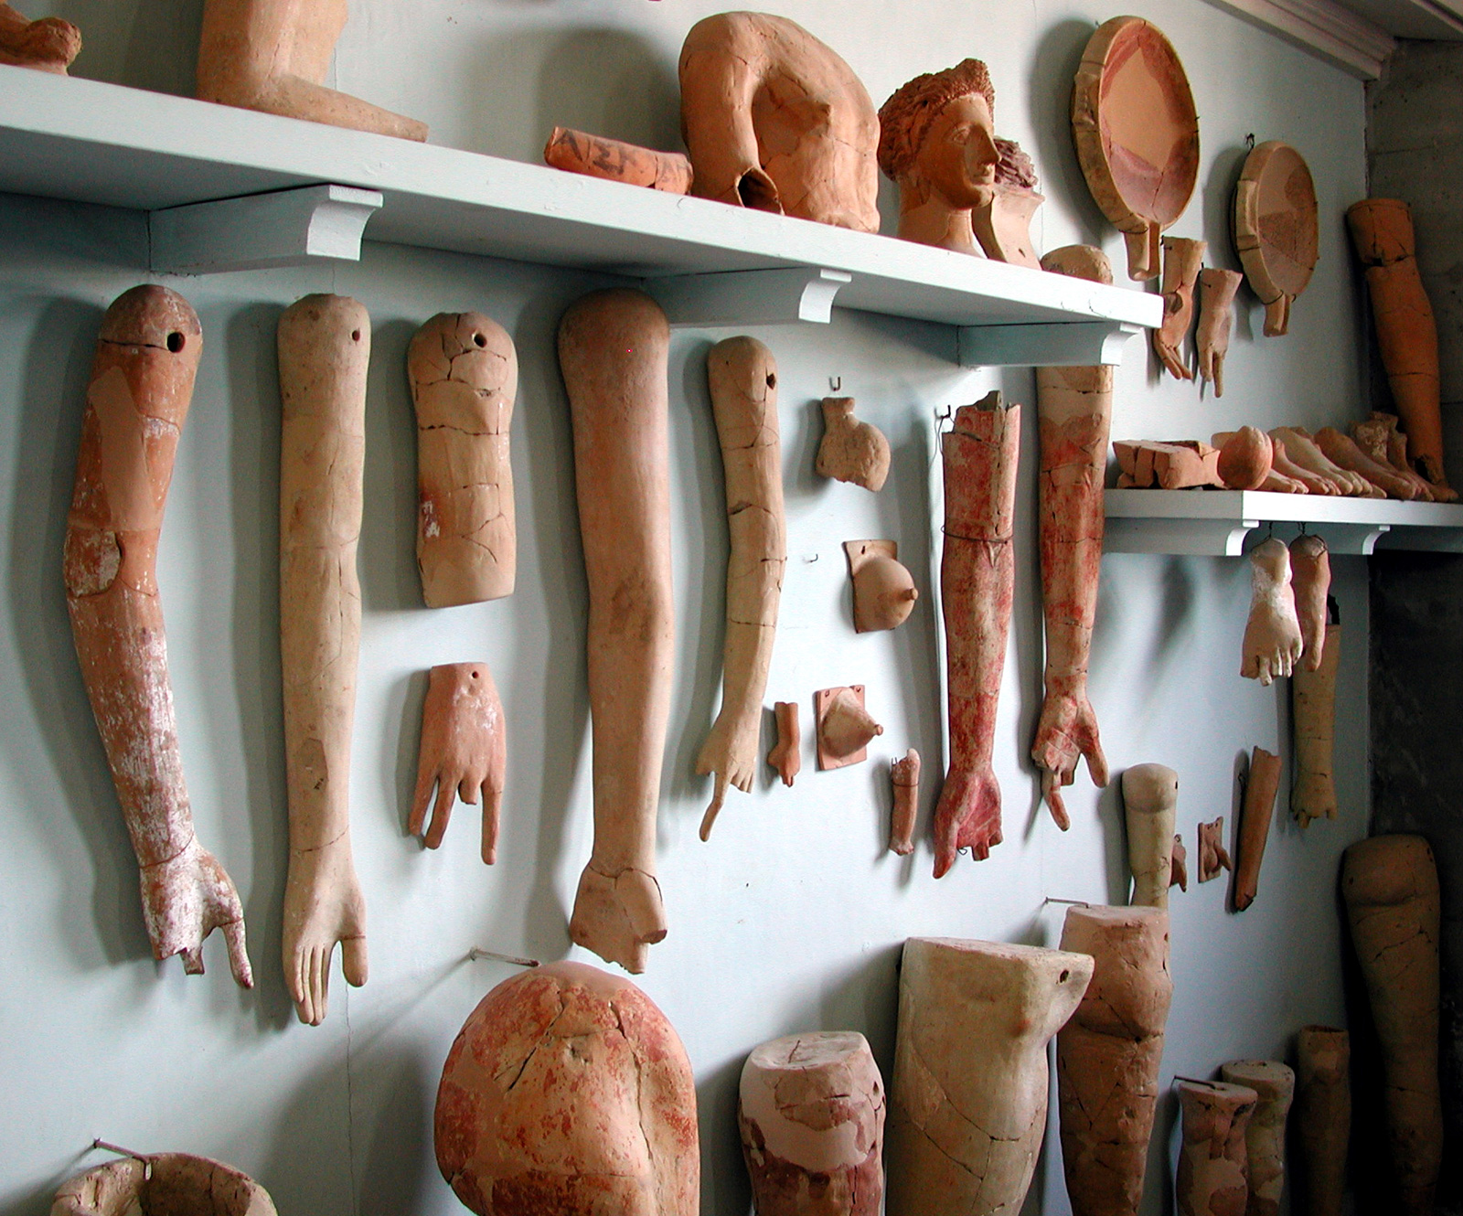

Slide 65
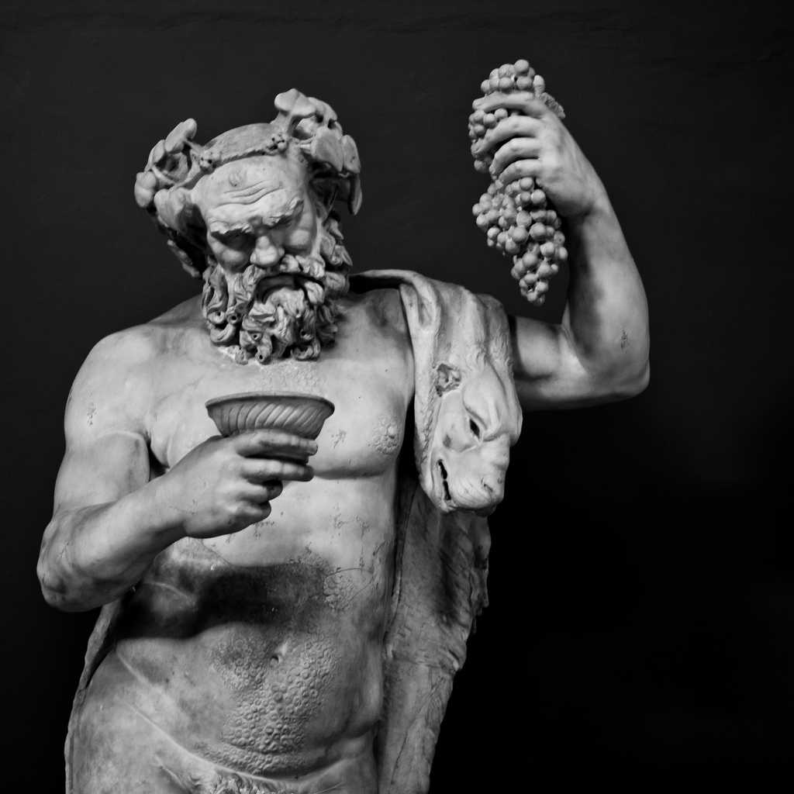

Slide 66
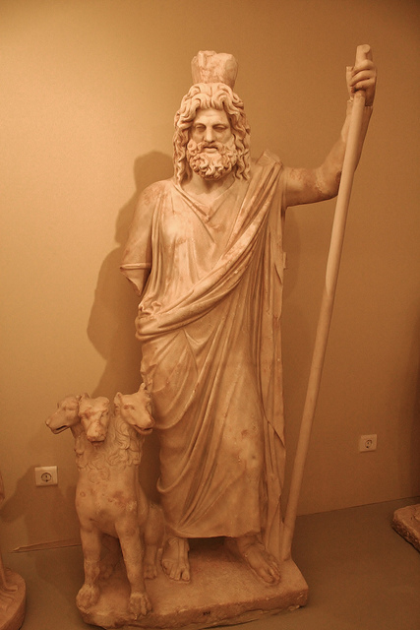

Slide 67
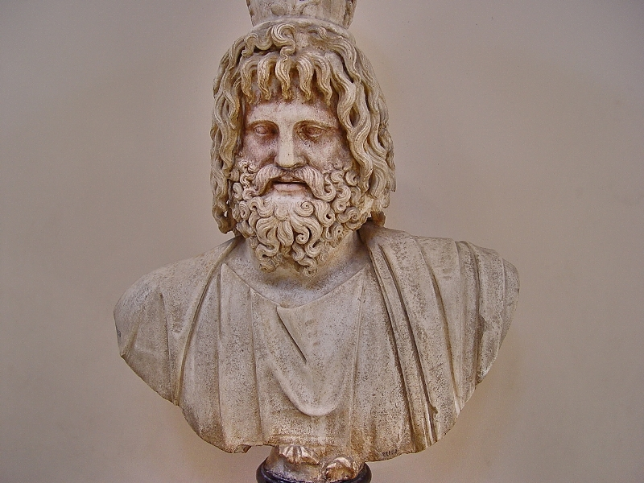

Slide 68
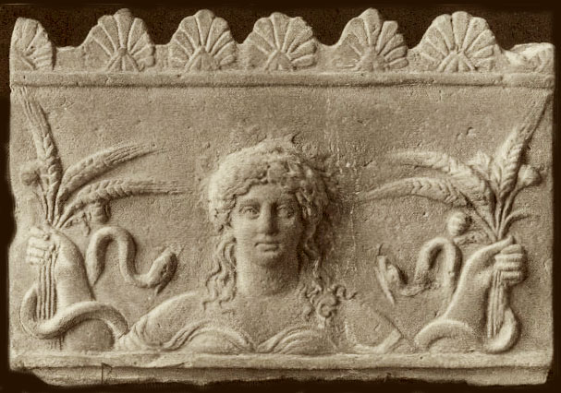

Slide 69
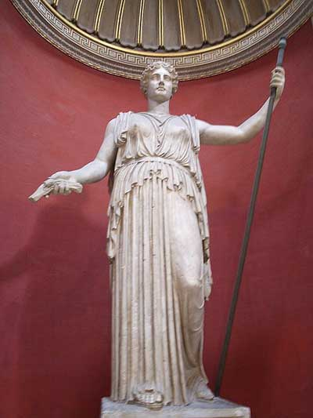

Slide 70
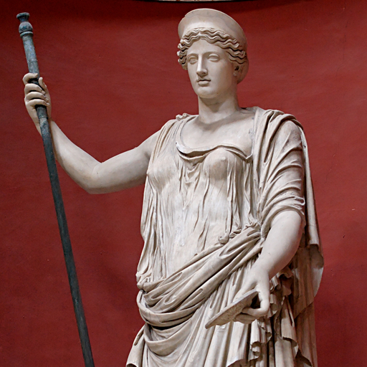

Slide 71
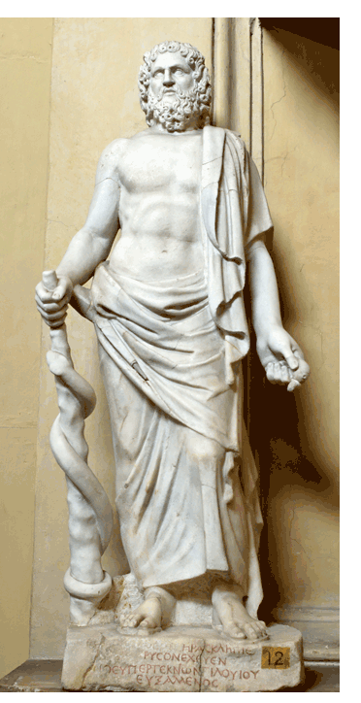

Slide 72
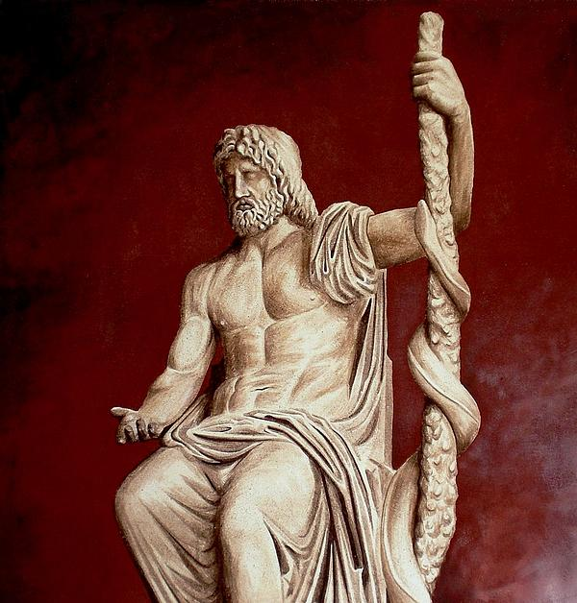

Slide 74
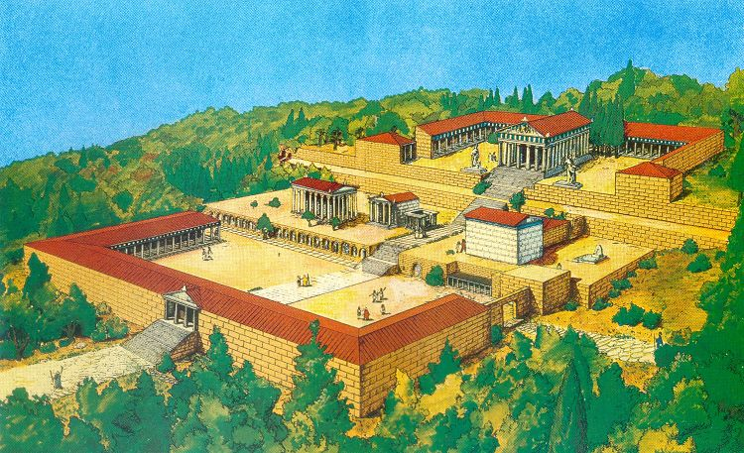

Slide 75
John 5:1-16
1 After this there was a feast of the Jews, and Jesus went up to Jerusalem.
2 Now there is in Jerusalem by the Sheep Gate a pool, which is called in Hebrew, Bethesda, having five porches.
3 In these lay a great multitude of sick people, blind, lame, paralyzed, waiting for the moving of the water.
4 For an angel went down at a certain time into the pool and stirred up the water; then whoever stepped in first, after the stirring of the water, was made well of whatever disease he had.
5 Now a certain man was there who had an infirmity thirty-eight years.
6 When Jesus saw him lying there, and knew that he already had been in that condition a long time, He said to him, “Do you want to be made well?”
7 The sick man answered Him, “Sir, I have no man to put me into the pool when the water is stirred up; but while I am coming, another steps down before me.”
8 Jesus said to him, “Rise, take up your bed and walk.”
9 And immediately the man was made well, took up his bed, and walked. And that day was the Sabbath.
10 The Jews therefore said to him who was cured, “It is the Sabbath; it is not lawful for you to carry your bed.”
11 He answered them, “He who made me well said to me, ‘Take up your bed and walk.’”
12 Then they asked him, “Who is the Man who said to you, ‘Take up your bed and walk’?”
13 But the one who was healed did not know who it was, for Jesus had withdrawn, a multitude being in that place.
14 Afterward Jesus found him in the temple, and said to him, “See, you have been made well. Sin no more, lest a worse thing come upon you.”
15 The man departed and told the Jews that it was Jesus who had made him well.
16 For this reason the Jews persecuted Jesus, and sought to kill Him, because He had done these things on the Sabbath.

Slide 76
John 5:1-16
1 After this there was a feast of the Jews, and Jesus went up to Jerusalem.
2 Now there is in Jerusalem by the Sheep Gate a pool, which is called in Hebrew, Bethesda, having five porches.
3 In these lay a great multitude of sick people, blind, lame, paralyzed, waiting for the moving of the water.
4 For an angel went down at a certain time into the pool and stirred up the water; then whoever stepped in first, after the stirring of the water, was made well of whatever disease he had.
5 Now a certain man was there who had an infirmity thirty-eight years.
6 When Jesus saw him lying there, and knew that he already had been in that condition a long time, He said to him, “Do you want to be made well?”
7 The sick man answered Him, “Sir, I have no man to put me into the pool when the water is stirred up; but while I am coming, another steps down before me.”
8 Jesus said to him, “Rise, take up your bed and walk.”
9 And immediately the man was made well, took up his bed, and walked. And that day was the Sabbath.
10 The Jews therefore said to him who was cured, “It is the Sabbath; it is not lawful for you to carry your bed.”
11 He answered them, “He who made me well said to me, ‘Take up your bed and walk.’”
12 Then they asked him, “Who is the Man who said to you, ‘Take up your bed and walk’?”
13 But the one who was healed did not know who it was, for Jesus had withdrawn, a multitude being in that place.
14 Afterward Jesus found him in the temple, and said to him, “See, you have been made well. Sin no more, lest a worse thing come upon you.”
15 The man departed and told the Jews that it was Jesus who had made him well.
16 For this reason the Jews persecuted Jesus, and sought to kill Him, because He had done these things on the Sabbath.

Slide 77
John 5:1-16
1 After this there was a feast of the Jews, and Jesus went up to Jerusalem.
2 Now there is in Jerusalem by the Sheep Gate a pool, which is called in Hebrew, Bethesda, having five porches.
3 In these lay a great multitude of sick people, blind, lame, paralyzed, waiting for the moving of the water.
4 For an angel went down at a certain time into the pool and stirred up the water; then whoever stepped in first, after the stirring of the water, was made well of whatever disease he had.
5 Now a certain man was there who had an infirmity thirty-eight years.
6 When Jesus saw him lying there, and knew that he already had been in that condition a long time, He said to him, “Do you want to be made well?”
7 The sick man answered Him, “Sir, I have no man to put me into the pool when the water is stirred up; but while I am coming, another steps down before me.”
8 Jesus said to him, “Rise, take up your bed and walk.”
9 And immediately the man was made well, took up his bed, and walked. And that day was the Sabbath.
10 The Jews therefore said to him who was cured, “It is the Sabbath; it is not lawful for you to carry your bed.”
11 He answered them, “He who made me well said to me, ‘Take up your bed and walk.’”
12 Then they asked him, “Who is the Man who said to you, ‘Take up your bed and walk’?”
13 But the one who was healed did not know who it was, for Jesus had withdrawn, a multitude being in that place.
14 Afterward Jesus found him in the temple, and said to him, “See, you have been made well. Sin no more, lest a worse thing come upon you.”
15 The man departed and told the Jews that it was Jesus who had made him well.
16 For this reason the Jews persecuted Jesus, and sought to kill Him, because He had done these things on the Sabbath.

Slide 78
John 5:1-16
1 After this there was a feast of the Jews, and Jesus went up to Jerusalem.
2 Now there is in Jerusalem by the Sheep Gate a pool, which is called in Hebrew, Bethesda, having five porches.
3 In these lay a great multitude of sick people, blind, lame, paralyzed, waiting for the moving of the water.
4 For an angel went down at a certain time into the pool and stirred up the water; then whoever stepped in first, after the stirring of the water, was made well of whatever disease he had.
5 Now a certain man was there who had an infirmity thirty-eight years.
6 When Jesus saw him lying there, and knew that he already had been in that condition a long time, He said to him, “Do you want to be made well?”
7 The sick man answered Him, “Sir, I have no man to put me into the pool when the water is stirred up; but while I am coming, another steps down before me.”
8 Jesus said to him, “Rise, take up your bed and walk.”
9 And immediately the man was made well, took up his bed, and walked. And that day was the Sabbath.
10 The Jews therefore said to him who was cured, “It is the Sabbath; it is not lawful for you to carry your bed.”
11 He answered them, “He who made me well said to me, ‘Take up your bed and walk.’”
12 Then they asked him, “Who is the Man who said to you, ‘Take up your bed and walk’?”
13 But the one who was healed did not know who it was, for Jesus had withdrawn, a multitude being in that place.
14 Afterward Jesus found him in the temple, and said to him, “See, you have been made well. Sin no more, lest a worse thing come upon you.”
15 The man departed and told the Jews that it was Jesus who had made him well.
16 For this reason the Jews persecuted Jesus, and sought to kill Him, because He had done these things on the Sabbath.

Slide 79
John 5:1-16
1 After this there was a feast of the Jews, and Jesus went up to Jerusalem.
2 Now there is in Jerusalem by the Sheep Gate a pool, which is called in Hebrew, Bethesda, having five porches.
3 In these lay a great multitude of sick people, blind, lame, paralyzed, waiting for the moving of the water.
4 For an angel went down at a certain time into the pool and stirred up the water; then whoever stepped in first, after the stirring of the water, was made well of whatever disease he had.
5 Now a certain man was there who had an infirmity thirty-eight years.
6 When Jesus saw him lying there, and knew that he already had been in that condition a long time, He said to him, “Do you want to be made well?”
7 The sick man answered Him, “Sir, I have no man to put me into the pool when the water is stirred up; but while I am coming, another steps down before me.”
8 Jesus said to him, “Rise, take up your bed and walk.”
9 And immediately the man was made well, took up his bed, and walked. And that day was the Sabbath.
10 The Jews therefore said to him who was cured, “It is the Sabbath; it is not lawful for you to carry your bed.”
11 He answered them, “He who made me well said to me, ‘Take up your bed and walk.’”
12 Then they asked him, “Who is the Man who said to you, ‘Take up your bed and walk’?”
13 But the one who was healed did not know who it was, for Jesus had withdrawn, a multitude being in that place.
14 Afterward Jesus found him in the temple, and said to him, “See, you have been made well. Sin no more, lest a worse thing come upon you.”
15 The man departed and told the Jews that it was Jesus who had made him well.
16 For this reason the Jews persecuted Jesus, and sought to kill Him, because He had done these things on the Sabbath.

Slide 80
John 5:1-16
1 After this there was a feast of the Jews, and Jesus went up to Jerusalem.
2 Now there is in Jerusalem by the Sheep Gate a pool, which is called in Hebrew, Bethesda, having five porches.
3 In these lay a great multitude of sick people, blind, lame, paralyzed, waiting for the moving of the water.
4 For an angel went down at a certain time into the pool and stirred up the water; then whoever stepped in first, after the stirring of the water, was made well of whatever disease he had.
5 Now a certain man was there who had an infirmity thirty-eight years.
6 When Jesus saw him lying there, and knew that he already had been in that condition a long time, He said to him, “Do you want to be made well?”
7 The sick man answered Him, “Sir, I have no man to put me into the pool when the water is stirred up; but while I am coming, another steps down before me.”
8 Jesus said to him, “Rise, take up your bed and walk.”
9 And immediately the man was made well, took up his bed, and walked. And that day was the Sabbath.
10 The Jews therefore said to him who was cured, “It is the Sabbath; it is not lawful for you to carry your bed.”
11 He answered them, “He who made me well said to me, ‘Take up your bed and walk.’”
12 Then they asked him, “Who is the Man who said to you, ‘Take up your bed and walk’?”
13 But the one who was healed did not know who it was, for Jesus had withdrawn, a multitude being in that place.
14 Afterward Jesus found him in the temple, and said to him, “See, you have been made well. Sin no more, lest a worse thing come upon you.”
15 The man departed and told the Jews that it was Jesus who had made him well.
16 For this reason the Jews persecuted Jesus, and sought to kill Him, because He had done these things on the Sabbath.

Slide 82
Mark 2:21-22
21 “No one sews a piece of unshrunk cloth on an old garment; or else the new piece pulls away from the old, and the tear is made worse.
22 “And no one puts new wine into old wineskins; or else the new wine bursts the wineskins, the wine is spilled, and the wineskins are ruined. But new wine must be put into new wineskins.”

Slide 83
Four key questions for us:
What does this teach us about the nature and character of God?
What does this teach us about the way God interacts with His people and mankind?
What does this mean for your relationship with
God the Father and Jesus Christ?
What does this teach us about Satan, the adversary of God and mankind?

Slide 84
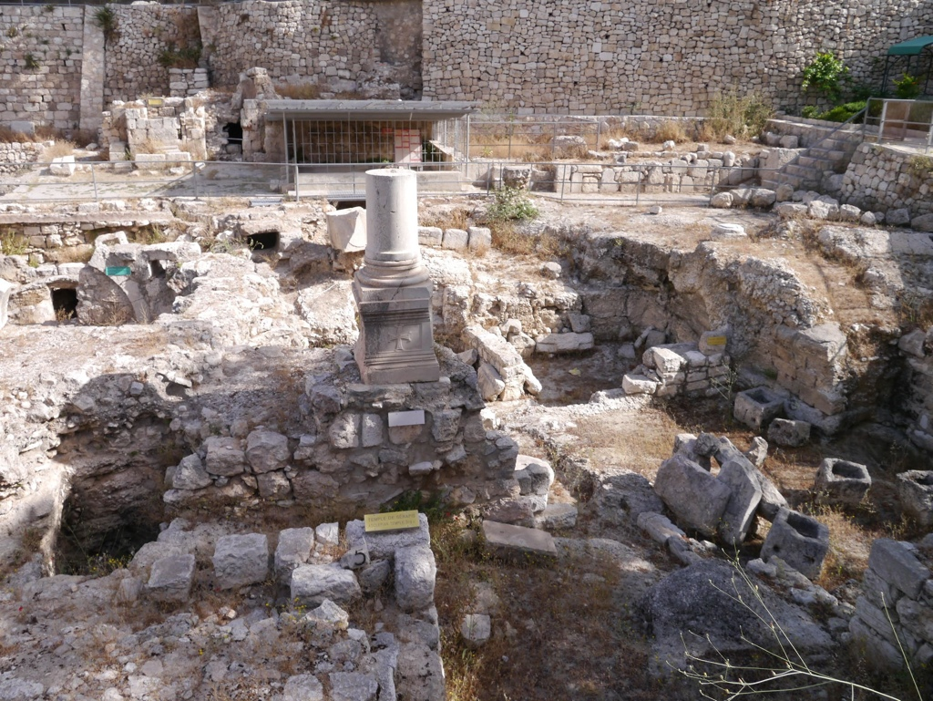

Slide 85
