Slide 1



Slide 2
The Gospels
The Background
and Calling
of Matthew

Slide 3
Purpose of Matthew’s Gospel
The Jews at that time expected a Messiah. Matthew’s main purpose in writing his Gospel is to prove to Jewish readers that Jesus is their promised Messiah. He does this primarily by showing how Jesus in His life and ministry fulfilled the Scriptures pointing to the Messiah. Matthew also emphasizes Jesus being a descendant of King David, as the Messiah was to be.

Slide 4
Structure of Matthew’s Gospel
Organized around five great discourses:
• The sermon on the mount in chapters 5-7.
• The commission to the 12 disciples in chapter 10.
• The parables of the Kingdom in chapter 13.
• The necessity for humility and forgiveness in chapter 18.
• The Olivet Prophecy in chapters 24-25.
Matthew ends each discourse with “When Jesus had finished saying these things,” or similar words.

Slide 5
Matthew’s name
Matthew (Hebrew Mattityahu) means “gift of God.”
Shortened form of Mattityahu is Mattayi, from which we get “Matthew.”
Matthew was a “gift of God,” because from him
we get his Gospel, which is the most detailed
record of the life of Jesus the Messiah. That has
been a great gift to all of mankind.

Slide 6
Matthew written to Hebrews
• Matthew’s emphasis on fulfillment of prophecy.
• His tracing of Jesus’ descent from Abraham
(Matthew 1:1–17).
• His lack of explanation of Jewish customs.
• His use of Jewish terminology such as “kingdom of heaven.”
• His emphasis on Jesus’ role as “Son of David.”
• This does not mean that Matthew restricts his Gospel to Jews. It has a universal outlook.

Slide 7
Matthew 1:1
1 The book of the genealogy of Jesus Christ,
the Son of David, the Son of Abraham:

Slide 8
Source documents in Genesis

Slide 9
Source documents in Genesis
Genesis 2:4 This is the history [genealogy] of the heavens and the earth when they were created.
Genesis 5:1 This is the book of the genealogy
of Adam.
Genesis 6:9 This is the genealogy of Noah.
Genesis 10:1 Now this is the genealogy of the sons of Noah: Shem, Ham, and Japheth.
Genesis 11:10 This is the genealogy of Shem.
Genesis 11:27 This is the genealogy of Terah.
Genesis 25:12 This is the genealogy of Ishmael, Abraham’s son.

Slide 10
Source documents in Genesis
Genesis 25:19 This is the genealogy of Isaac, Abraham’s son.
Genesis 36:1 This is the genealogy of Esau,
who is Edom.
Genesis 36:9 This is the genealogy of Esau the father of the Edomites in Mount Seir.
Genesis 37:2 This is the history [genealogy] of Jacob.

Slide 11
Source documents in Genesis
Genesis 25:19 This is the genealogy of Isaac, Abraham’s son.
Genesis 36:1 This is the genealogy of Esau,
who is Edom.
Genesis 36:9 This is the genealogy of Esau the father of the Edomites in Mount Seir.
Genesis 37:2 This is the history [genealogy] of Jacob.
(read more at ucg.org/brp: introduction to Genesis)

Slide 12
Source documents in Genesis
Genesis 25:19 This is the genealogy of Isaac, Abraham’s son.
Genesis 36:1 This is the genealogy of Esau,
who is Edom.
Genesis 36:9 This is the genealogy of Esau the father of the Edomites in Mount Seir.
Genesis 37:2 This is the history [genealogy] of Jacob.
(read more at ucg.org/brp: introduction to Genesis)
Matthew 1:1 The book of the genealogy of Jesus Christ, the Son of David, the Son of Abraham.

Slide 13
Matthew 1:1-17
• Tamar
• Rahab
• Ruth
• Bathsheba
• Mary

Slide 14
Matthew 1:1-17
• Tamar (gentile, adulteress)
• Rahab (gentile, prostitute)
• Ruth (gentile)
• Bathsheba (gentile, adulteress)
• Mary, mother of Jesus

Slide 15
Galatians 3:28
There is neither Jew nor Greek, there is neither slave nor free, there is neither male nor female; for you are all one in Christ Jesus.

Slide 16
The Messiah would descend from…
Abraham Genesis 22:18—In your seed all the nations of the earth shall be blessed . . .
Jacob Numbers 24:17—A Star shall come out of Jacob; A Scepter shall rise out of Israel . . .
Judah Genesis 49:10—The scepter shall not depart from Judah, Nor a lawgiver from between his feet, Until Shiloh comes . . .

Slide 17
The Messiah would descend from…
Jesse Isaiah 11:1—There shall come forth a Rod from the stem of Jesse, And a Branch shall grow out of his roots.
David 2 Samuel 7:13 —I will establish the throne of his [David’s] kingdom forever.

Slide 18
The Messiah would descend from…
Zerubbabel Haggai 2:22-23—I will overthrow the throne of kingdoms; I will destroy the strength of the Gentile kingdoms. I will overthrow the chariots And those who ride in them; the horses and their riders shall come down, every one by the sword of his brother.
23 ‘In that day,’ says the LORD of hosts, ‘I will take you, Zerubbabel My servant, the son of Shealtiel,’ says the LORD, ‘and will make you like
a signet ring; for I have chosen you,’ says the LORD of hosts.

Slide 19
Matthew shows Jesus
is descended from…
Abraham, Jacob and Judah in Matthew 1:2,
Jesse and David in Matthew 1:5-6,
Zerubbabel in Matthew 1:12-13.

Slide 20
Matthew 1:17
17 So all the generations from Abraham to David are fourteen generations, from David until the captivity in Babylon are fourteen generations, and from the captivity in Babylon until the Christ are fourteen generations.

Slide 21
Matthew 1:17
17 So all the generations from Abraham to David are fourteen generations, from David until the captivity in Babylon are fourteen generations, and from the captivity in Babylon until the Christ are fourteen generations.
Roman numerals: I = 1, V = 5, X = 10, L = 50,
C = 100, D = 500, M = 1,000

Slide 22
Matthew 1:17
17 So all the generations from Abraham to David are fourteen generations, from David until the captivity in Babylon are fourteen generations, and from the captivity in Babylon until the Christ are fourteen generations.
Roman numerals: I = 1, V = 5, X = 10, L = 50,
C = 100, D = 500, M = 1,000
Hebrew numerals: A = 1, B = 2,… D = 4, V = 6

Slide 23
Matthew 1:17
17 So all the generations from Abraham to David are fourteen generations, from David until the captivity in Babylon are fourteen generations, and from the captivity in Babylon until the Christ are fourteen generations.

Slide 24
Matthew 1:17
17 So all the generations from Abraham to David are fourteen generations, from David until the captivity in Babylon are fourteen generations, and from the captivity in Babylon until the Christ are fourteen generations.
Roman numerals: I = 1, V = 5, X = 10, L = 50,
C = 100, D = 500, M = 1,000
Hebrew numerals: A = 1, B = 2,… D = 4, V = 6
David = D-V-D

Slide 25
Matthew 1:17
17 So all the generations from Abraham to David are fourteen generations, from David until the captivity in Babylon are fourteen generations, and from the captivity in Babylon until the Christ are fourteen generations.
Roman numerals: I = 1, V = 5, X = 10, L = 50,
C = 100, D = 500, M = 1,000
Hebrew numerals: A = 1, B = 2,… D = 4, V = 6
David = D-V-D D = 4, V = 6, D = 4

Slide 26
Matthew 1:17
17 So all the generations from Abraham to David are fourteen generations, from David until the captivity in Babylon are fourteen generations, and from the captivity in Babylon until the Christ are fourteen generations.
Roman numerals: I = 1, V = 5, X = 10, L = 50,
C = 100, D = 500, M = 1,000
Hebrew numerals: A = 1, B = 2,… D = 4, V = 6
David = D-V-D D = 4, V = 6, D = 4 D-V-D = 14

Slide 27
Matthew 1:17
17 So all the generations from Abraham to David are fourteen generations, from David until the captivity in Babylon are fourteen generations, and from the captivity in Babylon until the Christ are fourteen generations.

Slide 28
Matthew 1:17
17 So all the generations from Abraham to David are fourteen generations, from David until the captivity in Babylon are fourteen generations, and from the captivity in Babylon until the Christ are fourteen generations.
Roman numerals: I = 1, V = 5, X = 10, L = 50,
C = 100, D = 500, M = 1,000
Hebrew numerals: A = 1, B = 2,… D = 4, V = 6
David = D-V-D D = 4, V = 6, D = 4 DVD = 14
DAVID DAVID DAVID

Slide 29
Quote from Papias, ca. A.D. 130
“Matthew collected the oracles [logia, meaning words or sayings] in the Hebrew language [literally tongue or dialect], and each interpreted them as best he could.”

Slide 30
Matthew 9:9
As Jesus passed on from there, He saw a man named Matthew sitting at the tax office. And He said to him, “Follow Me.” So he arose and followed Him.

Slide 31
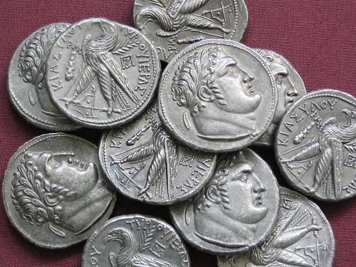

Slide 32
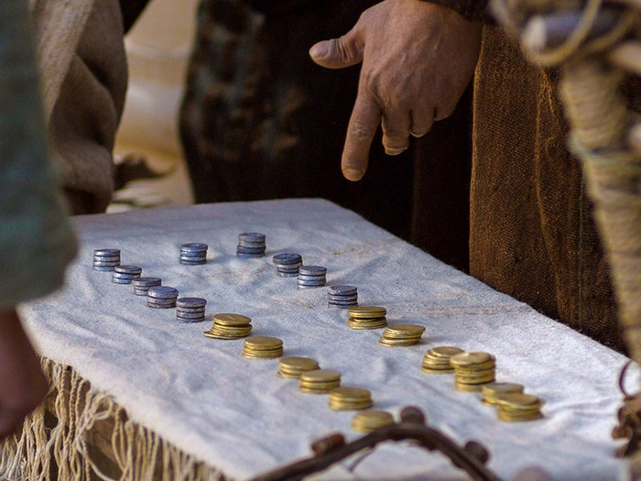

Slide 33
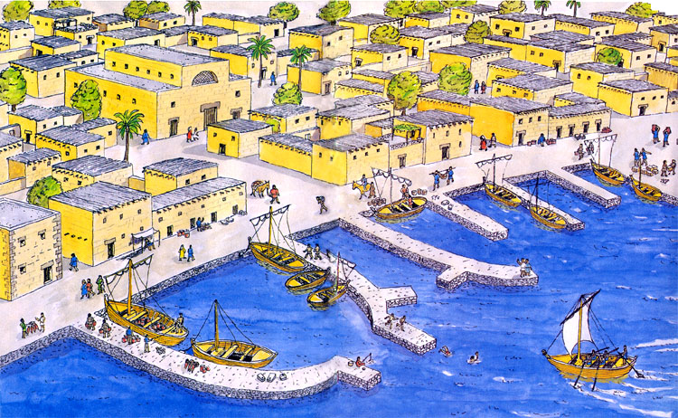

Slide 34
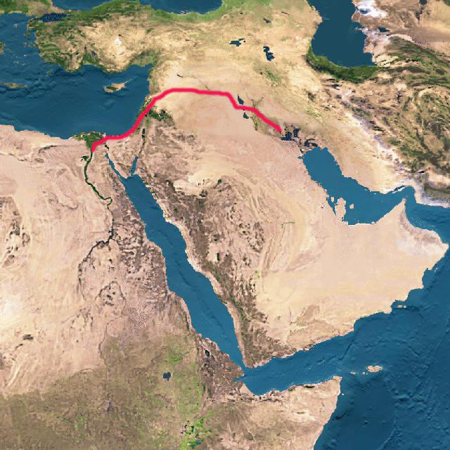

Slide 35
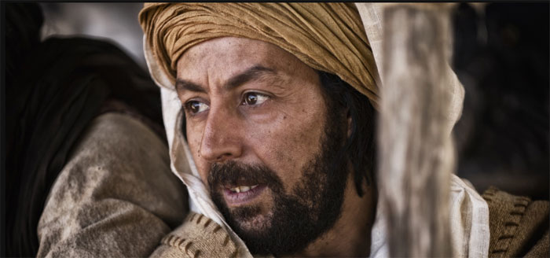

Slide 36
Luke 8:1-3
1 . . . He [Jesus] went through every city and village, preaching and bringing the glad tidings of the kingdom of God. And the twelve were with Him,
2 and certain women who had been healed of evil spirits and infirmities—Mary called Magdalene, out of whom had come seven demons,
3 and Joanna the wife of Chuza, Herod’s steward, and Susanna, and many others who provided for Him from their substance.

Slide 37
How tax collectors were viewed
Matthew 9:10-11: “tax collectors and sinners”
Matthew 11:19: “a glutton and a winebibber,
a friend of tax collectors and sinners”
Matthew 18:17: “a heathen and a tax collector”
Matthew 21:31-32: “tax collectors and harlots”
Luke 18:11: “I thank You that I am not like other men—extortioners, unjust, adulterers, or even as this tax collector”

Slide 38
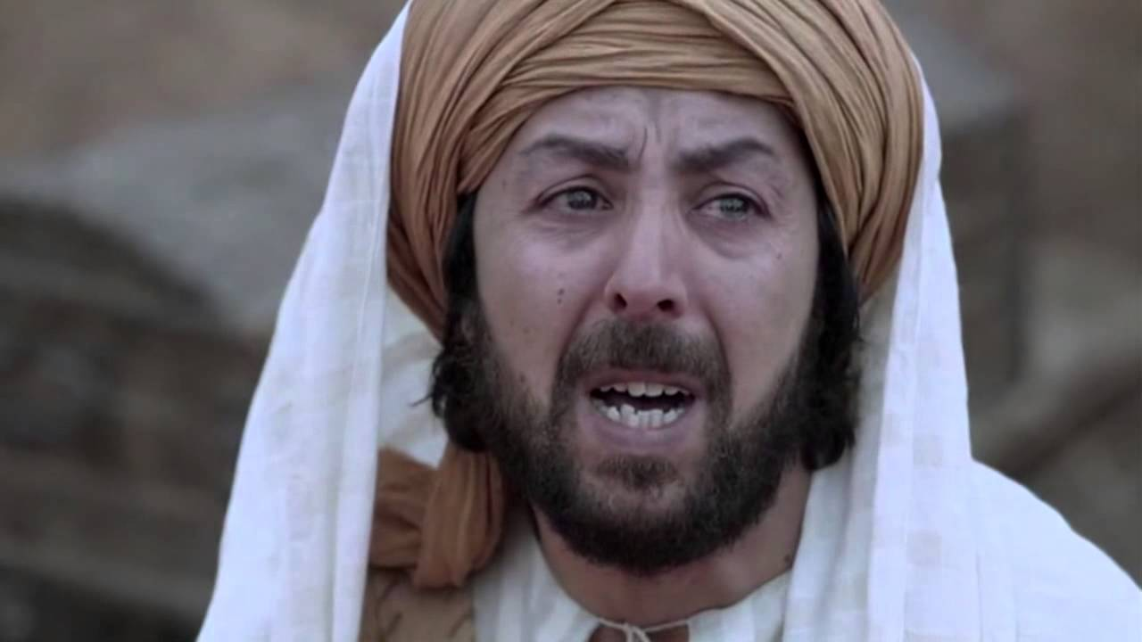

Slide 39
Mark 2:13-17
13 Then He went out again by the sea; and all the multitude came to Him, and He taught them.
14 As He passed by, He saw Levi the son of Alphaeus sitting at the tax office. And He said to him, “Follow Me.” So he arose and followed Him.

Slide 40
Luke 5:28-29
28 So he left all, rose up, and followed Him.
29 Then Levi gave Him a great feast in his own house. And there were a great number of tax collectors and others who sat down with them.

Slide 41
Luke 5:28-29
28 So he left all, rose up, and followed Him.
29 Then Levi gave Him a great feast in his own house. And there were a great number of tax collectors and others who sat down with them.
Matthew 9:10
10 Now it happened, as Jesus sat at the table in the house, that behold, many tax collectors and sinners came and sat down with Him and His disciples.

Slide 42
Mark 2:13-17
15 Now it happened, as He was dining in Levi’s house, that many tax collectors and sinners also sat together with Jesus and His disciples; for there were many, and they followed Him.
16 And when the scribes and Pharisees saw Him eating with the tax collectors and sinners, they said to His disciples, “How is it that He eats and drinks with tax collectors and sinners?”

Slide 43
Mark 2:13-17
17 When Jesus heard it, He said to them, “Those who are well have no need of a physician, but those who are sick. I did not come to call the righteous, but sinners, to repentance.”

Slide 44
Matthew 9:13
13 “But go and learn what this means: ‘I desire mercy and not sacrifice.’ For I did not come to call the righteous, but sinners, to repentance.”

Slide 45
Matthew 9:13
13 “But go and learn what this means: ‘I desire mercy and not sacrifice.’ For I did not come to call the righteous, but sinners, to repentance.”
Hosea 6:6
6 For I desire mercy and not sacrifice, and the knowledge of God more than burnt offerings.

Slide 46
Some Lessons/Takeaways
• God can forgive anything and everything.
• We need to forgive others.
• People make bad choices.
• Like Matthew, we are called to “Follow Him.”
• How do we see others?
• Matthew gave up everything—so must we.
• God’s plan to rescue us begins with forgiveness.
• God’s plan is centered on Jesus Christ.
• To be forgiven should bring joy and thankfulness .

Slide 50
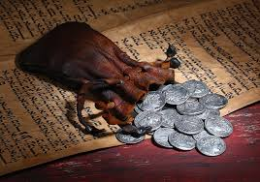

Slide 51
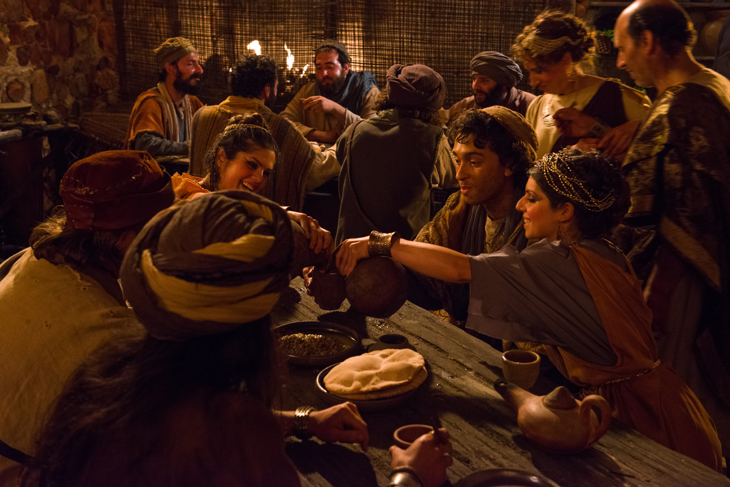

Slide 52
Matthew 14:1-2
1 At that time Herod the tetrarch heard the report about Jesus
2 and said to his servants, “This is John the Baptist; he is risen from the dead, and therefore these powers are at work in him.”

