Slide 1



Slide 2
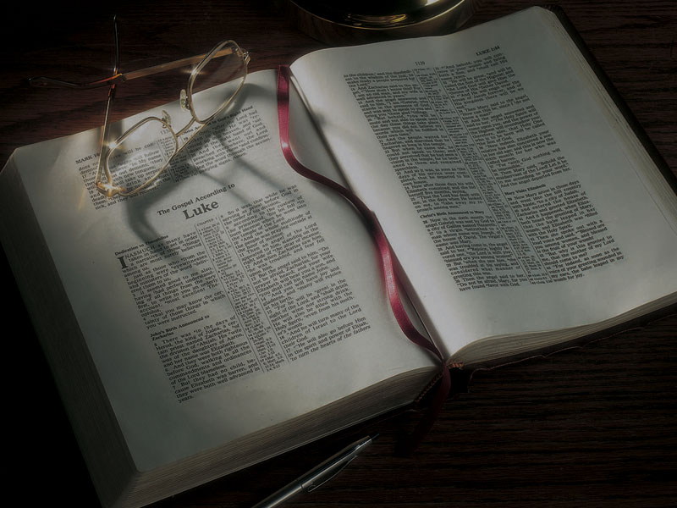
The Gospels
Jesus Heals a Paralyzed
Man Lowered
Through the Roof

Slide 3
Luke’s theme: Jesus’ divine authority
Luke 4:1-13: Jesus establishes His authority over Satan the adversary in the temptation in the wilderness.

Slide 4
Luke’s theme: Jesus’ divine authority
Luke 4:1-13: Jesus establishes His authority over Satan the adversary in the temptation in the wilderness.
Luke 4:14-30: Jesus claims Messianic authority when He teaches at the synagogue in Nazareth.

Slide 5
Luke’s theme: Jesus’ divine authority
Luke 4:1-13: Jesus establishes His authority over Satan the adversary in the temptation in the wilderness.
Luke 4:14-30: Jesus claims Messianic authority when He teaches at the synagogue in Nazareth.
Luke 4:31-37: Jesus establishes His authority over demons in casting out demon at the synagogue in Capernaum.

Slide 6
Luke’s theme: Jesus’ divine authority
Luke 4:1-13: Jesus establishes His authority over Satan the adversary in the temptation in the wilderness.
Luke 4:14-30: Jesus claims Messianic authority when He teaches at the synagogue in Nazareth.
Luke 4:31-37: Jesus establishes His authority over demons in casting out demon at the synagogue in Capernaum.
Luke 4:38-44: Jesus establishes His authority to heal temporary diseases by mass healings in Capernaum.

Slide 7
Luke’s theme: Jesus’ divine authority
Luke 5:1-11: Jesus establishes His authority over nature with the miraculous catch of fish.

Slide 8
Luke’s theme: Jesus’ divine authority
Luke 5:1-11: Jesus establishes His authority over nature with the miraculous catch of fish.
Luke 5:12-15: Jesus establishes His authority over chronic, terminal disease by healing the leper.

Slide 9
Luke’s theme: Jesus’ divine authority
Luke 5:1-11: Jesus establishes His authority over nature with the miraculous catch of fish.
Luke 5:12-15: Jesus establishes His authority over chronic, terminal disease by healing the leper.
Luke 5:17-26: Jesus establishes His authority to forgive sin with the healing of the paralyzed man.

Slide 10
Luke 5:17-26
17 Now it happened on a certain day, as He was teaching, that there were Pharisees and teachers of the law sitting by, who had come out of every town of Galilee, Judea, and Jerusalem. And the power of the Lord was present to heal them.

Slide 11
Mark 2:1-12
1 And again He entered Capernaum after some days, and it was heard that He was in the house.
2 Immediately many gathered together, so that there was no longer room to receive them, not even near the door. And He preached the word to them.
3 Then they came to Him, bringing a paralytic who was carried by four men.
4 And when they could not come near Him because of the crowd, they uncovered the roof where He was. So when they had broken through, they let down the bed on which the paralytic was lying.

Slide 12
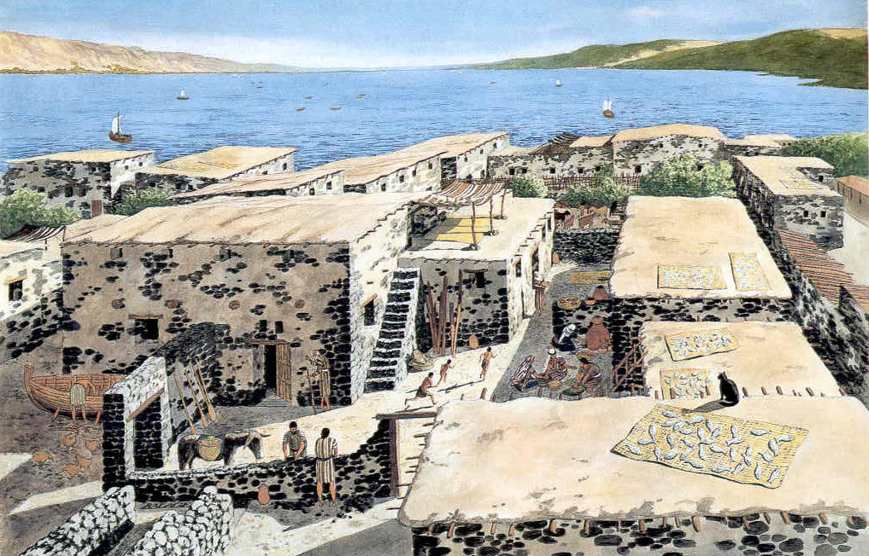

Slide 13
Mark 2:1-12
1 And again He entered Capernaum after some days, and it was heard that He was in the house.
2 Immediately many gathered together, so that there was no longer room to receive them, not even near the door. And He preached the word to them.
3 Then they came to Him, bringing a paralytic who was carried by four men.
4 And when they could not come near Him because of the crowd, they uncovered the roof where He was. So when they had broken through, they let down the bed on which the paralytic was lying.

Slide 15
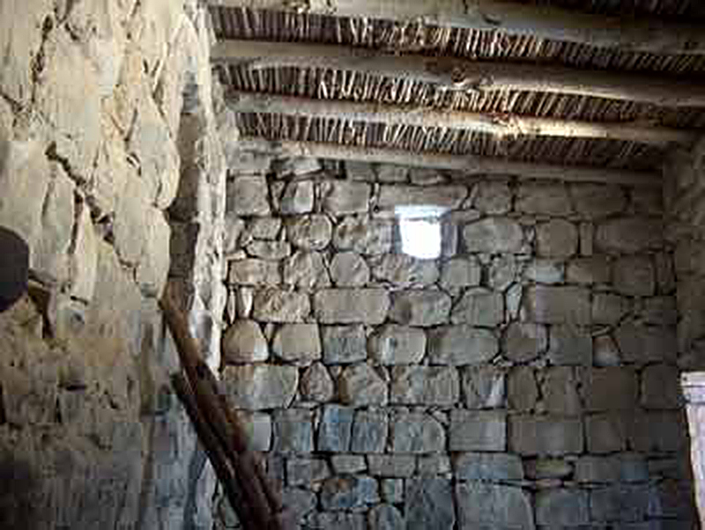

Slide 16
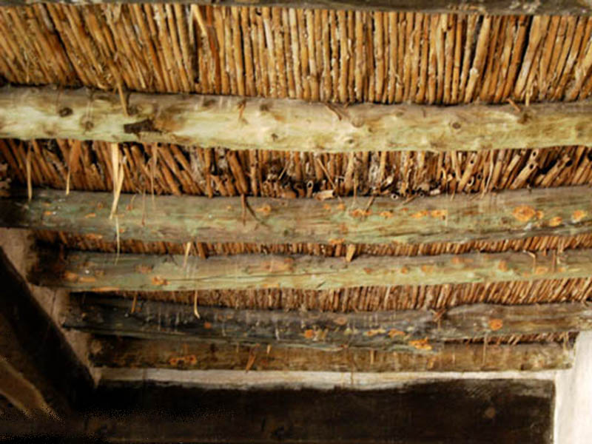

Slide 17
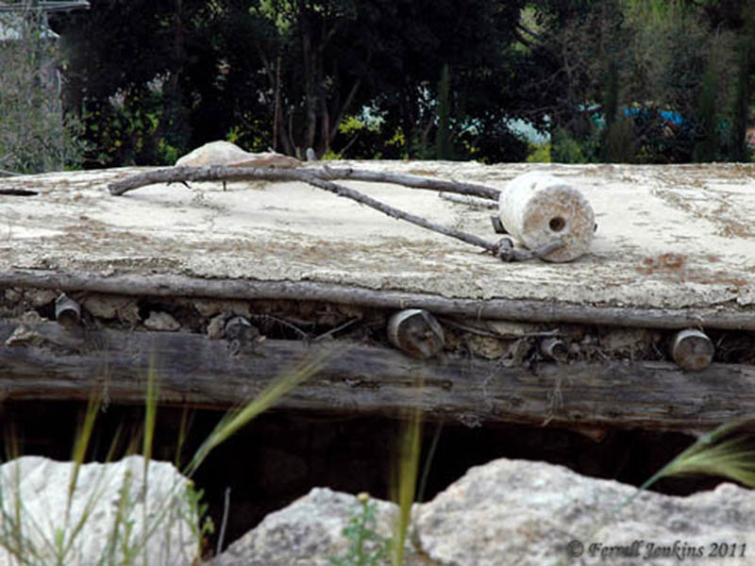

Slide 18
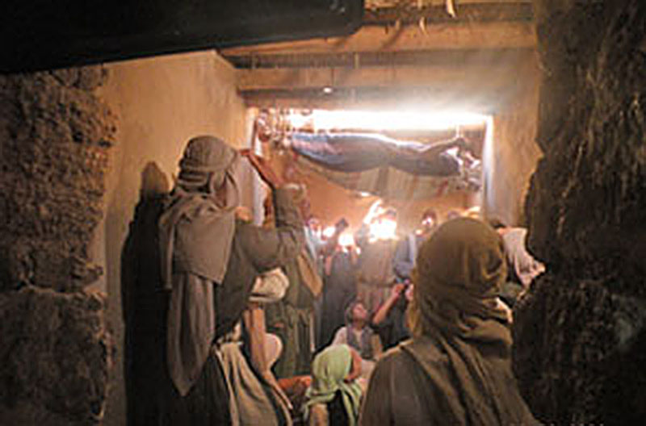

Slide 19
Luke 5:19
19 And when they could not find how they might bring him in, because of the crowd, they went up
on the housetop and let him down with his bed through the tiling into the midst before Jesus.

Slide 20


Slide 21
Luke 5:19
19 And when they could not find how they might bring him in, because of the crowd, they went up
on the housetop and let him down with his bed through the tiling into the midst before Jesus.
“tiling” = Greek keramos = anything made of clay

Slide 23
Luke 5:19
19 And when they could not find how they might bring him in, because of the crowd, they went up
on the housetop and let him down with his bed through the tiling into the midst before Jesus.
“tiling” = Greek keramos = anything made of clay

Slide 25
Mark 2:1-12
5 When Jesus saw their faith, He said to the paralytic, “Son, your sins are forgiven you.”
6 And some of the scribes were sitting there and reasoning in their hearts,
7 “Why does this Man speak blasphemies like this? Who can forgive sins but God alone?”
8 But immediately, when Jesus perceived in His spirit that they reasoned thus within themselves,
He said to them, “Why do you reason about these things in your hearts?

Slide 26
John 9:2
2 And His disciples asked Him, saying, “Rabbi,
who sinned, this man or his parents, that he was born blind?”

Slide 27
Mark 2:1-12
5 When Jesus saw their faith, He said to the paralytic, “Son, your sins are forgiven you.”
6 And some of the scribes were sitting there and reasoning in their hearts,
7 “Why does this Man speak blasphemies like this? Who can forgive sins but God alone?”

Slide 28
Leviticus 4, 5
Describing what happens after the proper sacrifices are offered:
4:26 . . . and it shall be forgiven him.
4:31 . . . and it shall be forgiven him.
4:35 . . . and it shall be forgiven him.
5:10 . . . and it shall be forgiven him.
5:13 . . . and it shall be forgiven him.
5:16 . . . and it shall be forgiven him.
5:18 . . . and it shall be forgiven him.

Slide 29
Mark 2:1-12
5 When Jesus saw their faith, He said to the paralytic, “Son, your sins are forgiven you.”
6 And some of the scribes were sitting there and reasoning in their hearts,
7 “Why does this Man speak blasphemies like this? Who can forgive sins but God alone?”

Slide 30
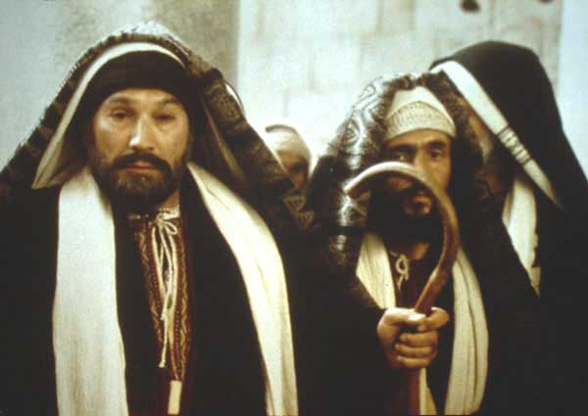

Slide 31
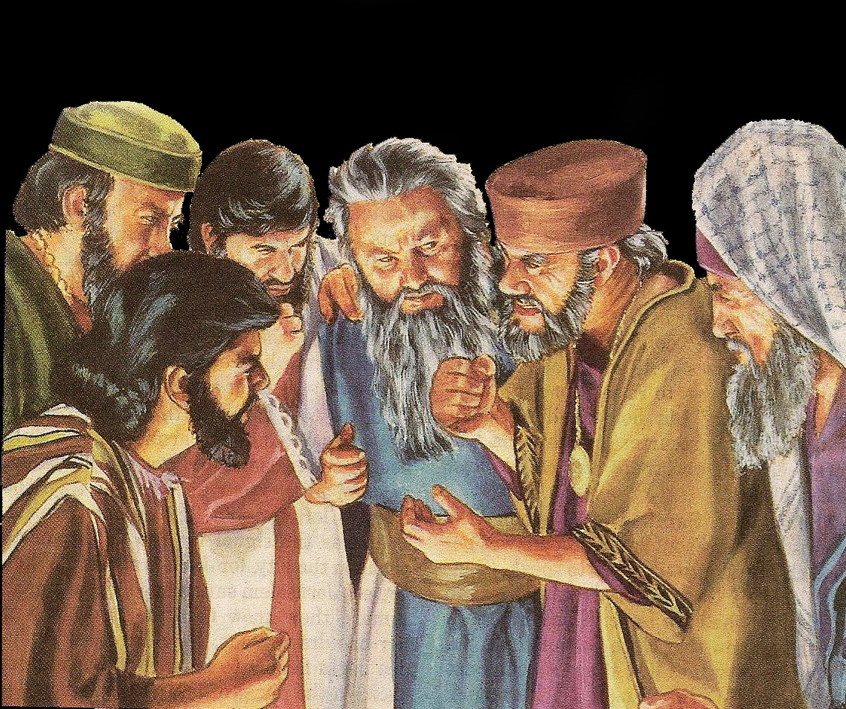

Slide 32
Mark 2:1-12
8 But immediately, when Jesus perceived in His spirit that they reasoned thus within themselves, He said to them, “Why do you reason about these things in your hearts?
9 “Which is easier, to say to the paralytic, ‘Your sins are forgiven you,’ or to say, ‘Arise, take up your bed and walk’?

Slide 33
Mark 2:1-12
10 “But that you may know that the Son of Man has power on earth to forgive sins”—He said to the paralytic,
11 “I say to you, arise, take up your bed, and go to your house.”
12 Immediately he arose, took up the bed, and went out in the presence of them all, so that all were amazed and glorified God, saying, “We never saw anything like this!”

Slide 34
Daniel 7:13-14
13 “I was watching in the night visions, and behold, One like the Son of Man, coming with the clouds of heaven! He came to the Ancient of Days, and they brought Him near before Him.
14 Then to Him was given dominion and glory and a kingdom, that all peoples, nations, and languages should serve Him. His dominion is an everlasting dominion, which shall not pass away, and His kingdom the one which shall not be destroyed.

Slide 35
Hebrews 10:11-14
11 And every priest stands ministering daily and offering repeatedly the same sacrifices, which can never take away sins.
12 But this Man, after He had offered one sacrifice for sins forever, sat down at the right hand of God,
13 from that time waiting till His enemies are made His footstool.
14 For by one offering He has perfected forever those who are being sanctified.

Slide 36
Mark 2:1-12
10 “But that you may know that the Son of Man has power on earth to forgive sins”—He said to the paralytic,
11 “I say to you, arise, take up your bed, and go to your house.”
12 Immediately he arose, took up the bed, and went out in the presence of them all, so that all were amazed and glorified God, saying, “We never saw anything like this!”

Slide 37
Luke 5:26
26 And they were all amazed, and they glorified God and were filled with fear, saying, “We have seen strange things today!”

Slide 38
Four key questions for us:
• What does this teach us about the nature and character of God the Father and Jesus Christ?
• What does this teach us about the way They interact with Their people and mankind?
• What does this mean for your relationship with
God the Father and Jesus Christ?
• What does this teach us about how we should think, act and live?

Slide 39
Four key questions for us:
• What does this teach us about the nature and character of God the Father and Jesus Christ?

Slide 40
Four key questions for us:
• What does this teach us about the nature and character of God the Father and Jesus Christ?
1. God is incredibly merciful – He can forgive a person who was not even expecting to be forgiven.

Slide 41
Four key questions for us:
• What does this teach us about the nature and character of God the Father and Jesus Christ?
1. God is incredibly merciful – He can forgive a person who was not even expecting to be forgiven.
2. God can and does at times give more than
we ask.

Slide 42
Four key questions for us:
• What does this teach us about the way They interact with Their people and mankind?

Slide 43
Four key questions for us:
• What does this teach us about the way They interact with Their people and mankind?
1. We start in a state of spiritual paralysis like the paralyzed man. God’s rescuing us from that state and restoring us to a right relationship with Him begins with forgiveness.

Slide 44
Four key questions for us:
• What does this teach us about the way They interact with Their people and mankind?
1. We start in a state of spiritual paralysis like the paralyzed man. God’s rescuing us from that state and restoring us to a right relationship with Him begins with forgiveness.
2. God’s work with us starts with rescue, then
leads to restoration.

Slide 45
Four key questions for us:
• What does this mean for your relationship with
God the Father and Jesus Christ?

Slide 46
Four key questions for us:
• What does this mean for your relationship with
God the Father and Jesus Christ?
1. Faith isn’t always just sitting back and letting God take care of everything and thinking we don’t have to do anything. At times faith requires action.

Slide 47
Four key questions for us:
• What does this mean for your relationship with
God the Father and Jesus Christ?
1. Faith isn’t always just sitting back and letting God take care of everything and thinking we don’t have to do anything. At times faith requires action.
2. Are we glorifying (praising) God for what He has done for us?

Slide 48
Four key questions for us:
• What does this teach us about how we should think, act and live?

Slide 49
Four key questions for us:
• What does this teach us about how we should think, act and live?
1. What kind of friend are you to those with disabilities?

Slide 50
Four key questions for us:
• What does this teach us about how we should think, act and live?
1. What kind of friend are you to those with disabilities?
2. Sometimes we carry our friends, sometimes our friends carry us.

Slide 53
Four key questions for us:
What does this teach us about the nature and character of God?
What does this teach us about the way God interacts with His people and mankind?
What does this mean for your relationship with
God the Father and Jesus Christ?
What does this teach us about Satan, the adversary of God and mankind?

Slide 54
Lessons/takeaways for us:
Jesus is our Savior, but He is also our Rescuer.
Jesus never turns people away.
Jesus needed quiet, alone time to spend with His heavenly Father—and so do we.
Sometimes God is unpredictable when it comes to our expectations.
Before our calling, we were like the leper—covered in our sins and cut off from God.
God responds to those who want to be cleansed and seek Him to be cleansed.
God uses “do and teach” with us.

Slide 55
