Slide 1

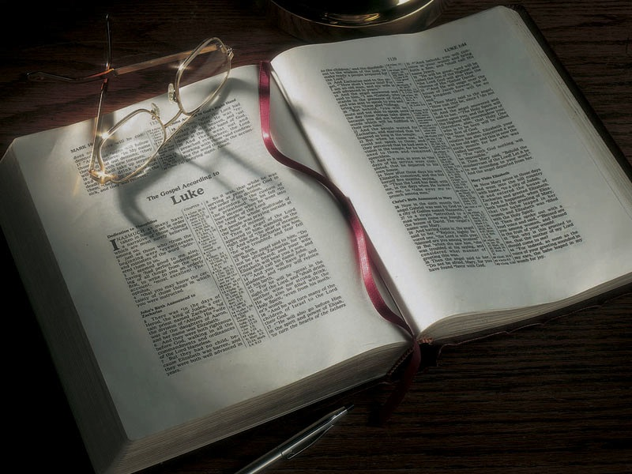

Slide 2
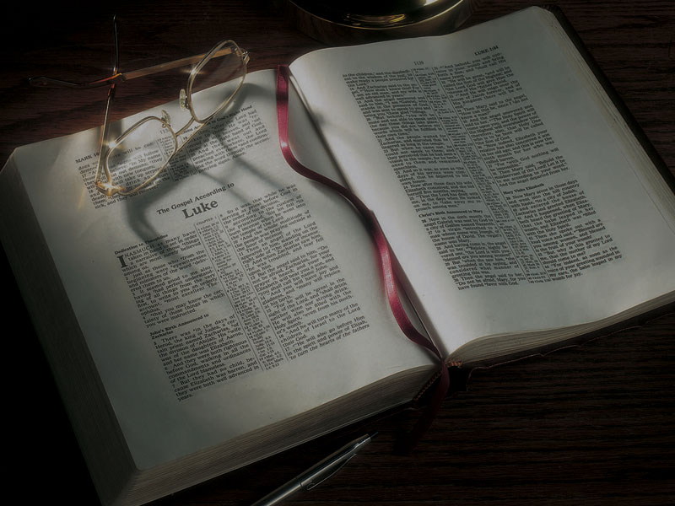
The Gospels
Jesus Chooses Peter, Andrew, James and John,
Heals a Possessed Man, Teaches With Authority

Slide 3
Luke 6:12-16
12 Now it came to pass in those days that He went out to the mountain to pray, and continued all night in prayer to God.
13 And when it was day, He called His disciples to Himself; and from them He chose twelve whom He also named apostles:
14 Simon, whom He also named Peter, and Andrew his brother; James and John; Philip and Bartholo-mew; Matthew and Thomas; James the son of Alphaeus, and Simon called the Zealot; Judas the son of James, and Judas Iscariot . . .

Slide 4
Acts 1:15, 21-26
15 And in those days Peter stood up in the midst of the disciples (altogether the number of names was about a hundred and twenty), and said…
21 “Therefore, of these men who have accompanied us all the time that the Lord Jesus went in and out among us,
22 “beginning from the baptism of John to that day when He was taken up from us, one of these must become a witness with us of His resurrection.”
23 And they proposed two: Joseph called Barsabas, who was surnamed Justus, and Matthias.

Slide 5
Acts 1:15, 21-26
24 And they prayed and said, “You, O Lord, who know the hearts of all, show which of these two You have chosen
25 “to take part in this ministry and apostleship from which Judas by transgression fell, that he might go to his own place.”
26 And they cast their lots, and the lot fell on Matthias. And he was numbered with the eleven apostles.

Slide 6
What has happened earlier?

Slide 7
What has happened earlier?
• Jesus traveled to Cana in Galilee and turned water into wine.

Slide 8
What has happened earlier?
• Jesus traveled to Cana in Galilee and turned water into wine.
• He traveled to Capernaum with His family and those first disciples.

Slide 9
What has happened earlier?
• Jesus traveled to Cana in Galilee and turned water into wine.
• He traveled to Capernaum with His family and those first disciples.
• He went to Jerusalem at the Passover and overturned the money-changers’ tables.

Slide 10
What has happened earlier?
• Jesus traveled to Cana in Galilee and turned water into wine.
• He traveled to Capernaum with His family and those first disciples.
• He went to Jerusalem at the Passover and overturned the money-changers’ tables.
• He met with Nicodemus and talked about what
it means to be born again.

Slide 11
What has happened earlier?
• Jesus traveled to Cana in Galilee and turned water into wine.
• He traveled to Capernaum with His family and those first disciples.
• He went to Jerusalem at the Passover and overturned the money-changers’ tables.
• He met with Nicodemus and talked about what
it means to be born again.
• He stayed in Judea for a while, with His disciples baptizing people.

Slide 12
What has happened earlier?
• After John the baptizer is imprisoned, Jesus leaves Judea.

Slide 13
What has happened earlier?
• After John the baptizer is imprisoned, Jesus leaves Judea.
• He travels through Samaria, meeting the woman at the well and teaching in Sychar.

Slide 14
What has happened earlier?
• After John the baptizer is imprisoned, Jesus leaves Judea.
• He travels through Samaria, meeting the woman at the well and teaching in Sychar.
• He starts teaching in various synagogues in Galilee.

Slide 15
What has happened earlier?
• After John the baptizer is imprisoned, Jesus leaves Judea.
• He travels through Samaria, meeting the woman at the well and teaching in Sychar.
• He starts teaching in various synagogues in Galilee.
• In Cana He heals the son of a royal official who lives in Capernaum.

Slide 16
What has happened earlier?
• After John the baptizer is imprisoned, Jesus leaves Judea.
• He travels through Samaria, meeting the woman at the well and teaching in Sychar.
• He starts teaching in various synagogues in Galilee.
• In Cana He heals the son of a royal official who lives in Capernaum.
• He returns to His hometown of Nazareth and is rejected and almost stoned to death.

Slide 17
What has happened earlier?
• After John the baptizer is imprisoned, Jesus leaves Judea.
• He travels through Samaria, meeting the woman at the well and teaching in Sychar.
• He starts teaching in various synagogues in Galilee.
• In Cana He heals the son of a royal official who lives in Capernaum.
• He returns to His hometown of Nazareth and is rejected and almost stoned to death.
• He moves to Capernaum.

Slide 18
Mark 1:16-20
16 And as He walked by the Sea of Galilee, He saw Simon and Andrew his brother casting a net into the sea; for they were fishermen.
17 Then Jesus said to them, “Follow Me, and I will make you become fishers of men.”
18 They immediately left their nets and followed Him.

Slide 19
Mark 1:16-20
19 When He had gone a little farther from there,
He saw James the son of Zebedee, and John his brother, who also were in the boat mending their nets.
20 And immediately He called them, and they left their father Zebedee in the boat with the hired servants, and went after Him.

Slide 20
Luke 5:1-11
1 So it was, as the multitude pressed about Him to hear the word of God, that He stood by the Lake of Gennesaret,
2 and saw two boats standing by the lake; but the fishermen had gone from them and were washing their nets.
3 Then He got into one of the boats, which was Simon’s, and asked him to put out a little from the land. And He sat down and taught the multitudes from the boat.

Slide 21
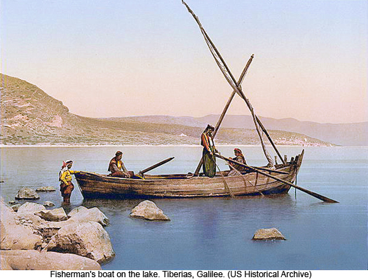

Slide 22
Luke 5:1-11
4 When He had stopped speaking, He said to Simon, “Launch out into the deep and let down your nets for a catch.”
5 But Simon answered and said to Him, “Master, we have toiled all night and caught nothing; nevertheless at Your word I will let down the net.”
6 And when they had done this, they caught a great number of fish, and their net was breaking.
7 So they signaled to their partners in the other boat to come and help them. And they came and filled both the boats, so that they began to sink.

Slide 23
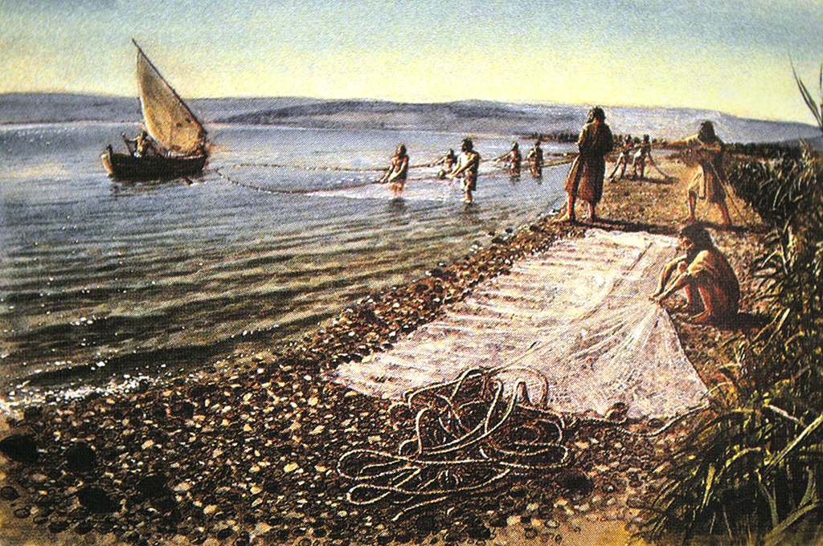

Slide 24
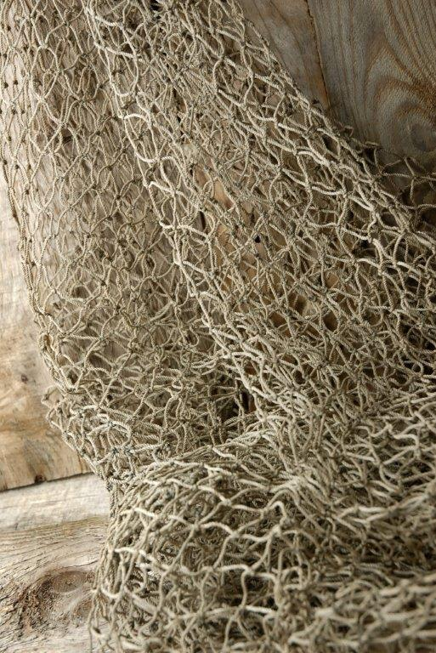

Slide 25
Luke 5:1-11
4 When He had stopped speaking, He said to Simon, “Launch out into the deep and let down your nets for a catch.”
5 But Simon answered and said to Him, “Master, we have toiled all night and caught nothing; nevertheless at Your word I will let down the net.”
6 And when they had done this, they caught a great number of fish, and their net was breaking.
7 So they signaled to their partners in the other boat to come and help them. And they came and filled both the boats, so that they began to sink.

Slide 26
Luke 5:1-11
8 When Simon Peter saw it, he fell down at Jesus’ knees, saying, “Depart from me, for I am a sinful man, O Lord!”
9 For he and all who were with him were aston-ished at the catch of fish which they had taken;
10 and so also were James and John, the sons of Zebedee, who were partners with Simon. And Jesus said to Simon, “Do not be afraid. From now on you will catch men.”
11 So when they had brought their boats to land, they forsook all and followed Him.

Slide 27
1 Corinthians 1:26-29
26 For you see your calling, brethren, that not many wise according to the flesh, not many mighty, not many noble, are called.
27 But God has chosen the foolish things of the world to put to shame the wise, and God has chosen the weak things of the world to put to shame the things which are mighty;
28 and the base things of the world and the things which are despised God has chosen, and the things which are not, to bring to nothing the things that are,
29 that no flesh should glory in His presence.

Slide 28
Useful qualities of fishermen:

Slide 29
Useful qualities of fishermen:
• Patience

Slide 30
Useful qualities of fishermen:
• Patience
• Perseverance

Slide 31
Useful qualities of fishermen:
• Patience
• Perseverance
• Courage

Slide 32
Useful qualities of fishermen:
• Patience
• Perseverance
• Courage
• Knowing when the moment is right

Slide 33
Useful qualities of fishermen:
• Patience
• Perseverance
• Courage
• Knowing when the moment is right
• Knowing what “bait” to use

Slide 34
Useful qualities of fishermen:
• Patience
• Perseverance
• Courage
• Knowing when the moment is right
• Knowing what “bait” to use
• What others can you think of?

Slide 35
Mark 1:21-28
21 Then they went into Capernaum, and immediately on the Sabbath He entered the synagogue and taught.
22 And they were astonished at His teaching, for He taught them as one having authority, and not
as the scribes.
23 Now there was a man in their synagogue with an unclean spirit. And he cried out,
24 saying, “Let us alone! What have we to do with You, Jesus of Nazareth? Did You come to destroy us? I know who You are—the Holy One of God!”

Slide 36
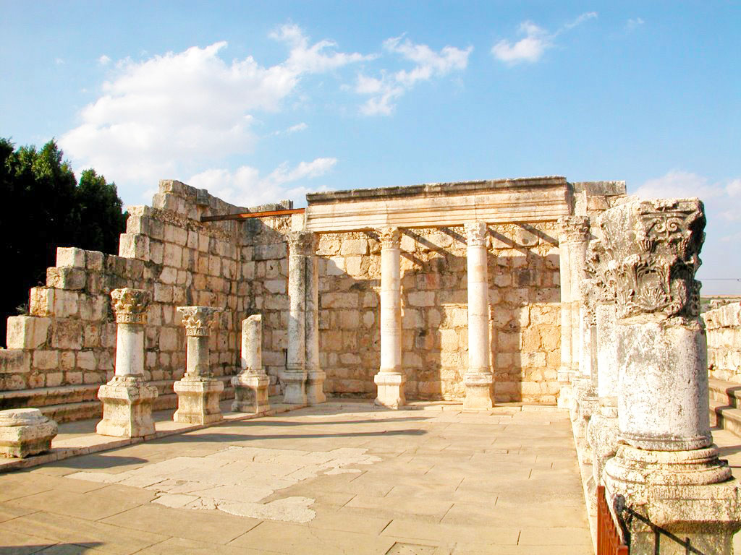

Slide 37
Mark 1:21-28
21 Then they went into Capernaum, and immediately on the Sabbath He entered the synagogue and taught.
22 And they were astonished at His teaching, for He taught them as one having authority, and not
as the scribes.
23 Now there was a man in their synagogue with an unclean spirit. And he cried out,
24 saying, “Let us alone! What have we to do with You, Jesus of Nazareth? Did You come to destroy us? I know who You are—the Holy One of God!”

Slide 38
Mark 1:21-28
25 But Jesus rebuked him, saying, “Be quiet, and come out of him!”
26 And when the unclean spirit had convulsed him and cried out with a loud voice, he came out of him.
27 Then they were all amazed, so that they questioned among themselves, saying, “What is this? What new doctrine is this? For with authority He commands even the unclean spirits, and they obey Him.”
28 And immediately His fame spread throughout
all the region around Galilee.

Slide 39
Revelation 12:3-4
3 And another sign appeared in heaven: behold, a great, fiery red dragon having seven heads and ten horns, and seven diadems on his heads.
4 His tail drew a third of the stars of heaven and threw them to the earth . . .

Slide 40
Revelation 12:3-4
3 And another sign appeared in heaven: behold, a great, fiery red dragon having seven heads and ten horns, and seven diadems on his heads.
4 His tail drew a third of the stars of heaven and threw them to the earth . . .
Revelation 1:20
20 “The mystery of the seven stars which you saw in My right hand . . . : The seven stars are the angels of the seven churches . . . .

Slide 41
Mark 1:21-27
21 Then they went into Capernaum, and immediately on the Sabbath He entered the synagogue and taught.
22 And they were astonished at His teaching, for He taught them as one having authority, and not
as the scribes. . . .
27 Then they were all amazed, so that they questioned among themselves, saying, “What is this? What new doctrine is this? For with authority He commands even the unclean spirits, and they obey Him.”

Slide 42
John 4:31
31 In the meantime His disciples urged Him, saying, “Rabbi, eat.”

Slide 43
John 3:1-2
1 There was a man of the Pharisees named Nicodemus, a ruler of the Jews.
2 This man came to Jesus by night and said to Him, “Rabbi, we know that You are a teacher come from God; for no one can do these signs that You do unless God is with him.”

Slide 44
Luke 20:27-28
27 Then some of the Sadducees, who deny that there is a resurrection, came to Him and asked Him,
28 saying: “Teacher [Rabbi], Moses wrote to us that if a man’s brother dies, having a wife, and he dies without children, his brother should take his wife and raise up offspring for his brother.

Slide 45
Matthew 22:35-36
35 Then one of them, a lawyer, asked Him
a question, testing Him, and saying,
36 “Teacher [Rabbi], which is the great commandment in the law?”

Slide 46
John 6:25
25 And when they [the people, the crowds] found Him on the other side of the sea, they said to Him, “Rabbi, when did You come here?”

Slide 47
Mark 1:21-27
21 Then they went into Capernaum, and immediately on the Sabbath He entered the synagogue and taught.
22 And they were astonished at His teaching, for He taught them as one having authority, and not
as the scribes. . . .
27 Then they were all amazed, so that they questioned among themselves, saying, “What is this? What new doctrine is this? For with authority He commands even the unclean spirits, and they obey Him.”

Slide 48
Matthew 21:23-27
23 Now when He came into the temple, the chief priests and the elders of the people confronted Him as He was teaching, and said, “By what authority [smicha] are You doing these things? And who gave You this authority [smicha]?”
24 But Jesus answered and said to them, “I also will ask you one thing, which if you tell Me, I likewise will tell you by what authority [smicha] I do these things:

Slide 49
Matthew 21:23-27
25 “The baptism of John—where was it from? From heaven or from men?” And they reasoned among themselves, saying, “If we say, ‘From heaven,’ He will say to us, ‘Why then did you not believe him?’
26 “But if we say, ‘From men,’ we fear the multitude, for all count John as a prophet.”
27 So they answered Jesus and said, “We do not know.” And He said to them, “Neither will I tell you by what authority [smicha] I do these things.

Slide 50
John 1:29-34
29 The next day John saw Jesus coming toward him, and said, “Behold! The Lamb of God who takes away the sin of the world!
30 “This is He of whom I said, ‘After me comes
a Man who is preferred before me, for He was before me.’
. . .
34 “And I have seen and testified that this is the Son of God.”

Slide 51
John 1:29-34
29 The next day John saw Jesus coming toward him, and said, “Behold! The Lamb of God who takes away the sin of the world!
30 “This is He of whom I said, ‘After me comes
a Man who is preferred before me, for He was before me.’
. . .
34 “And I have seen and testified that this is the Son of God.”

Slide 52
Mark 1:9-11
9 It came to pass in those days that Jesus came from Nazareth of Galilee, and was baptized by John in the Jordan.
10 And immediately, coming up from the water, He saw the heavens parting and the Spirit descending upon Him like a dove.
11 Then a voice came from heaven, “You are My beloved Son, in whom I am well pleased.”

Slide 53
Mark 1:9-11
9 It came to pass in those days that Jesus came from Nazareth of Galilee, and was baptized by John in the Jordan.
10 And immediately, coming up from the water, He saw the heavens parting and the Spirit descending upon Him like a dove.
11 Then a voice came from heaven, “You are My beloved Son, in whom I am well pleased.”

Slide 54
Matthew 28:16-20
16 Then the eleven disciples went away into Galilee,
to the mountain which Jesus had appointed for them. . . .
18 And Jesus came and spoke to them, saying, “All authority has been given to Me in heaven and on earth.
19 “Go therefore and make disciples of all the nations, baptizing them in the name of the Father and of the Son and of the Holy Spirit,
20 “teaching them to observe all things that I have commanded you; and lo, I am with you always, even to the end of the age.” Amen.

Slide 57
Four key questions for us:

Slide 58
Four key questions for us:
What does this teach us about the nature and character of God?

Slide 59
Four key questions for us:
What does this teach us about the nature and character of God?
What does this teach us about the way God interacts with His people and mankind?

Slide 60
Four key questions for us:
What does this teach us about the nature and character of God?
What does this teach us about the way God interacts with His people and mankind?
What does this mean for your relationship with
God the Father and Jesus Christ?

Slide 61
Four key questions for us:
What does this teach us about the nature and character of God?
What does this teach us about the way God interacts with His people and mankind?
What does this mean for your relationship with
God the Father and Jesus Christ?
What does this teach us about Satan, the adversary of God and mankind?

