Slide 1

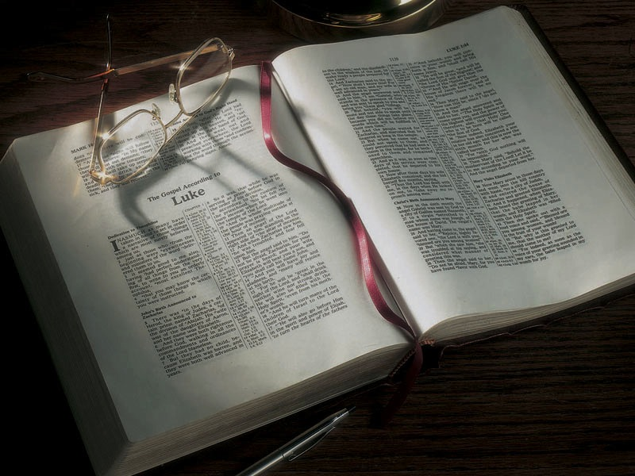

Slide 2
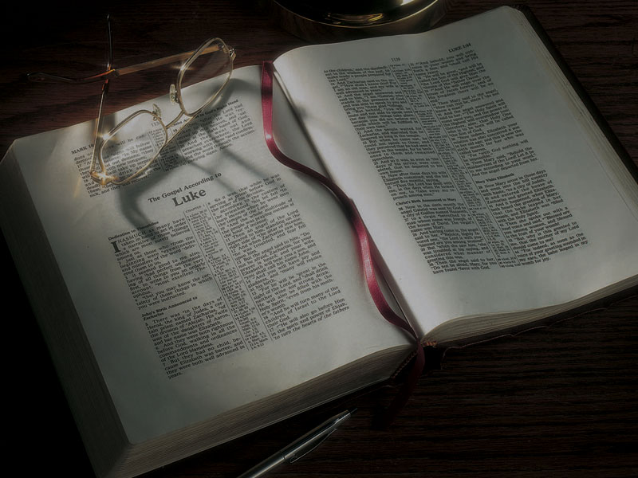
The Gospels
Jesus Moves
to Capernaum,
Chooses Peter, Andrew, James and John

Slide 3
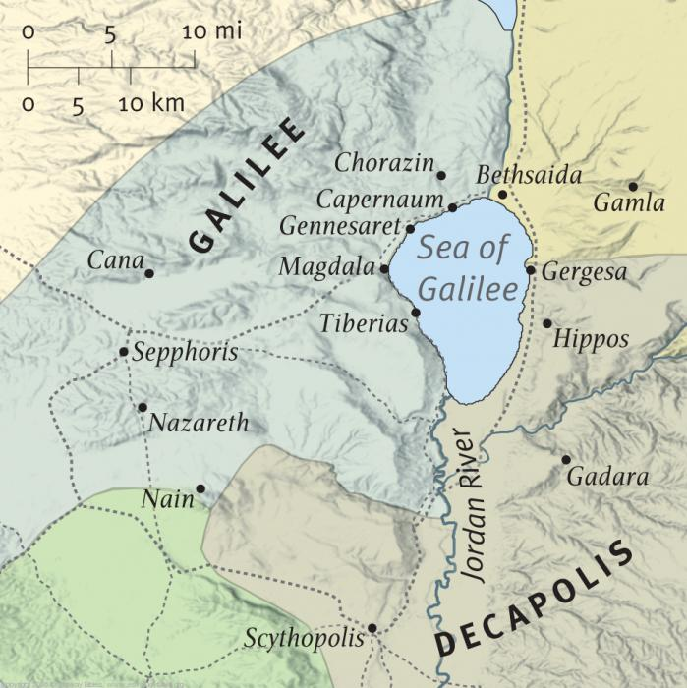

Slide 4
Pagans

Slide 5
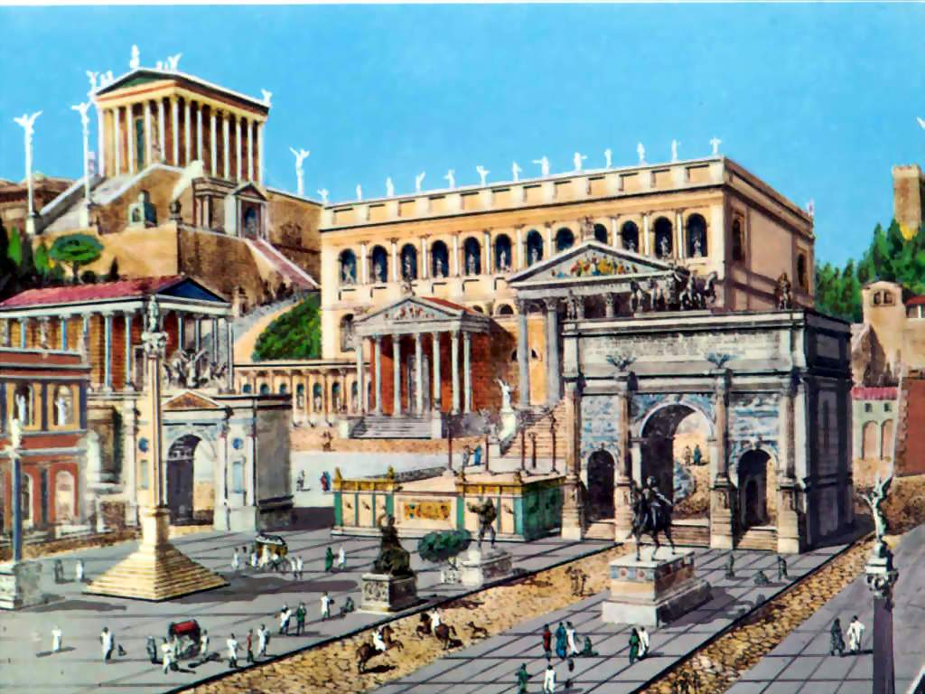

Slide 6
Zealots
Pagans

Slide 7
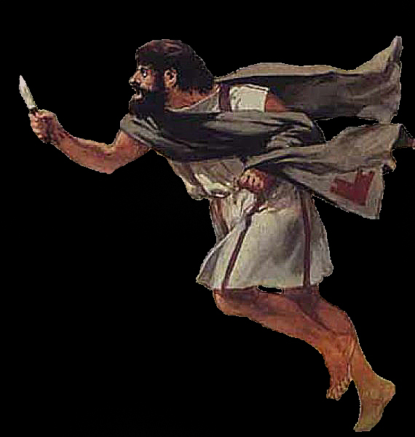

Slide 8
Zealots
Herodians
Pagans

Slide 9
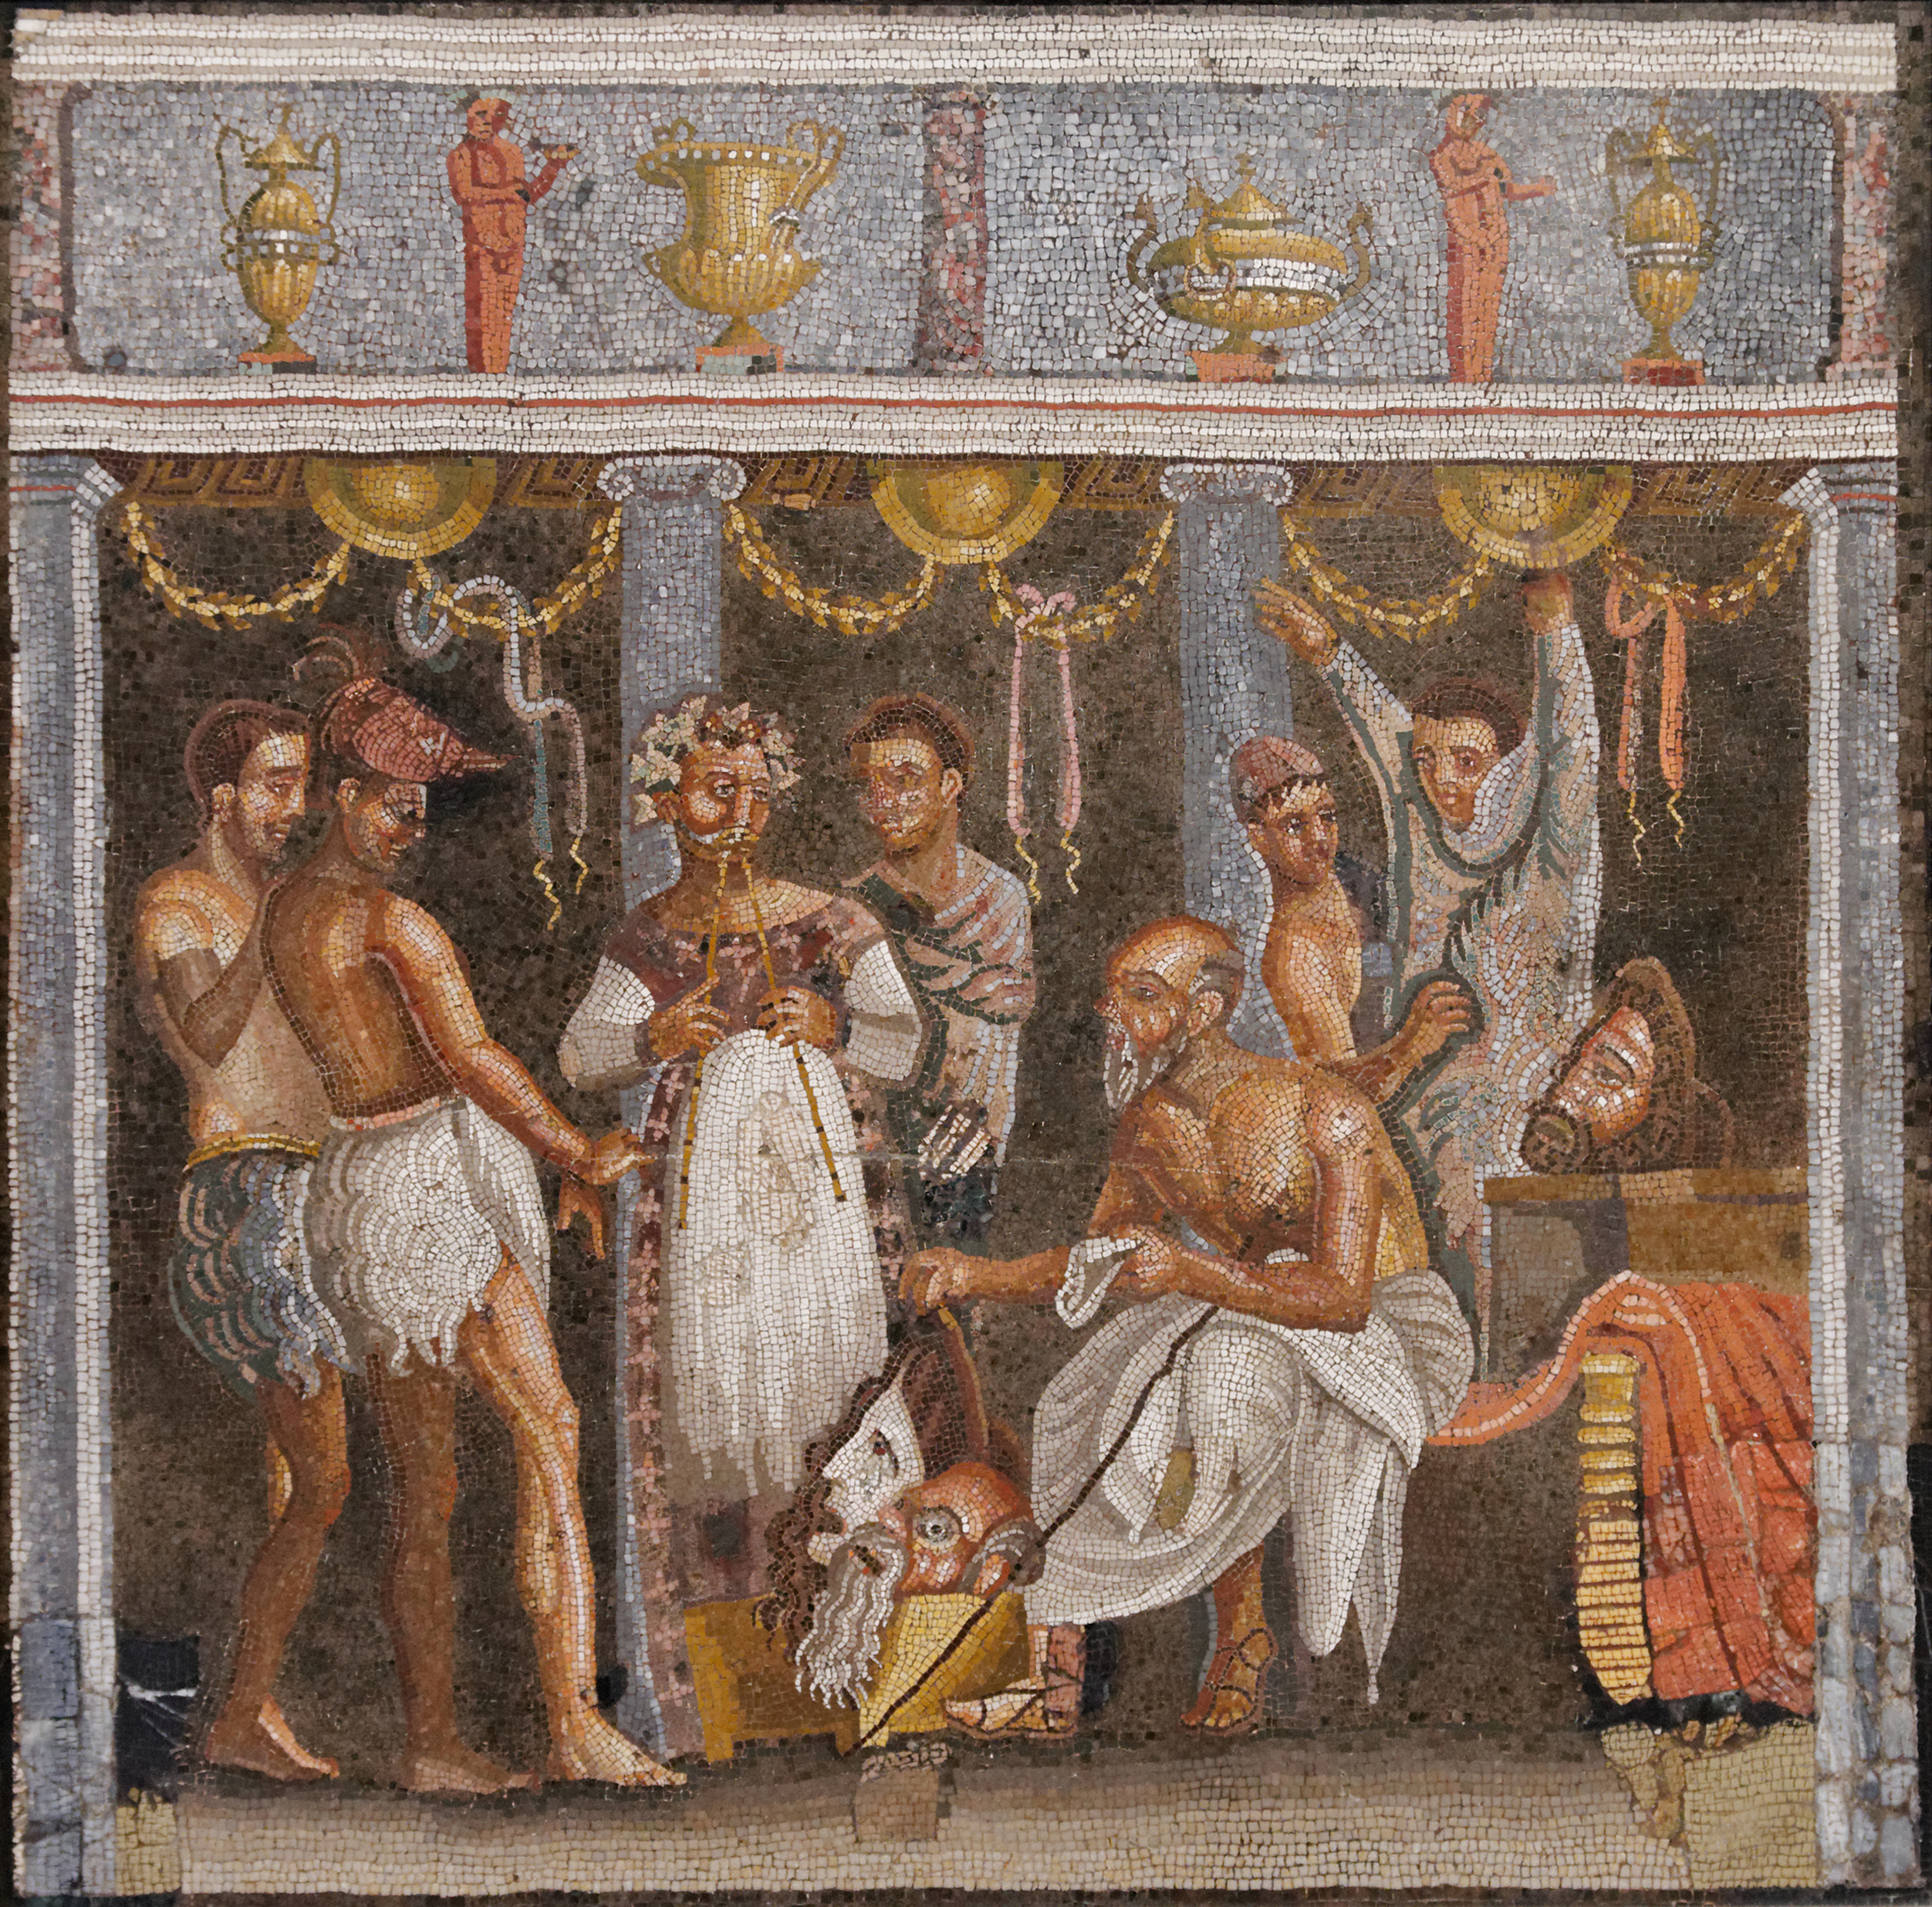

Slide 10
Zealots
Herodians
Pagans
Samaritans

Slide 11
Religious Jews
Zealots
Herodians
Pagans
Samaritans

Slide 12
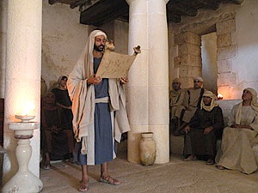

Slide 13
Religious Jews
Zealots

Slide 15
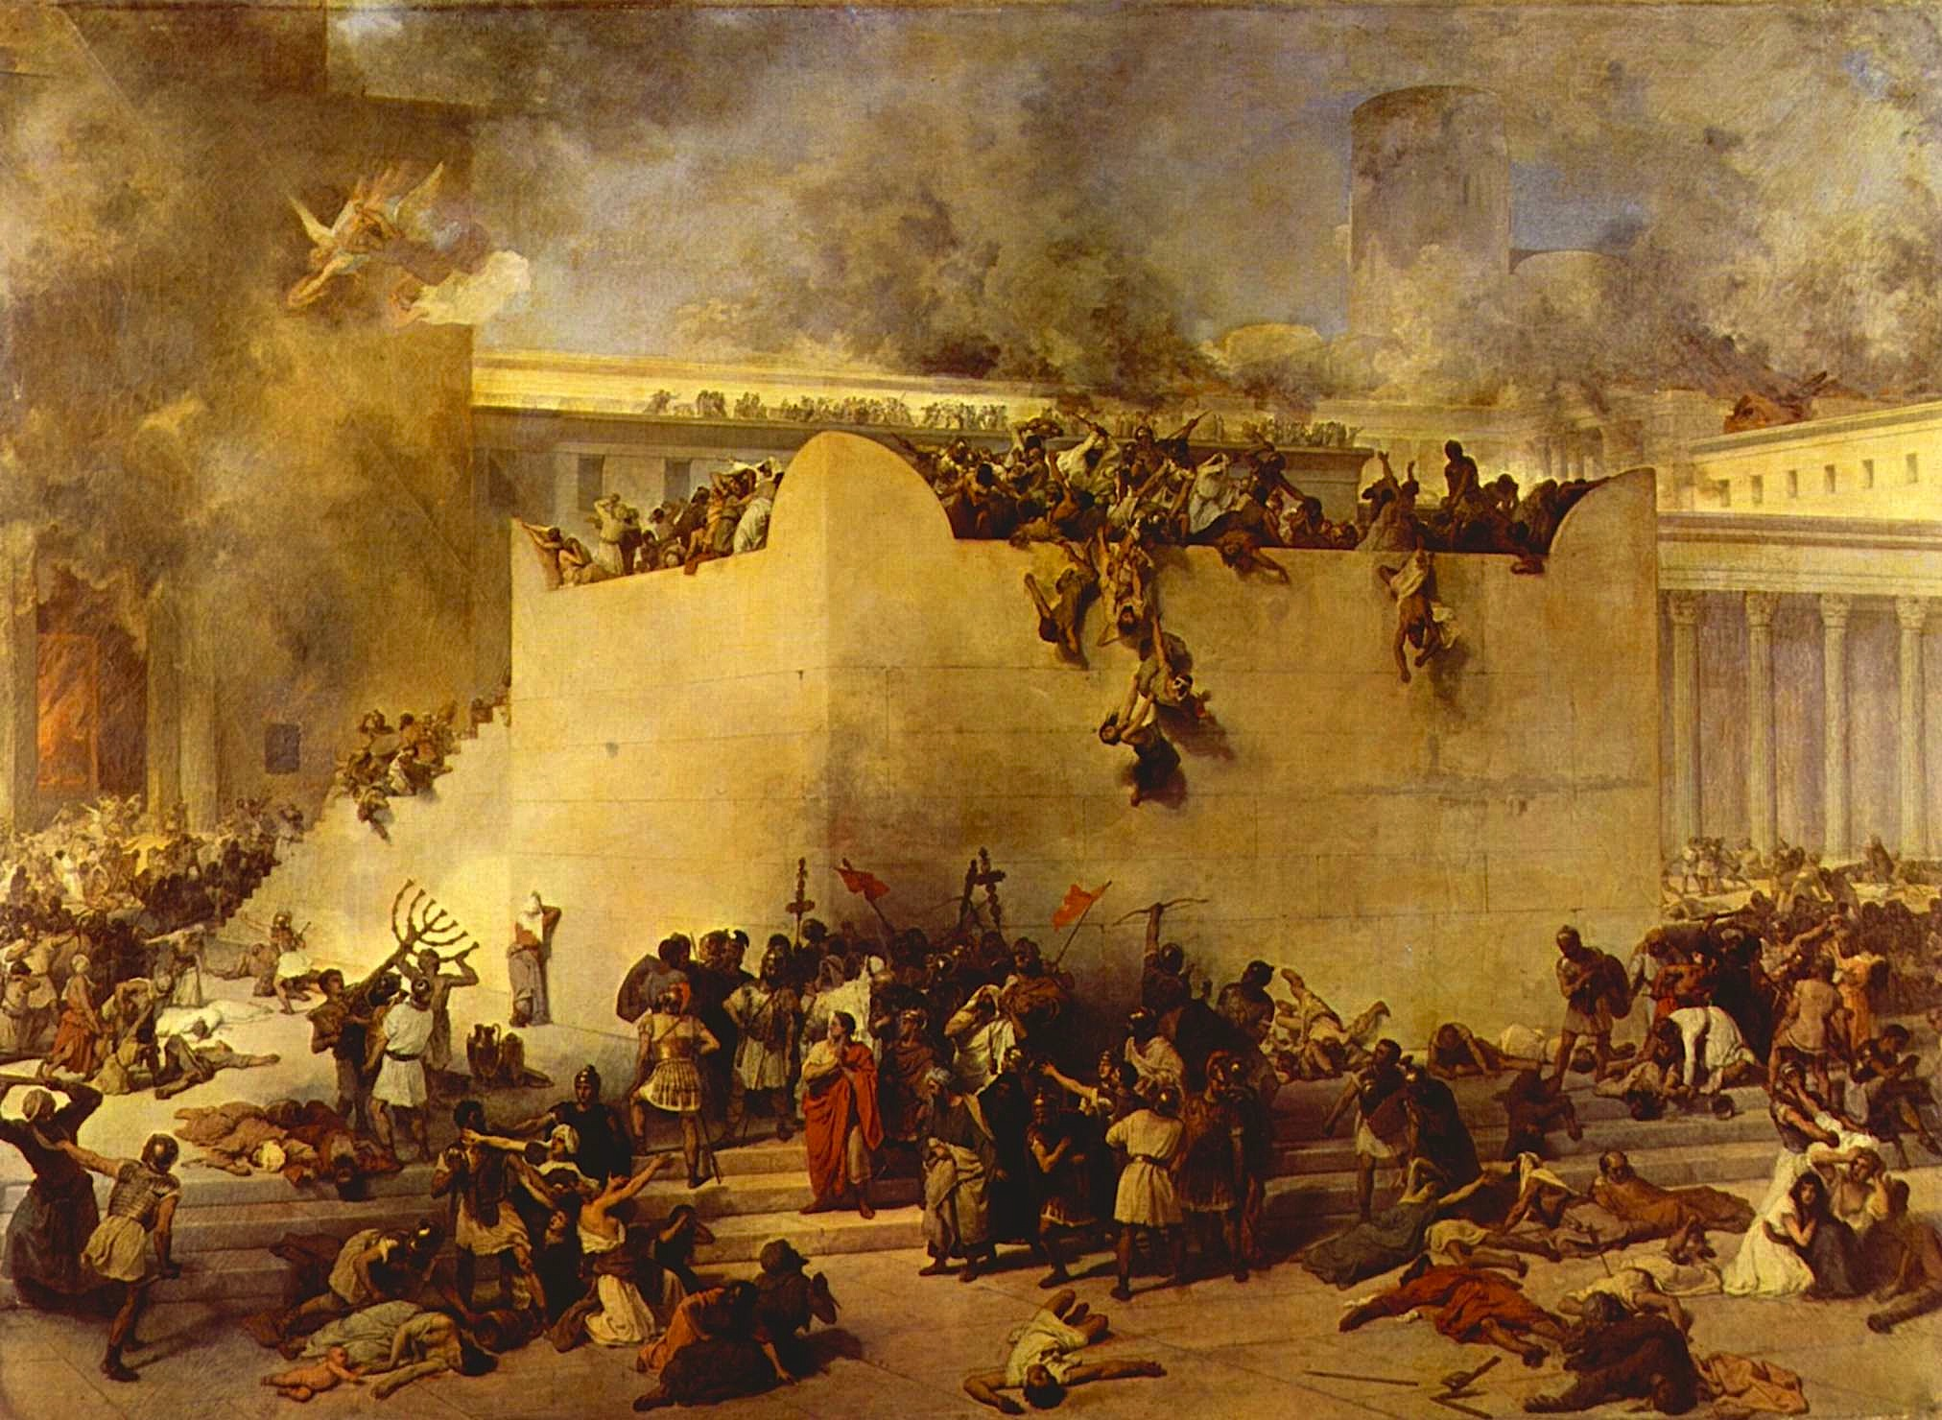

Slide 17
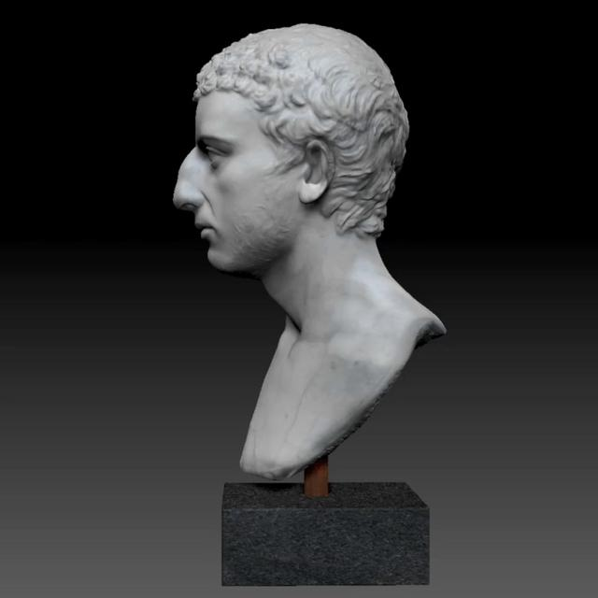
Flavius
Josephus
A.D. 37-100

Slide 18
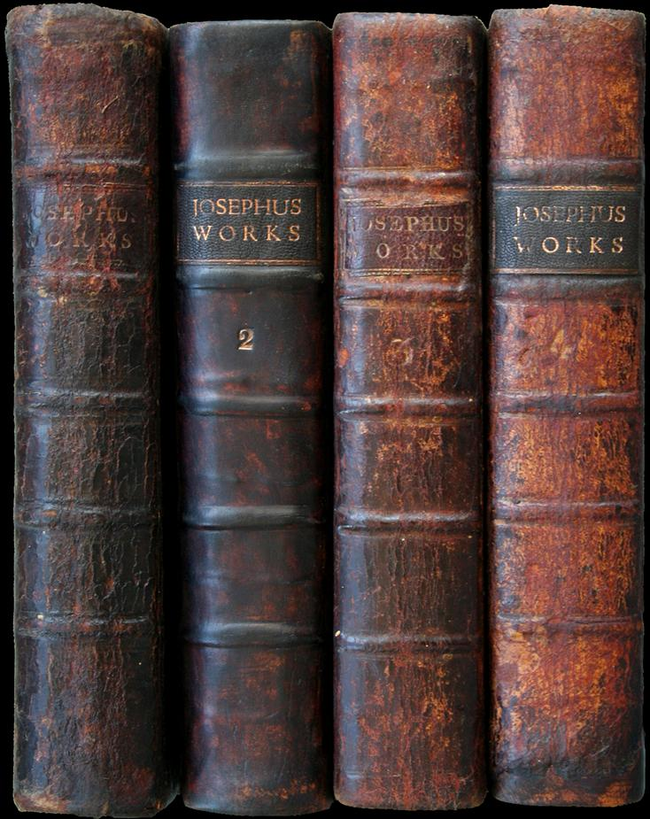

Slide 19
Matthew 4:13-16 / Isaiah 9:1-2
13 And leaving Nazareth, He came and dwelt in Capernaum, which is by the sea, in the regions of Zebulun and Naphtali,
14 that it might be fulfilled which was spoken by Isaiah the prophet, saying:
15 “The land of Zebulun and the land of Naphtali, by the way of the sea, beyond the Jordan, Galilee
of the Gentiles:
16 The people who sat in darkness have seen a great light, and upon those who sat in the region and shadow of death Light has dawned.”

Slide 20
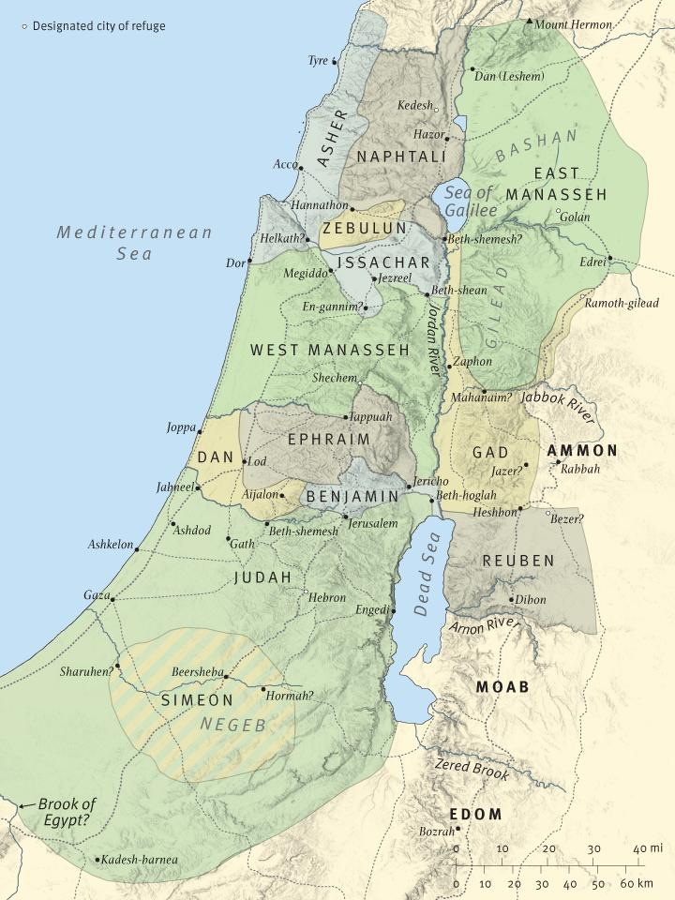
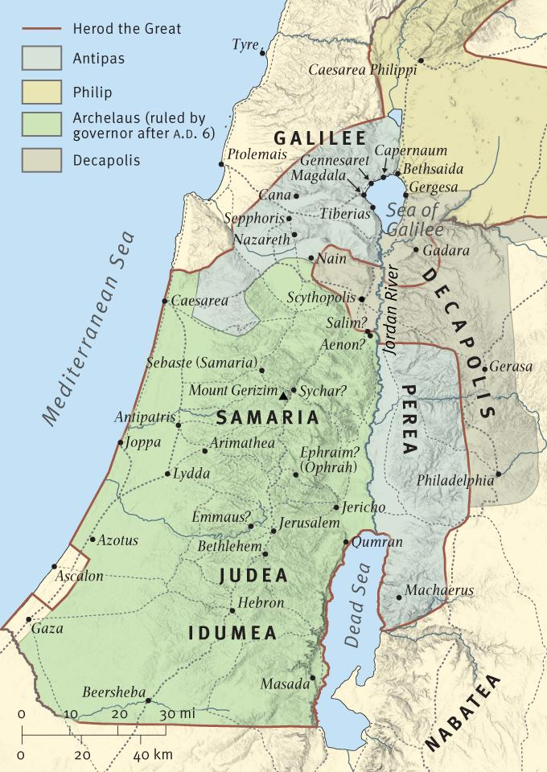

Slide 21
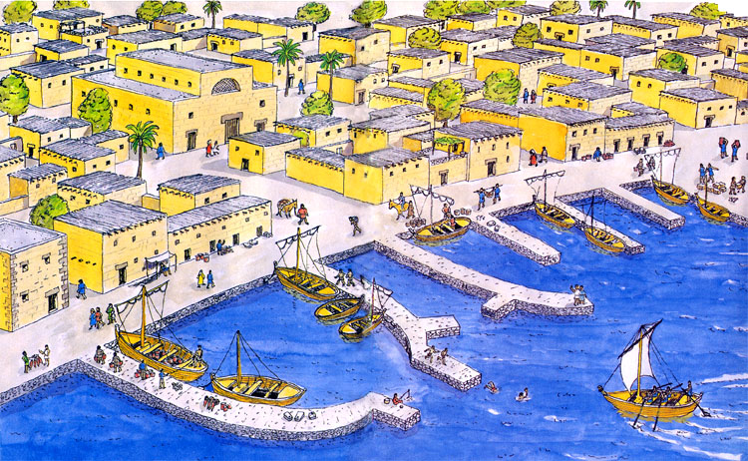

Slide 22
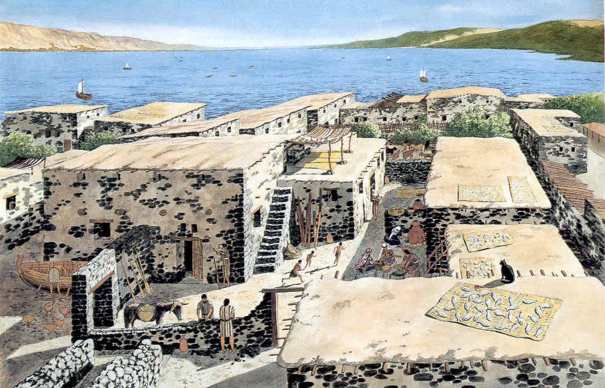

Slide 23
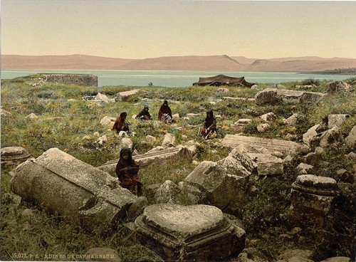

Slide 24
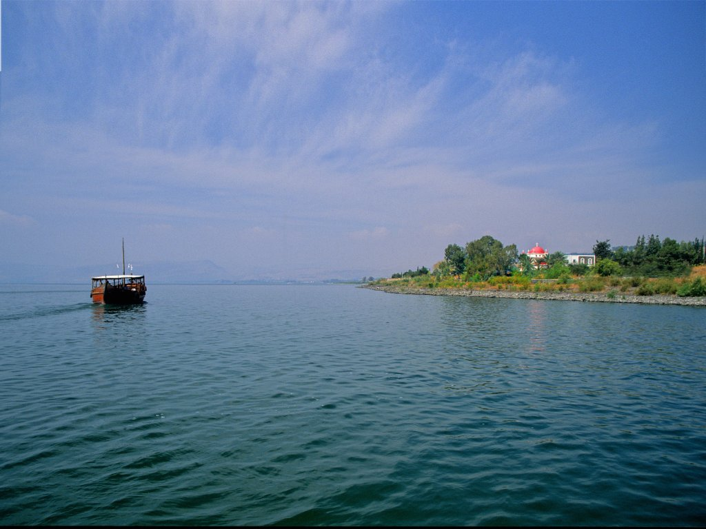

Slide 25
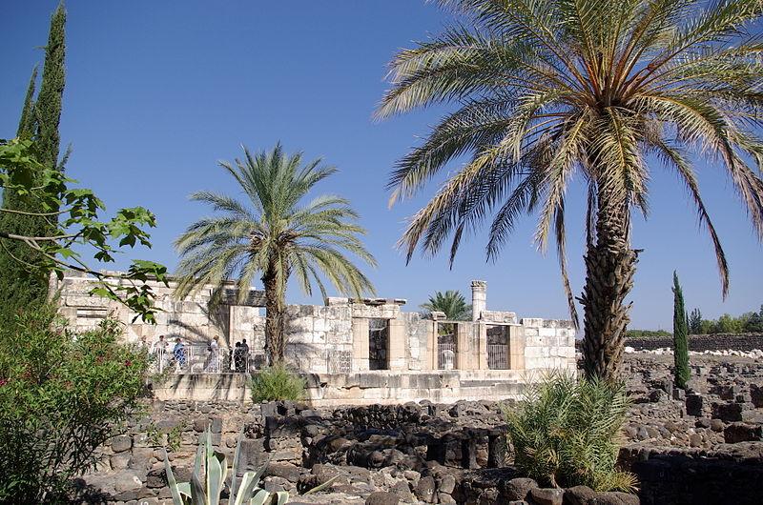

Slide 26
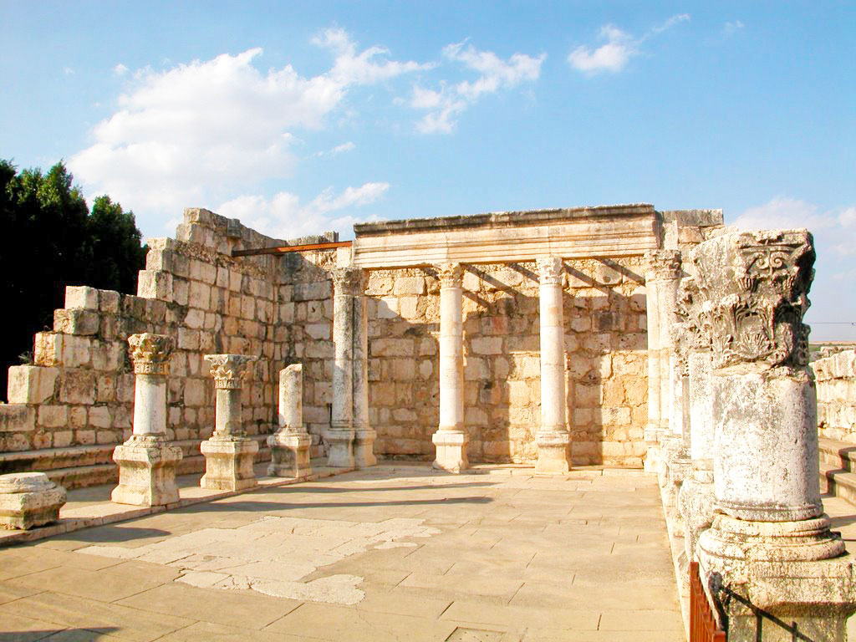

Slide 27
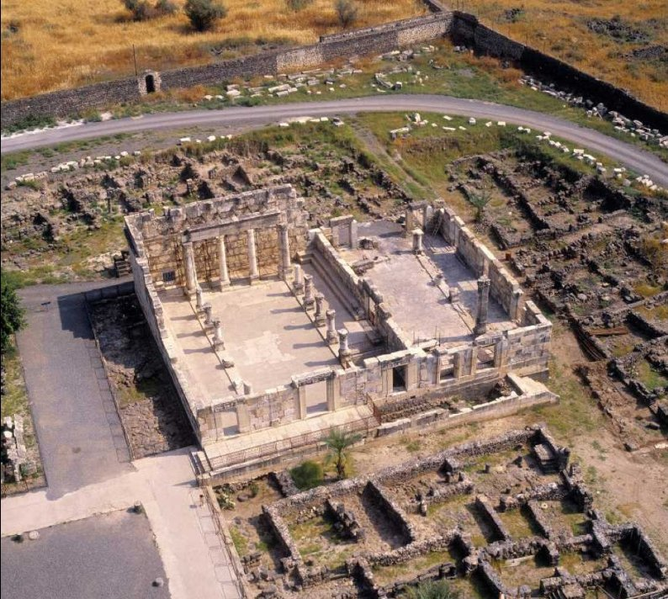

Slide 28
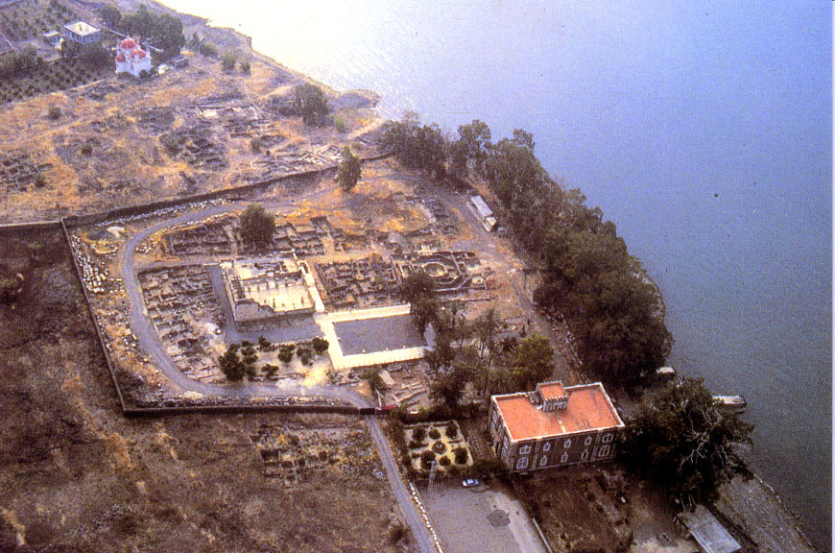

Slide 29
Deuteronomy 4:5-6
5 “Surely I have taught you statutes and judgments, just as the LORD my God commanded me, that you should act according to them in the land which you go to possess.
6 “Therefore be careful to observe them; for this is your wisdom and your understanding in the sight of the peoples who will hear all these statutes, and say, ‘Surely this great nation is a wise and understanding people.’”

Slide 30
Deuteronomy 4:5-6
5 “Surely I have taught you statutes and judgments, just as the LORD my God commanded me, that you should act according to them in the land which you go to possess.
6 “Therefore be careful to observe them; for this is your wisdom and your understanding in the sight of the peoples who will hear all these statutes, and say, ‘Surely this great nation is a wise and understanding people.’”
Israel was placed at the crossroads of the world
to be an example to the nations around them.

Slide 31
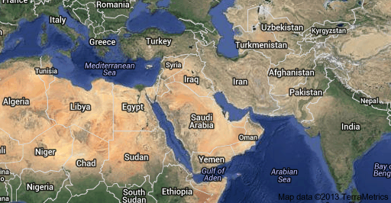

Slide 32
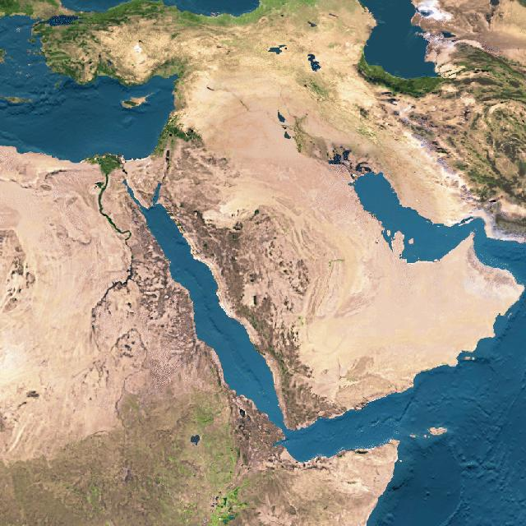

Slide 33
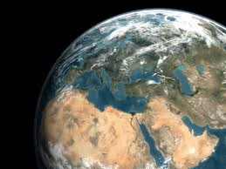

Slide 34
Matthew 6:14-16
14 “You are the light of the world. A city that is set on a hill cannot be hidden.
15 “Nor do they light a lamp and put it under a basket, but on a lampstand, and it gives light to all who are in the house.
16 “Let your light so shine before men, that they may see your good works and glorify your Father in heaven.

Slide 36


Slide 37
1 Kings 9:15
15 And this is the reason for the labor force which King Solomon raised: to build the house of the LORD, his own house, the Millo, the wall of Jerusalem, Hazor, Megiddo, and Gezer.

Slide 38
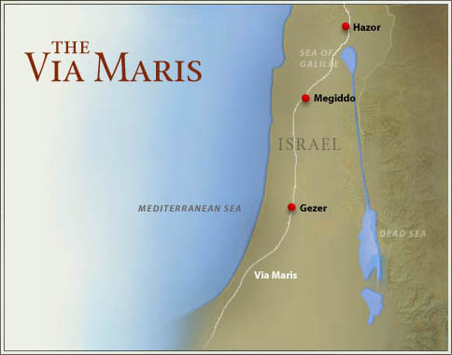

Slide 39
Matthew 4:13-16 / Isaiah 9:1-2
13 And leaving Nazareth, He came and dwelt in Capernaum, which is by the sea, in the regions of Zebulun and Naphtali,
14 that it might be fulfilled which was spoken by Isaiah the prophet, saying:
15 “The land of Zebulun and the land of Naphtali, by the way of the sea, beyond the Jordan, Galilee
of the Gentiles:
16 The people who sat in darkness have seen a great light, and upon those who sat in the region and shadow of death Light has dawned.”

Slide 43
Lessons/takeaways for us:

Slide 44
Lessons/takeaways for us:
1. God brings to pass what He has foretold.

Slide 45
Lessons/takeaways for us:
1. God brings to pass what He has foretold.
2. God is in perfect control and knows what He is doing.

Slide 46
Lessons/takeaways for us:
1. God brings to pass what He has foretold.
2. God is in perfect control and knows what He is doing.
3. God wants us to be examples to others of His way of life.

Slide 49
Four key questions for us:

Slide 50
Four key questions for us:
What does this teach us about the nature and character of God?

Slide 51
Four key questions for us:
What does this teach us about the nature and character of God?
What does this teach us about the way God interacts with His people and mankind?

Slide 52
Four key questions for us:
What does this teach us about the nature and character of God?
What does this teach us about the way God interacts with His people and mankind?
What does this mean for your relationship with
God the Father and Jesus Christ?

Slide 53
Four key questions for us:
What does this teach us about the nature and character of God?
What does this teach us about the way God interacts with His people and mankind?
What does this mean for your relationship with
God the Father and Jesus Christ?
What does this teach us about Satan, the adversary of God and mankind?

