Slide 1

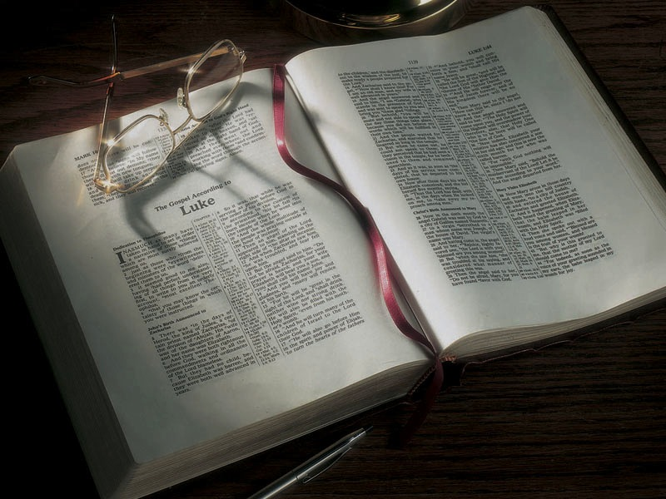

Slide 2
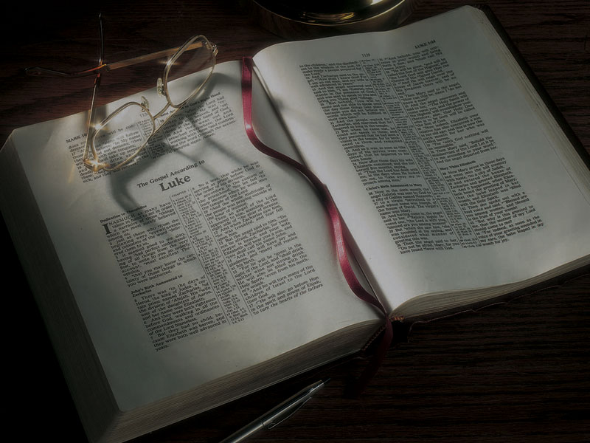
The Gospels
Jesus Heals a
Nobleman’s Son,
Then Is Rejected
in Nazareth

Slide 3
John 4:43-45
43 Now after the two days He departed from there and went to Galilee.
44 For Jesus Himself testified that a prophet has no honor in his own country.
45 So when He came to Galilee, the Galileans received Him, having seen all the things He did in Jerusalem at the feast; for they also had gone to the feast.

Slide 4
John 2:23, 3:2
23 Now when He was in Jerusalem at the Passover, during the feast, many believed in His name when they saw the signs which He did.
3:2 This man [Nicodemus] came to Jesus by night and said to Him, “Rabbi, we know that You are a teacher come from God; for no one can do these signs that You do unless God is with him.”

Slide 5
Matthew 4:17
17 From that time Jesus began to preach and
to say, “Repent, for the kingdom of heaven is
at hand.”

Slide 6
Matthew 4:17
17 From that time Jesus began to preach and
to say, “Repent, for the kingdom of heaven is
at hand.”
Mark 1:14-15
14 Now after John was put in prison, Jesus came
to Galilee, preaching the gospel of the kingdom
of God,
15 and saying, “The time is fulfilled, and the kingdom of God is at hand. Repent, and believe in the gospel.”

Slide 7
Daniel 7:13-14
13 I was watching in the night visions, and behold, One like the Son of Man, Coming with the clouds of heaven! He came to the Ancient of Days, and they brought Him near before Him.
14 Then to Him was given dominion and glory and a kingdom, that all peoples, nations, and languages should serve Him. His dominion is an everlasting dominion, which shall not pass away, and His kingdom the one which shall not be destroyed.

Slide 8
Isaiah 9:6-7
6 For unto us a Child is born, unto us a Son is given; and the government will be upon His shoulder. And His name will be called Wonderful, Counselor, Mighty God, Everlasting Father, Prince
of Peace.
7 Of the increase of His government and peace there will be no end, upon the throne of David and over His kingdom, to order it and establish it with judgment and justice From that time forward, even forever. The zeal of the LORD of hosts will perform this.

Slide 9
Isaiah 2:2-3
2 Now it shall come to pass in the latter days
that the mountain of the LORD’S house shall be established on the top of the mountains, and shall be exalted above the hills; and all nations shall flow to it.
3 Many people shall come and say, “Come, and let us go up to the mountain of the LORD, to the house of the God of Jacob; He will teach us His ways, and we shall walk in His paths.” For out of Zion shall
go forth the law, and the word of the LORD from Jerusalem.

Slide 10
Matthew 4:17
17 From that time Jesus began to preach and
to say, “Repent, for the kingdom of heaven is
at hand.”

Slide 11
Matthew 4:17
17 From that time Jesus began to preach and
to say, “Repent, for the kingdom of heaven is
at hand.”
Exodus 20:7
7 You shall not take the name of the LORD your God in vain, for the LORD will not hold him guiltless who takes His name in vain.

Slide 12
Luke 20:4
4 “The baptism of John—was it from heaven
or from men?”
Mark 14:62
62 “You will see the Son of Man sitting at the right hand of the Power, and coming with the clouds of heaven.”
John 4:23
23 “But the hour is coming, and now is, when the true worshipers will worship the Father in spirit and truth; for the Father is seeking such to worship Him.

Slide 13
Luke 4:14-15
14 Then Jesus returned in the power of the Spirit
to Galilee, and news of Him went out through all the surrounding region.
15 And He taught in their synagogues, being glorified by all.

Slide 14
John 4:46-54
46 So Jesus came again to Cana of Galilee where He had made the water wine. And there was a certain nobleman whose son was sick at Capernaum.
47 When he heard that Jesus had come out of Judea into Galilee, he went to Him and implored Him to come down and heal his son, for he was
at the point of death.

Slide 15
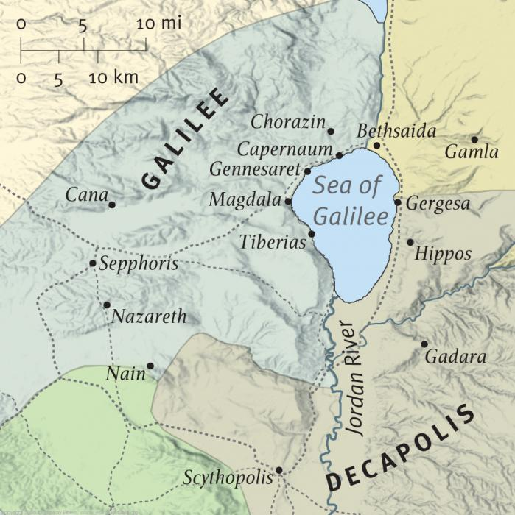

Slide 16
John 4:46-54
46 So Jesus came again to Cana of Galilee where He had made the water wine. And there was a certain nobleman whose son was sick at Capernaum.
47 When he heard that Jesus had come out of Judea into Galilee, he went to Him and implored Him to come down and heal his son, for he was
at the point of death.

Slide 18
John 4:46-54
48 Then Jesus said to him, “Unless you people see signs and wonders, you will by no means believe.”
49 The nobleman said to Him, “Sir, come down before my child dies!”
50 Jesus said to him, “Go your way; your son lives.” So the man believed the word that Jesus spoke to him, and he went his way.

Slide 19
John 4:46-54
51 And as he was now going down, his servants met him and told him, saying, “Your son lives!”
52 Then he inquired of them the hour when he got better. And they said to him, “Yesterday at the seventh hour the fever left him.”
53 So the father knew that it was at the same hour in which Jesus said to him, “Your son lives.” And he himself believed, and his whole household.
54 This again is the second sign Jesus did when He had come out of Judea into Galilee.

Slide 20
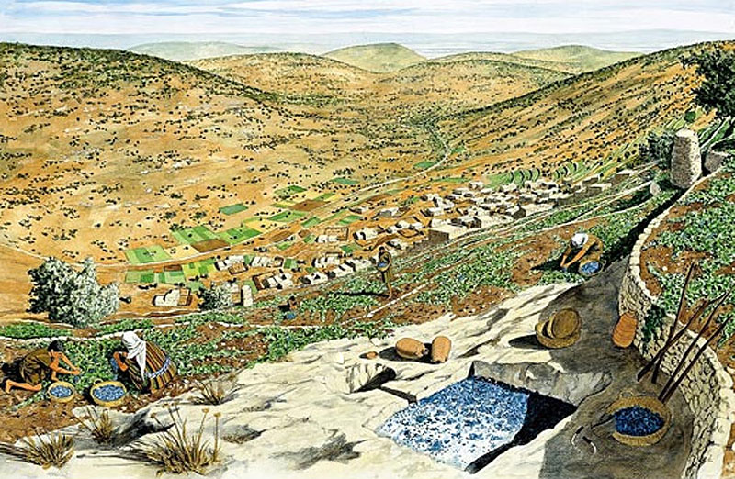

Slide 21
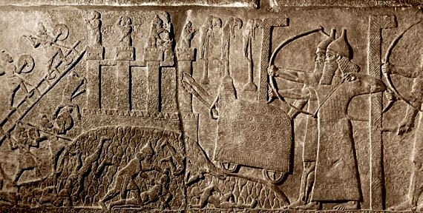

Slide 22
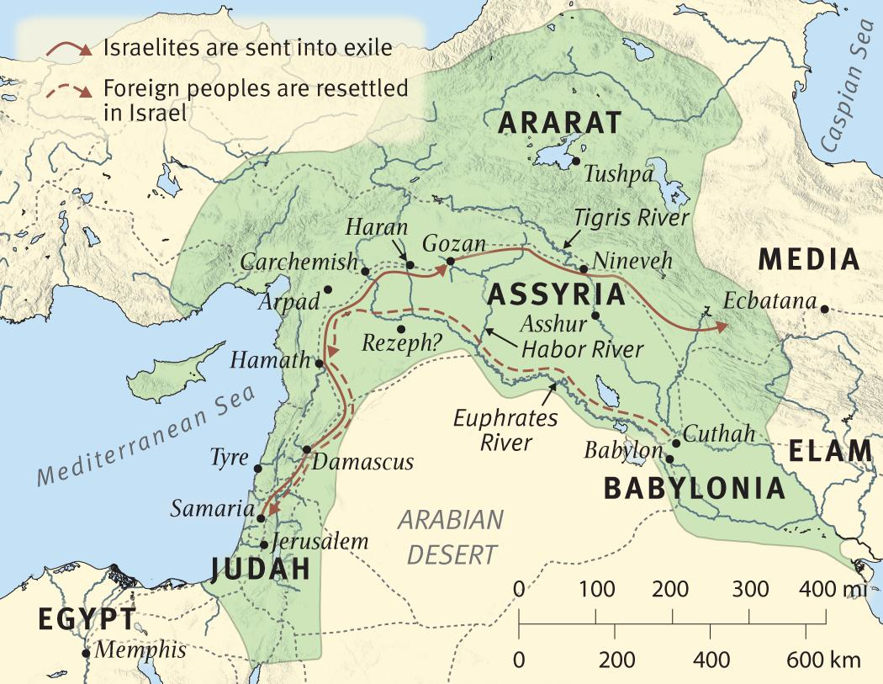

Slide 23
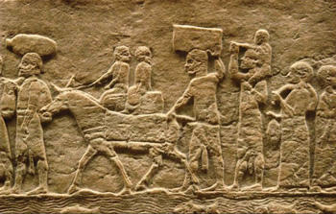

Slide 24
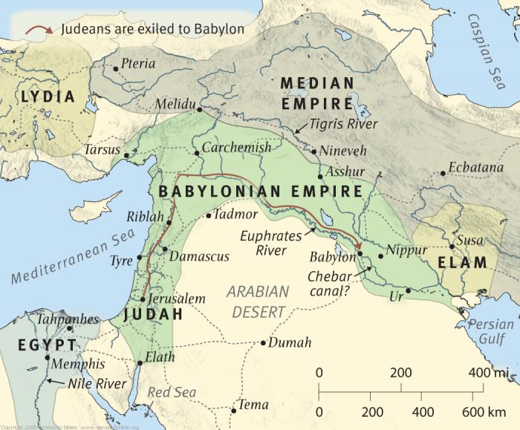

Slide 25
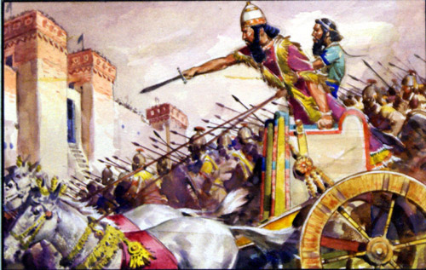

Slide 27
Isaiah 9:1-2
1 Nevertheless the gloom will not be upon her who is distressed, as when at first He lightly esteemed the land of Zebulun and the land of Naphtali, and afterward more heavily oppressed her, by the way
of the sea, beyond the Jordan, in Galilee of the Gentiles.
2 The people who walked in darkness have seen
a great light; those who dwelt in the land of the shadow of death, upon them a light has shined.

Slide 29
Luke 4:16-31
16 So He came to Nazareth, where He had been brought up. And as His custom was, He went into the synagogue on the Sabbath day, and stood up
to read.

Slide 30
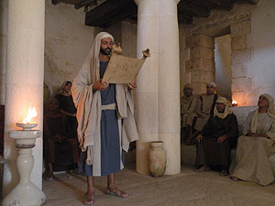

Slide 31
Luke 4:16-31
17 And He was handed the book of the prophet Isaiah. And when He had opened the book, He found the place where it was written:
18 “The Spirit of the Lord is upon Me, because He has anointed Me to preach the gospel to the poor; He has sent Me to heal the brokenhearted, to proclaim liberty to the captives and recovery of sight to the blind, to set at liberty those who are oppressed;
19 To proclaim the acceptable year of the Lord.”

Slide 32
Isaiah 61:1-6
1 “The Spirit of the Lord GOD is upon Me, because the LORD has anointed Me to preach good tidings to the poor; He has sent Me to heal the brokenhearted, to proclaim liberty to the captives, and the opening of the prison to those who are bound;
2 To proclaim the acceptable year of the LORD,
and the day of vengeance of our God; to comfort all who mourn,

Slide 33
Isaiah 61:1-6
3 To console those who mourn in Zion, to give them beauty for ashes, the oil of joy for mourning, the garment of praise for the spirit of heaviness; that they may be called trees of righteousness, the planting of the LORD, that He may be glorified.”
4 And they shall rebuild the old ruins, they shall raise up the former desolations, and they shall repair the ruined cities, the desolations of many generations.

Slide 34
Isaiah 61:1-6
5 Strangers shall stand and feed your flocks, and the sons of the foreigners shall be your plowmen and your vinedressers.
6 But you shall be named the priests of the LORD, they shall call you the servants of our God. You shall eat the riches of the Gentiles, and in their glory you shall boast.

Slide 35
Isaiah 61:1-6
1 “The Spirit of the Lord GOD is upon Me, because the LORD has anointed Me to preach good tidings to the poor; He has sent Me to heal the brokenhearted, to proclaim liberty to the captives, and the opening of the prison to those who are bound;
2 To proclaim the acceptable year of the LORD,
and the day of vengeance of our God; to comfort all who mourn,

Slide 36
Luke 4:16-31
20 Then He closed the book, and gave it back to the attendant and sat down. And the eyes of all who were in the synagogue were fixed on Him.

Slide 37
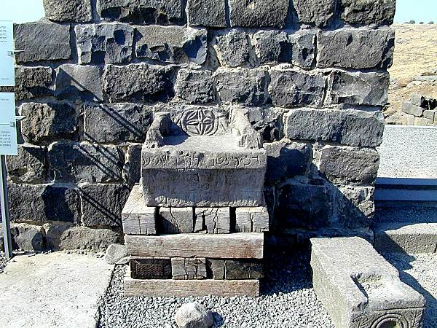
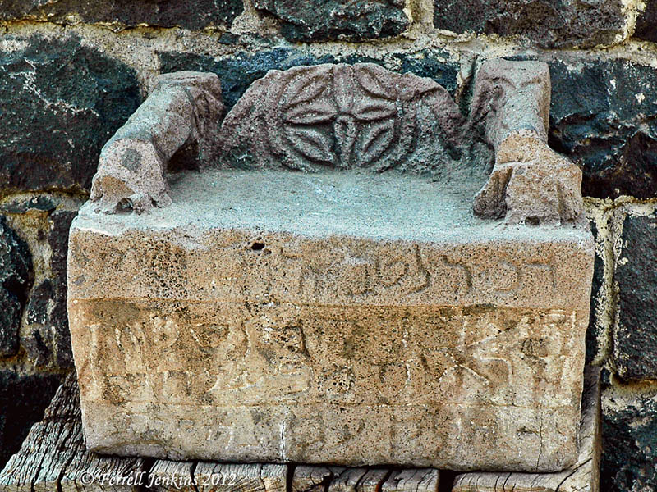
Luke 4:16-31
20 Then He closed the book, and gave it back to the attendant and sat down. And the eyes of all who were in the synagogue were fixed on Him.

Slide 38
Luke 4:16-31
20 Then He closed the book, and gave it back to the attendant and sat down. And the eyes of all who were in the synagogue were fixed on Him.

Slide 39
Luke 4:16-31
21 And He began to say to them, “Today this Scripture is fulfilled in your hearing.”
22 So all bore witness to Him, and marveled at the gracious words which proceeded out of His mouth. And they said, “Is this not Joseph’s son?”
23 He said to them, “You will surely say this proverb to Me, ‘Physician, heal yourself! Whatever we have heard done in Capernaum, do also here in Your country.’”
24 Then He said, “Assuredly, I say to you, no prophet is accepted in his own country.

Slide 40
Luke 4:16-31
25 “But I tell you truly, many widows were in Israel in the days of Elijah, when the heaven was shut up three years and six months, and there was a great famine throughout all the land;
26 “but to none of them was Elijah sent except to Zarephath, in the region of Sidon, to a woman who was a widow.
27 “And many lepers were in Israel in the time of Elisha the prophet, and none of them was cleansed except Naaman the Syrian.”

Slide 41
Luke 4:16-31
25 “But I tell you truly, many widows were in Israel in the days of Elijah, when the heaven was shut up three years and six months, and there was a great famine throughout all the land;
26 “but to none of them was Elijah sent except to Zarephath, in the region of Sidon, to a woman who was a widow. (1 Kings 17)
27 “And many lepers were in Israel in the time of Elisha the prophet, and none of them was cleansed except Naaman the Syrian.”

Slide 42
Luke 4:16-31
25 “But I tell you truly, many widows were in Israel in the days of Elijah, when the heaven was shut up three years and six months, and there was a great famine throughout all the land;
26 “but to none of them was Elijah sent except to Zarephath, in the region of Sidon, to a woman who was a widow. (1 Kings 17)
27 “And many lepers were in Israel in the time of Elisha the prophet, and none of them was cleansed except Naaman the Syrian.” (2 Kings 5)

Slide 43
Luke 4:16-31
28 So all those in the synagogue, when they heard these things, were filled with wrath,
29 and rose up and thrust Him out of the city; and they led Him to the brow of the hill on which their city was built, that they might throw Him down over the cliff.

Slide 44
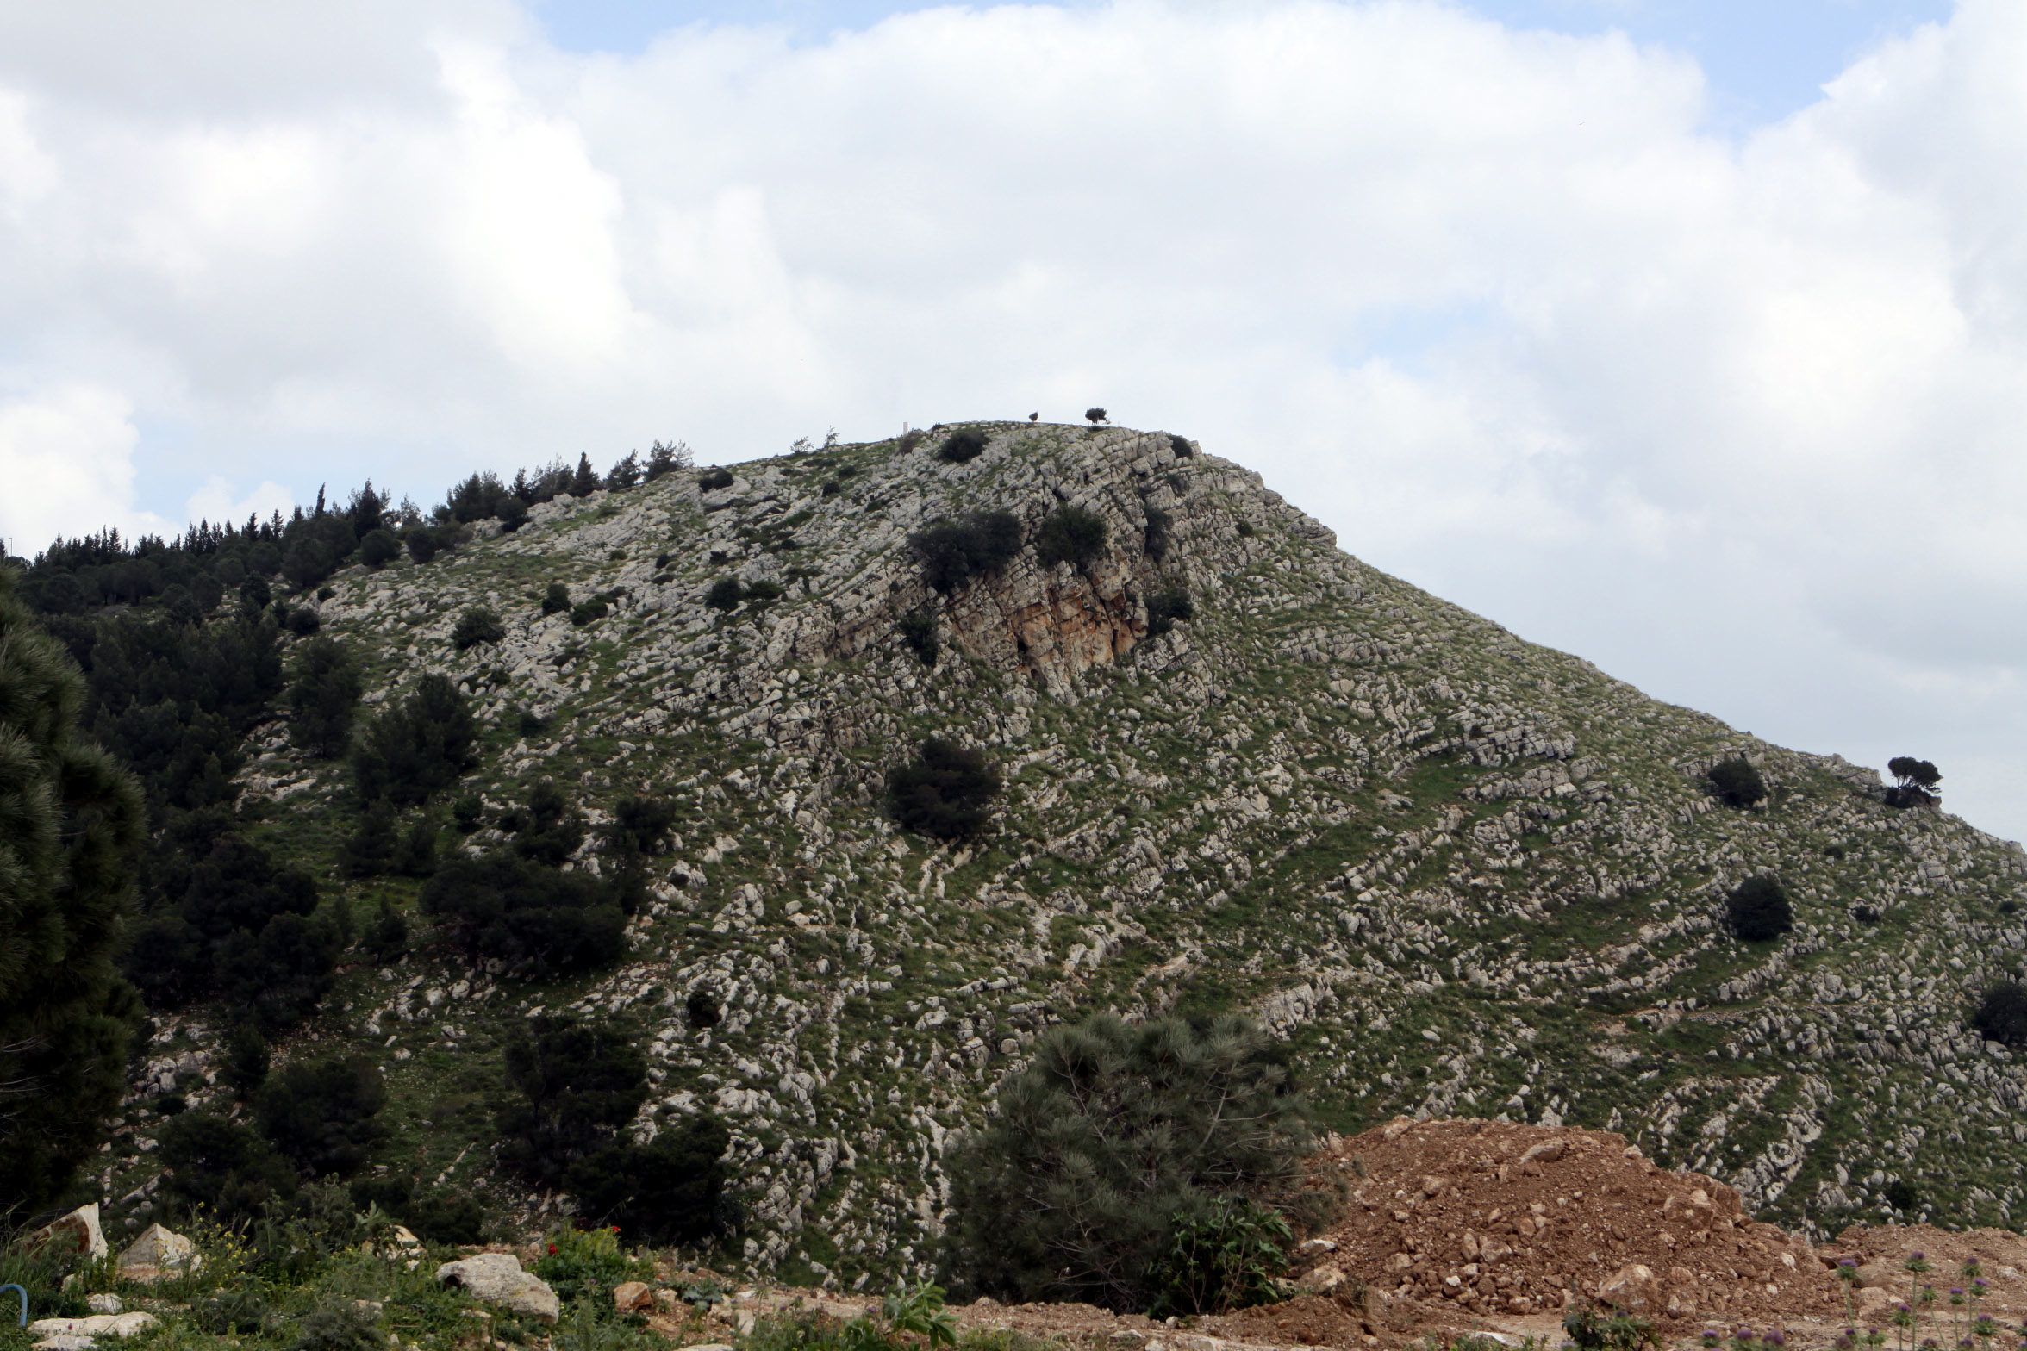

Slide 45
Luke 4:16-31
28 So all those in the synagogue, when they heard these things, were filled with wrath,
29 and rose up and thrust Him out of the city; and they led Him to the brow of the hill on which their city was built, that they might throw Him down over the cliff.
30 Then passing through the midst of them, He went His way.
31 Then He went down to Capernaum, a city of Galilee, and was teaching them on the Sabbaths.

Slide 48
