Slide 1



Slide 2
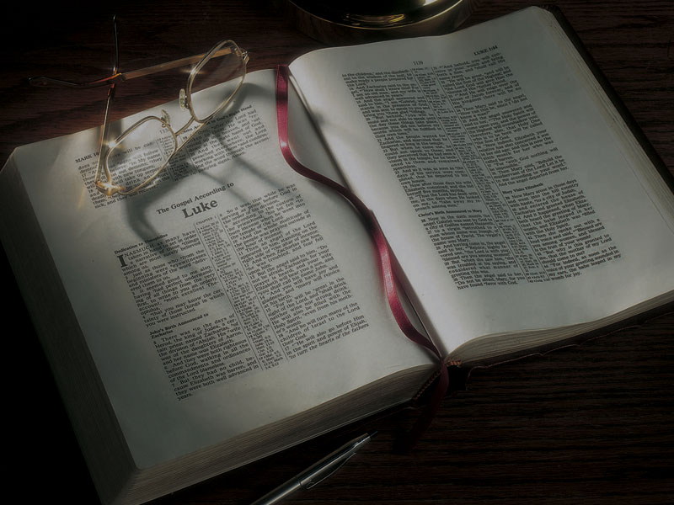
The Gospels
Jesus Turns
Water to Wine,
Cleanses the Temple

Slide 3
John 2:1-11
2:1 On the third day there was a wedding in Cana of Galilee, and the mother of Jesus was there.
2 Now both Jesus and His disciples were invited to the wedding.
3 And when they ran out of wine, the mother of Jesus said to Him, “They have no wine.”

Slide 4
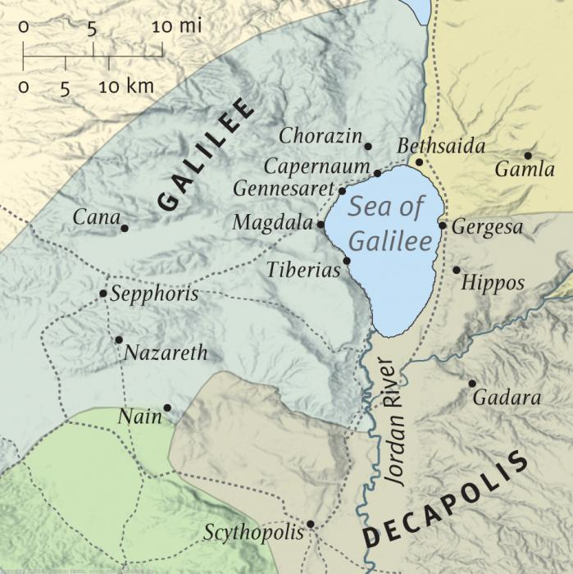
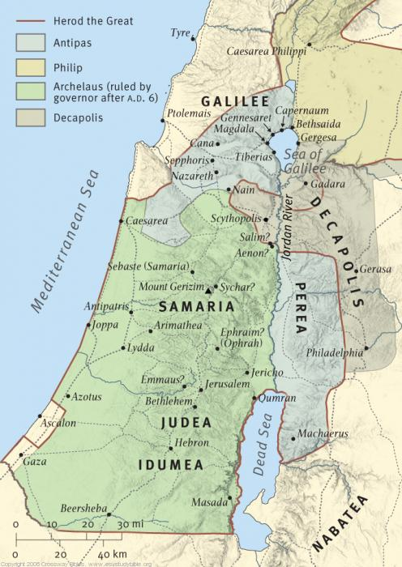

Slide 5
John 2:1-11
2:1 On the third day there was a wedding in Cana of Galilee, and the mother of Jesus was there.
2 Now both Jesus and His disciples were invited to the wedding.
3 And when they ran out of wine, the mother of Jesus said to Him, “They have no wine.”

Slide 6
John 2:1-11
4 Jesus said to her, “Woman, what does your concern have to do with Me? My hour has not yet come.”
5 His mother said to the servants, “Whatever He says to you, do it.”
6 Now there were set there six waterpots of stone, according to the manner of purification of the Jews, containing twenty or thirty gallons apiece.

Slide 7
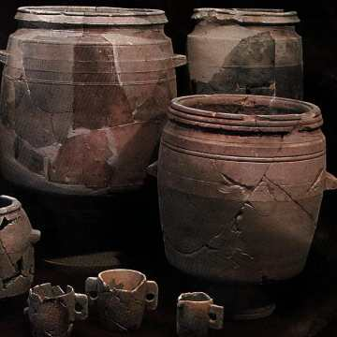

Slide 8
John 2:1-11
7 Jesus said to them, “Fill the waterpots with water.” And they filled them up to the brim.
8 And He said to them, “Draw some out now, and take it to the master of the feast.” And they took it.
9 When the master of the feast had tasted the water that was made wine, and did not know where it came from (but the servants who had drawn the water knew), the master of the feast called the bridegroom.

Slide 9
John 2:1-11
10 And he said to him, “Every man at the beginning sets out the good wine, and when the guests have well drunk, then the inferior. You have kept the good wine until now!”
11 This beginning of signs Jesus did in Cana of Galilee, and manifested His glory; and His disciples believed in Him.

Slide 10
Four key questions for us:

Slide 11
Four key questions for us:
What does this teach us about the nature and character of God?

Slide 12
Four key questions for us:
What does this teach us about the nature and character of God?
What does this teach us about the way God interacts with His people and mankind?

Slide 13
Four key questions for us:
What does this teach us about the nature and character of God?
What does this teach us about the way God interacts with His people and mankind?
What does this mean for your relationship with
God the Father and Jesus Christ?

Slide 14
Four key questions for us:
What does this teach us about the nature and character of God?
What does this teach us about the way God interacts with His people and mankind?
What does this mean for your relationship with
God the Father and Jesus Christ?
What does this teach us about Satan, the adversary of God and mankind?

Slide 15
What does this teach us?

Slide 16
What does this teach us?
God is kind and considerate.

Slide 17
What does this teach us?
God is kind and considerate.
He will be kind and considerate toward you.

Slide 18
What does this teach us?
God is kind and considerate.
He will be kind and considerate toward you.
God is generous and giving.

Slide 19
What does this teach us?
God is kind and considerate.
He will be kind and considerate toward you.
God is generous and giving.
He will be generous and giving toward you.

Slide 20
What does this teach us?
God is kind and considerate.
He will be kind and considerate toward you.
God is generous and giving.
He will be generous and giving toward you.
God meets our genuine needs.

Slide 21
What does this teach us?
God is kind and considerate.
He will be kind and considerate toward you.
God is generous and giving.
He will be generous and giving toward you.
God meets our genuine needs.
He will meet your needs also.

Slide 22
What does this teach us?
God is kind and considerate.
He will be kind and considerate toward you.
God is generous and giving.
He will be generous and giving toward you.
God meets our genuine needs.
He will meet your needs also.
God is a God of quality.

Slide 23
What does this teach us?
God is kind and considerate.
He will be kind and considerate toward you.
God is generous and giving.
He will be generous and giving toward you.
God meets our genuine needs.
He will meet your needs also.
God is a God of quality.
He wants us to be a people of quality.

Slide 24
What does this teach us?
God is kind and considerate.
He will be kind and considerate toward you.
God is generous and giving.
He will be generous and giving toward you.
God meets our genuine needs.
He will meet your needs also.
God is a God of quality.
He wants us to be a people of quality.
God wants us to be happy.

Slide 25
What does this teach us?
God is kind and considerate.
He will be kind and considerate toward you.
God is generous and giving.
He will be generous and giving toward you.
God meets our genuine needs.
He will meet your needs also.
God is a God of quality.
He wants us to be a people of quality.
God wants us to be happy.
He will help us to be happy.

Slide 26
What does this teach us?
God wants to be involved in your life.

Slide 27
What does this teach us?
God wants to be involved in your life.
He will be involved in your life if you let Him.

Slide 28
What does this teach us?
God wants to be involved in your life.
He will be involved in your life if you let Him.
God is involved in the small things.

Slide 29
What does this teach us?
God wants to be involved in your life.
He will be involved in your life if you let Him.
God is involved in the small things.
He will be involved in your small things if you
let Him.

Slide 30
Four key questions for us:
What does this teach us about the nature and character of God?
What does this teach us about the way God interacts with His people and mankind?
What does this mean for your relationship with
God the Father and Jesus Christ?
What does this teach us about Satan, the adversary of God and mankind?

Slide 31
John 2:1-12
12 After this He went down to Capernaum, He, His mother, His brothers, and His disciples; and they did not stay there many days.

Slide 33
Hebrews 4:15 (NRSV)
15 For we do not have a high priest who is unable to sympathize with our weaknesses, but we have one who in every respect has been tested as we are, yet without sin.

Slide 34
Matthew 13:54-55
54 And when He had come to His own country, He taught them in their synagogue, so that they were astonished and said, “Where did this Man get this wisdom and these mighty works?
55 “Is this not the carpenter’s son?

Slide 35
Matthew 13:54-55
54 And when He had come to His own country, He taught them in their synagogue, so that they were astonished and said, “Where did this Man get this wisdom and these mighty works?
55 “Is this not the carpenter’s son?
Mark 6:3
3 (Speaking of Jesus) “Is this not the carpenter?”

Slide 36
Matthew 13:54-55
54 And when He had come to His own country, He taught them in their synagogue, so that they were astonished and said, “Where did this Man get this wisdom and these mighty works?
55 “Is this not the carpenter’s son?
Mark 6:3
3 (Speaking of Jesus) “Is this not the carpenter?”
“carpenter” = Greek tekton = builder, craftsman

Slide 37
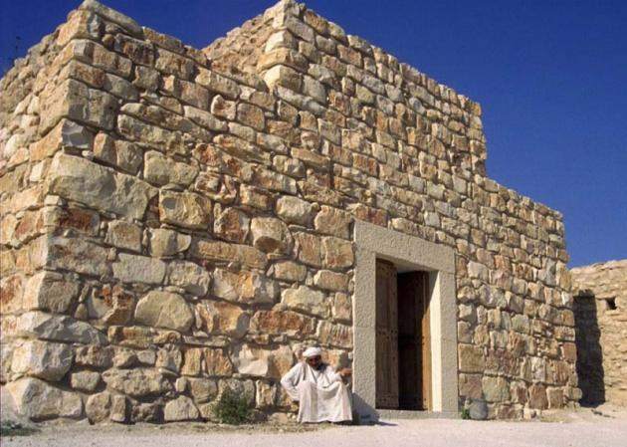

Slide 38
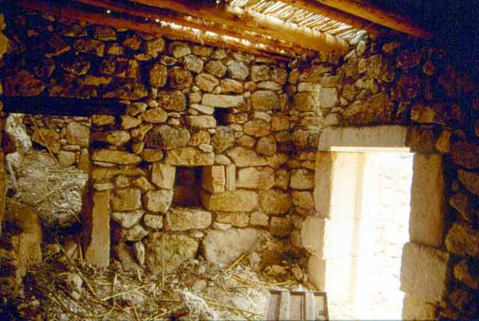

Slide 39
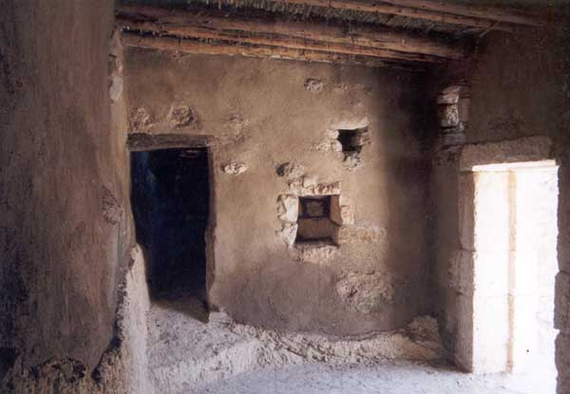

Slide 40
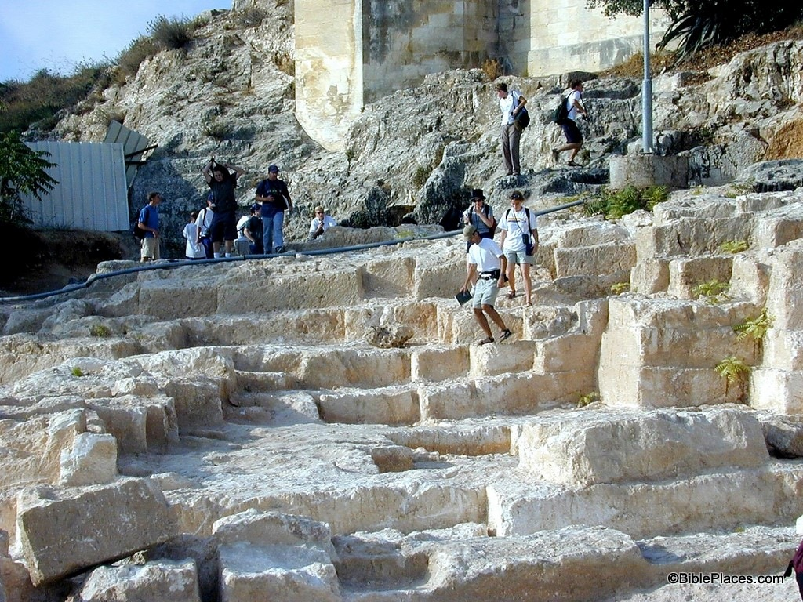

Slide 41
1 Corinthians 3:10
10 According to the grace of God which was given to me, as a wise master builder [architekton] I have laid the foundation, and another builds on it.

Slide 42
1 Peter 2:4-5
4 [We are] Coming to Him [Jesus Christ] as to a living stone, rejected indeed by men, but chosen
by God and precious,
5 you also, as living stones, are being built up
a spiritual house, a holy priesthood, to offer up spiritual sacrifices acceptable to God through
Jesus Christ.

Slide 43
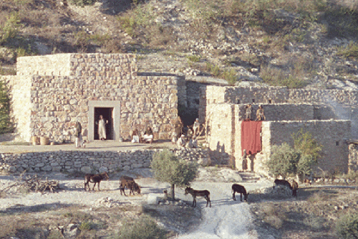

Slide 44
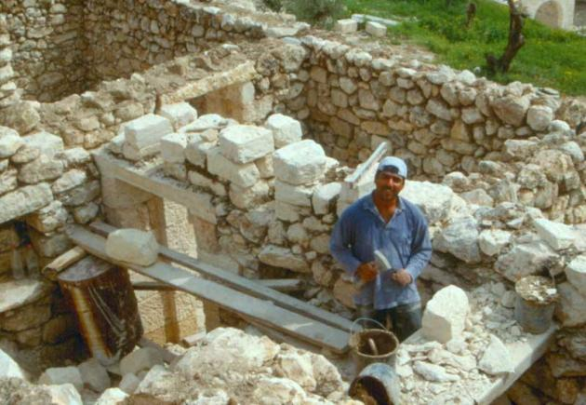

Slide 45
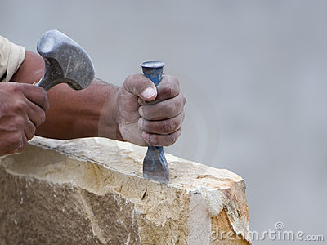

Slide 46
John 2:13-22
13 Now the Passover of the Jews was at hand, and Jesus went up to Jerusalem.
14 And He found in the temple those who sold oxen and sheep and doves, and the moneychangers doing business.
15 When He had made a whip of cords, He drove them all out of the temple, with the sheep and the oxen, and poured out the changers’ money and overturned the tables.

Slide 47
John 2:13-22
16 And He said to those who sold doves, “Take these things away! Do not make My Father’s house a house of merchandise!”

Slide 48
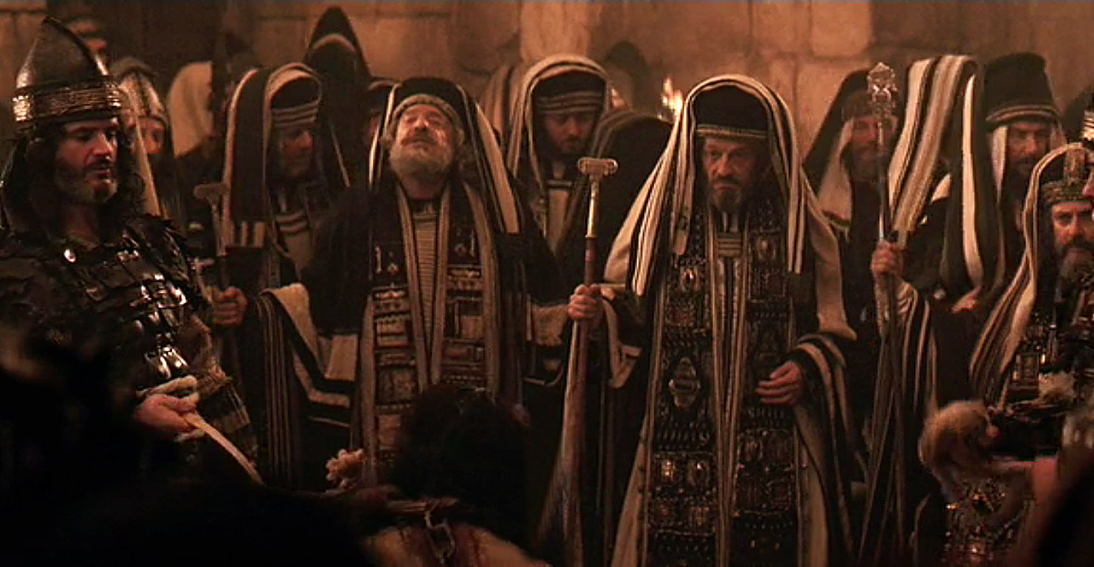

Slide 49
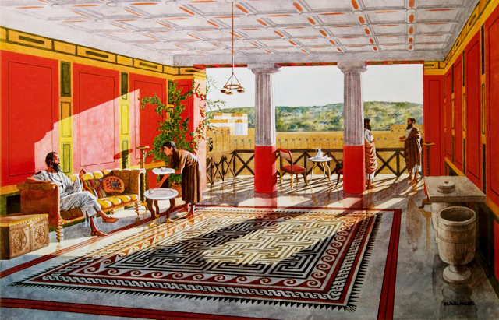

Slide 50
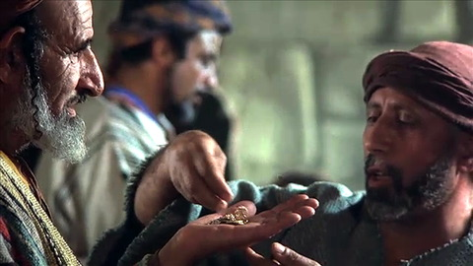

Slide 51
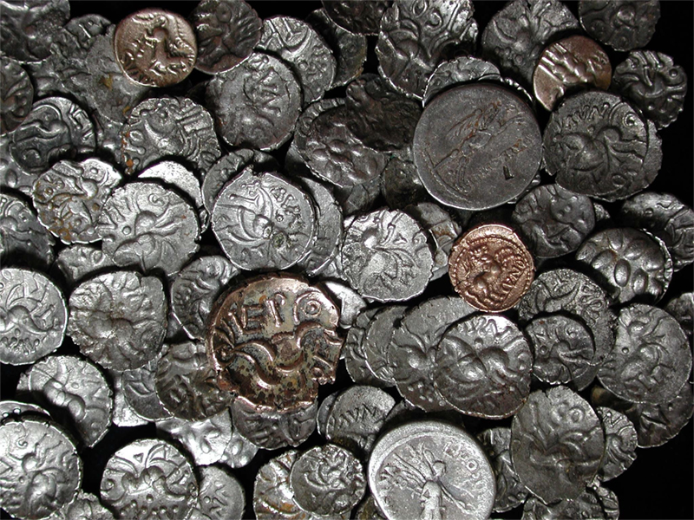

Slide 52
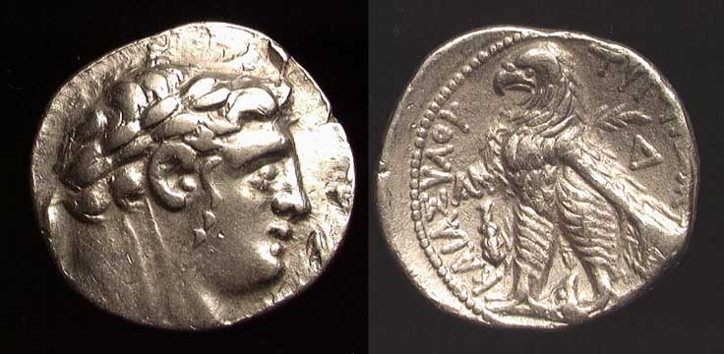

Slide 53
Exodus 30:11-14
11 Then the LORD spoke to Moses, saying:
12 “When you take the census of the children of Israel for their number, then every man shall give a ransom for himself to the LORD . . .
13 “This is what everyone among those who are numbered shall give: half a shekel according to the shekel of the sanctuary (a shekel is twenty gerahs). The half-shekel shall be an offering to the LORD.
14 “Everyone included among those who are numbered, from twenty years old and above, shall give an offering to the LORD.

Slide 55
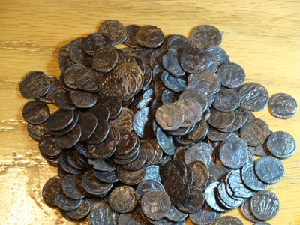

Slide 56
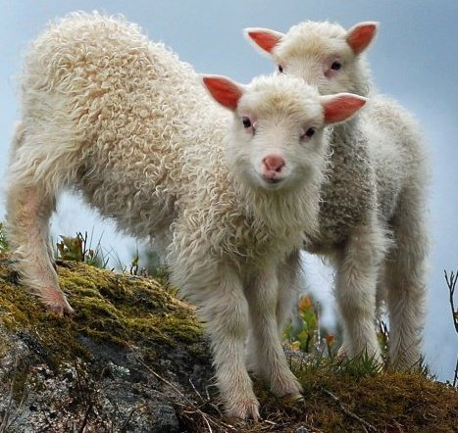

Slide 58
John 2:13-22
17 Then His disciples remembered that it was written, “Zeal for Your house has eaten Me up.”

Slide 59
Psalm 69:9
9 Because the zeal for Your house has eaten
me up . . .

Slide 60
Psalm 69:4, 21
4 Those who hate me without a cause are more than the hairs of my head . . .
(quoted in John 15:25)
21 They also gave me gall for my food, and for my thirst they gave me vinegar to drink.
(fulfilled in Matthew 27:34; Mark 15:23, 36;
Luke 23:36)

Slide 61
Psalm 69:6-13
6 Let not those who wait for You, O Lord GOD of hosts, be ashamed because of me; let not those who seek You be confounded because of me, O God of Israel.
7 Because for Your sake I have borne reproach; shame has covered my face.
8 I have become a stranger to my brothers, and an alien to my mother’s children;
9 Because zeal for Your house has eaten me up, and the reproaches of those who reproach You have fallen on me.

Slide 62
Psalm 69:6-13
10 When I wept and chastened my soul with fasting, that became my reproach.
11 I also made sackcloth my garment; I became a byword to them.
12 Those who sit in the gate speak against me, and I am the song of the drunkards.
13 But as for me, my prayer is to You, O LORD, in the acceptable time; O God, in the multitude of Your mercy, hear me in the truth of Your salvation.

Slide 63
John 2:13-22
18 So the Jews answered and said to Him, “What sign do You show to us, since You do these things?”
19 Jesus answered and said to them, “Destroy this temple, and in three days I will raise it up.”
20 Then the Jews said, “It has taken forty-six years to build this temple, and will You raise it up in three days?”
21 But He was speaking of the temple of His body.

Slide 64
John 2:13-22
22 Therefore, when He had risen from the dead,
His disciples remembered that He had said this to them; and they believed the Scripture and the word which Jesus had said.

Slide 68
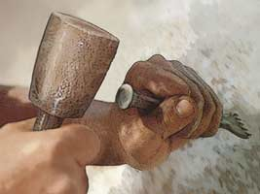

Slide 69
John 1:35-51
35 Again, the next day, John stood with two of his disciples.

Slide 70
John 1:35-51
35 Again, the next day, John stood with two of his disciples.
29 The next day John saw Jesus coming toward him, and said, “Behold! The Lamb of God who takes away the sin of the world! . . .
35 Again, the next day, John stood with two of his disciples . . .
43 The following day Jesus wanted to go to Galilee . . .

Slide 72
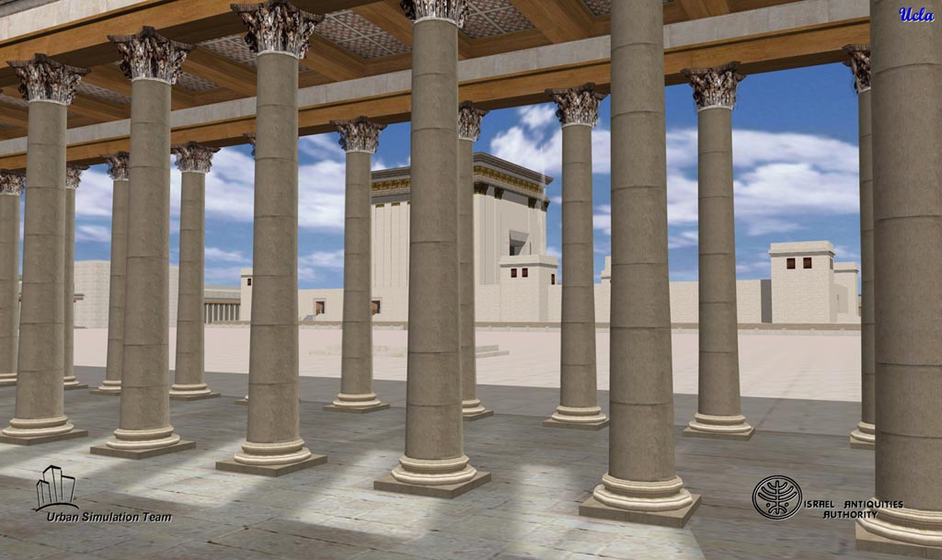
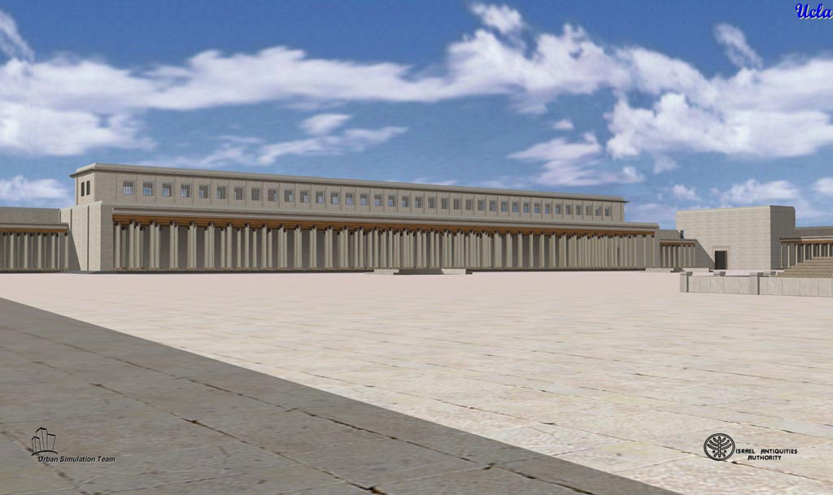
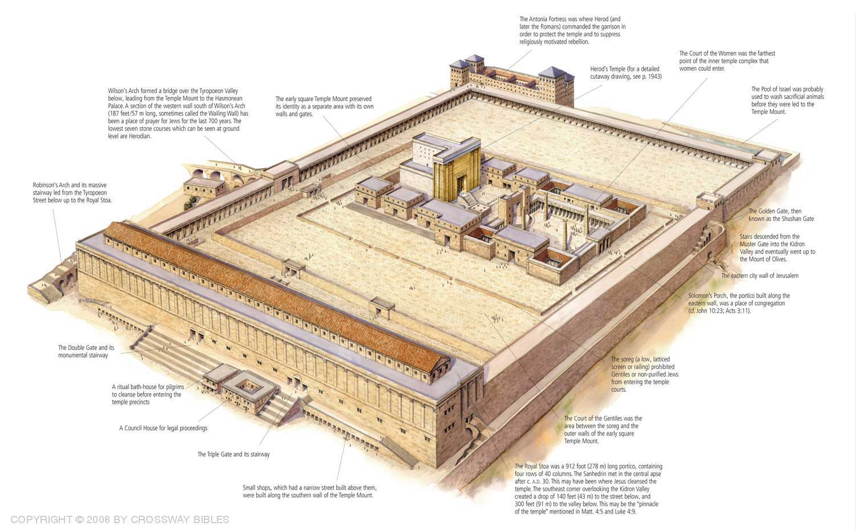
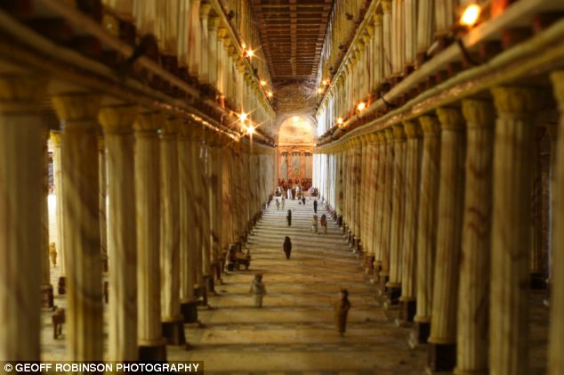
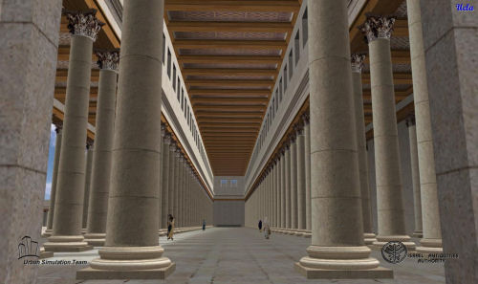

Slide 73
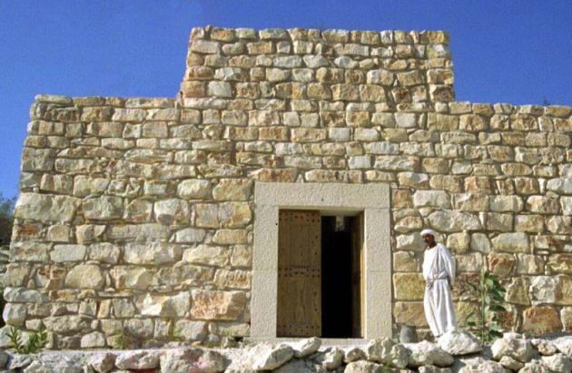

Slide 74
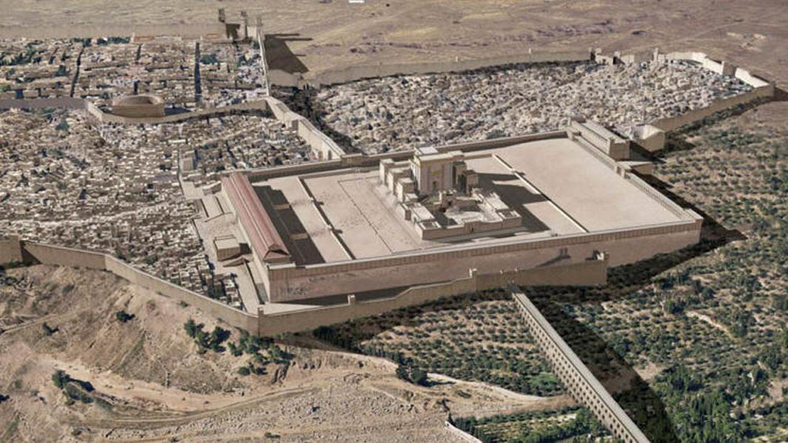

Slide 75
Keys to becoming a disciple:

Slide 76
Keys to becoming a disciple:
1. A disciple must spend as much time as possible with his master.

Slide 77
Keys to becoming a disciple:
1. A disciple must spend as much time as possible with his master.
2. A disciple must be totally committed to his master.

Slide 78
Keys to becoming a disciple:
1. A disciple must spend as much time as possible with his master.
2. A disciple must be totally committed to his master.
3. A disciple must serve his master.

Slide 79
Ephesians 4:11-13 (NIV)
11 It was he [Jesus Christ, the Head of the Church] who gave some to be apostles, some to be prophets, some to be evangelists, and some
to be pastors and teachers,
12 to prepare God’s people for works of service,
so that the body of Christ may be built up
13 until we all reach unity in the faith and in the knowledge of the Son of God and become mature, attaining to the whole measure of the fullness
of Christ.

Slide 80
John 1:35-51
35 Again, the next day, John stood with two of his disciples.
36 And looking at Jesus as He walked, he said, “Behold the Lamb of God!”
37 The two disciples heard him speak, and they followed Jesus.
38 Then Jesus turned, and seeing them following, said to them, “What do you seek?” They said to Him, “Rabbi” (which is to say, when translated, Teacher), “where are You staying?”

Slide 81
John 1:35-51
39 He said to them, “Come and see.” They came and saw where He was staying, and remained with Him that day (now it was about the tenth hour).
40 One of the two who heard John speak, and followed Him, was Andrew, Simon Peter’s brother.

Slide 82
John 18:15-16
15 And Simon Peter followed Jesus, and so did another disciple. Now that disciple was known to the high priest, and went with Jesus into the courtyard of the high priest.
16 But Peter stood at the door outside. Then the other disciple, who was known to the high priest, went out and spoke to her who kept the door, and brought Peter in.

Slide 83
What does this teach us?
God is kind and considerate.
He will be kind and considerate toward you.
God is generous and giving.
He will be generous and giving toward you.
God meets our genuine needs.
He will meet your needs also.
God is a God of quality.
He wants us to be a people of quality.
God wants us to be happy.
He will help us to be happy.
God wants to be involved in your life.
He will be involved in your life if you let Him.
God is involved in the small things.
He will be involved in your small things if you let Him.

Slide 84
John 21:20-24
20 Then Peter, turning around, saw the disciple whom Jesus loved following, who also had leaned on His breast at the supper, and said, “Lord, who is the one who betrays You?”
21 Peter, seeing him, said to Jesus, “But Lord, what about this man?”
22 Jesus said to him, “If I will that he remain till
I come, what is that to you? You follow Me.”

Slide 85
John 21:20-24
23 Then this saying went out among the brethren that this disciple would not die. Yet Jesus did not say to him that he would not die, but, “If I will that he remain till I come, what is that to you?”
24 This is the disciple who testifies of these things, and wrote these things; and we know that his testimony is true.

Slide 86
John 1:35-51
41 He first found his own brother Simon, and said to him, “We have found the Messiah” (which is translated, the Christ).
42 And he brought him to Jesus. Now when Jesus looked at him, He said, “You are Simon the son of Jonah. You shall be called Cephas” (which is translated, A Stone).

Slide 87
John 1:35-51
43 The following day Jesus wanted to go to Galilee, and He found Philip and said to him, “Follow Me.”
44 Now Philip was from Bethsaida, the city of Andrew and Peter.
45 Philip found Nathanael and said to him, “We have found Him of whom Moses in the law, and also the prophets, wrote—Jesus of Nazareth, the son of Joseph.”
46 And Nathanael said to him, “Can anything good come out of Nazareth?” Philip said to him, “Come and see.”

Slide 88
John 1:35-51
43 The following day Jesus wanted to go to Galilee, and He found Philip and said to him, “Follow Me.”
44 Now Philip was from Bethsaida, the city of Andrew and Peter.
45 Philip found Nathanael and said to him, “We have found Him of whom Moses in the law, and also the prophets, wrote—Jesus of Nazareth, the son of Joseph.”
46 And Nathanael said to him, “Can anything good come out of Nazareth?” Philip said to him, “Come and see.”

Slide 89
John 21:2
2 Simon Peter, Thomas called the Twin, Nathanael
of Cana in Galilee, the sons of Zebedee, and two others of His disciples were together.

Slide 91
John 1:35-51
47 Jesus saw Nathanael coming toward Him, and said of him, “Behold, an Israelite indeed, in whom is no deceit!”
48 Nathanael said to Him, “How do You know me?” Jesus answered and said to him, “Before Philip called you, when you were under the fig tree, I saw you.”

Slide 92
John 1:35-51
49 Nathanael answered and said to Him, “Rabbi, You are the Son of God! You are the King of Israel!”
50 Jesus answered and said to him, “Because I said to you, ‘I saw you under the fig tree,’ do you believe? You will see greater things than these.”
51 And He said to him, “Most assuredly, I say to you, hereafter you shall see heaven open, and the angels of God ascending and descending upon the Son of Man.”

Slide 93
Genesis 28:12
12 Then he dreamed, and behold, a ladder was set up on the earth, and its top reached to heaven; and there the angels of God were ascending and descending on it.

Slide 94
Daniel 7:13-14
13 “I was watching in the night visions, and behold, one like the Son of Man, coming with the clouds of heaven! He came to the Ancient of Days, and they brought Him near before Him.
14 Then to Him was given dominion and glory and a kingdom, that all peoples, nations, and languages should serve Him. His dominion is an everlasting dominion, which shall not pass away, and His kingdom the one Which shall not be destroyed.

