Slide 1

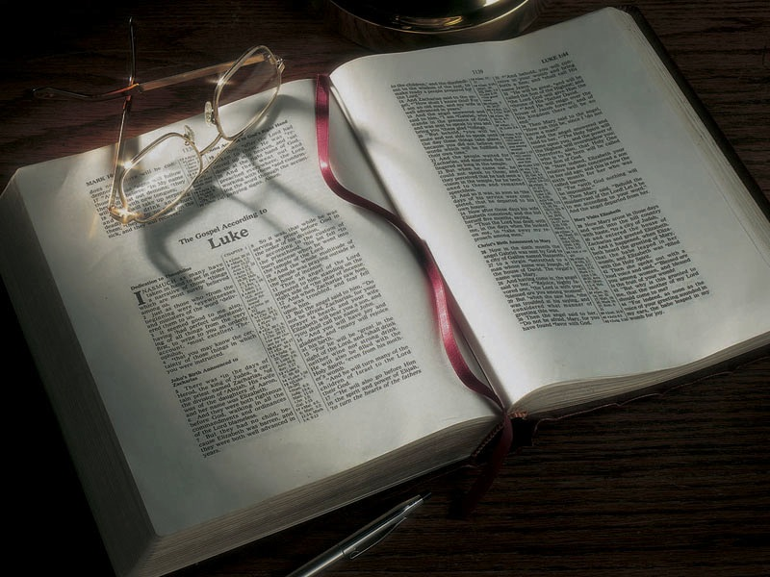

Slide 2
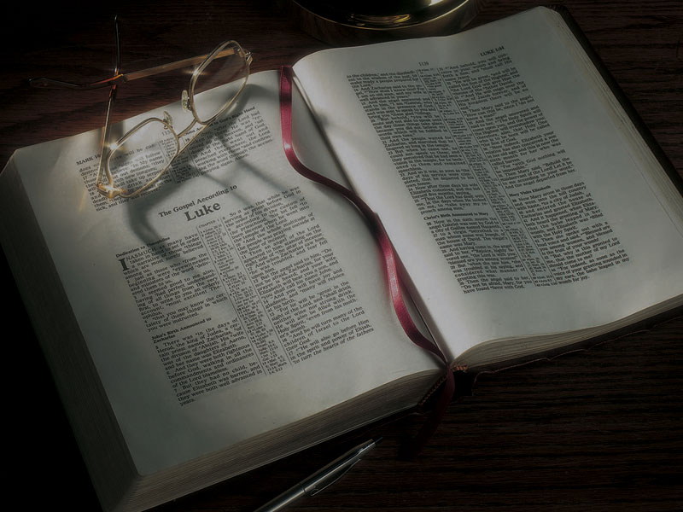
The Gospels
The Baptism
of Jesus

Slide 3
Luke 3:15-18
15 Now as the people were in expectation, and all reasoned in their hearts about John, whether he was the Christ or not,
16 John answered, saying to all, “I indeed baptize you with water; but One mightier than I is coming, whose sandal strap I am not worthy to loose. He will baptize you with the Holy Spirit and fire.

Slide 4
Luke 3:15-18
15 Now as the people were in expectation, and all reasoned in their hearts about John, whether he was the Christ or not,
16 John answered, saying to all, “I indeed baptize you with water; but One mightier than I is coming, whose sandal strap I am not worthy to loose. He will baptize you with the Holy Spirit and fire.
“baptize” = baptizo, meaning “immerse” or “submerge.”

Slide 5
Luke 3:15-18
15 Now as the people were in expectation, and all reasoned in their hearts about John, whether he was the Christ or not,
16 John answered, saying to all, “I indeed baptize you with water; but One mightier than I is coming, whose sandal strap I am not worthy to loose. He will baptize you with the Holy Spirit and fire.
“baptize” = baptizo, meaning “immerse” or “submerge.” It’s used of ships sinking, being “baptized” in the sea.

Slide 6
Luke 3:15-18
15 Now as the people were in expectation, and all reasoned in their hearts about John, whether he was the Christ or not,
16 John answered, saying to all, “I indeed baptize you with water; but One mightier than I is coming, whose sandal strap I am not worthy to loose. He will baptize you with the Holy Spirit and fire.
“with” = en, meaning “with,” “in,” “on,” or “by.”

Slide 7
Luke 3:15-18
15 Now as the people were in expectation, and all reasoned in their hearts about John, whether he was the Christ or not,
16 John answered, saying to all, “I indeed baptize you with in water; but One mightier than I is coming, whose sandal strap I am not worthy to loose. He will baptize you with in the Holy Spirit
and fire.
“with” = en, meaning “with,” “in,” “on,” or “by.”

Slide 8
Acts 19:1-5
1 And it happened, while Apollos was at Corinth, that Paul, having passed through the upper regions, came to Ephesus. And finding some disciples
2 he said to them, “Did you receive the Holy Spirit when you believed?” So they said to him, “We have not so much as heard whether there is a Holy Spirit.”
3 And he said to them, “Into what then were you baptized?” So they said, “Into John’s baptism.”

Slide 9
Acts 19:1-5
4 Then Paul said, “John indeed baptized with a baptism of repentance, saying to the people that they should believe on Him who would come after him, that is, on Christ Jesus.”
5 When they heard this, they were baptized in the name of the Lord Jesus.

Slide 10
Luke 3:15-18
16 John answered, saying to all, “I indeed baptize you with water; but One mightier than I is coming, whose sandal strap I am not worthy to loose. He will baptize you with the Holy Spirit and fire.
17 “His winnowing fan is in His hand, and He will thoroughly clean out His threshing floor, and gather the wheat into His barn; but the chaff He will burn with unquenchable fire.”
18 And with many other exhortations he preached to the people.

Slide 11
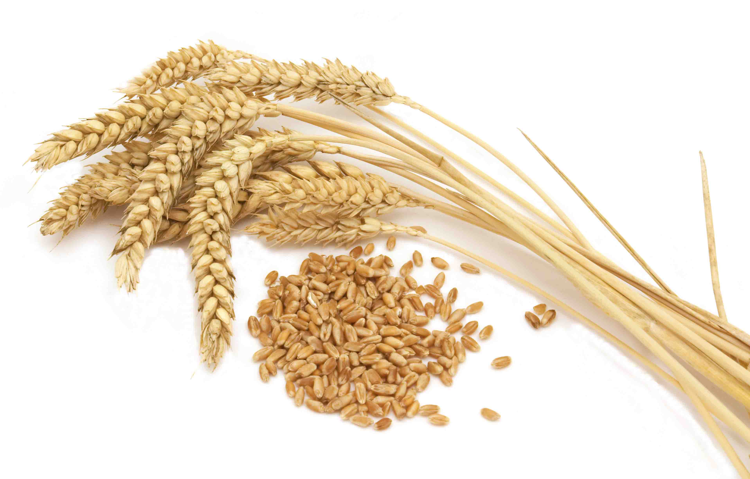

Slide 12
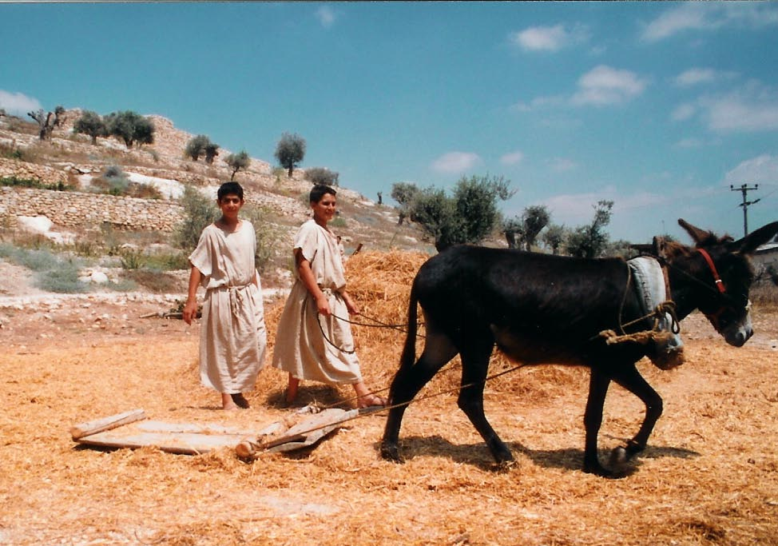

Slide 13
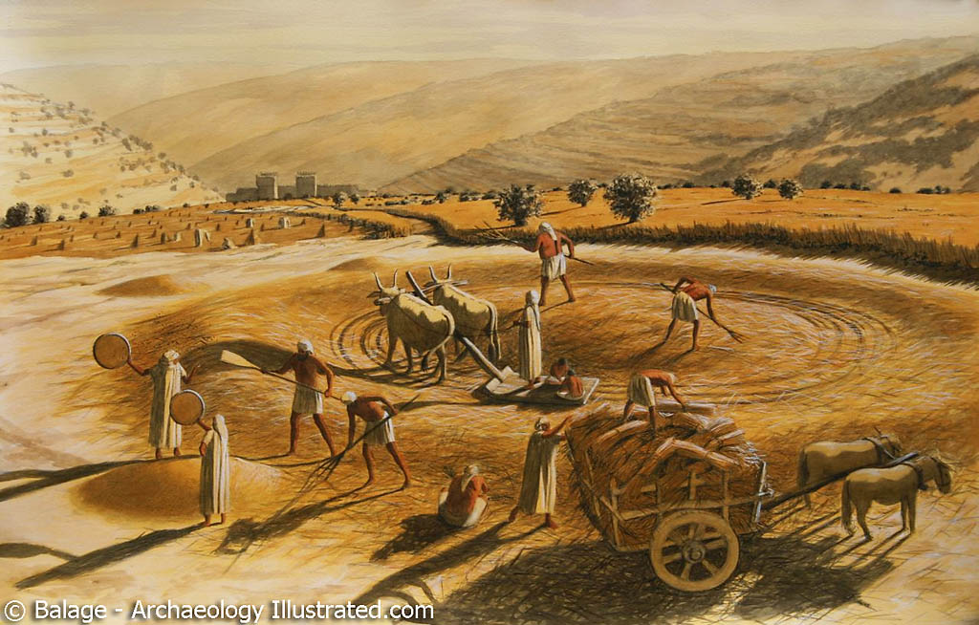

Slide 14
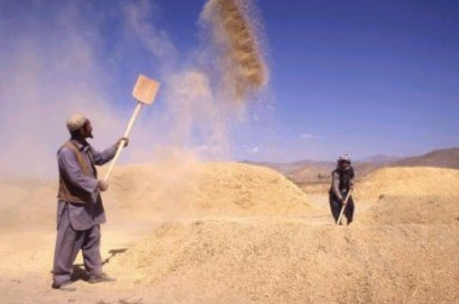

Slide 15
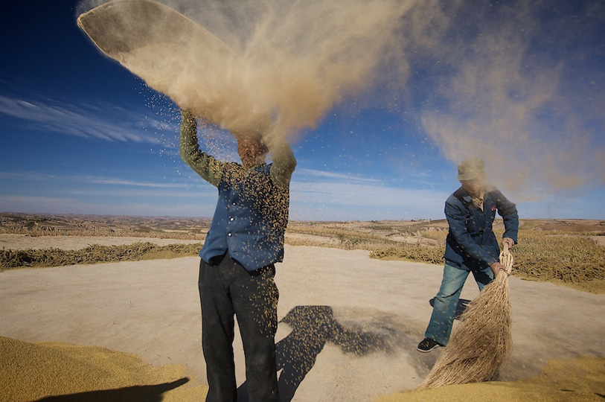

Slide 16
Jeremiah 15:7
7 And I will winnow them with a winnowing fan
in the gates of the land; I will bereave them of children; I will destroy My people, since they do not return from their ways.

Slide 17
Jeremiah 15:5-9
5 “For who will have pity on you, O Jerusalem? Or who will bemoan you? Or who will turn aside to ask how you are doing?
6 You have forsaken Me,” says the LORD, “You have gone backward. Therefore I will stretch out My hand against you and destroy you; I am weary of relenting!
7 And I will winnow them with a winnowing fan
in the gates of the land; I will bereave them of children; I will destroy My people, since they do not return from their ways.

Slide 18
Jeremiah 15:5-9
8 Their widows will be increased to Me more than the sand of the seas; I will bring against them, against the mother of the young men, a plunderer at noonday; I will cause anguish and terror to fall on them suddenly.
9 “She languishes who has borne seven; she has breathed her last; her sun has gone down while
it was yet day; she has been ashamed and con-founded. And the remnant of them I will deliver to the sword before their enemies,” says the LORD.

Slide 19
Matthew 3:4
4 The ungodly . . . are like the chaff which the wind drives away.
Hosea 13:3
3 Therefore they shall be like the morning cloud and like the early dew that passes away, like chaff blown off from a threshing floor and like smoke from a chimney.

Slide 20
Isaiah 5:24
24 Therefore, as the fire devours the stubble, and the flame consumes the chaff, so their root will be as rottenness, and their blossom will ascend like dust; because they have rejected the law of the LORD of hosts, and despised the word of the Holy One of Israel.

Slide 21
Isaiah 66:23-24
23 And it shall come to pass that from one New Moon to another, and from one Sabbath to another, all flesh shall come to worship before Me,” says the LORD.
24 “And they shall go forth and look upon the corpses of the men who have transgressed against Me. For their worm does not die, and their fire is not quenched. They shall be an abhorrence to all flesh.”

Slide 22
Jeremiah 7:20
20 Therefore thus says the Lord GOD: “Behold, My anger and My fury will be poured out on this place—on man and on beast, on the trees of the field and on the fruit of the ground. And it will burn and not be quenched.”

Slide 23
Luke 3:18
18 And with many other exhortations he preached to the people.

Slide 24
Matthew 3:13-15
13 Then Jesus came from Galilee to John at the Jordan to be baptized by him.
14 And John tried to prevent Him, saying, “I need to be baptized by You, and are You coming to me?”
15 But Jesus answered and said to him, “Permit it to be so now, for thus it is fitting for us to fulfill all righteousness.” Then he allowed Him.

Slide 25
Jeremiah 23:5-6
5 “Behold, the days are coming,” says the
LORD, “That I will raise to David a Branch of righteousness; a King shall reign and prosper, and execute judgment and righteousness in the earth.
6 In His days Judah will be saved, and Israel will dwell safely; now this is His name by which He will be called: THE LORD OUR RIGHTEOUSNESS.

Slide 26
Jeremiah 23:5-6
5 “Behold, the days are coming,” says the
LORD, “That I will raise to David a Branch of righteousness; a King shall reign and prosper, and execute judgment and righteousness in the earth.
6 In His days Judah will be saved, and Israel will dwell safely; now this is His name by which He will be called: THE LORD OUR RIGHTEOUSNESS.
Jesus is referring to this and saying He is Messiah!

Slide 27
Jeremiah 33:15-16
15 ‘In those days and at that time I will cause to grow up to David A Branch of righteousness; He shall execute judgment and righteousness in the earth.
16 In those days Judah will be saved, And Jerusalem will dwell safely. And this is the name by which she will be called: THE LORD OUR RIGHTEOUSNESS.’

Slide 28
Jeremiah 33:15-16
15 ‘In those days and at that time I will cause to grow up to David A Branch of righteousness; He shall execute judgment and righteousness in the earth.
16 In those days Judah will be saved, And Jerusalem will dwell safely. And this is the name by which she will be called: THE LORD OUR RIGHTEOUSNESS.’
Jesus is referring to this and saying He is Messiah!

Slide 29
Luke 3:21
21 When all the people were baptized, it came to pass that Jesus also was baptized; and while He prayed, the heaven was opened.

Slide 30
Luke 3:21
21 When all the people were baptized, it came to pass that Jesus also was baptized; and while He prayed, the heaven was opened.
Mark 1:10 (NIV)
10 . . . He saw heaven being torn (ripped) open . . .

Slide 31
Isaiah 64:1
1 Oh, that You would rend the heavens! That You would come down! That the mountains might shake at Your presence—
2 As fire burns brushwood, as fire causes water
to boil—to make Your name known to Your adversaries, that the nations may tremble at Your presence!

Slide 32
Isaiah 64:1
1 Oh, that You would rend the heavens! That You would come down! That the mountains might shake at Your presence—
2 As fire burns brushwood, as fire causes water
to boil—to make Your name known to Your adversaries, that the nations may tremble at Your presence!
God has now come to earth in the form of Jesus
of Nazareth, the Messiah.

Slide 33
Matthew 3:16
16 When He had been baptized, Jesus came up immediately from the water; and behold, the heavens were opened to Him, and He saw the Spirit of God descending like a dove and alighting upon Him.
Luke 3:22
22 And the Holy Spirit descended in bodily form like a dove upon Him…

Slide 34
Isaiah 11:1-2
1 There shall come forth a Rod from the stem of Jesse, and a Branch shall grow out of his roots.
2 The Spirit of the LORD shall rest [rest, settle down and remain] upon Him, the Spirit of wisdom and understanding, the Spirit of counsel and might, the Spirit of knowledge and of the fear of the LORD.

Slide 35
Isaiah 42:1
1 Behold! My Servant whom I uphold, My Elect One in whom My soul delights! I have put My Spirit upon Him; He will bring forth justice to the Gentiles.

Slide 36
Isaiah 61:1-3
1 The Spirit of the Lord GOD is upon Me, because the LORD has anointed Me to preach good tidings to the poor; He has sent Me to heal the broken-hearted, to proclaim liberty to the captives, and the opening of the prison to those who are bound;
2 To proclaim the acceptable year of the LORD, and the day of vengeance of our God; to comfort all who mourn,
3 To console those who mourn in Zion . . . that they may be called trees of righteousness, the planting of the LORD, that He may be glorified.”

Slide 37
Luke 3:22
22 And the Holy Spirit descended in bodily form like a dove upon Him, and a voice came from heaven which said, “You are My beloved Son; in You I am well pleased.”

Slide 38
Luke 3:22
22 And the Holy Spirit descended in bodily form like a dove upon Him, and a voice came from heaven which said, “You are My beloved Son; in You I am well pleased.”
John 5:37
37 And the Father Himself, who sent Me, has testified of Me. You have neither heard His voice
at any time, nor seen His form.

Slide 39
Psalm 2:7-9
7 “I will declare the decree: The LORD has said to Me, ‘You are My Son, today I have begotten You.
8 Ask of Me, and I will give You the nations for Your inheritance, and the ends of the earth for Your possession.
9 You shall break them with a rod of iron; You shall dash them to pieces like a potter’s vessel.’”

Slide 40
Psalm 2:1-6
1 Why do the nations rage, and the people plot a vain thing?
2 The kings of the earth set themselves, and the rulers take counsel together, against the LORD and against His Anointed, saying,
3 “Let us break Their bonds in pieces and cast away Their cords from us.”
4 He who sits in the heavens shall laugh; the LORD shall hold them in derision.

Slide 41
Psalm 2:1-6
5 Then He shall speak to them in His wrath, and distress them in His deep displeasure:
6 “Yet I have set My King on My holy hill of Zion.”
7 “I will declare the decree: The LORD has said to Me, ‘You are My Son, today I have begotten You.

Slide 42
Genesis 22:1-2
1 Now it came to pass after these things that God tested Abraham, and said to him, “Abraham!” And he said, “Here I am.”
2 Then He said, “Take now your son, your only son Isaac, whom you love, and go to the land of Moriah, and offer him there as a burnt offering on one of the mountains of which I shall tell you.”

Slide 43
Isaiah 42:1-4
1 “Behold! My Servant whom I uphold, My Elect One in whom My soul delights! I have put My Spirit upon Him; He will bring forth justice to the Gentiles.
2 He will not cry out, nor raise His voice, nor cause His voice to be heard in the street.
3 . . . He will bring forth justice for truth.
4 He will not fail nor be discouraged, till He has established justice in the earth; and the coastlands shall wait for His law.”

Slide 44
Luke 24:44
44 Then He said to them, “These are the words which I spoke to you while I was still with you, that all things must be fulfilled which were written in the Law of Moses and the Prophets and the Psalms concerning Me.”

Slide 45
Luke 24:44
44 Then He said to them, “These are the words which I spoke to you while I was still with you, that all things must be fulfilled which were written in the Law of Moses and the Prophets and the Psalms concerning Me.”
Law of Moses = Torah (“Law”)
Prophets = Nevi’im (“Prophets”)
Psalms = Kethuvim (“Writings”)
First letters T + N + K = TaNaKh

