Slide 1
https://youtu.be/lW9Uudkx42g

Slide 2
Solomon, in British Coronations
Assembly
January 26, 2017

Slide 3
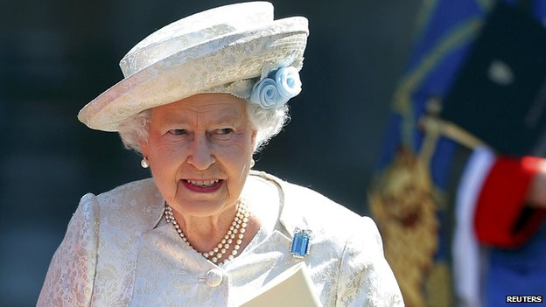
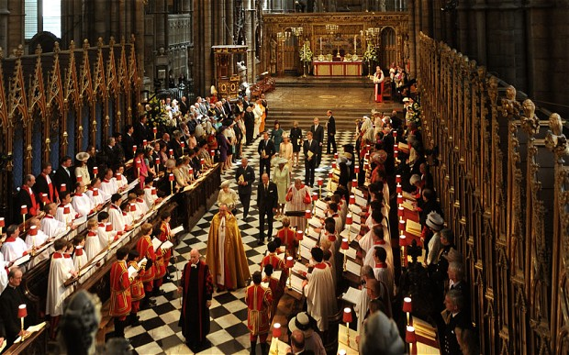

Slide 4
Zadok the Priest
One of 4 Royal anthems for the coronation of George II, 1727
Performed at every coronation since
Focus predates Handel

Slide 5
1 Kings 1:32–34
And King David said, “Call to me Zadok the priest, Nathan the prophet, and Benaiah the son of Jehoiada.” So they came before the king. The king also said to them, “Take with you the servants of your lord, and have Solomon my son ride on my own mule, and take him down to Gihon. There let Zadok the priest and Nathan the prophet anoint him king over Israel; and blow the horn, and say, ‘Long live King Solomon!’

Slide 6
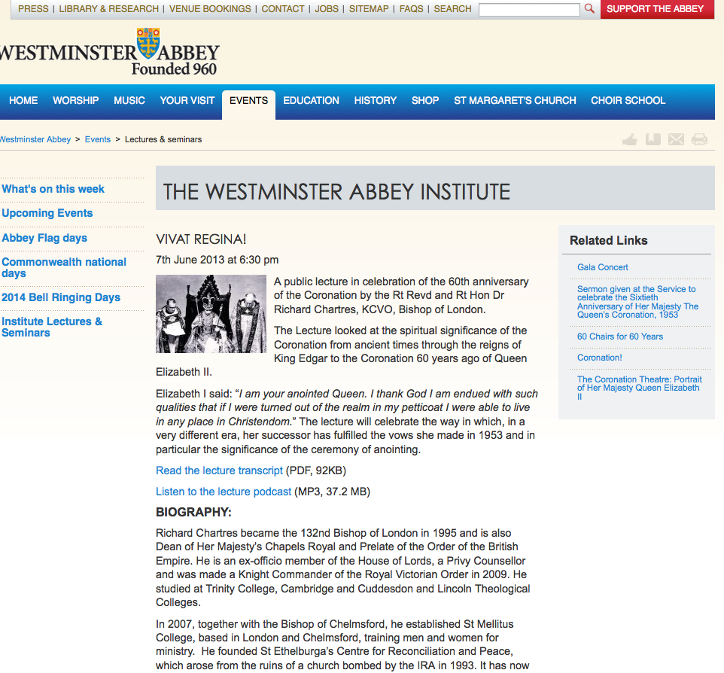

Slide 7
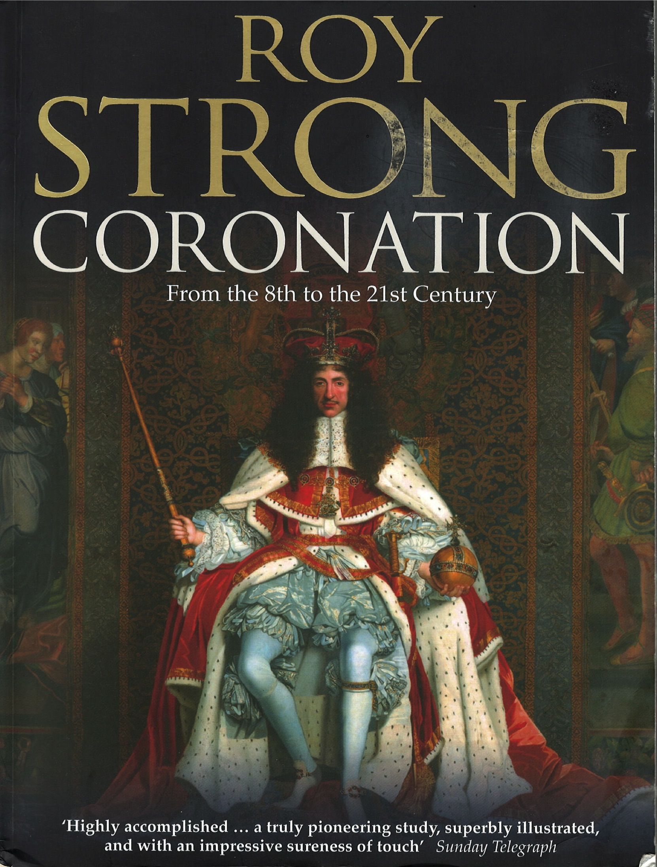

Slide 8
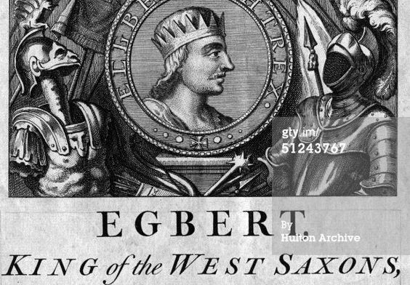
Crowned 839

Slide 9
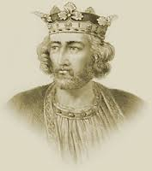
Edward 1:
Longshanks r. 1272-1307

Slide 10
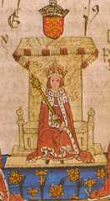
Edward 1
Page 101

Slide 11
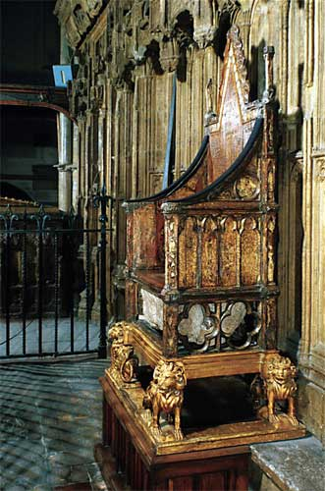
Edward I’s Coronation chair

Slide 12
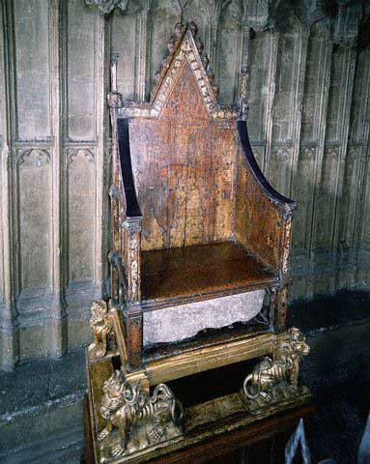
The chair was built to house the stone

Slide 13
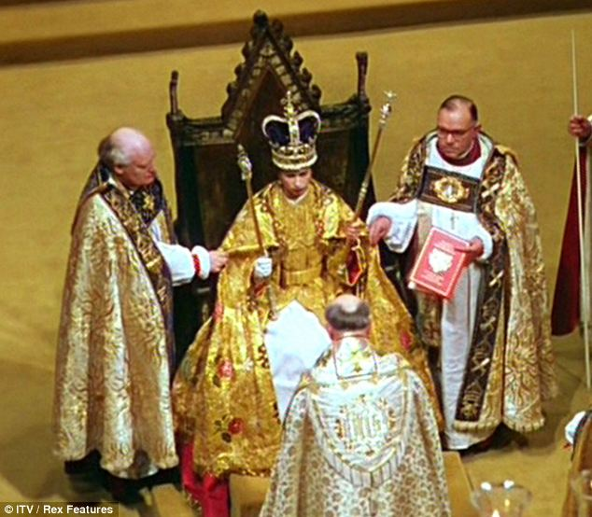

Slide 14
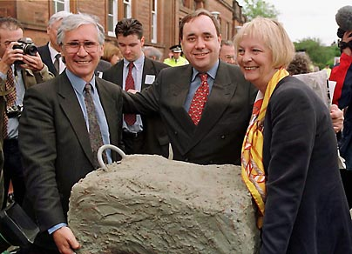

Slide 15
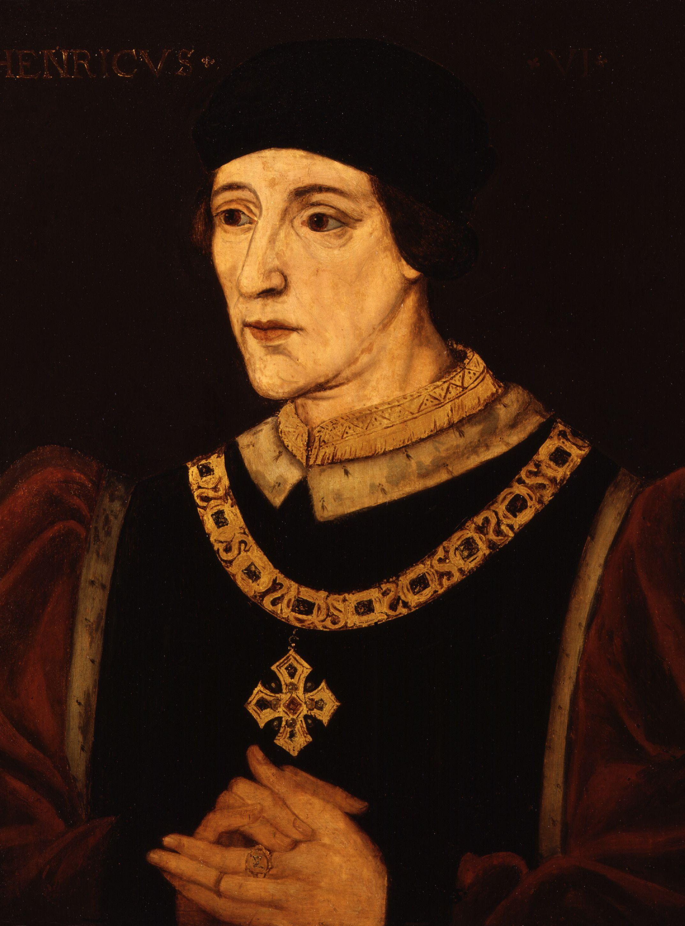
HENRY VI
1421–1471
King of England and France

Slide 16
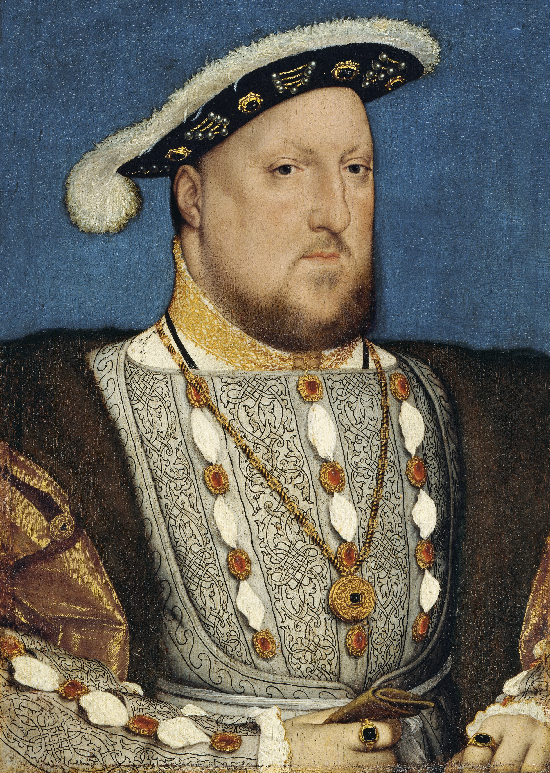
HENRY VIII
C 1536
Break with Rome and establishment of the English Church

Slide 17
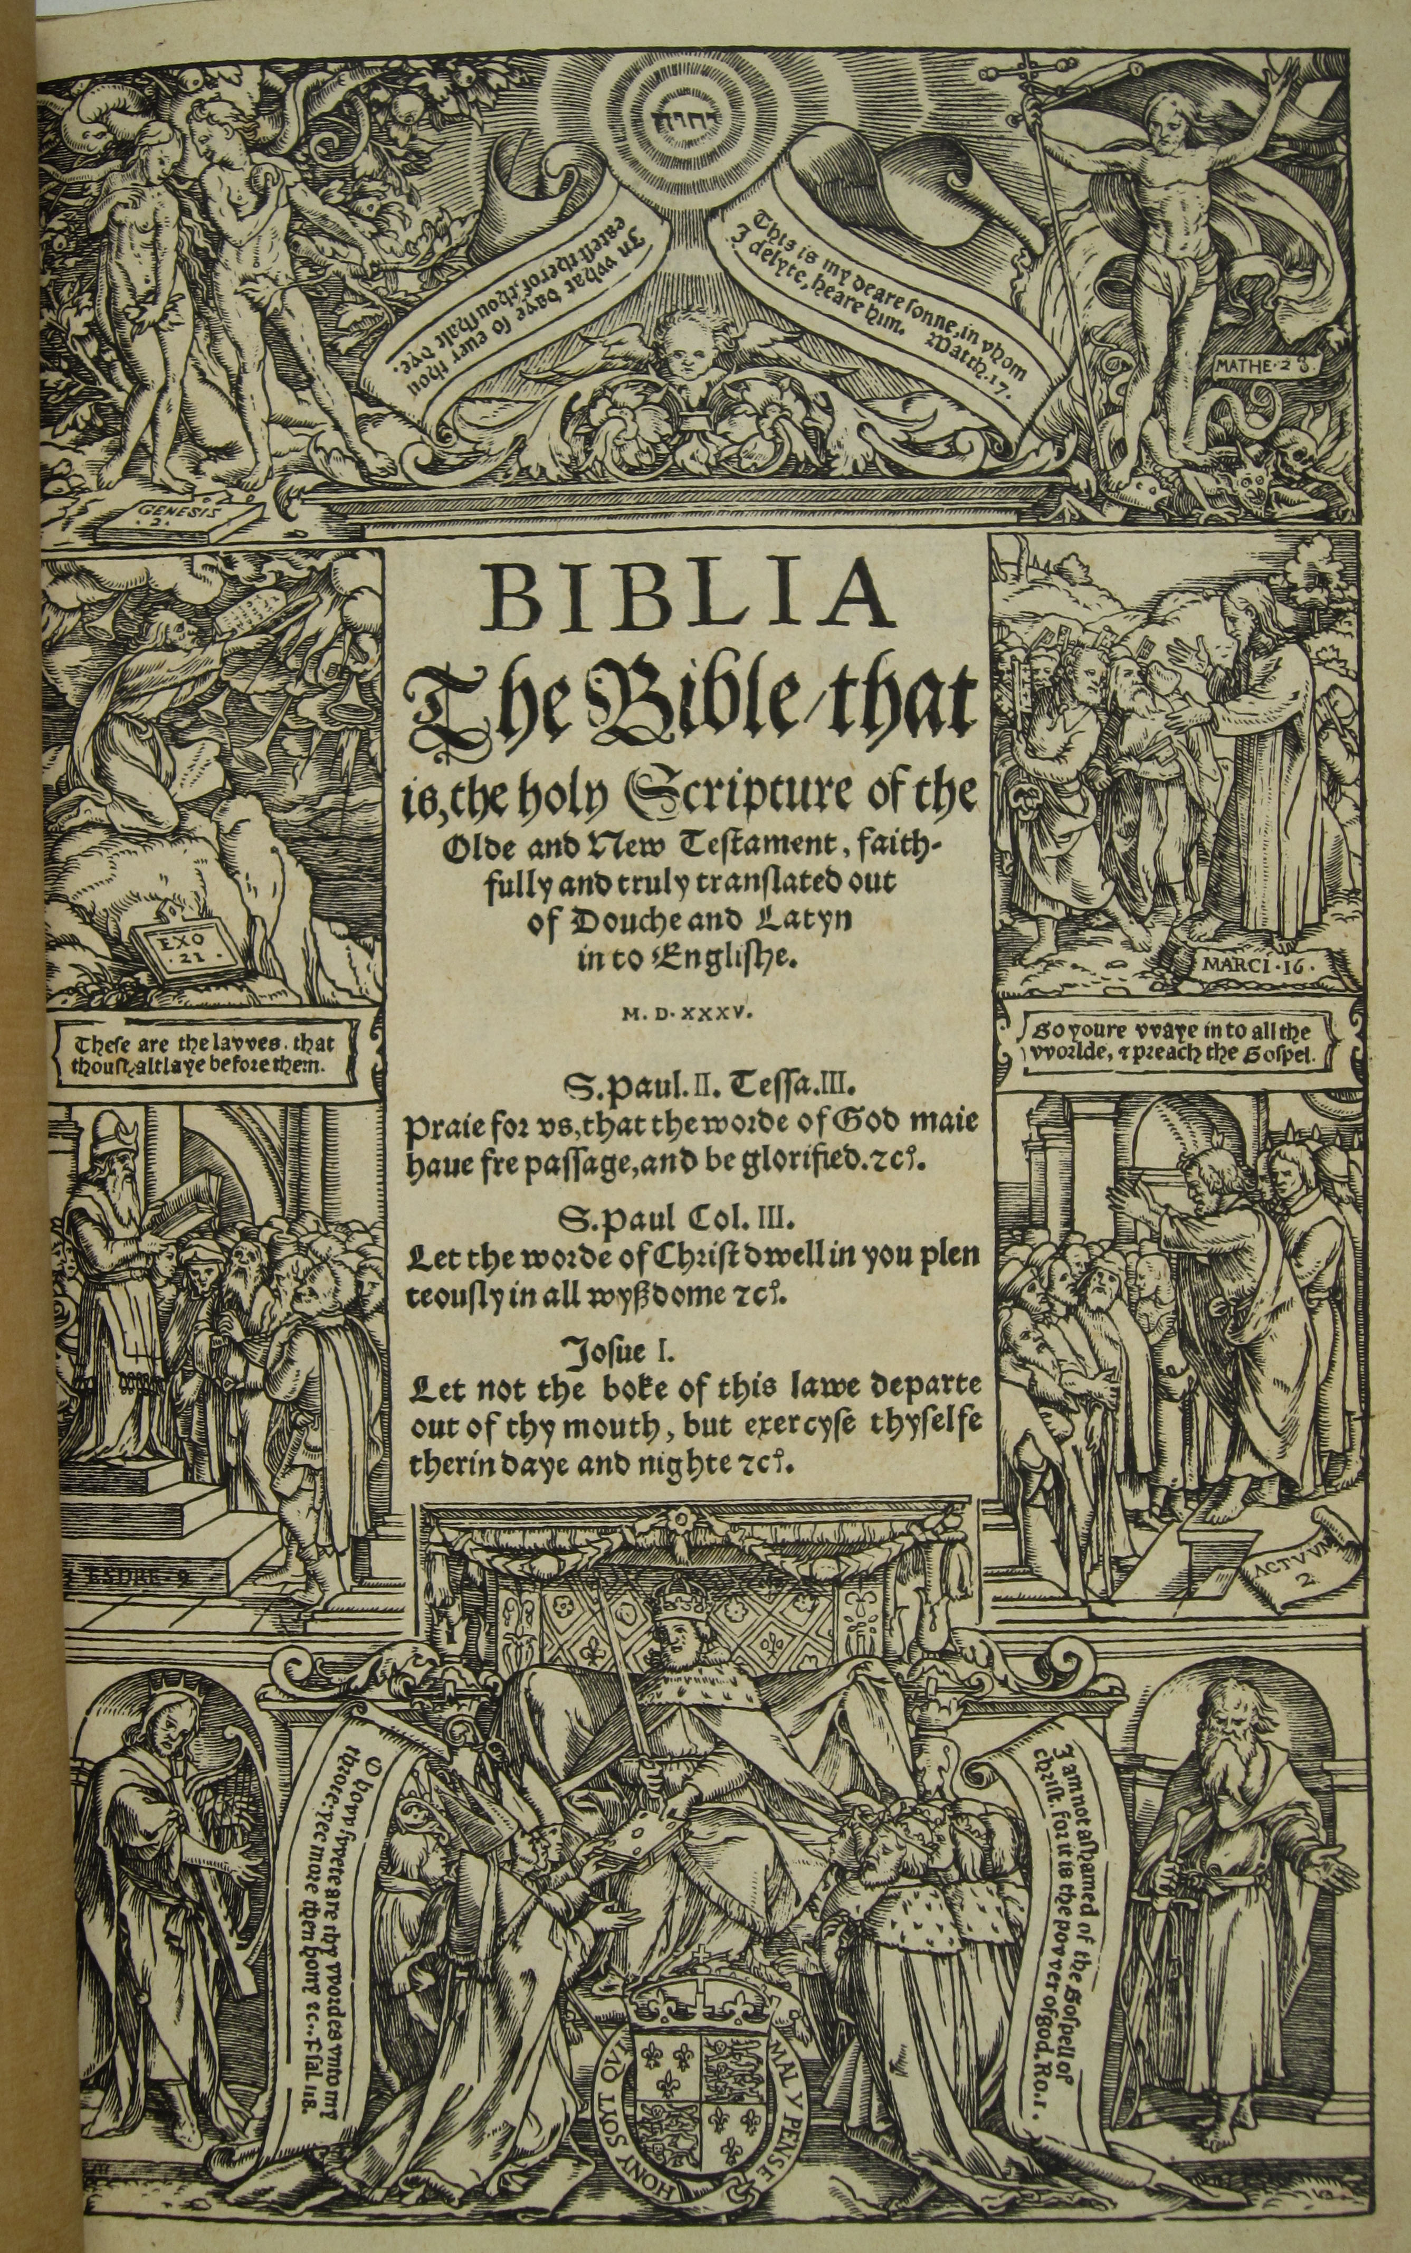

Slide 19
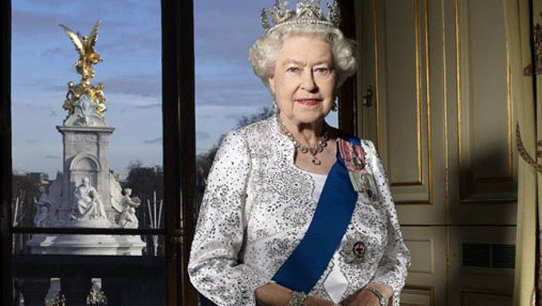

Slide 20
Importance
A God who involves Himself in history, in the affairs of humans
If true for others, why not for you.

Slide 21
Zadok

